Slide 1
Multisystem Inflammatory Syndrome in Children (MIS-C)
Amy Sanderson, MD
Boston Children’s Hospital
March 4, 2021

Slide 2
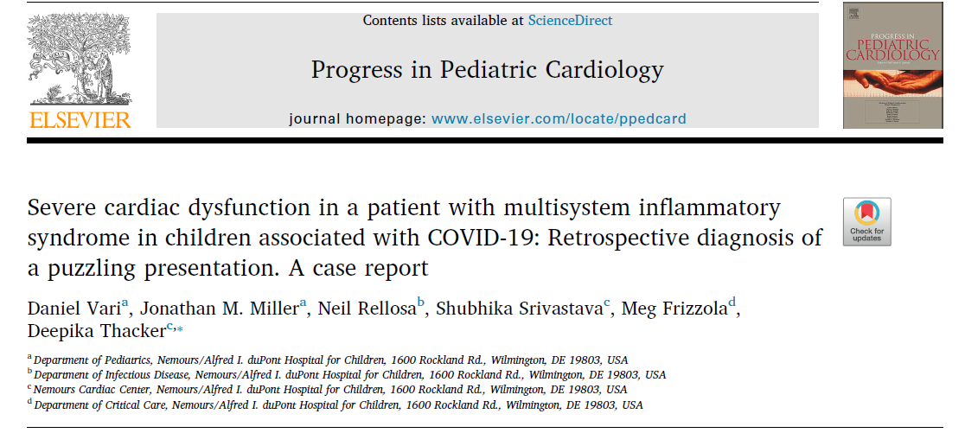
Vari. Progress in Pediatric Cardiology, Volume 58, 2020
Notes:
This is a report of one of the earliest known U.S. cases of MIS-C.

Slide 3
Case study
14-year old multiracial (Caucasian and Hispanic) male; PMH: constipation & eczema
Presented to the ED with 4 days of fever, fatigue, & abdominal pain (in stable condition without significant multisystem involvement)
During hospitalization, he developed severe LV dysfunction and mixed hypovolemic, distributive and cardiogenic shock
Discharged home after 12 days
F/U echo normal
Vari. Progress in Pediatric Cardiology, Volume 58, 2020
Notes:
The patient was discharged after a twelve day hospital course, on low dose aspirin for a presumptive diagnosis of atypical Kawasaki disease. He was initially continued on monthly penicillin G prophylaxis for possible rheumatic fever, though with a low index of suspicion.
Outpatient echocardiogram at 12 and 28 days after discharge revealed normal biventricular function and no coronary artery abnormalities.
Serology for SARS-CoV-2 was obtained three weeks after initial presentation and was positive for IgG, and the patient was retrospectively diagnosed with MIS-C.

Slide 4
CDC Case Definition
An individual aged <21 years presenting with fever, laboratory evidence of inflammation and evidence of clinically severe illness requiring hospitalization, with multisystem (>2) organ involvement; AND
No alternative plausible diagnoses; AND
Positive for current or recent SARS-CoV-2 infection by RT-PCR, serology, or antigen test; or exposure to a suspected or confirmed COVID-19 case within the 4 weeks prior to the onset of symptoms
www.cdc.gov/mis-c/hcp
Notes:
Fever >38.0°C for ≥24 hours, or report of subjective fever lasting ≥24 hours
Evidence of inflammation = including, but not limited to, one or more of the following: an elevated CRP, ESR, fibrinogen, procalcitonin, d-dimer, ferritin, LDH, or interleukin 6, elevated neutrophils, reduced lymphocytes and low albumin
organ involvement = cardiac, renal, respiratory, hematologic, gastrointestinal, dermatologic or neurological

Slide 5
Incidence
SARS-CoV-2 infection
322 per 100,000 (< 21 y/o)
MIS-C
2 per 100,000
It’s rare!
Dufort EM. N Engl J Med. 2020;383(4):347
Notes:
The initial reports of MIS-C emerged from the United Kingdom in April 2020
Since then, there have been reports of similarly affected children in other parts of the world, including Europe, Canada, the United States, and South Africa. Notably, there have been no reports of MIS-C from China or other Asian countries with high rates of COVID-19 early in the pandemic.
This study: New York State; 6/2020
In most studies, there was a lag of several weeks between the peak of COVID-19 cases within communities and the rise of MIS-C cases
This three- to four-week lag coincides with the timing of acquired immunity and suggests that MIS-C may represent a post-infectious complication of the virus rather than acute infection, at least in some children.

Slide 6
Pathophysiology
Immune dysregulation
Negative SARS-CoV-2 PCR
May have antibodies
Notes:
The pathophysiology of MIS-C is not well understood.
It has been suggested that the syndrome results from an abnormal immune response to the virus, with some clinical similarities to Kawasaki disease, macrophage activation syndrome and cytokine release syndrome.
However, some children do have positive PCR testing

Slide 7
Presenting symptoms
Persistent fevers (median duration 4 to 6 days) | 100%
Gastrointestinal symptoms (abd pain, N/V, diarrhea) | 60-100%
Rash | 45-76%
Conjunctivitis | 30-81%
Mucous membrane involvement | 27-76%
Neurocognitive symptoms (headache, lethargy, confusion) | 29-58%
www.uptodate.com
Notes:
Different case definitions were used in different studies, which may explain some of the variability in the reported frequency of these findings.
Gastrointestinal symptoms are particularly common and prominent, with the presentation in some children mimicking appendicitis. Some children have been noted to have terminal ileitis on abdominal imaging and/or colitis on colonoscopy.
Neurocognitive symptoms are common and may include headache, lethargy, confusion, or irritability. A minority of patients present with more severe neurologic manifestations, including encephalopathy, seizures, coma, meningoencephalitis, muscle weakness, and brainstem and/or cerebellar signs.

Slide 8
Presenting symptoms
Respiratory symptoms (tachypnea, dyspnea) | 21-65%
Sore throat | 10-16%
Myalgias | 8-17%
Swollen hands/feet | 9-16%
Lymphadenopathy | 6-16%
www.uptodate.com
Notes:
Respiratory symptoms, when present, are most often due to severe shock. Cough is uncommon. Though some children require supplemental oxygen or positive pressure ventilation for cardiovascular stabilization, severe pulmonary involvement (eg, acute respiratory distress syndrome) is not a prominent feature.

Slide 9
Clinical Findings
Shock | 32-76%
Criteria for complete Kawasaki disease met | 22-64%
Myocardial dysfunction (by echo or elevated troponin/BNP) | 51-90%
Arrhythmia | 12%
Acute respiratory failure requiring noninvasive or invasive ventilation | 28-52%
Acute kidney injury | 8-52%
Serositis (small pleural, pericardial, and ascites) | 24-57%
Hepatitis or hepatomegaly | 5-21%
Encephalopathy, seizures, coma, or meningoencephalitis | 6-7%
www.uptodate.com
Notes:
The frequency of cardiac involvement in MIS-C is uncertain. In three large case series, approximately 30 to 40 percent of children had depressed LV function and 8 to 19 percent had coronary artery abnormalities. These reports included patients with severe MIS-C as well as milder cases. Case series including only severely affected patients reported considerably higher rates of depressed LV function (approximately 50 to 60 percent) and CA abnormalities (approximately 20 to 50 percent).

Slide 10
Laboratory findings
Lymphocytopenia | 80-95%
Neutrophilia | 68-90%
Mild anemia | 70%
Thrombocytopenia | 31-80%
Hypoalbuminemia | 48-95%
Mildly elevated liver enzymes | 62-70%
Elevated lactate dehydrogenase | 10-60%
Hypertriglyceridemia | 70%
www.uptodate.com

Slide 11
Laboratory findings
C-reactive protein | 90-100%
Erythrocyte sedimentation rate | 75-80%
D-dimer | 67-100%
Fibrinogen | 80-100%
Ferritin | 55-76%
Procalcitonin | 80-95%
Interleukin-6 | 80-100%
Troponin | 50-90%
BNP or NT-pro-BNP | 73-90%
www.uptodate.com

Slide 12
Imaging findings
Echocardiogram
Depressed LV function | 31-58%
Coronary artery dilation/aneurysm | 8-38%
Other findings can include mitral regurgitation and pericardial effusion | --
Chest radiograph
Normal in many patients | --
Abnormal findings included small pleural effusions, patchy consolidations, focal consolidation, and atelectasis | --
www.uptodate.com

Slide 13
Imaging findings
Chest CT
Findings generally similar to those on chest radiograph
A few patients had nodular ground-glass opacification
Abdominal imaging (ultrasound and/or CT)
Findings are nonspecific, including free fluid, ascites, bowel and mesenteric inflammation, including terminal ileitis, mesenteric adenopathy/adenitis, and pericholecystic edema
www.uptodate.com

Slide 14
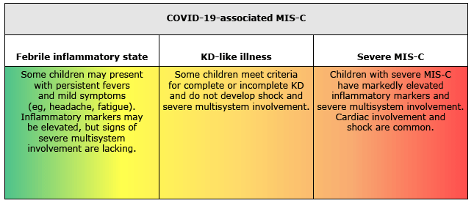
Clinical spectrum
www.uptodate.com
Notes:
As more is learned about MIS-C, it is becoming apparent that there is a wide spectrum of disease severity. The initial case series largely reported the most severe end of the spectrum, resulting in a high reported incidence of shock, myocardial involvement, and respiratory failure. It is likely that as recognition of milder forms of MIS-C increases, the incidence of shock, left ventricular (LV) dysfunction, respiratory failure, and acute kidney injury will be lower.

Slide 15
COVID-19 or MIS-C?
COVID-19
MIS-C
Median age 11.7 years
More likely to be Hispanic or Latino
More likely to have ≥ 1 chronic medical conditions
57% had GI symptoms
Higher platelet count
Median age 8.9 years
More likely to be non-Hispanic Black
More likely to have mucocutaneous findings
90% had GI symptoms
More likely to have cardiac involvement
Feldstein LR. JAMA. February 24, 2021
Notes:
1116 cases, 48% MIS-C & 52% COVID-19. In patients with MIS-C, 52% had a positive SARS-CoV-2 PCR test result, 45% were SARS-CoV-2 antibody positive only, 31% were positive for both, and 19% did not have an antibody test performed
80% of patients with MIS-C and COVID-19 each had severe respiratory involvement
73.8% with MIS-C and 43.8% with COVID-19 were admitted to the intensive care unit, 1.9% with MIS-C and 1.4% with COVID-19 died during hospitalization

Slide 16
Kawasaki Disease or MIS-C?
Kawasaki Disease
MIS-C
Infants and young children
Higher incidence in East Asia and in pts of Asian descent
Absolute lymphocyte and platelet counts tend to be higher
Inflammatory markers tend to be less elevated
Older children & adolescents
Black & Hispanic children disproportionally affected
GI symptoms (abdominal pain) are very common
Myocardial dysfunction and shock occur more commonly
Notes:
While many children with MIS-C meet criteria for complete or incomplete Kawasaki disease, the epidemiology differs from that of classic KD.
In three large case series, 25 to 45 percent of patients were black, 30 to 40 percent Hispanic, 15 to 25 percent white, and 3 to 28 percent Asian

Slide 17
Codes
MIS-C due to Covid-19 (current infection)
MIS-C due to previous Covid-19 infection (resolved)
U07.1 COVID-19 (principal diagnosis)
M35.8 Other specified systemic involvement of connective tissue (secondary diagnosis)
M35.8 Other specified systemic involvement of connective tissue (principal diagnosis) for the MIS-C
B94.8 Sequelae of other specified infectious and parasitic diseases (secondary diagnosis) for the sequelae of a COVID-19 infection
Notes:
MIS-C does not have a specific ICD-10-CM code

Slide 18
Management based on presentation
Shock
Volume resuscitation
Vasoactive/inotropic agents
Kawasaki
IVIG
Glucocorticoids
Cardiac dysfunction
LV dysfunction: IV diuretics and inotropic agents
ECMO
Aspirin
VAD
Notes:
Shock: Epinephrine or norepinephrine are the preferred vasoactive agents for the management of fluid-refractory shock in children. Epinephrine is preferred when there is evidence of left ventricular (LV) dysfunction. In children presenting with severe LV dysfunction, the addition of milrinone may be helpful.
Features of Kawasaki disease: Patients who meet criteria for incomplete or complete KD should receive standard therapies for KD, including IVIG, aspirin, and glucocorticoids if there are persistent signs of inflammation or coronary artery dilation/aneurysm.

Slide 19
Antibiotics
Antivirals
IVIG
Steroids
Prednisone
Remdesivir
Methylpred
Intravenous immune globulin
Prednisolone
Ceftaroline + Zosyn
Ceftriaxone + Vancomycin OR
Notes:
Antibiotics: MIS-C can present with signs and symptoms that mimic those of septic shock and toxic shock syndrome. Thus, patients presenting with severe multisystem involvement, particularly those with shock, should receive prompt empiric broad-spectrum antibiotic therapy pending culture results. Antibiotics should be discontinued once bacterial infection has been excluded if the child's clinical status has stabilized.
Antivirals: The role of SARS-CoV-2 antiviral therapies in the management of MIS-C is uncertain. Use of antiviral agents is generally limited to children with severe MIS-C manifestations who have evidence of active infection. An infectious disease consult to guide decision-making is recommended.
IVIG: Recommended for all patients who meet criteria for complete or incomplete KD, most patients with moderate to severe MIS-C (shock, cardiac involvement, other manifestations requiring ICU care). Patients should have blood drawn for serologic testing for SARS-CoV-2 and other pathogens prior to administration of IVIG.
Steroids: The role of glucocorticoid therapy in patients with MIS-C is uncertain, and practice is not standardized. One recommended approach is to treat patients with any of the following: severe or refractory shock, KD-like features plus a risk factor for IVIG resistance or persistent fevers and rising inflammatory markers despite treatment with IVIG. Glucocorticoid therapy is initially given as IV methylprednisolone. Once the patient has defervesced and is improved clinically, this can be transitioned to an equivalent oral dose of prednisolone or prednisone by the time of discharge and then tapered off over three to four weeks.

Slide 20
Other therapies
Interleukin-1 inhibitors
Anakinra
Canakinumab
IL-6 inhibitors
Tocilizumab
Convalescent plasma
Antithrombotic therapy
Notes:
The benefits and risks of adjunctive therapies are uncertain. Patients with MIS-C are at risk of experiencing thrombotic complications, such as LV thrombus, DVT and PE.

Slide 21
Outcome
Prognosis is uncertain!
Most children survive
Most with cardiac involvement recover function
Nature & frequency of long-term complications are unknown
Notes:
The prognosis of MIS-C is uncertain, given that it is a relatively new clinical entity and long-term follow-up studies are lacking. Most children survive, but there have been several deaths reported.
Most patients with cardiac involvement had recovery of ventricular function and resolution of arrhythmias, though in some reports, approximately 20 percent of affected patients still had mildly depressed function at the time of hospital discharge.
The nature and frequency of long-term complications from MIS-C are unknown as post-discharge follow-up data are not yet available.

Slide 22
Thank you!
Questions??
amy.sanderson@childrens.harvard.edu

