Slide 1
Emerging CDI Trends in 2015: CDI Survey Findings and Tips to Elevate Physician Engagement
John Zelem, MD, FACS, Vice President, Clinical & Regulatory

Slide 2
Learning Objectives
What are documentation basics for physicians?
Identify common areas for physician documentation improvement.
What are methods that may be used to help engage physicians to improve documentation?
What are the trends across the country to achieve all of these objectives?

Slide 3
Introduction
Speaker has nothing to disclose.
The American Hospital Association, in conjunction with Executive Health Resources, launched the inaugural Clinical Documentation Improvement Trends Survey in February 2015.
Trends were revealed in Clinical Documentation Improvement (CDI) programs by 1,000+ CDI, coding, HIM and other hospital professionals involved in documentation initiatives across the United States.

Slide 4

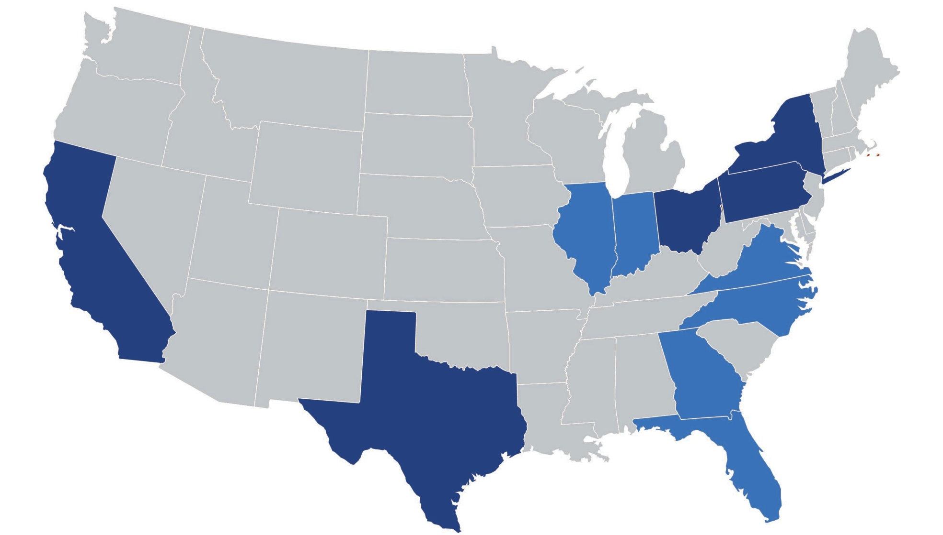


About the Survey
All 50 states represented (plus Washington D.C. and Puerto Rico)
Respondents distribution across states is in line with hospital market share by state
States with highest
response rates
indicated in blue

Slide 5
About the Respondents
Primarily CDI professionals completed the survey
71%
CDI Professionals

Slide 6
Physician Documentation Today

Slide 7

Setting the Stage

Slide 8
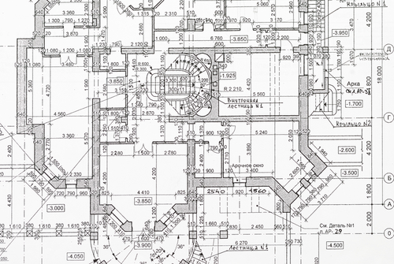
What the Auditors Expect
Accuracy and Specificity

Slide 9

What Typically is Provided

Slide 10
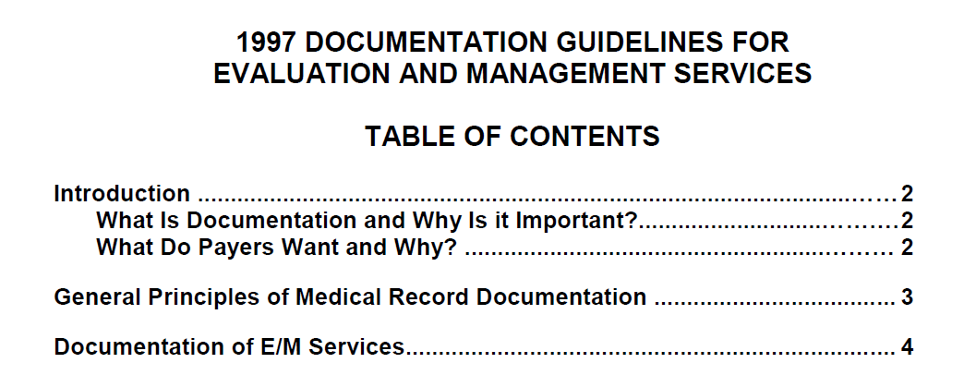
Last Set of Medicare Guidelines

Slide 11
And in 1997
Audits Did not Exist
RACs
MACs
Commercial

Slide 12
But Today!
Part of the new audience
Recovery
Auditors
Commercial
MAC

Slide 13
Documentation Basics: Have They Been Forgotten? Breaking Down The Chart

Slide 14
Pervasive Documentation Issue
98.5% CDI programs have physicians who could improve their documentation practices according to survey results

Slide 15
Some of the problems
Physicians document for other physicians
Not for coders, CDI, UM, auditors
Physicians assume that others understand
Physicians do not adequately document the acuity with which patients present
The Electronic Medical Record has not been the solution
Top 3 physician barriers from survey:
66.5% Lack of understanding of importance
47.5% Lack of time
38% Lack of interest

Slide 16

Documentation Truths Related to EMRs
Organizes physician notes
Does NOT support an inherent improvement of quality (copy forward)
Standardizes required details
Does NOT automatically elevate documentation standards
Stratifies clinical information
Does NOT modify physicians’ thinking to match fields
Natural language processing and computer assisted coding can be an effective solution to address the documentation gaps prevalent in EMR systems

Slide 17
Results of Better Documentation
Clinical Support for Codes
Better Accuracy and Specificity
Better Patient Safety
400 K lost lives/year
(1200 747s down)
Better Quality Measures
Better Quality of Care

Slide 18

Important Chart Elements
ED Visit When Present
Orders
Certification
History & Physical
Progress Notes
Discharge Summary
Operative/Procedure Reports
Consults
Labs/Tests/EKG

Slide 19
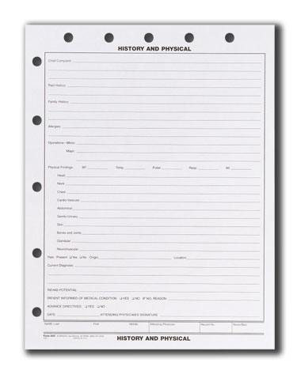
History and Physical
1
Arguably one of the most important chart documents
2
Should be a stand-alone
The same regardless of LOC
3
Influential for preventing denials
Good for patient care

Slide 20
History and Physical – Tells a Story
Data/Elements
Summary Thoughts
CC
HPI
PMHx, SHx, ROS
Assessment/Plan
Physici an
Assessment/Plan
Intent for Care
Suspects
Concerns
Risks
VS, PE
Labs
Tests, EKG, Xrays
First day and every day

Slide 21
H&P Statistics
Element | National 433 Charts | % Absent
H&P Present | 416 | 3.92%
Element | # Present of 416 Charts | % Absent
CC | 350 | 15.86%
HPI | 409 | 1.68%
PMx | 401 | 3.60%
SHx | 391 | 6.01%
ROS | 300 | 27.88%
VS | 347 | 18.99%
PE | 404 | 5.29%
Labs | 277 | 32.63%
Xrays, EKG, Tests | 258 | 37.98%
Assessment | 369 | 11.30%
Plans | 363 | 12.74%
*John Zelem 2015 general ad hoc chart review sample

Slide 22
Keys to Physician Documentation
Suspects
What Does the Physician Suspect?
Concerns
High/Low Concerns
Predictable Risks
How predictable are the concerns?
Intent
Intent for treatment and 2 MN
Assessment/Plan Elements
BECAUSE
BECAUSE

Slide 23
Assessment/Plan Elements
Element | National 433 Charts | % Absent
H&P Present | 416 | 3.92%
Element | # Present of 416 Charts | % Absent
Suspects | 335 | 19.47%
Concerns | 215 | 48.32%
Risk | 78 | 81.25%
Intent | 341 | 17.61%
*John Zelem 2015 general ad hoc chart review sample

Slide 24
Discharge Summary
H&P
Hospital Course
Final Diagnosis
Stable for DC
DC Meds and Plan

Slide 25
Elements of Discharge Summary
Element | National 433 Charts | % Absent
DCS Present | 367 | 15.24%
Element | # Present of 367 Charts | % Absent
H&P | 142 | 61.31%
Hospital Course | 338 | 7.90%
Final Dx | 342 | 6.81%
Stable for DC | 176 | 52.04%
Discharge Meds and Discharge Instructions were addressed here but are not shown
*John Zelem 2015 general ad hoc chart review sample

Slide 26
Adequate DCS???
…asked to review a discharge summary after a SNF Medical Director refused to accept the patient “without more information.” This is the Discharge Summary verbatim:
“Discharge Summary:
Chronic venous ulcer left leg
Procedure performed:
Debridement incision drainage
STSG
Hospital Course:
Admitted for IV antibiotics and above procedures. Did well post op. To rehab.”
…when told we needed a decent discharge summary so we could discharge the patient.
His reply: “Since when?”
“related story from Google Rac Relief Blog – 10/1/14”

Slide 27
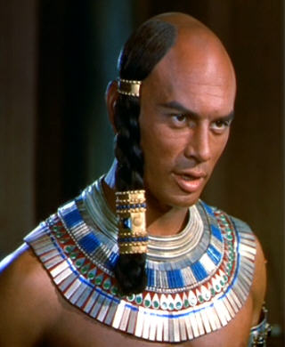
Documentation in 1600 BC
If it wasn’t written
It wasn’t done
“So let it be written, so let it be done”

Slide 28
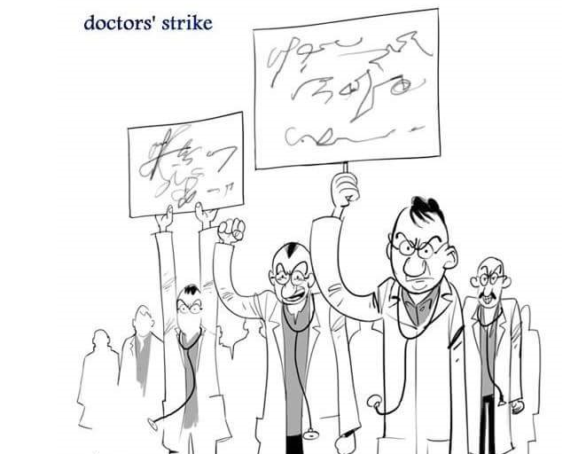
Illegible??
If you can’t read it, it wasn’t done

Slide 29
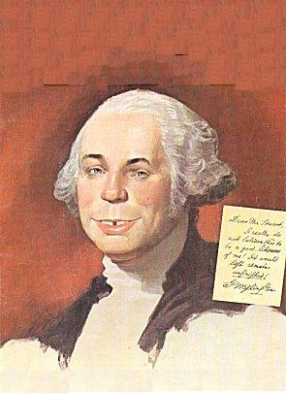
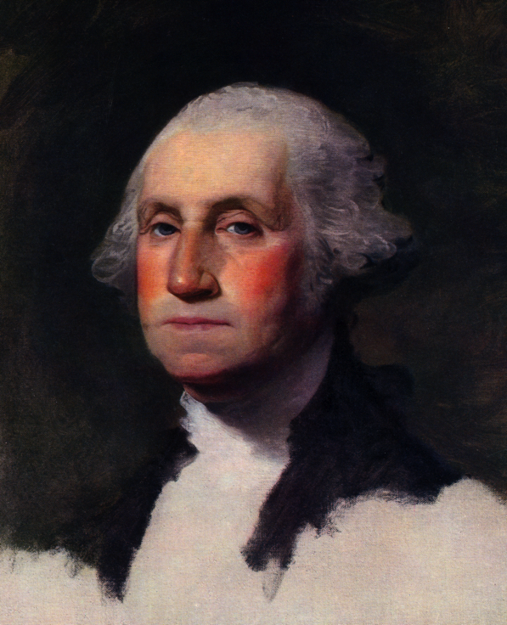
Paint the Picture Properly with WORDS
What you want…
“THIS IS SO OBVIOUS”
may not be…
what you might get
Not so OBVIOUS in the documentation

Slide 30
Barriers to Physician Engagement

Slide 31
Barriers
Non-physician
Physician
Lack of Hospital Leadership’s Commitment – 46.7%
Lack of Ongoing Physician Training – 44.9%
Lack of Streamlined Query/Response Process – 57.6%
Lack of Understanding of Importance of Documentation – 66.5%
Lack of Time – 47.5%
Lack of Interest – 38%

Slide 32

Technology’s Influence
18.5% viewed IT/technical difficulties as a key barrier preventing physicians from being effectively engaged in CDI
Only 13.5% indicated a strong technology platform as the most important factor to a achieving a successful CDI program
61.1% of CDI programs have a technology platform in place (with another 11% with plans to implement technology)
Case selection for CDI review is influenced by technology at 16.7%

Slide 33
The Norm
According to the survey the vast majority (95%) of CDI programs struggle to engage physicians
Barriers include:
lack of hospital leadership’s commitment,
lack of ongoing training for physicians,
lack of collaboration,
…the list goes on

Slide 34
Physician Response/Cooperation/Documentation
***Largest Factor for Ensuring a Successful CDI Process
CDI Programs Struggle to Engage Physicians
95%
Have physicians who could improve documentation practices
98.5%

Slide 35
How to E.N.G.A.G.E. Physician Cooperation

Slide 36
E.N.G.A.G.E.
Executive Support
Negate physician concepts
Gain Cooperation
Advisors
Get better documentation
Educate

Slide 37
Executive Support
“But they will take their patients to neighboring hospitals”
“That doctor does a lot of volume here”
A lot of DCS and other documentations are overdue
Giving up to 30 days to complete a DCS
Bending over backwards to make life “easier” for the physician
Enables poor behavior
Don’t want to upset the docs

Slide 38
Negate physician concepts
“This is so hospitals can get paid more”
Medicare allows for better coding for:
Accuracy and specificity
Compares Physicians to their Peers
“Urosepsis” – Patient dies day 1 or 2
Non-codable – SOI/ROM = 1/1
Reimbursement
Consequences
ROM – Risk of Mortality – graded 1-4
SOI – Severity of Illness – graded 1-4
Quality Measures
Physician Benefits of better documentation

Slide 39
Gain Cooperation
Cooperation through Motivation
WIIFM
What’s In It For Me?
Helping them understand
Quality Measures
Value Based Modifier (VBM)
Bundled Payments
HCC
Medicare Physician Compare, HealthGrades.com, and more
Potential Employment Metrics/Payer Preferences
Medicare Spending per Beneficiary
Present on admission (POA)
Transmittal 541
Industry Approaches

Slide 40
Role of Quality and Value

Slide 41
Collateral Benefits of CDI
Actuarial determinants used to extrapolate expected mortality, complication rates and LOS
Indexes reflect rankings
Number of Deaths
Risk of Dying
= Risk-Adjusted Mortality Rate

Slide 42
CMS Move to Payment for Quality for Providers
Category 1: FFS, not linked to quality or efficiency
Category 2: FFS, linked to quality
Portion of payment varies based on the quality or efficiency of health care delivery
Category 3: Alternative Payment Models built on FFS Architecture
Some payment is linked to the effective management of a population or an episode of care. Payment still triggered by delivery of services but opportunity for shared savings or 2-sided risk
Category 4: Population-Based Payment
Payment is not directly triggered by service delivery so volume is not linked to payment. Clinicians and organizations are paid and responsible for the care of a beneficiary for a long period (> 1 yr)

Slide 43
Advisors
Help to make sure that documentation can be supportive as RAC, MAC, Commercial Payer DRG Denials are increasing with the reason being “not clinically supported” (The fact that the doctor writes a diagnosis does not mean that it is supported in the chart)
Elevates documentation practices that mitigate vague, incomplete and conflicting information from CDIS to physicians to coders
Help queries to be more effectively and expeditiously answered as the peer to peer engagement can bridge the gap in documentation interpretation
Serve as a clinical advisor to CDS and coders
Aid in ongoing physician education

Slide 44
Advisors
If trained extensively in CDI principles:
Physicians respond to physicians in a different way — can converse about the case as peers in a non-leading way
Physician to Physician conversations — serve to re-inforce solid documentation principles because physicians learn well through case — reinforcement
Supports the CDI program

Slide 45
Advisors
The five main attributes a physician advisor must have are:
Broad clinical knowledge base
Respect from the medical staff
Ability to effectively communicate with physicians and non-physicians
Availability
Broad knowledge base of clinical medicine across all specialties

Slide 46
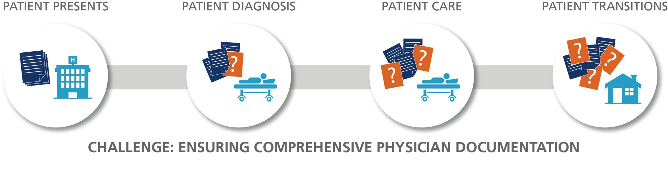
Get Better Documentation
Gaps created with hand-offs
Details not captured or transferred
ED tests not logged by treating physician
Other clinicians’ perspective siloed
Physicians don’t “think in ink”
Diagnosis and plan of care not detailed
Key info omitted in physician summary
Clarification sought through queries
CDI struggles with gaps in patient story
Plan of care and variables vague
Key info omitted in physician summary
Unresolved queries
Coding doesn’t have needed detail
Inaccurate DRG = missed reimbursement
Weakened defensibility
CMI and quality impacts

Slide 47
Educate
Educate physicians the way it works — not the way you’ve always done it
SURVEY REMINDER: Real-time, patient specific conversations are the most effective education strategy to make physicians aware of how to improve documentation (84.3% of survey participants agree) and some of the most prevalent approaches hospitals use to educate physicians were deemed ineffective
Acknowledge the limited time that physician resources can allocate to CDI
SURVEY REMINDER: Conflicting priorities and limited bandwidth leave hospitals seeking outside physician expertise to augment CDI program effectiveness (83% of physician advisors/champions spend 0–10 hours a week supporting CDI)
Make sure physicians know there’s room for improvement across the board
SURVEY REMINDER: Despite the expertise of your medical staff or where you’re at on the CDI program stage continuum, improvement opportunities are a universal theme with 98.5% of programs having physicians who could improve documentation practices

Slide 48





Physician Education is the Answer (55.1% Agree)
Delivery method makes a substantial difference in delineating the most effective educational approach
84.3%
9.9%
2.0%
2.4%
1.4%
One-on-One Case-by-Case Conversations
Web-based
Poster / flyer
Email / mailing
Lecture / seminar

Slide 49



Despite Where Your Program is on the CDI Continuum…
A physician-to-physician interaction model makes an impact in:
Elevating physician engagement and documentation quality
Implementing case-specific education from peers
Managing queries real-time (pre-discharge)
Addressing CDI resource constraints
Augmenting physician resources with limited training
STAGE
Introduction
Growth
Mature
Physician-to-Physician
Physician-to-Physician
Physician-to-Physician

Slide 50
Best Practices Examined
How an individual patient case documentation review program (with physician-to-physician discussions, as appropriate) works
Review
Substantiate
Engage
Document
Determine if greater specificity is needed in documentation
Clarify if a query is valid or needed
CDI expert physician interacts directly with the appropriate treating physician to gain clarification in the documentation and provide case-specific education and feedback
Provide a written summary of the physician conversation to the CDI specialist who can then verify the physician has appropriately updated the chart

Slide 51
John Zelem, MD, FACS, Vice President, Compliance and Physician Education
484-574-7686
jzelem@ehrdocs.com

Slide 52
©2015 Executive Health Resources, Inc.
All rights reserved.
No part of this presentation may be reproduced or distributed.
Permission to reproduce or transmit in any form or by any means
electronic or mechanical, including presenting, photocopying,
recording and broadcasting, or by any information storage and
retrieval system must be obtained in writing from Executive
Health Resources. Requests for permission should be directed
to INFO@EHRDOCS.COM.

