Slide 1

Transforming Today’s CDI Model to Support Value Based Payments
Shannon Newell, RHIA, CCS Director, CDI Quality Initiatives

Slide 2
Learning Objectives
At the completion of this session participants will be able to:
Understand how documentation and code assignment impact the selection and risk adjustment of encounters included in claims based quality measures linked to payment
Gain insights into the increasing alignment of physician and hospital interests in accurate and complete documentation
Identify CDI Program evolution requirements to effectively support clinical documentation impactful in today’s value based payment era

Slide 3

CMS Shift to Value Based Care
Move away from payment for volume
Improve care coordination
Promote alignment of financial and other incentives to increase the quality of care and lead to better outcomes
Lower Cost
Goals - increase % of Medicare provider payments linked to quality outcomes and alternate payment models
Quality: 2016 85% → 2018 90%
APMs: 2016 30% →2018 50%
Value
Improve Quality
HHS Secretary Burwell
Posting January 2015

Slide 4
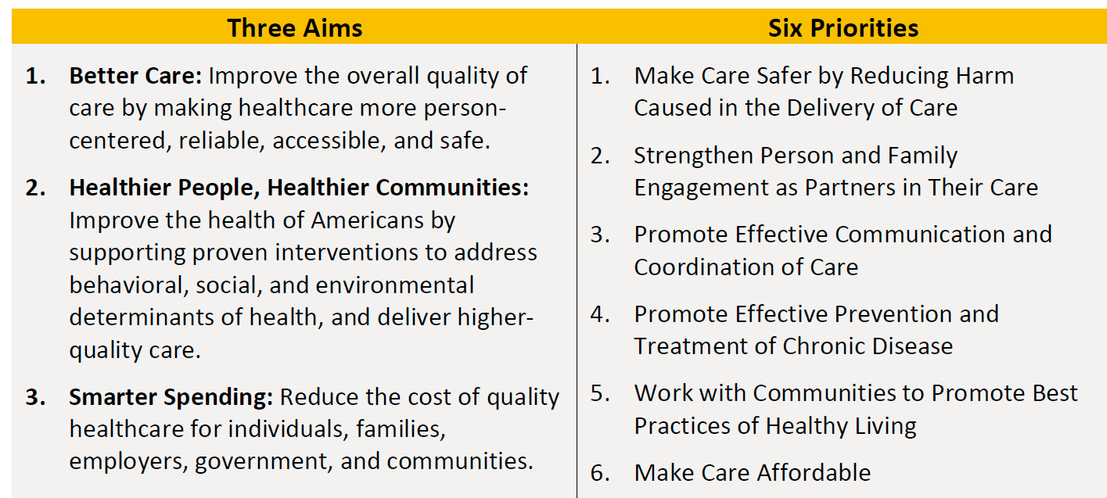
National Quality Strategy Vision
To optimize health outcomes by improving quality and transforming the healthcare system
Source: https://www.cms.gov/Medicare/Quality-Initiatives-Patient-Assessment-Instruments/QualityInitiativesGenInfo/CMS-Quality-Strategy.html

Slide 5
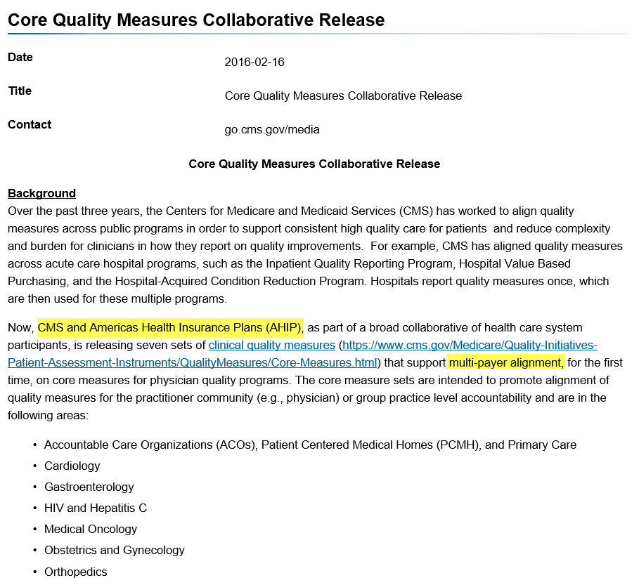
Commercial Payers Following CMS Lead
70%
Payers
https://www.cms.gov/Newsroom/MediaReleaseDatabase/Fact-sheets/2016-Fact-sheets-items/2016-02-16.html

Slide 6




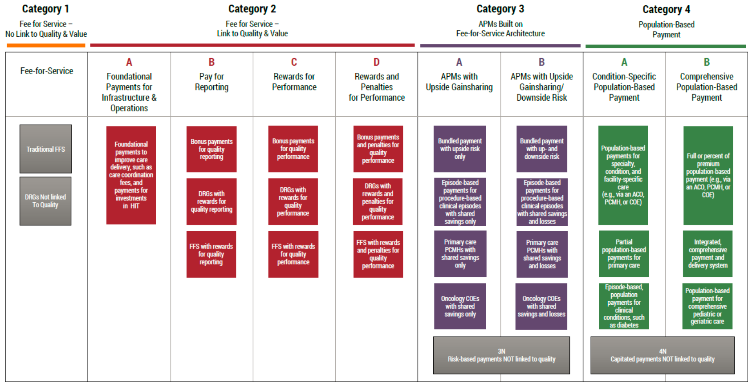

CMS Payment Model Evolution

Slide 7
Category 2 – Fee for Service Link to Value
Physician fee schedule adjustments
Providers rated on four criteria weighted and scored to create a composite score; the score adjusts provider fee for service reimbursement
Merit-Based Incentive Payment System (MIPS)
Quality (50%) | PQRS / VBM
Advancing Care Information (25%) | EHR use
Clinical Practice Improvement Activities (15%)
Cost (10%) | VBM
Calendar Year | 2019 | 2020 | 2021 | 2022
Physician Fee Schedule Adj | +/- 4% | +/- 5% | +/- 7% | +/- 9%
Incentive 10%
Data in 2017 impacts performance in 2019

Slide 8
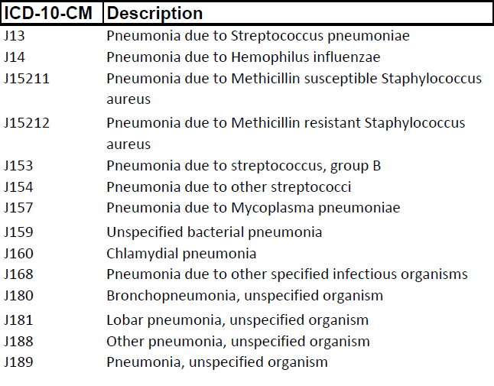
Value Based Modifier (VBM)
Acute composite index
Hospital admissions with select acute diagnoses
Bacterial pneumonia
UTI
Dehydration
Bacterial Pneumonia
Principal Diagnosis Codes

Slide 9
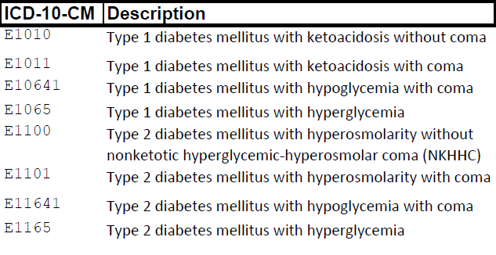
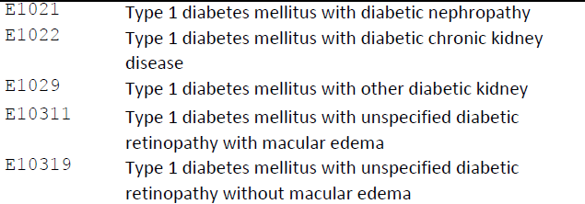
Value Based Modifier (VBM) (cont)
Chronic composite index
Hospital admissions with select chronic diagnoses
Short term complications - diabetes
Long term complications - diabetes
Uncontrolled - diabetes
Diabetes may be secondary diagnosis if patient had a lower extremity amputation
Diabetes Principal Diagnosis
Codes - Excerpts

Slide 10
Value Based Modifier (VBM) (cont)
Medicare spending per beneficiary measure (MSPB)
Part A and Part B costs
Immediately prior to, during, and for 30 days following a qualifying stay
Risk adjustment methodology - Hierarchical Condition Categories (HCC)
The HCC risk adjustment methodology is also utilized by payers (Medicare Advantage, some commercial) to determine physician payment rates.

Slide 11
HCC Impact on Payment
HCCs are hierarchical categories used to predict healthcare expenditures of individuals
CMS calculates risk for a member based on the following:
Demographics (i.e. Age, Sex)
Reported (ICD-10) diagnoses (chronic conditions – acute conditions)
Reported diagnoses are used to prospectively adjust capitation payments for a given enrollee/member based on them enrollee/member’s health status
At the end of the collection year, Value Based Models (VBM) utilize risk score (patient health status), cost of care (medical expenses) and quality of care for reimbursement
Diagnosis codes are submitted on claims
Risk scores are calculated
Risk Adjustment Factor (RAF) impacts reimbursement for next calendar year

Slide 12
HCC Risk Adjustment Methodology
CMS accounts for varying severities within a disease grouping with payments based on the most severe form
Example:
January 2016 Sally Smith is diagnosed with: LUQ Breast Cancer = HCC 12
June 2016 Sally Smith is diagnosed with: LUQ breast cancer = HCC 12 (0.146) with metastasis to ribs = HCC 8 (2.625)
Note: Coefficients shown are based on CMS PY2017 HCC Model V22 – community, non-dual, aged

Slide 13
Risk Adjustment Factor (RAF) Financial Comparison
Sue Smith DOB 1/10/1931 Clinical picture: Diabetic CKD Stage 5, Chronic Diastolic CHF & COPD
No conditions documented or patient not seen in CY
84 year old female – Full benefit dual aged | .739
No COPD documented | --
No Diabetes documented | --
No CKD Stage 5 documented | --
No Chronic Diastolic CHF documented | --
No disease interaction | --
No disease interaction | --
No disease interaction | --
Total RAF score | .739
PMPM Payment | $566
Annual Payment | $6,788
Conditions not documented to highest specificity & missing documentation
84 year old female – Full benefit dual aged | .739
COPD J44.9 (HCC 111) | .422
Diabetes w/o Compl. E11.9 (HCC 19) | .097
No CKD Stage 5 documented | --
No Chronic Diastolic CHF documented | --
No disease interaction | --
No disease interaction | --
No disease interaction | --
Total RAF score | 1.258
PMPM Payment | $963
Annual Payment | $11,555
All condition precisely documented
84 year old female – Full benefit dual aged | .739
COPD J44.9 (HCC 111) | .422
Diabetes w/ diabetic CKD E11.22 (HCC 18) | .346
CKD Stage 5 N18.5 (HCC 136) | .244
Chronic Diastolic CHF I50.32 (HCC 85) | .355
Disease Interaction (DM + CHF) | .205
Disease Interaction (CHF + RF) | .271
Disease Interaction (CHF + COPD) | .240
Total RAF score | 2.582
PMPM Payment | $1975
Annual Payment | $23,716
Medicare Advantage (full benefit dual) – HCC v12 PY2017

Slide 14
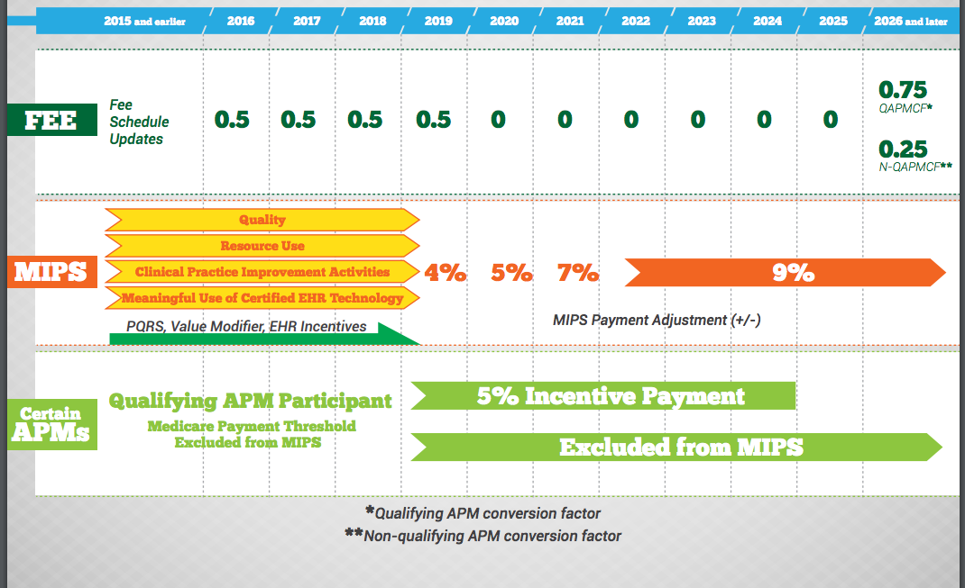

Alternative Payment Model (APM) Participation Incentivized

Slide 15
Category 2 – Fee for Service Link to Value
Hospital Pay for Performance Programs
FY | HACRP | HVBP | HRRP | Overall
2015 | 1.00% | 1.50% | 3.00% | 5.50%
2016 | 1.00% | 1.75% | 3.00% | 5.75%
2017 | 1.00% | 2.00% | 3.00% | 6.00%
Risk-adjusted claims based outcome measures include:
Patient Safety Indicator (PSI) 90
Mortality Rates
Readmission Rates
THA/TKA Complication Rates
Medicare Spending Per Beneficiary (MSPB)
Payment measures

Slide 16
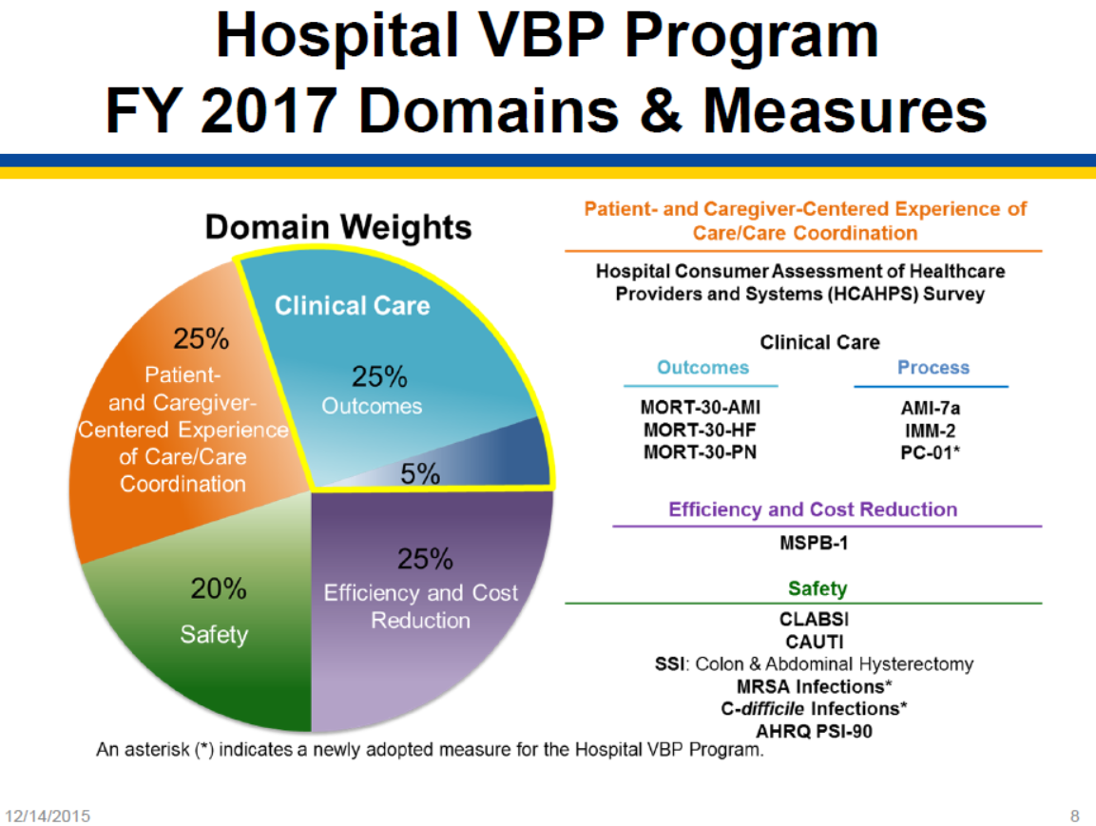
HVBP – FY2017
CDI impacts claims based measures: mortality, MSPB, APRQ PSI-90

Slide 17
CDI Impacts Claims Based Measures
Code assignment has a significant impact on claims based measure performance
Code assignment is based on physician documentation for the encounter
Patient Care
Performance
Payment
Profiles
Patient Care Improvement
Medical Records Documentation
Other Warehouses
Clinical Registries
Clinical Abstraction
ICD 10 Code Assignment
Payers
Claim

Slide 18
Pneumonia Mortality
Risk Standardized Mortality Rate Pneumonia (v10.0) – Effective FY 2021 (IPPS FY2015)
Inclusion | Pneumonia as principal diagnosis, or Sepsis as principal diagnosis with pneumonia as other diagnosis (POA)
Exclusions | Severe sepsis as SDx (POA)
 | Discharged AMA
Risk Adjustment of Entire Cohort
MCANCER |  | MALNUTRITION | HEMATOLICAL DISORDER
DEMENTIA |  | RESPFAILURE | FIBROSIS LUNG
LIVERDIS |  | CHF | HXMI
…29 risk adjustment comorbid category groups
Cohort
Inclusions
Exclusions
Risk adjustment variables

Slide 19
Pneumonia Mortality – Risk Adjustment Inpatient/Ambulatory Documentation Impact
ID discharges in cohort
ID outcome of interest
Risk adjust cohort
(CMS) Predicted/Expected
Key takeaway - All discharges in the cohort “count” in the measure; not limited to mortality
12 month “lookback”. Part A & B claims. “Complications”

Slide 20
Pneumonia Mortality – Risk Adjustment Weighted Comorbidity Groups
Comorbidity Category Groups
Paralysis…:
-plegia (mono, hemi,…)
-functional quadriplegia
-not “weakness” unless associated with stroke

Slide 21
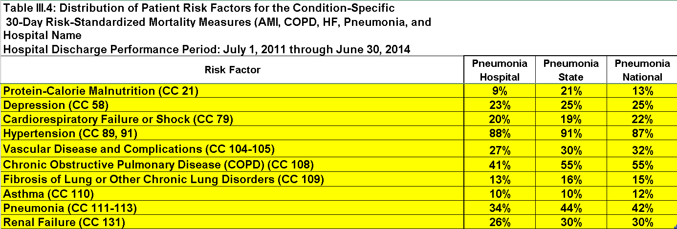
Pneumonia Mortality – Risk Adjustment CMS Feedback Reports
Quality and CDI Program synergy?
Clinical documentation and/or code reporting opportunities?

Slide 22
Category 3 – APM Build on Fee-for-Service Infrastructure
The Comprehensive Care Joint Replacement Payment Model (CJR)
Hospital repayment
Mandatory bundled payment for defined episode of care
90 day episode
Total joint replacements lower extremity (MS-DRGs 469, 470)(Includes fractures)
Two sided payment model
Hospital accountable for financial risk
April 1, 2016 through December 31, 2020
Above
target
price
Performance Year
episode cost reconciliation
Below
target
price
Quality
Composite Score
Hospital reconciliation payment

Slide 23
Category 3 – APM Build on Fee-for-Service Infrastructure (cont)
The Comprehensive Care Joint Replacement Payment Model (CJR)
Hospital repayment
Quality composite score determines:
Eligibility for reconciliation payment
Amount of repayment or reconciliation payment (through reduction of up to 50% of the CMS 3% discount)
Above
target
price
Performance Year
episode cost reconciliation
Below
target
price
Quality
Composite Score
Hospital reconciliation payment

Slide 24
Risk Standardized Complication Rate (RSCR)
What is It | Risk adjusted measure to estimate the rate of defined complications with elective primary THA and TKA
Population (Cohort) | ICD-10 procedure driven (total hip, total knee) Exclusions: partial hips; fractures, other
Impact | 50% of CJR quality composite HVBP (Outcome Domain)
Complication | Timeframe for occurrence
AMI | Within 7 days of index admission admit date
Pneumonia | Same as above
Sepsis/septicemia/shock | Same as above
Surgical site bleeding | During index admission or within 30 days of admit date
PE/DVT | During index admission or within 30 days of admit date
Death | During index admission or within 30 days of admit date
Mechanical complications | During index admission or within 90 days of admit date
Peri-prosthetic joint/ wound infection | Same as above

Slide 25
RSCR – Risk Adjustment Inpatient/Ambulatory Documentation Impact
Comorbidity categories - unique to each measure
Risk adjustment weights assigned to each comorbid category – unique to each measure
ICD-10 codes - mapped to each comorbid category
“Complication” codes -unique to each comorbid category
Renal Failure: “chronic renal insufficiency”
“Morbid
obesity”

Slide 26
Clinical Documentation Integrity (CDI) Program
Goal:
Improve the clinical reliability and integrity of health care data thereby appropriately defining the patient population under treatment
Objective:
Promote and support the accurate and complete capture of clinical documentation and reported codes
Benefits:
Reimbursement
Quality profiles
Improved population analytics

Slide 27
Risk Adjustment Methodology Variations
Purpose of Risk Adjustment | To compensate for differences among patients that may affect their healthcare outcomes (e.g. comorbidities, demographics) and support: Provider comparisons Assessment of treatment efficacy Allocation of funds for treatment
Methodology Variations: | Outcome of interest Measure
AHRQ
Condition Categories
Hierarchical Condition Categories
PSI-90
Mortality
Readmissions
Complications
Payment measures
Medicare Advantage
MSBP
VBM
ACOs
PACE
MSSP

Slide 28
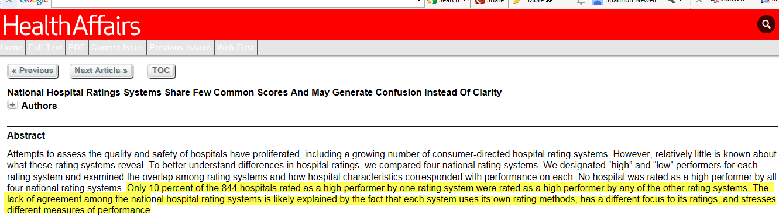
What Measures? Risk Adjustment?
http://m.content.healthaffairs.org/content/34/3/423.abstract?sid=6c0faf3e-5fc0-45f1-80ba-5e3c39982828
Numerous methodologies for quality measures
Each system has its own methodologies
Lack of agreement among the national hospital rating systems
Example: Only 10% of hospitals rated as a high performer by one rating system were rated as a high performer by other leading national hospital rating systems

Slide 29
Risk Adjustment Focus: The Denominator
Cohort selection
Inclusions
Exclusions
Risk adjustment
Observed / expected rate
Discharge
Discharge
Discharge
Inclusions
Eligible Discharges
(Denominator)
(Population at risk)
Risk Adjustment
Outcomes of Interest
(Numerator)

Slide 30
CDI Record Review Process
Support accurate translation of case mix complexity
Physician documentation and/or terminology
Coding guidelines
Congruence of clinical picture and reported ICD-10 codes
Defined process to align with organization’s CDI Program objectives
Patient population and scope
Provider communication
CDS, Coder and CDI Physician Advisor responsibilities, tools, process
Provider Documentation
Clinical Documentation Specialist
CDI Physician Advisor
ICD-10 Coder

Slide 31
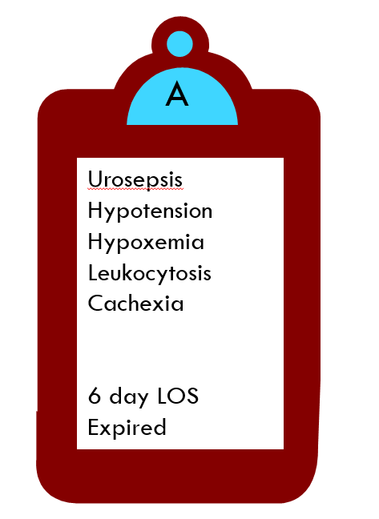
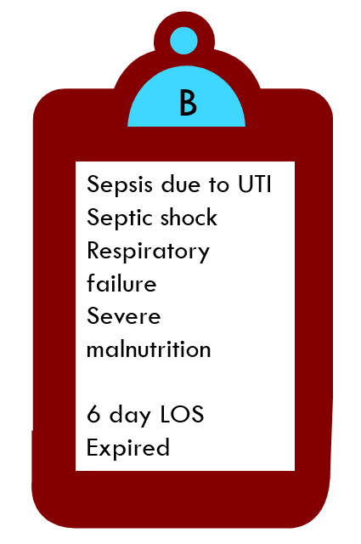
CDI Program Objective – MS-DRGs
UTI
Bacteremia
Hypotension
Hypoxemia
Cachexia
6 day LOS
Expired
Sepsis due to UTI
Septic shock
6 day LOS
Expired
MS-DRG 690
Urinary tract infection
w/o complication
MS-DRG 871
Sepsis major complication

Slide 32
CDI Program Objective – APR-DRGs
1
2
UTI
Bacteremia
Hypotension
Hypoxemia
Cachexia
6 day LOS
Expired
Sepsis due to UTI
Septic shock
Resp failure, acute
Malnutrition
6 day LOS
Expired
MS-DRG 690
Urinary tract infection w/o complication
SOI score - 3
ROM score - 3
MS-DRG 871
Sepsis w major complication
SOI score – 4
ROM score - 4

Slide 33
The Impact of Accurate Translation
Quality Measure | Cohort | Provider Documentation | Provider Documentation & Reported Codes | Quality Measure Impact
Complications | THA/TKA | “Renal insufficiency” | “CKD” | Strengthened risk adjustment
Readmissions | Pneumonia | “Hypoxemia”* | <not reported> | Weakened risk adjustment
Readmissions | Pneumonia | “Sepsis” | “Severe sepsis” POA | Patient excluded from cohort
Mortality | Heart Failure | “Diastolic dysfunction” | “Diastolic heart failure” | Patient included in cohort
PSI 90 | Post-op sepsis | <none> | “Pressure ulcer” “stage 2” | Patient excluded from cohort
PSI 90 | Post-op sepsis | <none> | <none> | Admission type “elective” – Patient excluded from cohort

Slide 34
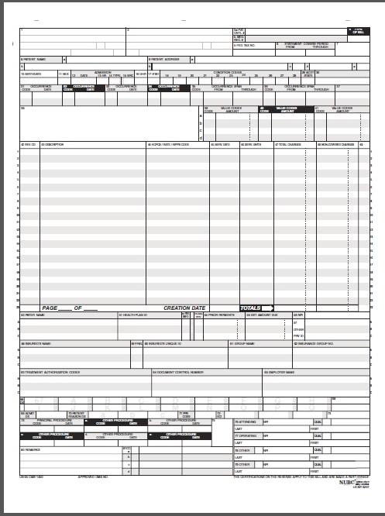

Claims Data – Key Inputs
Inpatient = UB-04
Diagnoses
UB-04 = 25
1500 = 6
Procedures and dates
UB-04 = 25
1500 = 6
Other fields:
Admission Source
aka Point of Origin
Admission type
Discharge status
Provider attribution
Outpatient = 1500
Source: https://www.cms.gov/Medicare/CMS-Forms/CMS-Forms/Downloads/CMS1500.pdf

Slide 35
CDI Program Infrastructure
Designed to support organizational objectives
Provider Engagement
Documentation Infrastructure
Performance Monitoring
CDI Medical Record Reviews
CDI Program

Slide 36

CDI Program Elevation
Health system leadership team is aware of CDI impact on claims based outcomes linked to payment across continuum
CDI Program objectives are aligned with organizational priorities
Expertise in claims based measure structure, risk adjustment methodologies, CDI vulnerabilities is maintained
CDI Program infrastructure supports data driven collaborative approach to documentation capture and reported codes
CDI record reviews
Point of care documentation capture
Performance monitoring

Slide 37
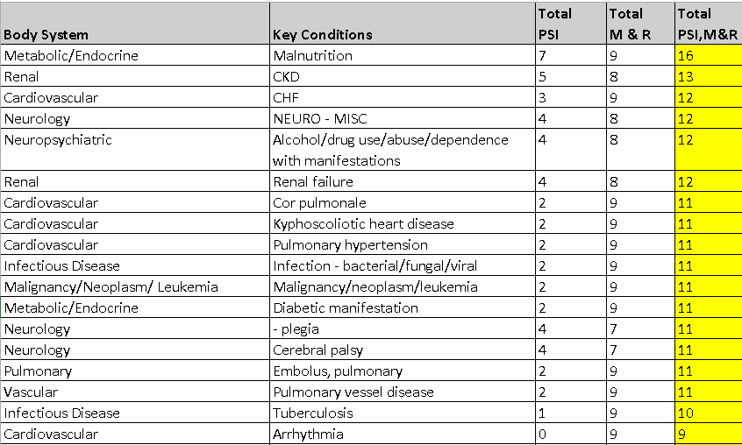
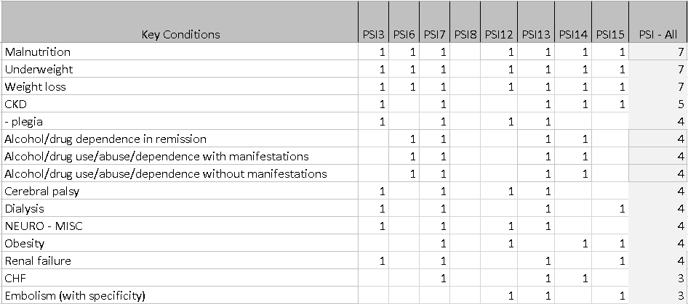
Data Driven Approach
Key conditions:
Comorbid category → ICD-10 codes
ICD-10 codes → common concepts
Example: diabetes

Slide 38
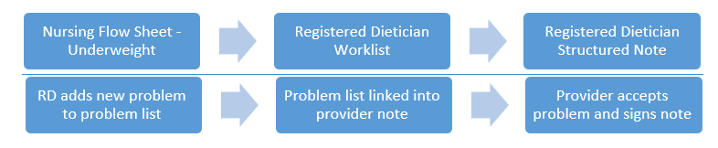
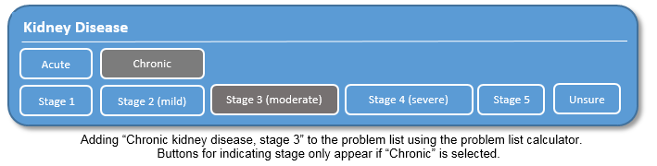
Documentation Capture Re-Design
Collaborative documentation capture - “underweight”
Point of care capture – CKD stage

Slide 39

Patient Benefits
Clinical documentation supports both:
Opportunities to reduce the frequency of events
Risk adjusted outcome measure performance
Patient Centered Around Episodes of Care
CDI Across the Continuum

Slide 40
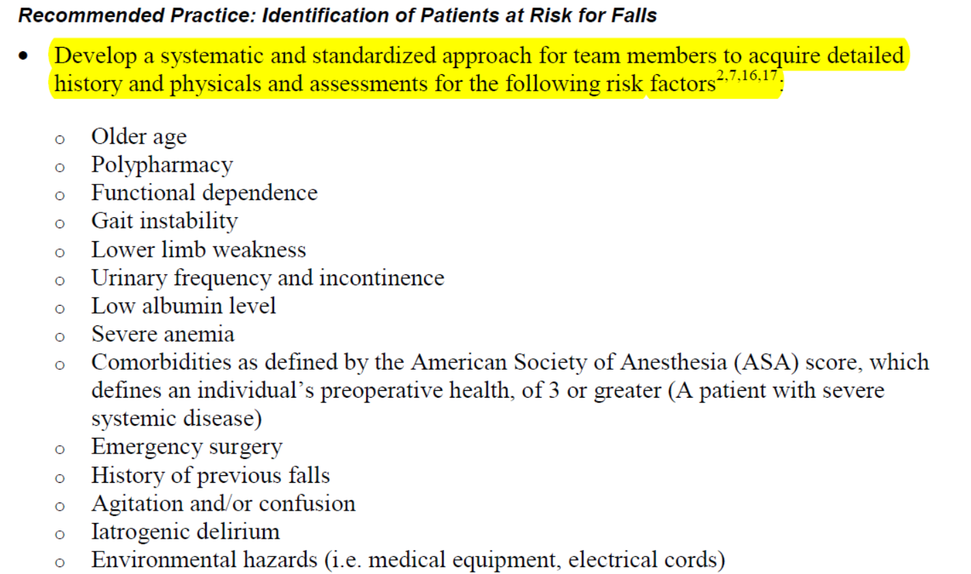
Patient Benefits (cont) PSI 8 (In-Hospital Falls) - Example
Concurrently identified risk variables support prevention opportunities
Documented risk variables support expected fall rates
Source: http://www.qualityindicators.ahrq.gov/Resources/Toolkits.aspx
Patient Centered Around Episodes of Care
CDI Across the Continuum

Slide 41
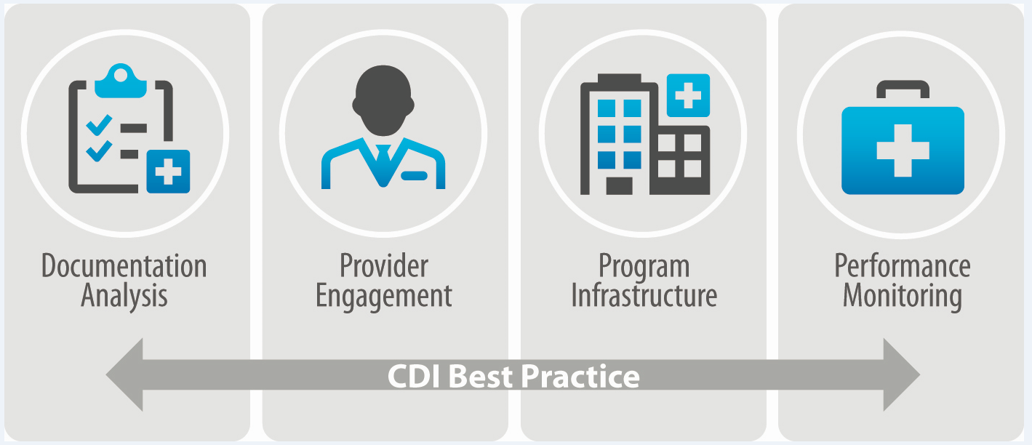
Summary
Clinical documentation and reported codes across the continuum:
Drive your organization’s performance for risk adjusted claims based outcomes.
Impact hospital and provider reimbursement.
Influence effectiveness of clinical performance improvement initiatives.
Expanded use of risk adjustment requires CDI Program elevation.
CDI Across the Continuum
Patient Centered Around Episodes of Care
CDI Across the Continuum

Slide 42

Q&A

