Slide 1
What the H-ECMO?: Team work to finding solutions to a challenging problem
Team Approach-
CDI, CV Critical Care intensivist, Director of Revenue Cycle Coding, and more ☺
February 13, 2019

Slide 2
Coding changes
Pre-October 2018- ECMO DOCUMENTED, regardless of PDX, intent, or approach, would end up in DRG 003. The word ECMO acted as an IMPACTING PROCEDURE (a procedure that determines the DRG).
Post-October 2018- the word ECMO does not always “drive the procedure”- it will with Central cannulation only.

Slide 3
Shift in Mentality and increased understanding
The term ECMO is more complicated than realized- the different methods of cannulation, have different indications, and physiologically impacts on the body.
It is a big shift in mentality to understand, and ensure the variety of needed elements involved with “ECMO” are documented and described accurately- Device name, insertion, end destination of catheter, indication.
There is ECMO and ECMO incorporated with other device/functions

Slide 4
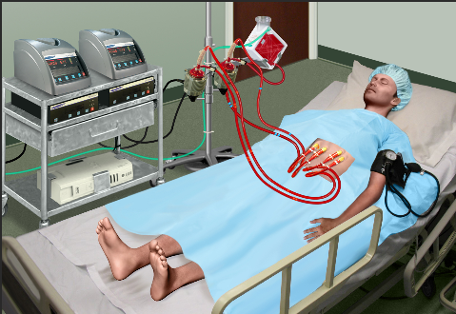
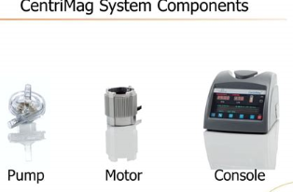
ECMO/ECLS –extra corporeal membrane oxygenation/extra corporeal life support
Modern ECMO is usually conducted with integrated devices designated ECMO machines. These machines include all of the basic components: blood pump, membrane lung and conduit tubing. Depending on the application additional components may be included ( heat exchanger, monitors, alarms)

Slide 5
The cost of poor team work
The change resulted in a significant decrease in reimbursement, but without good team work, the impact could be more than it should be.
Team that worked to ensure proper coding- Coding Leadership, CDI Leadership, LVAD coordinator, DON, CVT surgeons, CV Critical Care providers, CDI and coding team mates, and CDI professionals in similar facilities

Slide 6
Challenges
Huge change in coding, led to understanding, our knowledge deficit.
Areas that required education for our team to ensure accurate coding, of the intense services by providers: equipment/devices used; indication; intent; and a detailed description of procedure, including body part in PCS path.
Ensuring different departments receive education, voice concerns, share research, specialty knowledge, and case details to confidently be in compliance with changes-Administration, clinical team, Coding and CDI.

Slide 7
One key- Final Rule MS-DRG UPDATE
“In cases where a percutaneous external heart assist device is utilized, in combination with a percutaneous ECMO procedure, effective October 1, 2018, the ICD-10 MS-DRG Version 36 GROUPER logic results in a case assignment to MS-DRG 215 because the percutaneous external heart assist device procedure is designated as an O.R. procedure and assigned to MS-DRG 215.”
https://www.federalregister.gov/documents/2018/08/17/2018-16766/medicare-program-hospital-inpatient-prospective-payment-systems-for-acute-care-hospitals-and-the

Slide 8
Solutions
CDI and Coding sought education of different types ECMO and devices from CV team
We did lots of research- medical literature, device company, coding guidelines and index, federal registries, conferenced with outside facilities
Educate team members on Device- indication, coding device key, PCS guidelines
Worked with providers to implement template to include essential elements

Slide 9
Critical Care ECMO Initiation Note Elements:
Indication:****Cardiogenic shock***STEMI *** Severe acute hypoxemic respiratory failure/ ARDS***Refractory Septic Shock***Other______
Mode: Peripheral or Central : V-V ECMO *** V- A ECMO
Inflow/ Insertion site: *** French single or multi stage or Avalon***Right or Left ***Femoral or IJ or R atrium
Tip of catheter: ***Right Atrium/Heart *** other
Outflow/Insertion Site *** French*** Right or Left*** Femoral or IJ or Aorta
Tip of catheter: *** Iliac artery *** Aorta *** *** IVC *** Pulmonary artery
Antegrade line : *** French , placed on ***
Oxygenator: quadrox; clot***
Deviced Used: ***Centrimag short term external heart assist ***Centrimag Blood pump for respiratory support
Flow: ****
RPM: *** , RPM changes : *** secondary to ***
Sweep:***LPM: *** increased/decreased secondary to ***
Anticoagulation: Heparin drip, monitor with *** antiXa or PTT

Slide 10
Resources- cheat sheet
Guidelines from:
Extracorporeal Life Support Organization (ELSO)
Common DRGs with length of stay and estimated reimbursement helped “ non-coding world” talk the same language

Slide 11
Thank you and good luck working together!

Slide 12
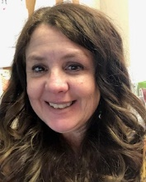
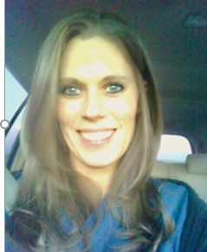
Presenters and Contributors
Ann Donnelly, RN, BSN, CCDS- Manager of CDI Tulsa Region, Hillcrest Medical Center, Ardent Health Services. Ann has 25 years of nursing experience in Critical Care, PACU, Burn and Telemetry/Step- down; and 8 years’ experience in Clinical Documentation. She has worked in a variety of CDI software, and computer systems in the CDI industry. She has worked in community, to teaching facilities, and each of these different experiences has helped her understand the many nuances of documentation. She enjoys helping others find their drive to be their best. She is proud to work in an industry that is proving itself to be an important support to many cogs in the health care cycle. She is happy to be a part of “an awesomely collaborative team”. She loves the challenging and encouragement they give to become the best they can be.
Ann.Donnelly@hillcrest.com
Darcy Watts, RN, with 10 years Critical Care Nursing experience with Hillcrest Medical Center/ Ardent Health Services. She has done CDI for almost 2 years. She has used her clinical knowledge and provider relationships from her time in ICU to quickly jump into working on projects and developing her presentation and coding skills. She finds CDI challenging- some days exhilarating, and some exhausting but always rewarding. She likes knowing she makes a difference in the huge impact of documentation and outcomes for her organization.
Darcy.Watts@hillcrest.com
Dr. Ghuloom is a cardiovascular critical care intensivist at Oklahoma Heart Institute with expertise in advanced heart failure, including mechanical circulatory support (VAD and ECMO) and heart transplant cardiovascular intensive care. Prior to joining Oklahoma Heart Institute, he was a cardiovascular critical care specialist at Tufts University. Board certified in Critical Care Medicine and Internal Medicine; Critical Care Fellowship – Baylor College of Medicine, Houston, Texas Internal Medicine Residency – Wayne State University, Detroit, Michigan Medical degree – Arabian Gulf University, Manama, Bahrain ;Bachelor of Science degree – Arabian Gulf University, Manama, Bahrain
Adel.Ghuloom@hillcrest.com
Jeff Lewis, RHIA, CDIP, CCS , Director, Revenue Cycle Coding, with 25 years of health care experience. He has extensive process management and hands on experience in the areas of revenue cycle management, regulatory compliance, ICD-10-CM/PCS coding/auditing, CMS RAC Management, directing HIM coding departments and hospital CDI programs.
Jeffrey.Lewis@ardenthealth.com

Slide 13
References
Extracorporeal Life Support Organization (ELSO) Guidelines for Adult Respiratory Failure August, 2017
Centers for Medicare & Medicaid Services. ICD-10-CM/PCS MS-DRG v36.0 Definitions Manual. https://www.cms.gov/ICD10Manual/version36-fullcode-cms/fullcode_cms/P0001.html
https://www.cms.gov/Medicare/Coding/ICD10/2019-ICD-10-PCS.html
Abbott. CentriMag™ Acute Circulatory Suport System. Indications, Safety & Warnings. https://www.sjm.com/en/professionals/featured-products/heart-failure-management/mechanical-circulatory-support/acute-circulatory-support-system/centrimag-acute-circulatory-support-system/isw
https://www.uhcprovider.com/content/dam/provider/docs/public/...
https://med.noridianmedicare.com/web/jfb/policies/ncd/percutaneous-endovascular-cardiac-assist-procedures-and-devices
https://www.abiomed.us/reimbursement/
https://www.ncbi.nlm.nih.gov/pmc/articles/PMC5337209/, Cannulation techniques for extracorporeal life support, Evgeny Pavlushkov, Marius Berman, and Kamen Valchanov
http://mmplusinc.com/news-articles/item/ipps-fy-2019-final-rule-ms-drg-updates

