Slide 1
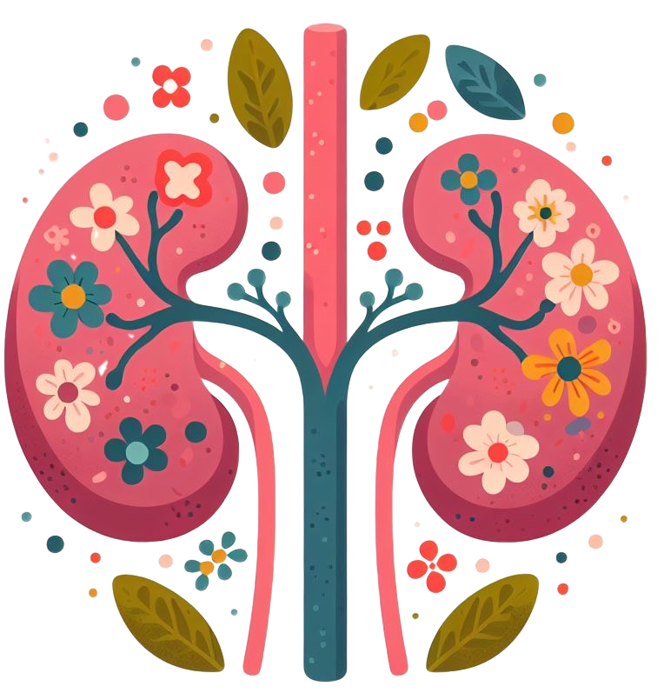
Decoding AKI- Mastering KDIGO Guidelines and Its Application
Presented By,
Anjali Baji MSN , RN.

Slide 2
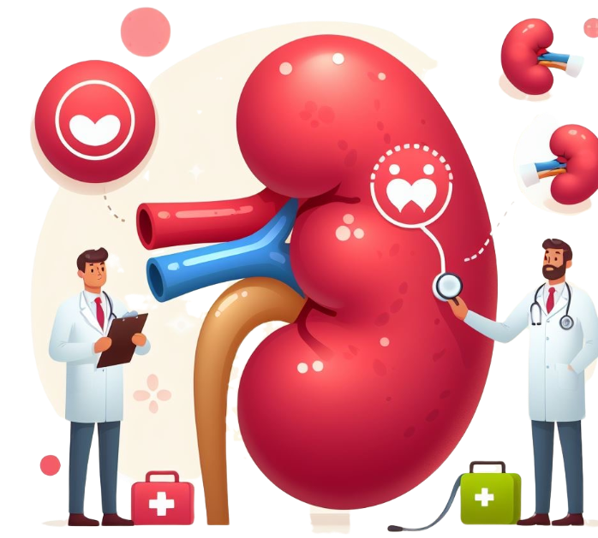
Table of Contents
01
Definition
02
Etiology
Prerenal, Intra renal post renal.
03
Pathophysiology
04
Clinical features
05
KDIGO criteria
06
Conclusion

Slide 3
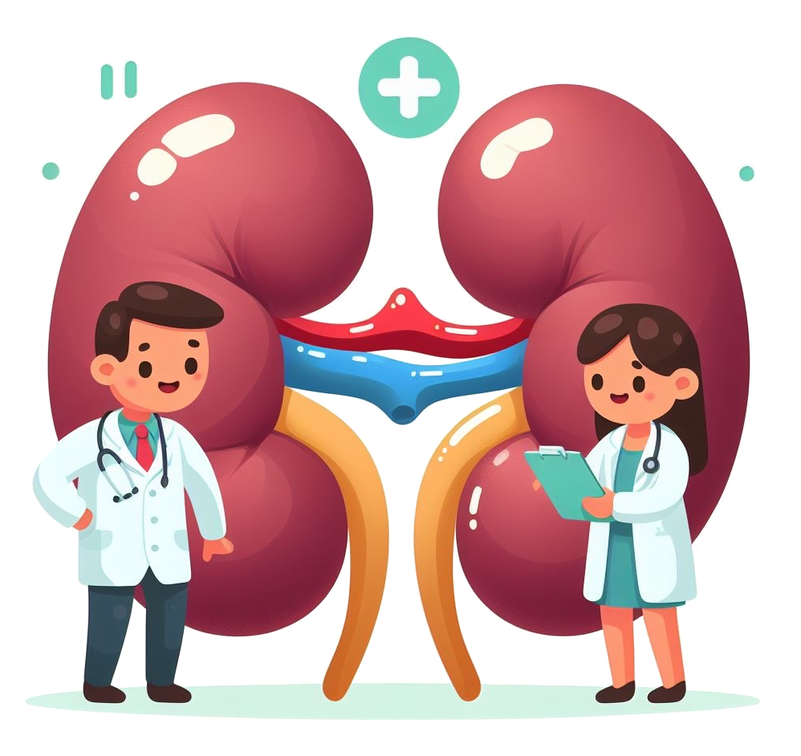
Acute kidney injury (AKI) refers to an abrupt decrease in kidney function, resulting in the retention of urea and other nitrogenous waste products and in the dysregulation of extracellular volume and electrolytes.

Slide 4
The Significance of AKI
What does any of these numbers of CKD has to do with AKI aka Acute kidney injury ?????
11.8% among women worldwide has CKD
10.4% men worldwide has CKD
AKI, is experienced by 13.3 million people each year, may resolve or lead to CKD or kidney failure in the future. (ISN- International society of Nephrology)
850 million people worldwide have some form of kidney disease

Slide 5
Acute kidney Injury
AKI is seen in 10-15% of people admitted to the hospital and in more than 50% of people admitted to the intensive care unit (ICU).
People who have experienced AKI are at increased risk of developing chronic kidney disease in the future.
Among hospital survivors of AKI without pre-existing CKD, 11.6% were diagnosed with CKD in the 3 months following discharge. This percentage progressively increased to 20.7% at 24 months. There was also high mortality in the population, with 36.7% having died by 24 months.
.

Slide 6
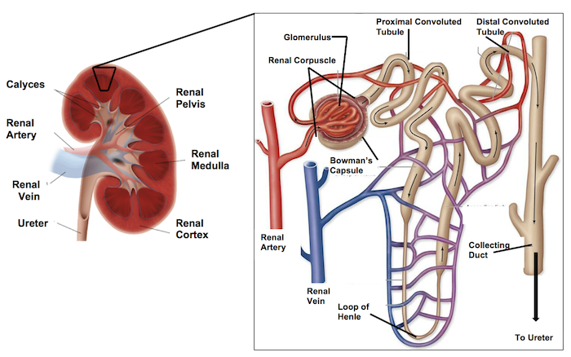
The renal system consists of the kidney, ureters, bladder and the urethra.
Nephrons , the urine-producing functional structures of the kidney. The microscopic structural and functional unit of the kidney is the nephron. Each kidney has approximately 1 million Nephrons. It processes the blood supplied to it via Glomerular filtration, reabsorption, secretion and excretion; the consequence of those processes is the production of urine.

Slide 7
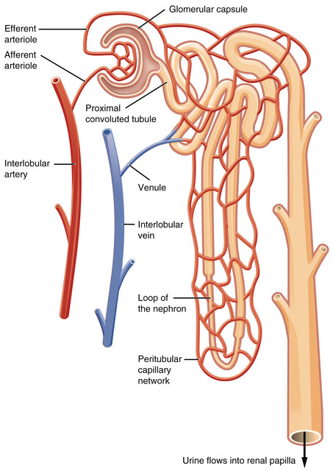
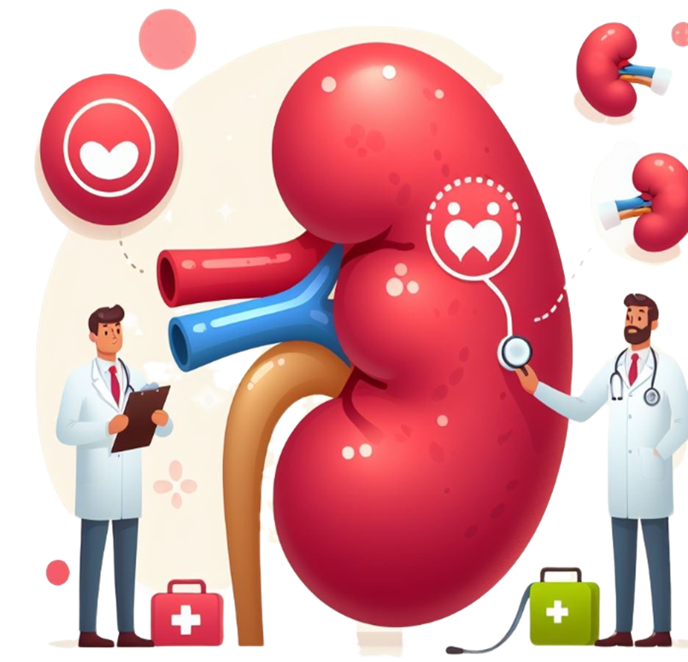
1
Filtration
Blood enters the kidneys through the renal artery, where it is filtered in the nephrons. It filters out waste products, excess water, and electrolytes from the blood
2
Reabsorption
As the filtrate passes through the renal tubules, essential substances like glucose, amino acids, and certain ions are reabsorbed back into the bloodstream.
3
Secretion:
The tubules also actively secrete additional waste products and excess ions into the filtrate, which will be excreted as urine.
Excretion:
4
The final urine, which contains waste products, excess water, and unneeded substances, is collected in the renal pelvis and then transported to the bladder via the ureters. It is eventually excreted from the body through the urethra.

Slide 8
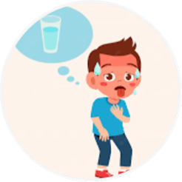
UNDERSTANDING THE THREE POSSIBLE ETIOLOGIES OF AKI
PRE-RENAL
INTRA RENAL
POST RENAL
Notes:
.

Slide 9
PRE-RENAL (accounts for 60%–70% of all inpatient renal failure.)
Renal failure due to compromised blood flow to the kidneys.
CAUSES
Hypotension
Dehydration
Hemorrhage
Shock
Burns
Gastroenteritis
Sepsis
Congenital cardiac conditions causing reduced cardiac output
Cardiac output decreases
Reduced blood flow (perfusion) to the kidneys
Blood filtering mechanism is altered
Buildup of waste products and fluid in the body.
PATHOPHYSIOLOGY
AKI

Slide 10
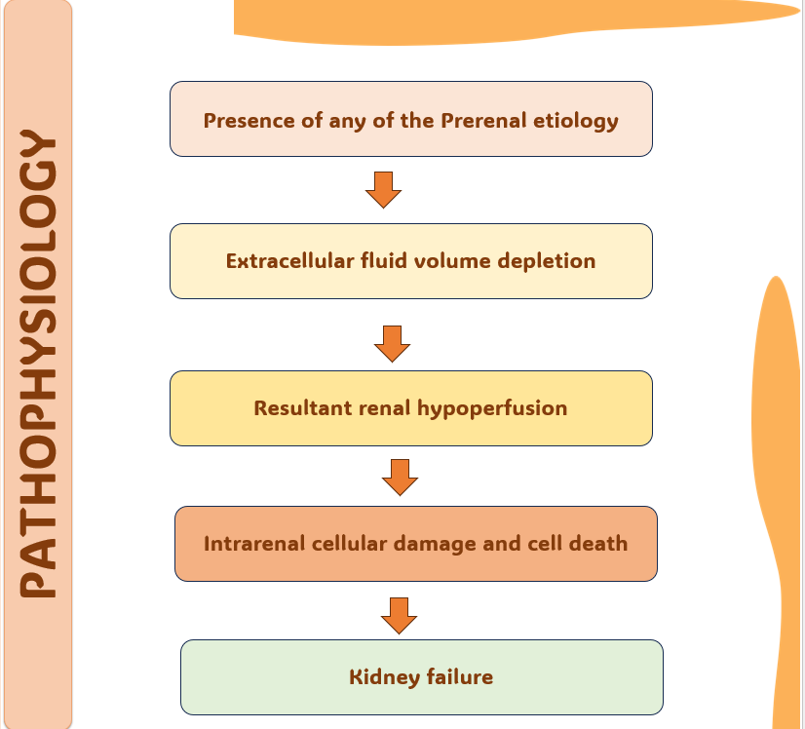
RELATION OF PRERENAL ETIOLOGY AND RENAL CELL DAMAGE

Slide 11
INTRA-RENAL- Most common is ATN ( Acute tubular Necrosis)
Renal failure due to diseased, ischemic , infarcted or necrotic changes in the renal parenchyma.
CAUSES
Acute glomerular Nephritis /AGN/PSGN
( MCC)
Nephrotoxins
Acute tubular necrosis ( MCC)
Chemotherapy / Radiation
Diabetic Nephropathy
Hypertensive kidney disease
Sarcoidosis
Hemolytic Uremic Syndrome (HUS) ( MCC)
Infections
Intra renal events
Tubular epithelial cell necrosis/ cell death
Necrosed epithelium slough off into tubules
Brown granular casts THAT CAN PLUG THE TUBULES
Reduced GFR
Decreased Urine production, increased BUN and creatinine.
CLASSIC ATN SIGN
PATHOPHYSIOLOGY

Slide 12
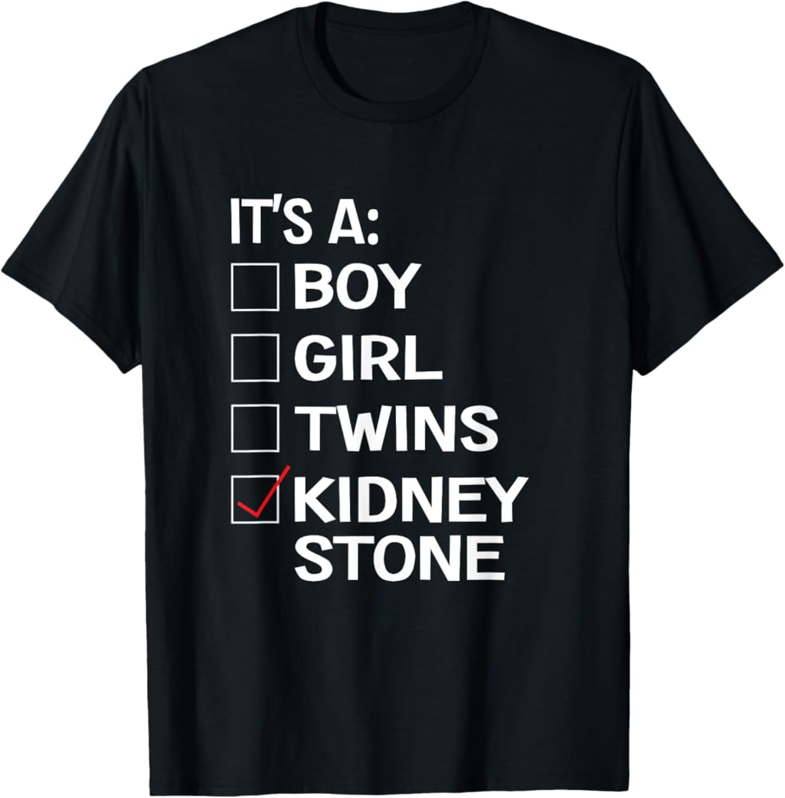
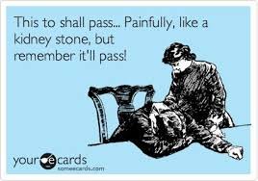
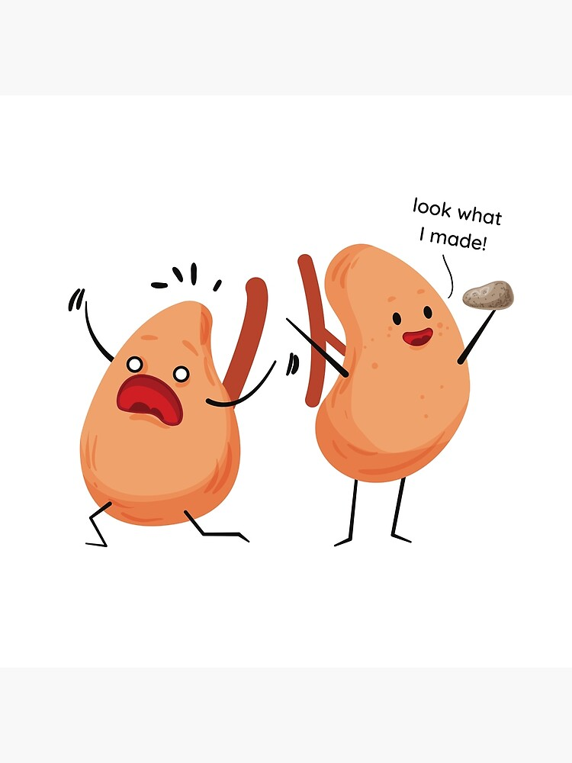
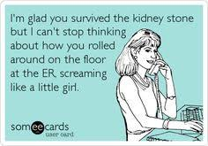
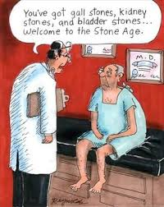

Slide 13
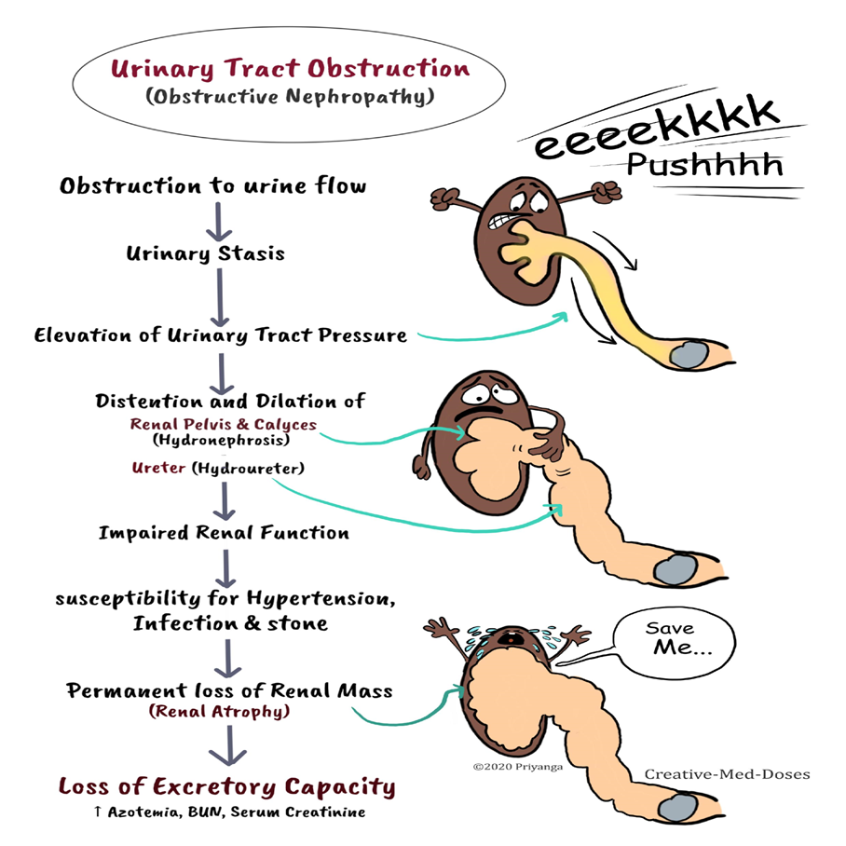
POST RENAL
Renal failure due to an obstructive process somewhere in the excretion of waste from the renal calyx to the urethra.
CAUSES
Kidney stones
Ureteral strictures
Neoplasms
Adhesions
Neurogenic bladder
Post operative complications
PATHOPHYSIOLOGY

Slide 14
Systemic Conditions
Multisystem Inflammatory Syndrome in Children (MIS-C)- Associated with COVID 19
Shock
Multiorgan dysfunction/ MODS
Rhabdomyolysis: This condition involves the breakdown of muscle tissue, releasing myoglobin into the bloodstream, which can be toxic to the kidneys and cause AKI. It can be triggered by trauma, extreme physical exertion, or certain infections.
Inborn Errors of Metabolism: Conditions like methylmalonic acidemia/ MMA or primary hyperoxaluria can cause metabolic disturbances that lead to AKI.
Hereditary Syndromes: Certain genetic syndromes, such as Alport syndrome or Wilms tumor, can predispose children to kidney dysfunction and AKI.
Acute Kidney Injury from Hemodynamic Changes- Major surgeries, especially those involving the heart or requiring cardiopulmonary bypass

Slide 15
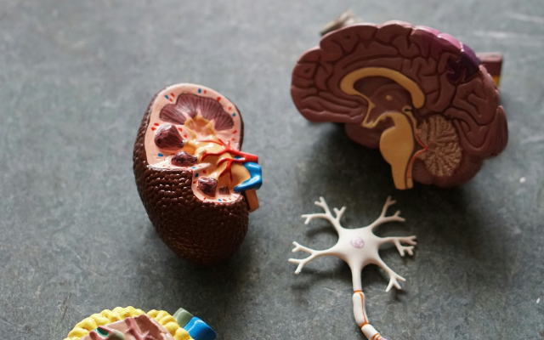
Contrast Nephropathy
RISK FACTORS
Older age
Preexisting chronic kidney disease
Diabetes mellitus
Heart failure
Multiple myeloma
High doses of a hyperosmolar contrast agent (eg, during percutaneous coronary interventions)
Factors that reduce renal perfusion, such as volume depletion or the concurrent use of nonsteroidal anti-inflammatory drugs (NSAIDs), diuretics, or angiotensin-converting enzyme (ACE) inhibitors
Concurrent use of nephrotoxic medications (eg, aminoglycosides)
Liver failure
Contrast nephropathy is worsening of renal function after IV administration of radiocontrast and is usually temporary. Contrast nephropathy is acute tubular necrosis, caused by an iodinated radiocontrast agent, all of which are nephrotoxic.
The precise mechanism of radiocontrast toxicity is unknown but is suspected to be some combination of renal vasoconstriction and direct cytotoxic effects
Diagnosis is based on a progressive rise in serum creatinine 24 to 48 hours after contrast is given.
Treatment is supportive.

Slide 16
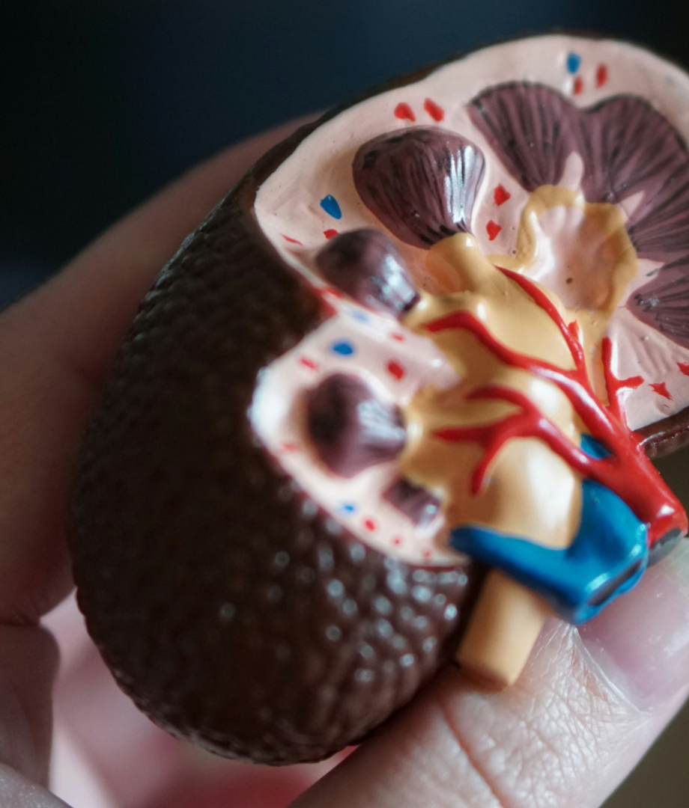
Common medications associated with nephrotoxicity
Acetaminophen
NSAIDS
Antidepressants (e.g- Amitriptyline, doxepin, fluoxetine)
Mood stabilizers (e.g- Lithium)
Antihistamines (e.g- Diphenhydramine, doxylamine)
Antimicrobials
Antiretrovirals
Chemotherapeutic agents
Contrast dye
Proton pump inhibitors.

Slide 17
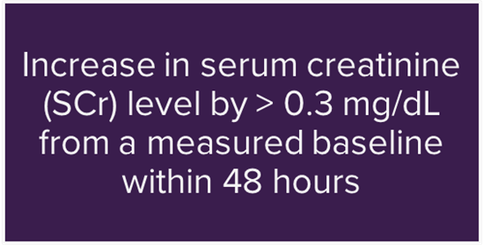
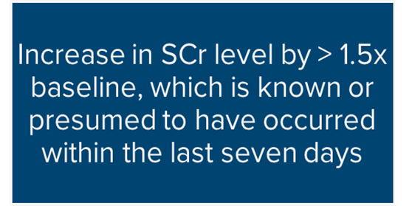
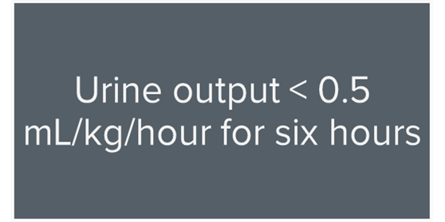
DIAGNOSTIC CRITERIA
The most recognized consensus-based criteria for AKI are defined by the KDIGO( Kidney Disease Improving Global Outcomes ) organization. Published in 2012 and are applicable to both adults and pediatric patients.
Prospective AKI Determination
Retrospective AKI Determination
Based on urine output

Slide 18
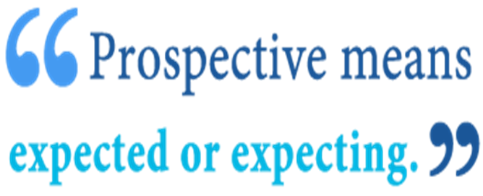
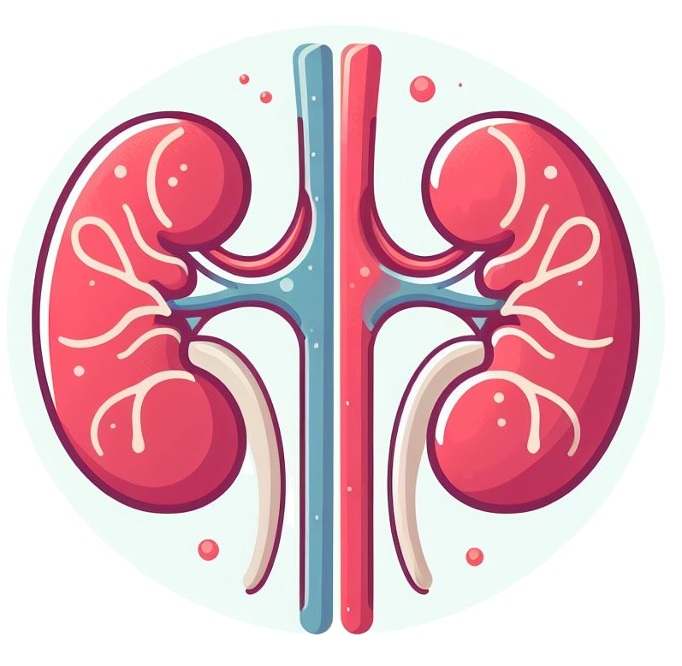
Prospective AKI Determination
The > 0.3 mg/dL criterion can only be applied prospectively.
Increase in serum creatinine (SCr) level by > 0.3 mg/dL from a measured baseline within 48 hours.
An increase of at least 0.3 mg/dL must be observed between the two values.
LAB | 8/20 | 8/21 | 8/22
Creatinine | 0.9 | 1.4 | 1.5

Slide 19
Retrospective AKI Determination
Increased creatinine >1.5 x baseline, which is known or presumed to have occurred within 7 days​.
KDIGO instructs that if a baseline creatinine cannot be confirmed, use the lowest SCr obtained during the hospitalization to diagnose the presence of AKI.
AKI may not be definitively diagnosed for a patient admitted with an elevated SCr until the creatinine levels can be viewed retrospectively, allowing identification of the lowest level.
LAB | 8/20 | 8/21 | 8/23
Creatinine | 2.5 | 1.2 | 1.0

Slide 20
Example - Retrospective AKI Determination
What is the baseline creatinine?​ 1.0
Which criteria will you use: Retrospective or Prospective? Retrospective ​
Does this patient have AKI?​ Lets calculate
Baseline creatinine is 1.0​
Use the Retrospective criteria​
1.5 X 1.0 (baseline) = 1.5​. ( The highest the patient had on admission was 2.5)
Yes, the patient has AKI​

Slide 21
Urine Output AKI determination
Patients with severe cases of AKI may be symptomatic and present with oliguria. The KDIGO criterion of < 0.5 mL/kg/hour for six hours is often supported within.

Slide 22
Urine Output AKI determination
A 90 kg man produces 220 mL of urine over 6 hours.
Equation = Urine output divided by total weight divided by total hours .
Urine output = 220 mL in 6 hrs
Total weight = 90 kg
So , 220 ml divided by 90 kg = 2.44 mL/kg , then this is divided by 6 to get the amount in 1 hour = 0.41 mL/kg/hour.
Expectation is 0.5 ml/kg/hour. AKI is supported
OR
Expectation is 0.5 ml/kg/hour.
Weight of the man is 90 kg
So , 0.5 x90 =45ml/hrs
So, for 6 hrs = 45x 6 = 270ml.
How much is the output = 220ml .
So AKI is supported.

Slide 23
Let's practice
LAB | 8/25 | 8/26 | 8/27
CREATININE | 0.9 | 1.2 | 1.3
Prospective /AKI Present
LAB | 8/25 | 8/26 | 8/27
CREATININE | 0.7 | 0.5 | 0.6
No AKI
LAB | 8/25 | 8/26 | 8/27
CREATININE | 2.9 | 2.0 | 1.5
Retrospective/ AKI Present
LAB | 8/25 | 8/26 | 8/27
CREATININE | 1.5 | 1.0 | 0.7
Retrospective/ AKI present
LAB | 8/25 | 8/26 | 8/27
CREATININE | 2.8 | 2.6 | 2.5
No AKI

Slide 24
Newborn AKI
Serum Creatinine based definitions – For clinical care, neonatal AKI has been most defined as:
•S Cr ≥1.5 mg or An increase in S Cr of at least 0.2 to 0.3 mg/dL per day from a previous lower value
The Serum Creatinine value at birth reflects the maternal Serum Creatinine and normally decreases over time .
Similar to GFR, Serum Creatinine normally varies with gestational and postnatal age.
In term infants, S Cr declines rapidly in the first or two weeks of life to nadir values (SCr 0.2 to 0.4 mg/dl, which remain stable through the first year of life , whereas in preterm infants, the decline is slower, and nadir values are reached over the first one to two months.
VALUES OF NORMAL CREATININE IN PRETERM INFANTS
•GA 24 to 27 weeks – >1.6 mg/dL
•GA 28 to 29 weeks – >1.1 mg/dL
•GA 30 to 32 weeks – >1.0 mg/dL

Slide 25
Treatment
Treat the underlying cause ( Treat the etiology)
IV fluids
Adjustment of medication regimen for degree of renal dysfunction
Nephrology consult
Identify Nephrotoxic drugs – Metformin, Morphine , Gabapentin.
If obstructive nephropathy , Surgical intervention.
Blood works , Urinalysis, Serial serum creatinine levels.
Dialysis
.

Slide 26
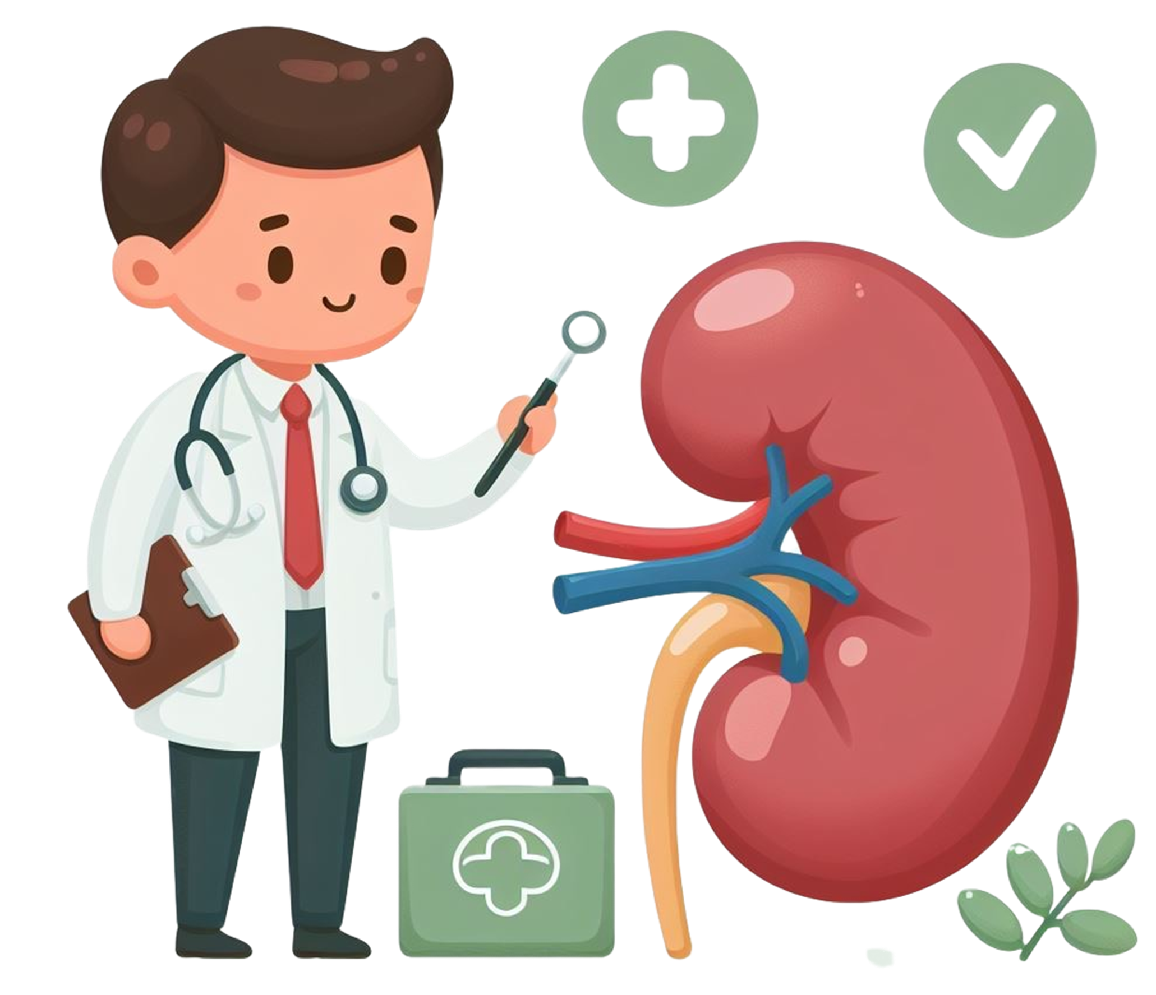
CDI Thinking
Treatment methods
How high is the creatinine , is there a baseline to compare to?
Effects of Nephrotoxicity
Any medications discontinued recently
DRUG Abuse and its effect
Pre- renal, renal or post renal factors
Any recent procedures with contrast
Any predisposing factors for AKI

Slide 27
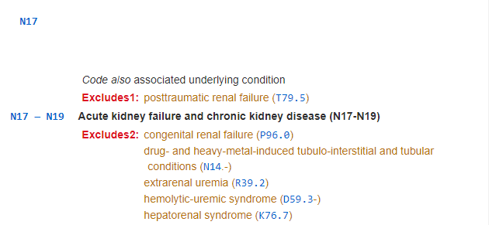
CODING
AKI is classified to the code grouping of N17.
The “code also” note instructs to “code also any associated underlying condition.” An Excludes1 indicates that these codes should not be reported with T79.5, Post-traumatic renal failure.
Question:
A 60-year-old female was diagnosed with acute kidney injury (AKI) due to acute tubular necrosis (ATN) secondary to contrast nephropathy. What are the appropriate code assignments for acute kidney injury due to acute tubular necrosis secondary to contrast nephropathy?
Answer:
Assign codes N17.0, Acute kidney failure with tubular necrosis, N14.1, Nephropathy induced by other drugs, medicaments and biological substances, and T50.8X5A, Adverse effect of diagnostic agents, initial encounter, for acute kidney injury (AKI) due to acute tubular necrosis (ATN) secondary to contrast nephropathy.
Question:
A patient with a history of a kidney transplant presents with acute renal failure (ARF) due to dehydration. Is acute renal failure always considered a complication of the kidney transplant?
Answer:
Assign codes T86.19, Other complication of kidney transplant, N17.9, Acute kidney failure, unspecified, and E86.0, Dehydration, to capture the effect on the transplanted kidney with the ARF and dehydration. Code T86.19 is assigned to capture the fact that the function of the transplanted kidney is affected by the ARF, but the transplant itself has not failed.

