Slide 1
Pediatric Shock
Theodore K. M. DeMartini, MD
Dec 7, 2023

Slide 2
Objectives
Describe types and characteristics of pediatric shock
Briefly review therapeutic considerations for different kinds of shock
Discuss nuances of documentation of pediatric shock

Slide 3
Shock: definition
SHOCK
≠
HYPOTENSION

Slide 4
Shock: definition
HYPOTENSION
≠
SHOCK

Slide 5
Shock: definition
Inadequate oxygen delivery to meet demand of tissues on a macro and a micro level
DO₂ < VO₂
DO₂ = CO x CaO2
DO₂ = (HR x SV) x [(SaO₂ x Hgb x 1.36)+(PaO₂ x 0.003)]
BP = CO x SVR
Notes:
In normal states, DO2 is much greater than VO2 and represents a buffer (“oxygen reserve”). In early shock states, tissues can increase extraction (delivery-independent). As compensation becomes inadequate, consumption becomes “delivery dependent” and the anaerobic threshold is crossed, leading to lactic acidosis.

Slide 6
Shock: contributors
Heart Rate:
Bradycardia: high vagal tone, heart block
Tachycardia: SVT, V tach, JET
Stroke Volume
Decreased Preload: hypovolemia, AV desynchrony, impaired venous return
Decreased Contractility: myopathies, ischemia, medication effects
Increased Afterload: generally relative to contractility

Slide 7
Shock: contributors
SaO₂/PaO₂: 5 causes of hypoxemia
Hemoglobin concentration: phlebotomy, hemorrhage, marrow failure
Failure of normal blood distribution

Slide 8
Compensatory Responses
Effective blood volume
Vasoconstriction
Decreased renal losses
Fluid re-distribution to intravascular space
Cardiac Performance
Increase HR
Increase Contractility
Increase Preload
Vital Organ Perfusion
Oxygen offloading
Notes:
Vasoconstriction: epinephrine, angiotensin II, vasopressin
Decreased renal losses: Aldosterone, ADH
Fluid redistribution: osmotic pressure

Slide 9
Stages of Shock
Compensated
No hypotension
Uncompensated
Irreversible

Slide 10
Types of Shock
Septic
Hypovolemic
Hemorrhagic
Cardiogenic
Distributive
Obstructive
Type | Preload | Afterload | Contractility
Hypovolemic | ↓ | ↑ | ↔
Cardiogenic | ↑ | ↑ | ↓
Distributive | ↑, ↓, or ↔ | ↓ | ↑
Obstructive | ↓ | ↑ | ↔

Slide 11
Septic Shock
Causes: sepsis
Mixture of several shock types:
Cardiogenic: acute systolic insufficiency
Distributive: vasoplegia
Hypovolemic: increased capillary permeability leads to fluid shifting to extravascular space

Slide 12
Septic Shock
Presentation: variable
Cold: poor perfusion, low-normal blood pressure
Low CO, high SVR
Warm: normal to overly perfused, “flashy,” low BP (esp diastolic)
Normal to low CO, low SVR
Notes:
Presentation can change over course of illness

Slide 13
Septic Shock: diagnosis
SIRS criteria
SIRS + suspected/confirmed infection = sepsis
Severe sepsis: signs of end-organ perfusion impairment
Septic shock: requiring vasoactive infusions to support perfusion
qSOFA (adults)
Positive if 2/3 variables present: GCS <15, RR >21, SBP <101
Less sensitive than SIRS
NOT recommended by Surviving Sepsis guidelines 2021

Slide 14
Septic Shock: pathophysiology
Infections trigger innate immune system via pathogen-associated molecular patterns (PAMPs) or damage-associated molecular patterns (DAMPs)
The innate immune system then releases pro-inflammatory cytokines (TNF-α, IL-1, IL-6) to activate leukocytes, the complement system, and endothelial adhesion molecules
Sepsis is an exaggerated response of the above mechanisms

Slide 15
Septic Shock: pathophysiology
Inflammation due to sepsis activates the coagulation cascade
Can vary from mild thrombocytopenia to disseminated intravascular coagulation
Microthrombi form in tissues
Fibrinolysis is inhibited
Activated Protein C is downregulated, leading to ongoing immune over-activity

Slide 16
Septic Shock: pathophysiology
After initial immune hyperactivity, prolonged state of immunosuppression occurs
T cell apoptosis and decreased response to cytokines
Neutrophils have fewer cytokine receptors

Slide 17
Septic Shock: pathophysiology
Decreased delivery of O_{2:}
Cardiomyopathy due to cytokines (TNF-α, IL-1β), decreased cardiac myocyte function and mitochondrial function. Systolic and diastolic dysfunction is seen
Arterial and venous dilation: decreased BP and venous return/preload
Capillary leak due to loss of endothelial barriers
Microthrombi preventing delivery to certain tissues
Impaired O₂ utilization:
Mitochondrial dysfunction due to reactive oxygen species (ROS)

Slide 18
Septic Shock: treatment
Fluid: 30ml/kg within 3 hours?
Restrictive fluid strategies?
Use markers of perfusion (lactate) to guide therapy
Broad-spectrum antibiotics given early in course (<1 hour)
Vasoactive medications: inotropy, vasoconstriction
Steroids???

Slide 19
Septic Shock: documentation
Say “septic shock!”
Give cause, if known (be specific)
Show signs of shock
Describe therapies
Ex.: septic shock as indicated by a lactic acidosis and acute kidney injury, due to E. coli bacteremia, treated with antibiotics and requiring epinephrine and vasopressin infusions after fluid resuscitation.

Slide 20
A word about documentation…
It’s okay to be wrong
Don’t hedge!
X vs. Y vs. Z
As new information becomes available, explicitly correct prior diagnoses
“Found to have congenital heart disease leading to cardiogenic shock, septic shock ruled out.”

Slide 21
Cardiogenic Shock
Congenital: muscular dystrophy, cardiomyopathies, CHD
Acquired: myocarditis, arrhythmias, sepsis
Iatrogenic: dauna-/doxorubicin, post-CPB, anesthetics
Presentation: cool, poor perfusion, diaphoresis, normal to low BP
Low CO, high SVR
Diagnosis: physical exam, markers of organ function, echocardiogram

Slide 22
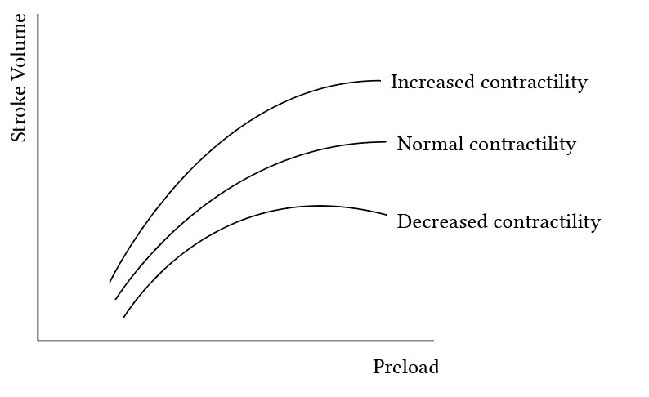
Cardiogenic Shock: treatment
Limited/judicious use of fluid: preload may be beneficial
Diuresis: careful diuresis if fluid overloaded

Slide 23
Cardiogenic Shock: treatment
Inotropy: dobutamine, milrinone
Vasodilators: nitroprusside
Anti-arrhythmics
Vasoconstrictors?
Extra-Corporeal Life Support (ELSO, ECMO)

Slide 24
Cardiogenic Shock: documentation
Specify type of heart failure, cause (if known), effects/signs, and therapies
Indicate if expected, e.g., after cardiopulmonary bypass
Ex.: Cardiogenic shock shown by a lactic acidosis and altered mental status, likely due to acute on chronic systolic heart failure from known dilated cardiomyopathy and new cardiac arrest, being treated with milrinone, afterload reduction with nitroprusside, and careful diuresis.

Slide 25
Hypovolemic Shock
Causes: sepsis, diarrhea, poor oral intake ± vomiting, excessive sweating, inappropriate diuresis (DKA, DI, adrenal insufficiency)
Presentation: tachycardic, hypotensive, dry skin and mucous membranes, poor skin turgor
Normal to low CO, high vascular tone but low SVR
P=V x R

Slide 26
Hypovolemic Shock
Compensatory mechanisms:
Tachycardia (increase CO)
Vasoconstriction
R-A-A axis activation (sodium retention), ADH release
Hypotension is a LATE finding (>30% circulating volume loss)
If volume loss is due to urinary output then it is not a good metric

Slide 27
Hypovolemic Shock: treatment
Volume!
Isotonic fluids: NS or LR
10-20ml/kg aliquots
Dosing per examination
Consider ongoing losses: inappropriate urine output, diarrhea, insensible losses
Beware SIADH: monitor electrolytes
If shock continues after 40-60ml/kg resuscitation, consider alternative diagnoses:
Sepsis, cardiogenic shock, hemorrhage

Slide 28
Hemorrhagic Shock
Leading cause of death in children
Causes: hemorrhage
May be internal: head (neonates), chest, abdomen, pelvis, GI
Long bones less common in kids
Coagulopathy
Subset of hypovolemia:
Additional component of decreased CaO₂
Includes an inflammatory state: MODS, ARDS
Normal blood volume: Neonates 80-100ml/kg, >3mo 70ml/kg

Slide 29
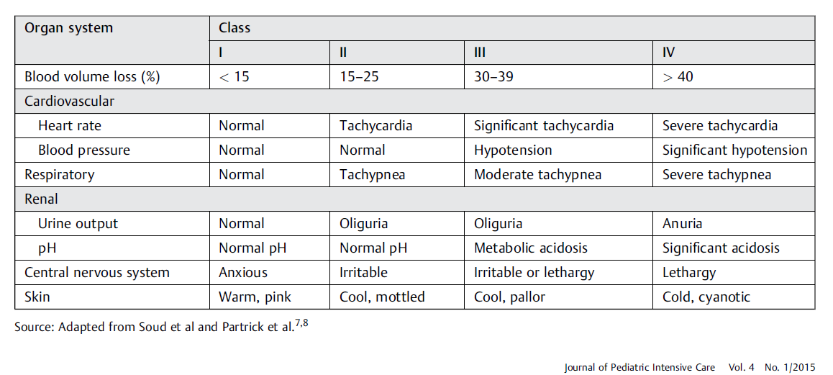
Hemorrhagic Shock
Presentation: similar to hypovolemic, pale
Normal to high CO (if volume is adequate), normal SVR if volume adequate, low if inadequate

Slide 30
Hemorrhagic Shock: treatment
Control bleeding
Correct coagulopathy
Consider initial crystalloid fluid bolus
Provide blood products
Beware massive transfusion syndrome: >40ml/kg blood replaced
Use “balanced” resuscitation: 1:1:1 or 3:1:1 PRBC/FFP/Plts
Goal hemoglobin >7g/dL
Permissive hypotension
Excluding head trauma

Slide 31
Hemorrhagic Shock: pitfalls
Coagulopathy
Mitigated by balanced resuscitation
Inflammatory response
TRALI
Hyperkalemia
Hypocalcemia

Slide 32
Hemorrhagic Shock: documentation
Describe source of bleeding, cytopenias (be specific), highlight signs of shock, therapies delivered, complications
Indicate if expected, e.g., after surgery
Ex.: hemorrhagic shock with altered mental status and hypotension due to acute gastrointestinal hemorrhage with anemia and thrombocytopenia, now treated with PRBC and platelet transfusion. Coagulopathy treated with FFP, subsequent hypocalcemia corrected with calcium bolus.

Slide 33
Distributive Shock
Causes: vasoplegia (sepsis, post-bypass), CNS injury
Presentation: profoundly hypotensive, warm, possibly normal HR
Normal to high CO, low SVR
Treatment: Vasoconstrictors (norepinephrine, phenylephrine, vasopressin)

Slide 34
Obstructive Shock
Causes: Tension pneumo, tamponade, massive PE
Presentation: similar to cardiogenic shock, JVD, hepatomegaly
Pneumo: decreased breath sounds
Tamponade: muffled heart sounds, pulsus paradoxus
Diagnosis: clinical, CXR, echo, CTA

Slide 35
Obstructive Shock
Treatment: cause specific
Needle thoracotomy
Pericardiocentesis
anticoagulation

Slide 36
References
1. Wheeler DS. Pediatric Shock: An Overview. Open Pediatr Med Journal. 2013;7(1):2-9. doi:10.2174/1874309901307010002
2. Djogovic D, Davidow J, Brindley P. Hemorrhagic Shock. Evidence-Based Emerg Med. Published online 2009:373-380. doi:10.1002/9781444303674.ch36
3. Brissaud O, Botte A, Cambonie G, et al. Experts’ recommendations for the management of cardiogenic shock in children. Ann Intensive Care. 2016;6(1):1-16. doi:10.1186/s13613-016-0111-2
4. Gyawali B, Ramakrishna K, Dhamoon AS. Sepsis: The evolution in definition, pathophysiology, and management. SAGE Open Med. 2019;7:205031211983504. doi:10.1177/2050312119835043
5. Bhaskar P, Davila S, Hoskote A, Thiagarajan R. Use of ecmo for cardiogenic shock in pediatric population. J Clin Med. 2021;10(8):1-15. doi:10.3390/jcm10081573
6. Cruz AT, Lane RD, Balamuth F, et al. Updates on pediatric sepsis. J Am Coll Emerg Physicians Open. 2020;1(5):981-993. doi:10.1002/emp2.12173
7. Evans L, Rhodes A, Alhazzani W, et al. Surviving sepsis campaign: international guidelines for management of sepsis and septic shock 2021. Intensive Care Med. 2021;47(11):1181-1247. doi:10.1007/s00134-021-06506-y
8. Dehmer JJ, Adamson WT. Massive transfusion and blood product use in the pediatric trauma patient. Semin Pediatr Surg. 2010;19(4):286- 291. doi:10.1053/j.sempedsurg.2010.07.002
Hobson MJ, Chima RS. Pediatric Hypovolemic Shock. Open Pediatr Med Journal. 2013;(7):10-15.
Eisenberg MA, Riggs R, Paul R, et al. Association Between the First-Hour Intravenous Fluid Volume and Mortality in Pediatric Septic Shock. Ann Emerg Med. Published online 2022. doi:10.1016/j.annemergmed.2022.04.008
Meyhoff TS, Hjortrup PB, Wetterslev J, et al. Restriction of Intravenous Fluid in ICU Patients with Septic Shock. N Engl J Med. 2022;2022:2459-2470. doi:10.1056/nejmoa2202707

Slide 37
Thank You
Questions?

