Slide 1
Brain Compression & Cerebral Edema
Lucinda Lo, MD
Childrens Hospital of Philadelphia
Amy Sanderson, MD
Boston Children’s Hospital

Slide 2
Dr. Sanderson is a consulting associate with Pediatric Resource Group.

Slide 3
Learning objectives
1. Describe the physiology leading to brain compression and cerebral edema
2. Differentiate between the various types of cerebral edema
3. Identify clues in the medical record indicating the presence of brain compression and cerebral edema

Slide 4
Case example
22 month old female with a few months of limping; progresses to R hemiparesis.
Brain MRI:
Large mass lesion in the R temporal lobe extending into the R parietal & occipital regions
There is L midline shift of 2.2 cm & obstructive hydrocephalus secondary to compression of the third ventricle
There is mass effect & L shift upon the midbrain, cerebral peduncles & pons
There is transependymal edema around the dilated L lateral ventricle
Diffuse sulcal effacement

Slide 5
Case example
The Neurosurgery team documents:
“Right choroid plexus tumor, trapped right ventricular system, midline shift”
What is missing?
Brain compression, transependymal edema & obstructive hydrocephalus

Slide 6
Cranial vault
CSF (10%)
Blood (10%)
Brain (80%)
Notes:
To understand these diagnoses, let’s first review the structure of the cranial vault. Brain parenchyma, blood flow and cerebrospinal fluid all contribute to intracranial volume. The blood-brain barrier is comprised of cells that separate brain tissue from the contents of blood vessels. Finally, the skull surrounds the brain, protecting it from trauma.

Slide 7
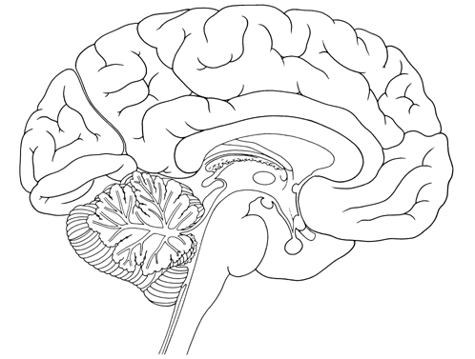
Brain parenchyma
Sulci
Cerebrum
Cerebellum
Brainstem
https://cbs.umn.edu/jensen/image-bank/nervous-system
Notes:
Gyri are the bumps on the surface of the brain and sulci are the dips in between the gyri.

Slide 8
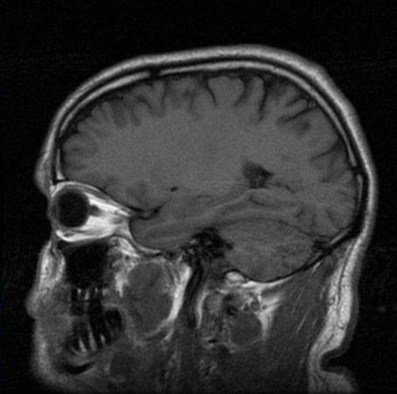
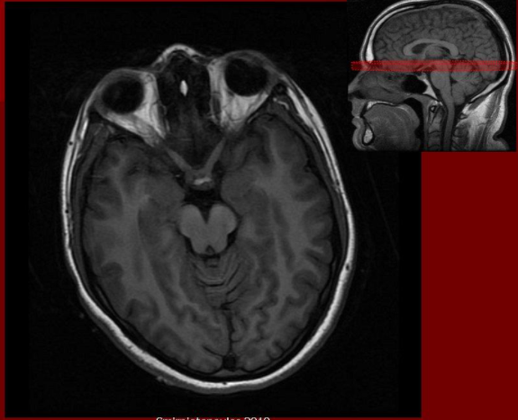

Sulci

Slide 9
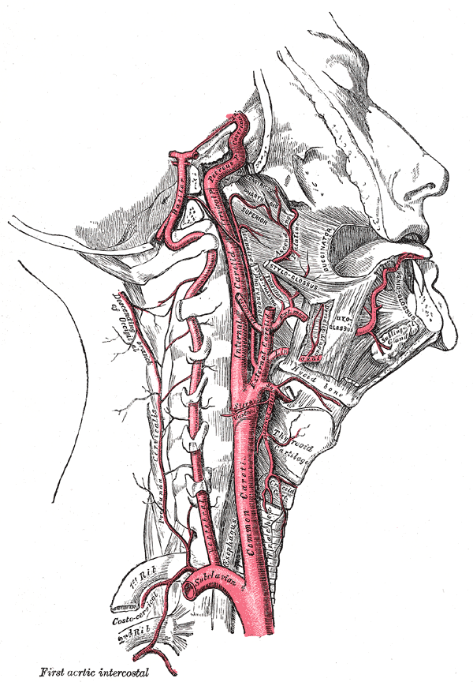
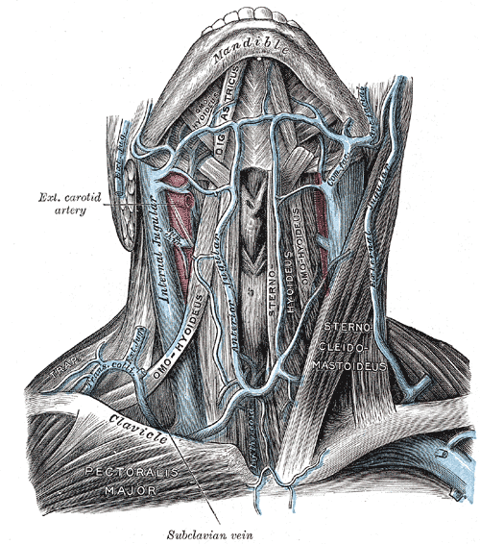
Blood
Arterial blood supply
Venous drainage
https://www.bartleby.com/107/illus513.html
https://www.bartleby.com/107/illus558.html

Slide 10
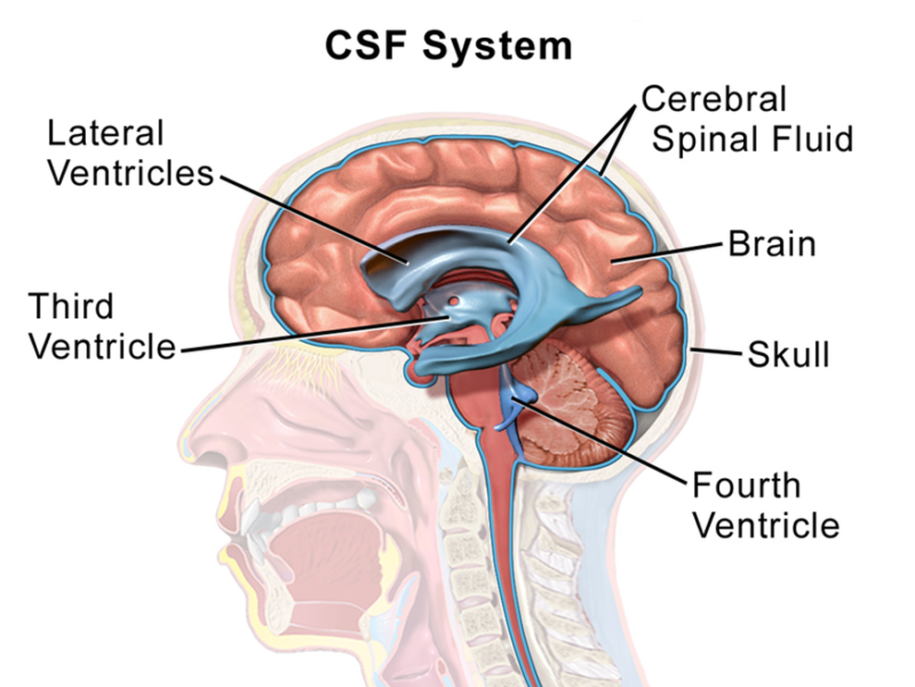
Cerebrospinal fluid (CSF)
https://commons.wikimedia.org/wiki/File:Blausen_0216_CerebrospinalSystem.png

Slide 11
Increased intracranial pressure
Brain swelling
Increased blood flow to the brain
Obstruction of CSF outflow
Masses
Tumors
Pocket of infection (abscess)
Abnormal blood vessels (vascular malformations)
Bleeding in or around the brain
Notes:
Because the overall volume of the cranial vault cannot change in the patient with closed cranial sutures, an increase in the volume of one component or the presence of something else, like a brain tumor, necessitates the displacement of other structures. This will cause an increase in pressure inside the skull. In children, the bones of the skull may not be totally fused together, so the skull can expand to a slight degree (or the brain can expand a little through the soft spot on a baby’s head).
When intracranial pressure increases, the brain has compensatory measures to mitigate damage. However, when these measures are exhausted, worsening brain injury ensues. This leads to decreased blood flow to the brain, further depriving the brain of oxygen.
What causes increased ICP? Brain swelling, which happens when there is extra water in the tissues of the brain . This is called cerebral edema.
Obstruction of CSF outflow leads to enlarged ventricles, called hydrocephalus

Slide 12
Cranial vault
CSF (10%)
Blood (10%)
Brain (80%)
Notes:
Let’s review the structure of the cranial vault again. CSF and blood make up about 10% and the brain comprises 80% of the available space. The skull surrounds the brain.

Slide 13
Increased intracranial pressure
CSF (5%)
Blood (10%)
Brain (80%)
Tumor (5%)
Notes:
In this example, the patient has a brain tumor. Because of the limited space of the skull, the amount of CSF decreases to maintain a normal pressure in the brain. The body tries to maintain normal blood flow so the brain receives the oxygen that it needs. Here, the brain is compressed by the tumor, which can cause neurologic problems depending on which part of the brain is affected.

Slide 14
Increased intracranial pressure
CSF (5%)
Blood (5%)
Tumor with surrounding edema (20%)
Brain (70%)
Notes:
In this example, the brain tumor has enlarged with surrounding edema. The maximum amount of CSF has been displaced and the pressure in the skull has increased to the point that blood flow is decreased. The brain will now sustain further injury because it is not getting enough oxygen. This will cause brain cells to die, which leads to more edema throughout the whole brain.

Slide 15
Increased intracranial pressure – obstructive hydrocephalus
Blood (10%)
Brain (40%)
CSF (50%)
Notes:
In this example (which is pretty extreme), the patient has obstructive hydrocephalus – the CSF cannot leave the cranial vault because something is blocking it’s path. Here, the brain is compressed by the hydrocephalus.

Slide 16
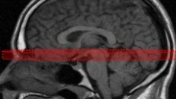

Notes:
We’re going to look at some images from head CTs and brain MRIs. Just to orient you, when we look at the images of the brain, it’s like the brain is sliced like this.

Slide 17
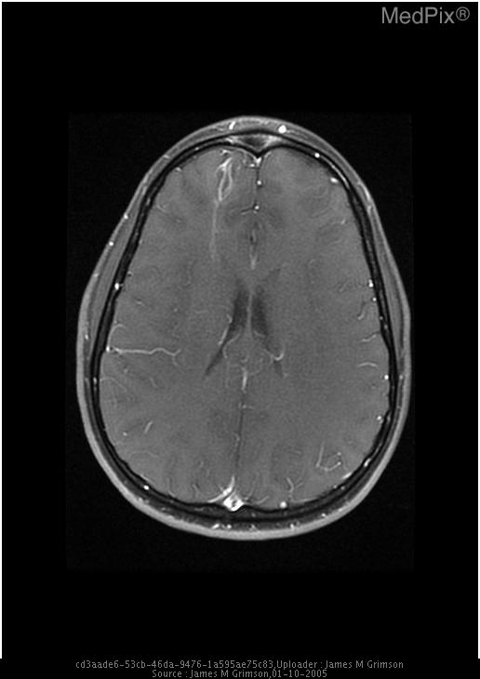
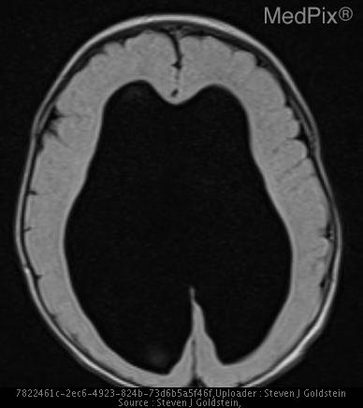
Obstruction of CSF outflow
https://medpix.nlm.nih.gov
Normal ventricles
Hydrocephalus
Notes:
On the left, the ventricles are filled with CSF (dark structures in the middle of the picture) and are about normal size. On the right, there is obstruction of CSF outflow, which leads to very enlarged ventricles, called hydrocephalus.

Slide 18
Case example
22 month old female with a few months of limping; progresses to R hemiparesis.
The Neurosurgery team documents:
“Right choroid plexus tumor, trapped right ventricular system, midline shift”
What is missing?
Brain compression, transependymal edema & obstructive hydrocephalus

Slide 19
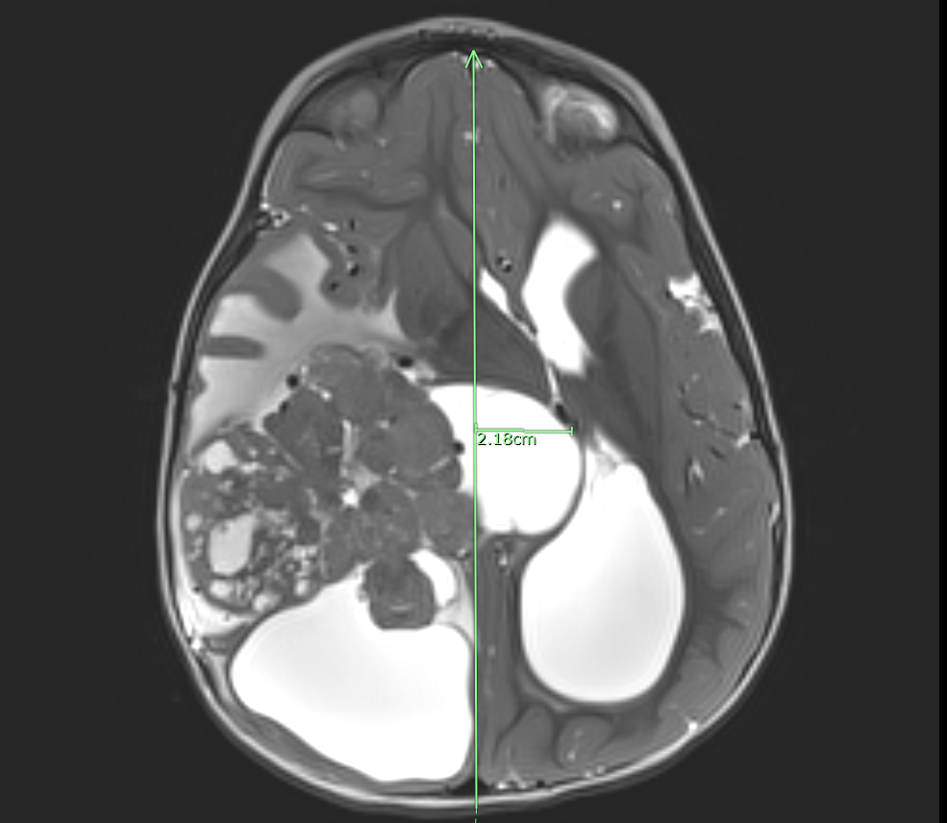
Case example
Tumor
Hydrocephalus

Slide 20
Mass effect, midline shift, sulcal effacement
What do these terms mean?
Mass effect = brain is being compressed
Midline shift = center line of brain is shifted
Sulcal effacement = brain pushed against the skull or it is swollen
Why do clinicians use the terms?
They are the terms the radiologist uses
They describe the problem
How bad it is
The location of the problem
Notes:
Midline shift means that the center line of the brain is shifted over because the brain parenchyma is being pushed by something.
Remember, the sulci are the dips in between the bumps on the surface of the brain. When the brain is being pushed up right next to the skull, the bumps flatten out and you can’t see the sulci anymore on imaging.
What’s the problem with these terms? You can’t code them

Slide 21
Mass effect & midline shift
Midline shift
Tumor causing mass effect
Notes:
This is our patient and you can see that the tumor is causing mass effect on surrounding brain tissue.
In this case, the midline shift is due to both the tumor and the enlarged ventricles. The measurement that the radiologist did shows that the midline of the brain is pushed over 2.18cm from where it should be.

Slide 22
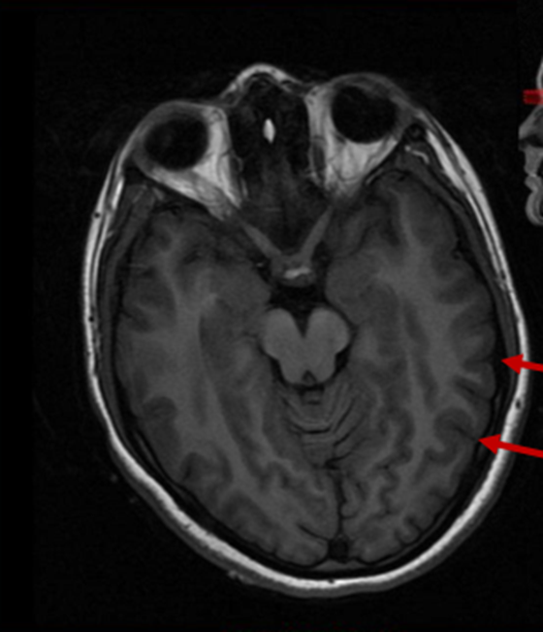
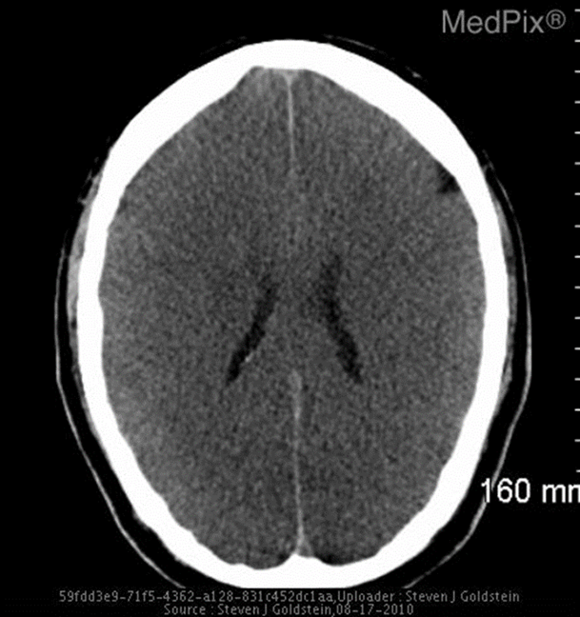
Sulcal effacement
No effacement
Effacement
https://medpix.nlm.nih.gov

Slide 23
Cerebral edema
Results from abnormal buildup of water within the brain tissue
3 different types
Vasogenic
Cytotoxic
Hydrostatic
Notes:
Cerebral edema results from abnormal buildup of water within the brain tissue. Understanding the different types is important because treatment options differ depending on the physiologic derangement

Slide 24
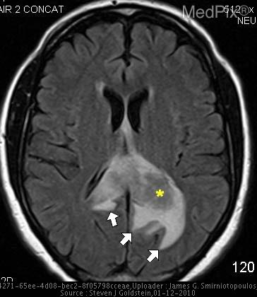
Vasogenic edema
Increased permeability of the blood-brain barrier
Water and other substances moving from blood vessels into brain tissue
Brain tumors and cerebral abscesses
https://medpix.nlm.nih.gov
Notes:
Vasogenic edema is caused by increased permeability of the blood-brain barrier . So that means that water and other substances, such as protein and electrolytes, move from blood vessels into brain tissue. Common causes include brain tumors and cerebral abscesses.

Slide 25

Cytotoxic edema
Injury on the cellular level
Brain cells swell
Loss of gray-white differentiation
Sulcal effacement/obliteration of sulci
https://medpix.nlm.nih.gov
Notes:
Injury on the cellular level leads to cytotoxic edema. There is disruption of cell membranes with water shifting from the outside to the inside of cells, causing them to swell.
Many times, this is due to lack of blood flow and oxygen to the brain as can happen during a stroke or cardiac arrest.
In this image, there is diffuse brain swelling with very small ventricles, obliteration of sulci and loss of gray-white differentiation. We’ll talk more about the last finding in the next slide.

Slide 26
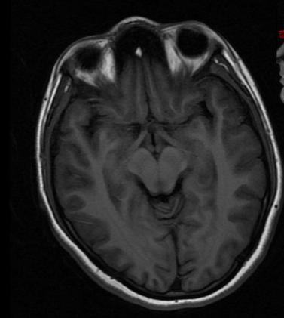
Cytotoxic edema
Gray-white preservation
Loss of gray-white differentiation
https://medpix.nlm.nih.gov
Notes:
These are different imaging modalities but I’m using them to highlight gray and white matter.
On the left, there is good preservation of the difference in gray and white matter. On the right, it’s hard to differentiate between the gray and white matter….the brain tissue all looks the same color.

Slide 27
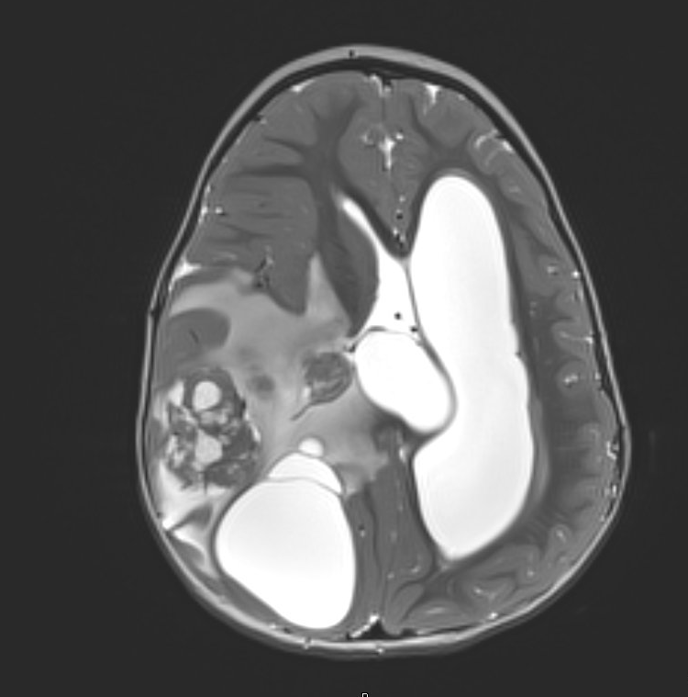
Hydrostatic edema
Cerebral spinal fluid moves from the ventricles into the brain tissue
Also known as transependymal edema
Obstructive hydrocephalus
Notes:
Hydrostatic cerebral edema can occur with obstructive hydrocephalus and happens when cerebral spinal fluid moves from the ventricles into the brain parenchyma. This is also called transependymal edema.

Slide 28
Herniation
Part of the brain is displaced into an adjacent space
Can be due:
Cerebral edema
Space-occupying lesion
Tumor
Blood clot
Collection of abnormal blood vessels
Abscess
Notes:
In my experience, clinicians are pretty good at documenting brain herniation. This is a process that ensues when part of the brain is displaced into an adjacent space and can be due to cerebral edema and/or a space occupying lesion that causes brain compression.

Slide 29
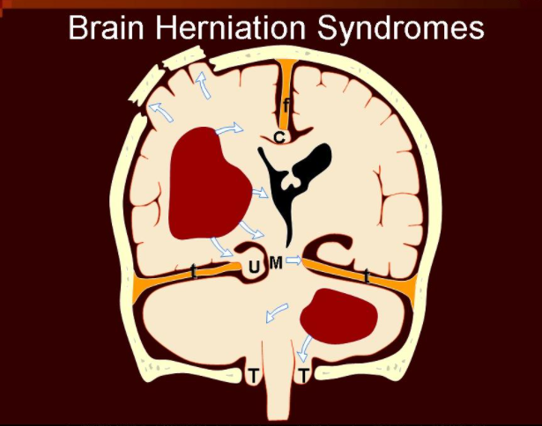
https://medpix.nlm.nih.gov
Notes:
This illustration demonstrates different kinds of herniation. It is if you are looking at the brain straight ahead. The red areas represent blood clots in the brain.
If there is a skull fracture, then the brain can herniate through that fracture. Here are some terms that you might see in the chart. “C” represents subfalcine herniation. “U” represents uncal herniation. “T” represents tonsillar herniation.

Slide 30
Consider brain compression/cerebral edema when…
Confusion/disorientation/coma
Headache
Lethargy/poor coordination
Abnormal pupil exam
Nausea/vomiting
https://medpix.nlm.nih.gov
Notes:
It is important for clinicians to recognize when cerebral edema and brain compression are present as both are serious and can be life-threatening. Although cerebral edema and brain compression may have different underlying mechanisms, patients with either or both can present with similar findings. Common signs and symptoms include:

Slide 31
Consider brain compression/cerebral edema when…
Mass effect
Midline shift
Hydrocephalus
Sulcal effacement
Herniation
https://medpix.nlm.nih.gov
Notes:
To look for evidence of cerebral edema and/or brain compression, CDI specialists can review the diagnostic section of the medical record. CT and MRI are excellent modalities to identify brain abnormalities but it is important to note that imaging is not an absolute requirement for the diagnosis of brain compression or cerebral edema - physicians can make these diagnoses based on a patient’s history and physical exam.

Slide 32
Consider brain compression/cerebral edema when…
VP shunt malfunction/hydrocephalus/brain tumor/intracranial hemorrhage
Meningitis/encephalitis
Stroke(ischemic and/or hemorrhagic)
DKA/↓ Na/↑ammonia
Cardiac arrest/HIE/drowning/neonatal depression
https://medpix.nlm.nih.gov
Notes:
Other documented diagnoses can be a clue that cerebral edema and/or brain compression may be present .

Slide 33
Consider brain compression/cerebral edema when…
VP shunt placement/revision/decompressive craniectomy/EVD placement
Tumor resection/abscess drainage/hemorrhage evacuation
Hypertonic saline/mannitol/hyperventilation
Corticosteroids
Hypothermia/sedatives
https://medpix.nlm.nih.gov
Notes:
CDI specialists can also look at documented therapies and treatment plans. Reviewing procedure notes or operative reports may provide some insight. CDI specialists can look for placement or revision of a ventriculo-peritoneal shunt, decompressive craniectomy, brain tumor excision, placement of an external ventricular drain, drainage of a cerebral abscess or evacuation of an intracranial hemorrhage/hematoma.
Osmotic agents such as hypertonic saline and mannitol are commonly used to decrease intracranial pressure. Hyperventilation can be used as a temporizing measure to decrease intracranial hypertension since this causes a decrease in cerebral blood flow.
Corticosteroids such as dexamethasone are a mainstay of treatment for vasogenic edema due to brain tumors.
In addition, hypothermia and sedative medications are sometimes used when a patient has suffered a significant brain injury because they can decrease cerebral metabolism, which may provide some benefit to the injured brain.

Slide 34
In summary
1. Cerebral edema and brain compression are important diagnoses to identify, treat and document
2. However, physicians don’t always document these diagnoses in a way that can be coded
3. HIM professionals can find clues to these diagnoses in several parts of the medical record

