Slide 1
Three Steps To Successfully Maintain CDI In the NICU
By: Julian Everett BSN, RN
Orlando Health Medical System
Arnold Palmer Medical Center
June 7, 2018

Slide 2
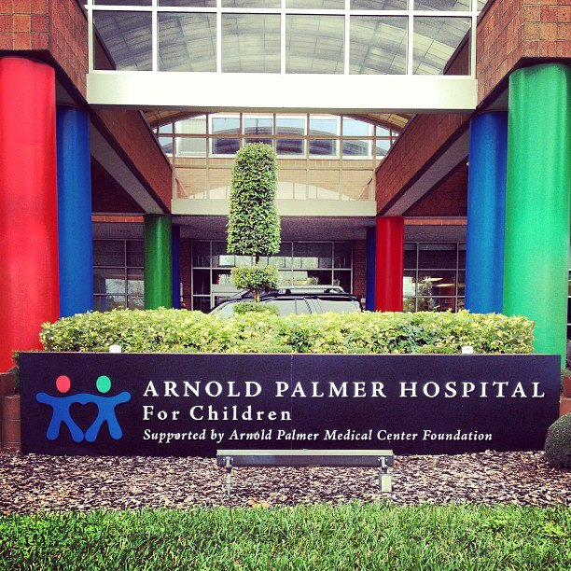
Arnold Palmer Medical Center
Winnie Palmer Hospital for Women and Babies
Arnold Palmer Hospital for Children

Slide 3
Orlando Health CDI Program
Established in March 2016 with 7 Nurses
Program has expanded to 40 clinical documentation specialists
Areas of Coverage (Adults, Pediatrics and Obstetrics)
We have 7 CDS’s that work underneath APMC

Slide 4
Alexander Center for Neonatology
Our Level III NICU is capable of the highest level of care for high-risk newborns, and is one of the largest and most technologically advanced NICUs in the U.S
Our NICU demonstrates the best outcome statistics in Florida for low-birth-weight babies. U.S. News & World

Slide 5
STEP 1

Slide 6
Know the Population
Physician will have a stronger engagement with a CDI who knows the neonatal population
Literature recommendation:
Neonatal Intensive Care by Merenstein &
Gardner’s and Stable by Kristine Karlsen

Slide 7
Query Opportunities
Pulmonary Hypertension
ECMO
Respiratory Failure
DIC
IVH
INO

Slide 8
STEP 2

Slide 9
Know the Language
A/B’s = Apnea and Bradycardia
A/B SS = Apnea/Bradycardia Self Stimulation
A/B MS = Apnea/Bradycardia Mild Stimulation
A/B Mods = Apnea/Bradycardia Moderate Stimulation

Slide 10
Cont..
HIE = Hypoxic Ischemic Encephalopathy
PIE = Interstitial Emphysema
BPD = Bronchopulmonary Dysplasia
RDS = Respiratory Distress Syndrome
NEC = Necrotizing Enterocolitis
IVH = Intraventricular Hemorrhage

Slide 11
STEP 3

Slide 12
ENGAGEMENT
Conduct monthly educational meetings
Trend common queries
Build a partnership
Be consistent
Notes:
Physician love praises showed them how much they have improved with their documentation

Slide 13
Our Success
We have a 100% response rate
All queries are closed out within 48 hours
Increase of patients being discharged in a
SOI of 3 & 4
Resolved the improper use of “Post-Operative Respiratory Failure”

