Slide 2
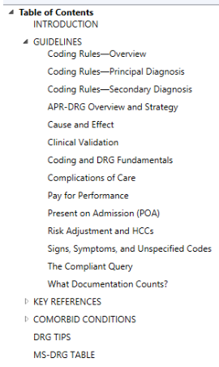
CDI Pocket Guide ebook table of contents

Slide 4
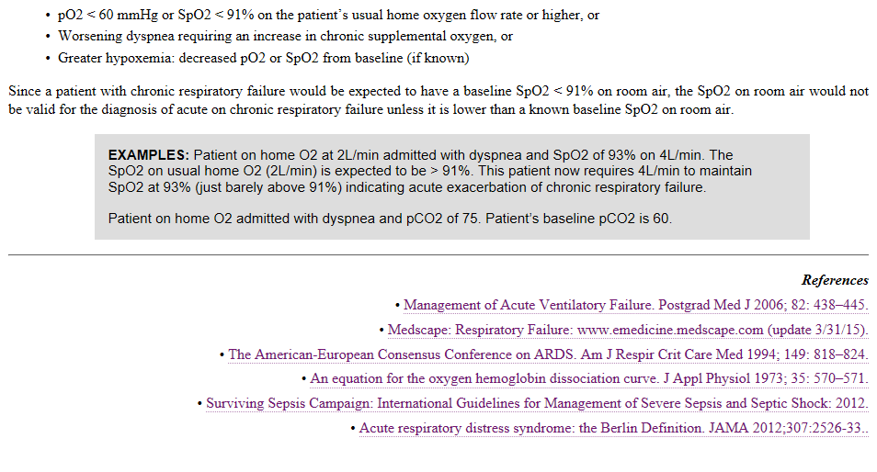
Respiratory failure (continued)

Slide 5
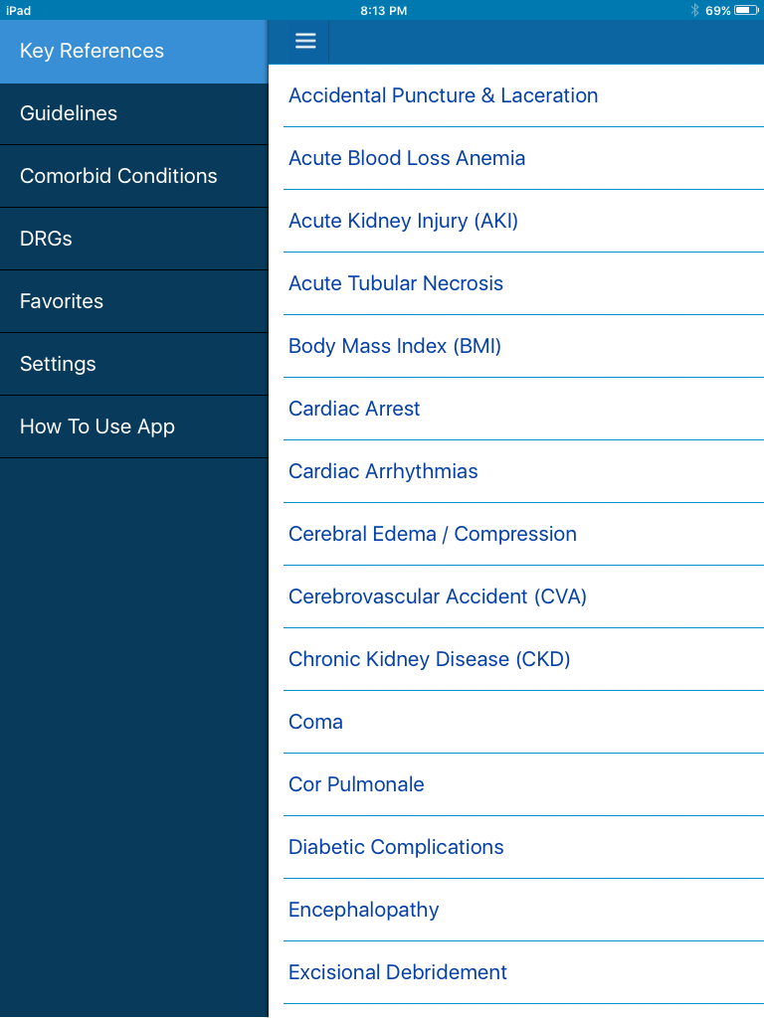
CDI Pocket Guide Digital Editions

Slide 6
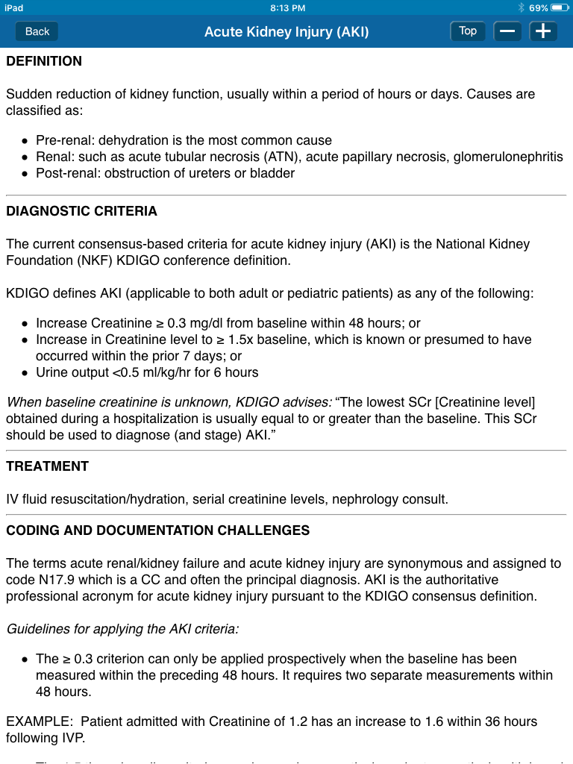
CDI Pocket Guide Digital Editions

