Slide 1
Cardiology Review
Michael Bolooki, MD, MSc
Lee Physician Group Cardiology
Medical Director of Informatics
Florida ACDIS Quarterly Meeting
April 7, 2018
Notes:
Along with CMIO, Physician champion for Quality Documentation
Purpose: Medical literature is a different language.
Give a view of what your physicians read and learn, from a doc’s perspective

Slide 2
Disclosure
I have no relevant financial relationships to disclose.

Slide 3
Evidence
International guidelines
UpToDate
“I was taught…”

Slide 4
Outline
Heart Failure
Arrhythmias
Abnormal Troponin

Slide 5
Outline
Heart Failure
Arrhythmias
Abnormal Troponin

Slide 6
Prevalence
AHA report in 2013 = 5.1 M in the US
Framingham Heart Study data from 2006
Increases with age
Men 50 to 59 = 8/1000, 80 to 89 = 66/1000
Women 50 to 59 = 8/1000, 80 to 89 = 79/1000
African-Americans up to 25% higher
Estimates include symptomatic HF
Actual rates are higher

Slide 7
Definition
Inability of the heart to keep up with demand
Results from one or more functional / structural disorders
Anything that impairs ventricular filling or emptying

Slide 8
Diagnosis
Clinical with the aid of x-ray, ultrasound, and labs
Presence of signs and symptoms
Modified Framingham Clinical Criteria
NYHA Class
CXR, echo, and labs support diagnosis
EF from other sources
BNP can help with diagnosis and prognosis
Systolic or diastolic dysfxn does not always mean HF
Notes:
Dyspnea, fatigue, fluid retention
Modified Framingham clinical criteria
Major: Orthopnea, PND, elevated JVP, rales, S3, edema on CXR, cardiomegaly on CXR
Minor: bilateral leg edema, DOE, pleural effusion, tachycardia, nocturnal cough
Positive if 2 major or 1 major + 2 minor
NYHA Classification
I – no limitation in ordinary activities
II – mild limitation
III – marked limitation; symptoms on exertion
IV – symptoms at rest

Slide 9
Diagnosis
Red flags: PND, orthopnea, weight gain with edema
Past history clues: alcohol or drug use, family history, recent chest pain or known CAD
Exam: typically rales and pedal edema, presence of S3 or JVD are associated with worse outcomes
CXR: pulmonary edema, vascular congestion, vascular prominence, Kerley B lines

Slide 10
Timing
Acute – typically hours, days, or weeks
Acute appropriate if new and recent onset
Chronic = pre-existing symptoms/treatment
Acute on chronic

Slide 11
Systolic
EF ≤ 40%
Look for typical signs and symptoms
Provider may note type of cardiomyopathy but still need EF
Typical medications:
ACE, ARB, ARNI, BB, diuretics, aldosterone antagonists, digoxin, nitrates …

Slide 12
Diastolic
EF ≥ 50%
Diastolic dysfunction on echo, any grade
Typical signs and symptoms
Typical medications:
Diuretics, anti-hypertensive

Slide 13
Combined HF
EF ≤ 40%
Diastolic dysfunction on echo
Signs and symptoms of HF

Slide 14
Other
HFrEF – same as systolic HF
HFpEF – clinical HF with normal EF
Nothing states requirement of diastolic dysfxn
Measurement of DD can be difficult
If truly normal function, rule out alternate dx
High output heart failure

Slide 15
Other
Presence of other cardiac dx (valve, pericardial)
True HF needing diuresis?
Or symptoms all attributed to other dx?
Suspected HF: if diuresis leads to weight loss (>4 kg) which relieves symptoms, very likely dealing with HF
What about EF 41-49%?

Slide 16
Cardiomyopathy
Disease of heart muscle
Ischemic, non-ischemic, viral
Hypertrophic, non-compaction, eosinophilic, etc
Can include systolic and/or diastolic dysfxn
Dx alone does not mean HF in absence of signs/symptoms

Slide 17
References
Chow et al. (2017). Role of Biomarkers for the Prevention, Assessment, and Management of Heart Failure. Circulation. 135: e1054-e1091.
Maron et al. (2006). Contemporary definitions and classification of the cardiomyopathies: an American Heart Association Scientific Statement from the Council on Clinical Cardiology, Heart Failure and Transplantation Committee; Quality of Care and Outcomes Research and Functional Genomics and Translational Biology Interdisciplinary Working Groups; and Council on Epidemiology and Prevention. Circulation. 113(4): 1807.
Yancy et al. (2013). 2013 ACCF/AHA Guideline for the Management of Heart Failure. JACC. 62(16).
Yancy et al. (2017). 2017 ACC/AHA/HFSA Focused Update of the 2013 ACCF/AHA Guideline for the Management of Heart Failure. JACC. 70(6).

Slide 18
Outline
Heart Failure
Arrhythmias
Abnormal Troponin

Slide 19
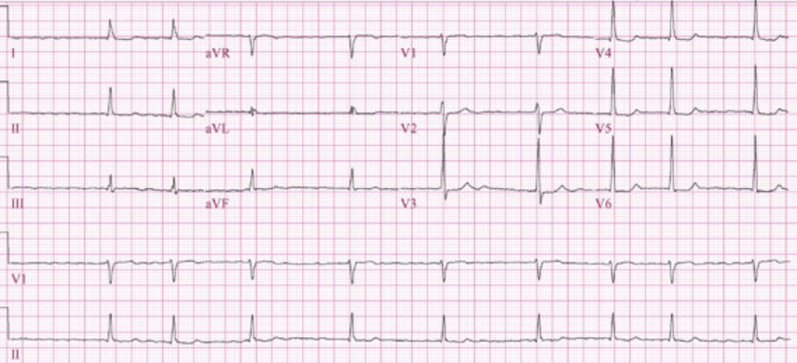
Fib

Slide 20
Atrial Fibrillation
Irregular rhythm, focus in left atrium typically near pulmonary veins
Most often rapid in absence of meds
Symptoms from rate and/or rhythm
Progressive disease
Rate vs Rhythm control’
Cardioversion – electrical or pharmacologic
Ablation

Slide 21
Atrial Fib
Type / Timing
New onset
Paroxysmal – intermittent or self-terminating within 7 days
Persistent – more than 7 days, needs cardioversion to restore sinus rhythm
Chronic
“Long-standing” Persistent – 12 months or more
Permanent
Chronic/long-standing
Joint decision to not pursue rhythm control

Slide 22
Medications
Anticoagulants
Vitamin K antagonist
Warfarin (Coumadin, Jantoven)
Direct thrombin inhibitor
Dabigatran (Pradaxa)
Factor Xa inhibitors
Rivaroxaban (Xarelto), Apixaban (Eliquis), Edoxaban (Savaysa)
Anti-arrhythmic
Flecainide (Tambocor), propafenone (Rhythmol)
Amiodarone (Cordarone), dronedarone (Multaq), sotalol (Betapace), dofetilide (Tikosyn)

Slide 23
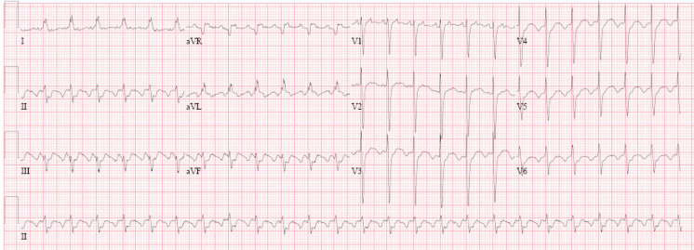
Flutter

Slide 24
Atrial Flutter
Rapid, regular atrial rates, typically 250-300 bpm
Ventricular rate based on AV conduction
More difficult to control with meds
Ablation has high success rates in typical flutter

Slide 25
Flutter Types
12 lead ECG
Typical
Circuit involves cavo-tricuspid isthmus
Classic sawtooth inferior leads
CCW circuit with positive flutter in V1
Atypical
Other region of atria
Sawtooth less prominent or other leads

Slide 26
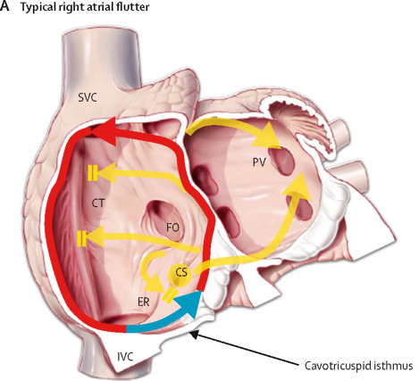
Typical Flutter
From thelancet.com

Slide 27
References
January et al. (2014). AHA/ACC/HRS Guideline for the Management of Patients With Atrial Fibrillation. Circulation. 130: e199-e267.
Page et al. (2015). ACC/AHA/HRS Guideline for the Management of Adult Patients with SVT. Circulation. 132: e000.

Slide 28
Outline
Heart Failure
Arrhythmias
Abnormal Troponin

Slide 29
Elevated Troponin
Any value above reference lab cut-off
Clinical significance should drive the diagnosis
True Myocardial Infarction
Rise and/or fall in troponin
Along with symptoms, ECG changes, or imaging to support infarct/ischemia
Elevated troponin
Abnormal value without above factors

Slide 30
Chest Pain
Priority - History and EKG
Red flags
Sub-sternal discomfort
Provoked by exertion or emotional stress
Relieved by rest or nitro
Typical angina has all 3 components
Atypical has 2 of 3
Non-angina pain has 0 or 1

Slide 31
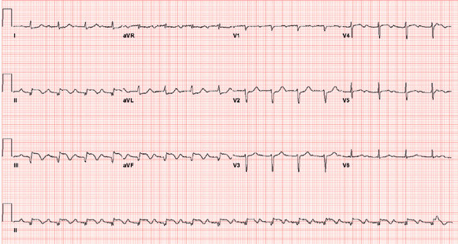
STEMI EKG

Slide 32
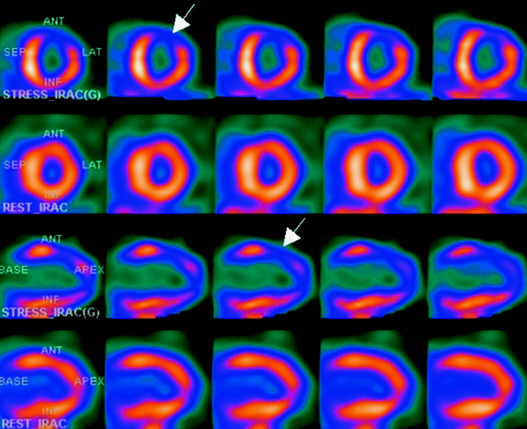
Nuclear image

Slide 33
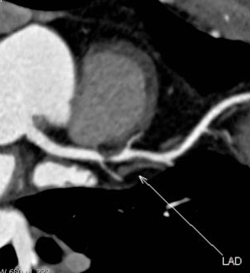

Slide 34
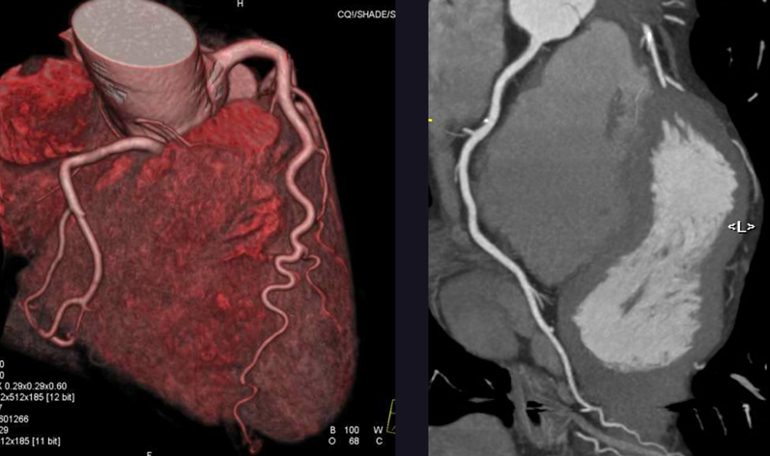
CCTA image

Slide 35
Types of MI
1 – spontaneous, plaque rupture, dissection, etc
2 – supply/demand mismatch
Sepsis, respiratory failure, severe anemia, tachyarrhythmia, coronary spasm or emboli
3 – sudden death, suspected MI but no troponin
4a – related to PCI; 4b – related to stent thrombosis
5 – related to CABG

Slide 36
Type 2 MI
Clinical diagnosis
Sounds like MI but with clear supply/demand issue
ICD-10 = I21.A1

Slide 37
Other Causes
Trivial troponin with symptoms, consider ACS / unstable angina
Troponin without signs of MI?
Demand ischemia
Non-cardiac

Slide 38
Reference
Thygesen et al. (2012). Third Universal Definition of Myocardial Infarction. Circulation. 126: 2020-2035.

Slide 39
Questions?

