Slide 1

congenital heart defects
Karen Bridgeman, MSN, RN, CCDS
Medical University of South Carolina
Leah Savage, MSN, RN, CCDS
Norton Children’s Hospital

Slide 2



Louisville, KY
Notes:
CDI for 7 years, formerly TCU, med-surg, mother/baby…. 1 year CDI
Started pediatric program Feb.1 2016
Formerly Kosair children’s Hospital
250 bed facility- 104 beds are NICU
Kentucky's only full-service, free-standing pediatric care facility dedicated exclusively to caring for children.
1 of only 2 Level I Pediatric Trauma Center

Slide 3
Learning Objectives
At the completion of this educational activity, the learner will be able to:
  Describe the complex anatomy of common congenital heart defects.
  Discuss the intricacies of various congenital anomalies for accurate code assignment in ICD-10.
  Identify documentation needs related to congenital heart defects.
  Develop query opportunities for secondary diagnoses in congenital heart defects.
  Relate the CMS ICD-10-CM/PCS Official Guidelines for Coding and Reporting for appropriate code assignment in congenital heart defects.

Slide 4

It’s all about a strawberry….
The average newborn heart is approximately the size of a strawberry
By FoeNyx, France - Self-published work by FoeNyx, CC BY-SA 3.0, https://commons.wikimedia.org/w/index.php?curid=21279

Slide 5
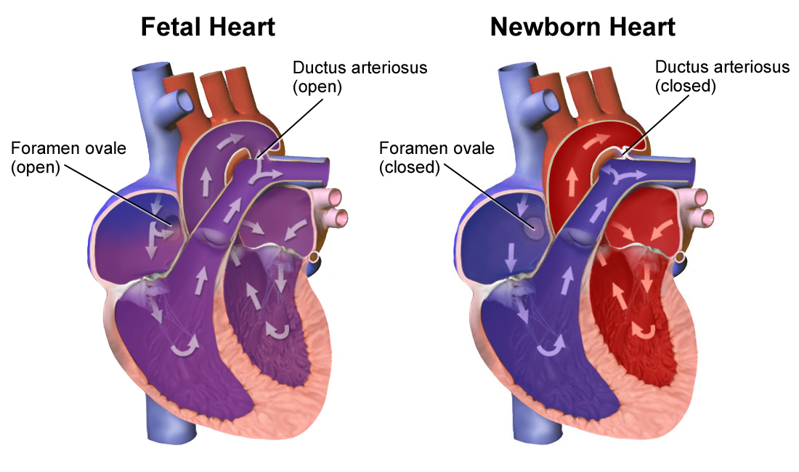
Healthy Hearts
https://commons.wikimedia.org/wiki/File%3ANeonatal_Heart_Circulation.png

Slide 6
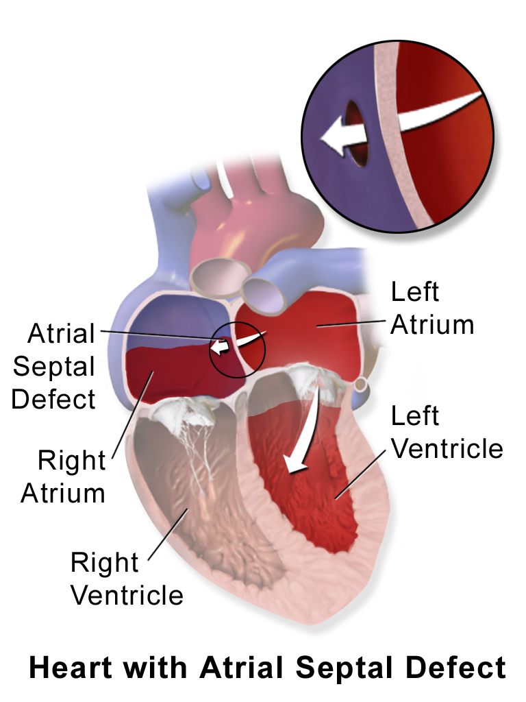
Atrial Septal Defect
Hole in the atrial septum between the right and left atriums.
Oxygenated blood is pumped back to the lungs rather than to the body.
One of the most common CHD’s.
Patent Foramen Ovale (PFO) develops when the foramen ovale fails to close after birth.
Surgery
  Root operation
    Repair
      Direct closure, ligation
    Supplement
      Graft, patch, tissue
Blausen.com staff (2014). "Medical gallery of Blausen Medical 2014". WikiJournal of Medicine 1 (2). DOI:10.15347/wjm/2014.010. ISSN 2002-4436. - Own work, CC BY 3.0, https://commons.wikimedia.org/w/index.php?curid=28761799

Slide 7
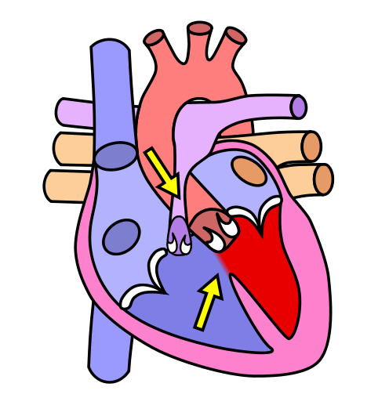
Ventricular septal defects
Hole in the ventricular septum
Oxygenated blood moves from the left ventricle into the right ventricle, returning right back to the lungs again
May result in CHF as early as 8 weeks
May develop pulmonary HTN
One of the most common CHD’s
Surgery
  Root operation
    Repair
      Direct closure, ligation
    Excision
      Infunidbulectomy (right ventricle)
    Supplement
      Graft, patch, tissue
https://commons.wikimedia.org/w/index.php?curid=964413

Slide 8
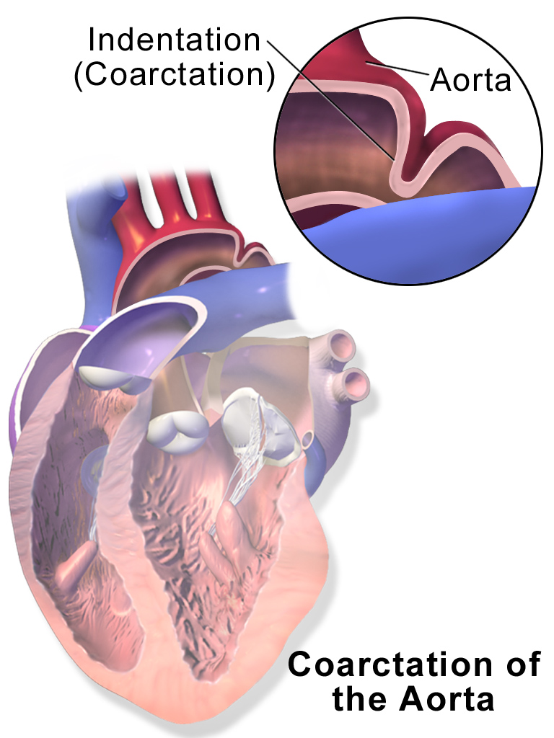
Coarctation of the aorta
Stricture usually noted in the descending aorta.
Prostaglandins to keep the PDA open
Root operation
    Excision
      End to end anastomosis
    Dilation
      Balloon angioplasty
    Supplement
      Aortoplasty, subclavian artery flap
  Body Part
    Ascending aorta
      Aortic valve to innominate artery
    Aortic Arch
      Innominate artery, left common carotid artery, and left subclavian artery
    Descending Aorta
      Left subclavian artery to level of diaphragm
Blausen.com staff (2014). "Medical gallery of Blausen Medical 2014". WikiJournal of Medicine 1 (2). DOI:10.15347/wjm/2014.010. ISSN 2002-4436. - Own work, CC BY 3.0, https://commons.wikimedia.org/w/index.php?curid=29294585

Slide 9
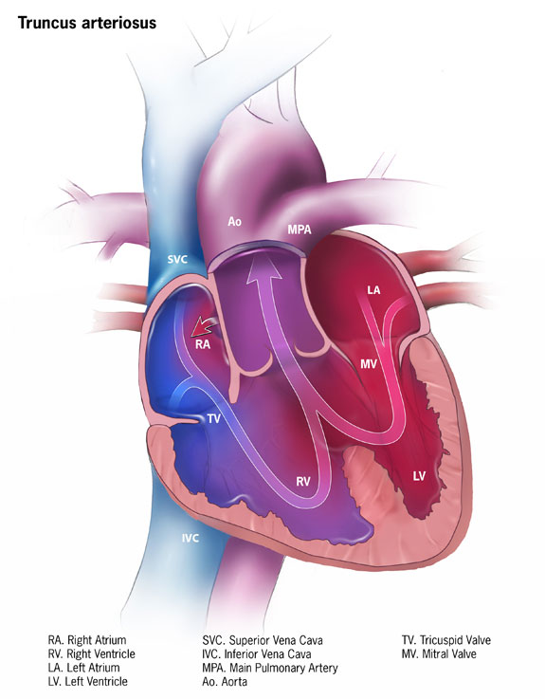
Truncus arteriosus
The aorta and pulmonary artery are fused together to form a single large vessel, called truncus arteriosus, with a single valve → truncal valve
The truncal valve is directly above the VSD
Carries oxygenated and non-oxygenated blood to the lungs as well as to the body.
May develop CHF and pulmonary HTN.
Repair truncus arteriosus
  Creation: Aortic valve created from truncal valve
  Bypass: RV to PA conduit
  VSD closure
  PFO closure
By Centers for Disease Control and Prevention - Centers for Disease Control and Prevention, CC0, https://commons.wikimedia.org/w/index.php?curid=29525836

Slide 10
Truncus arteriosus
The aorta and pulmonary artery are fused together to form a single large vessel, called the truncus arteriosus, with a single valve, truncal valve
The truncal valve is directly above the VSD
Carries oxygenated and non-oxygenated blood to the lungs as well as to the body.
May develop CHF and pulmonary HTN.
Repair truncus arteriosus
  Creation
    Aortic valve created from truncal valve
  Bypass
    RV to PA conduit
  VSD closure
  PFO closure
By Centers for Disease Control and Prevention - Centers for Disease Control and Prevention, CC0, https://commons.wikimedia.org/w/index.php?curid=29525836

Slide 11
Hypoplastic Left Heart Syndrome
Hypoplastic left heart syndrome (HLHS).
Rare, complex congenital heart defect.
Left side of the heart is severely underdeveloped.
And unable to pump blood throughout the body, forcing the right side to do all of the pumping.
Blood flow to the body is severely restricted.
Fatal cardiac abnormality if not surgically addressed (<2 weeks).
Notes:
Statistics- 1 out of every 4,344 babies born in the United States each year is born with hypoplastic left heart syndrome (from CDC) or ~960 babies per year.
25 years ago this diagnosis would have been a fatal one
(Patana & Yabrodi and Mastropietro)

Slide 12
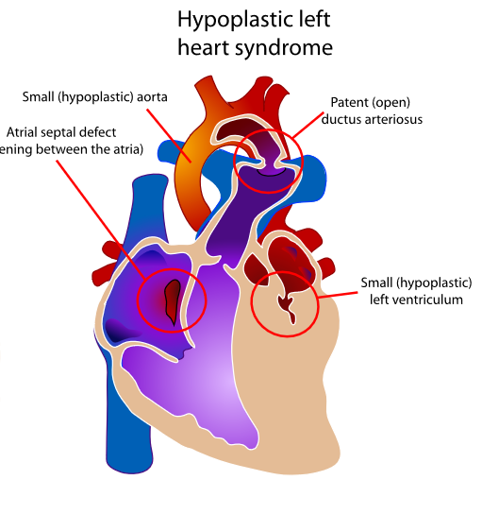
Hypoplastic Left Heart Syndrome Anatomy
Underdevelopment of the left side of the heart
  Mitral stenosis/atresia
  Aortic stenosis/atresia
  Hypoplastic left ventricle
  Hypoplastic aortic arch
PFO or ASD (typically)
Large PDA (supplies blood to systemic circulation)
Coarctation of the aorta(common)
100% of systemic blood flow is ductal dependent
When the patent ductus arterious (PDA) closes, acute cardiogenic shock will develop
https://commons.wikimedia.org/wiki/File%3AHypoplastic_left_heart_syndrome.svg
Notes:
Patana & Yabrodi and Mastropietro)
Early use of prostaglandins is indicated to keep the ducts open

Slide 13
Hypoplastic Left Heart Syndrome
Treatment (palliative)
Goal: Fontan circulation or Total Cavo-pulmonary connection (TCPC)
3 Stages:
Norwood- performed in the first few weeks of life
Glenn- performed at 4-6 months of life
Fontan- 18mos- 3yrs of age
Notes:
Treatment is palliative, the only correction is a heart transplant
Norwood is one of the highest risk and costliest surgeries of any congenital heart surgery ….. Now has >90% survival rate. Glenn and Fontan have evolved into low-risk surgeries (Ohye, Schranz, & D’Udekem, 2016).
Survival rate in the 1970’s was 0%... These surgeries have improved survival rate to >90% with many children living into adulthood (Ohye, Schranz, & D’Udekem, 2016 and Yabrodi & Mastropietro, 2016).

Slide 14
Norwood procedure
Goal: right ventricle is to become the main pumping chamber for systemic circulation
What must happen?
Creation of Neoaorta
Oversew MPA
Atrial septectomy
Modified Blalock- Taussig or Sano shunt
Ligate and divide PDA
Notes:
First successful intervention for HLHS was undertaken by Dr. Norwood in 1983.
Have to make the hypoplastic aorta larger to allow systemic and pulmonary circulation
Atrial septotomy- removal of the atrial septum
Modified Blalock- Taussig or Sano shunt
Mouhammad &, Mastropietro, 2016
Ohye, Schranz, & D’Udekem, 2016

Slide 15
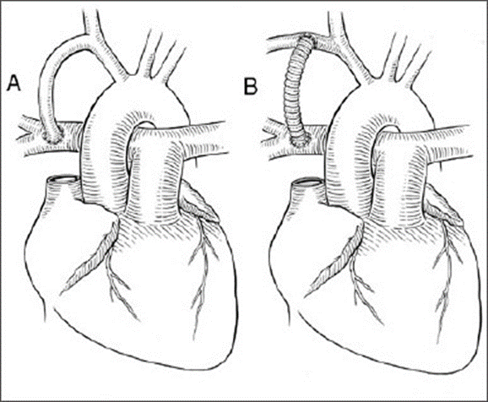
Norwood procedure- BT shunt 021*0**
Section 0-Medical and Surgical
Body system 2- Heart and Great Vessels
Operation 1- Bypass
Body Part | Approach | Device | Qualifier
P Pulmonary Trunk Q Pulmonary Artery, Right R Pulmonary Artery, Left | 0 Open | 8 Zooplastic tissue 9 Autologous venous tissue A Autologous arterial tissue J Synthetic substitute K- Nonautologous tissue substitute | A Innominate Artery B Subclavian Artery D Carotid Artery
https://commons.wikimedia.org/w/index.php?title=Special:Search&profile=default&fulltext=Search&search=Modified+Blalock-+Taussig+shunt&uselang=en&searchToken=appmom09npj66jog2zbzqm4ac#/media/File:Blalock_shuntWiki.jpg

Slide 16
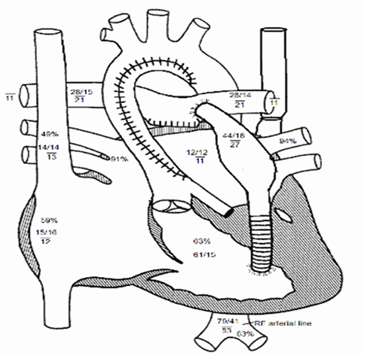
Norwood procedure- BT shunt 021*0**
Section 0-Medical and Surgical
Body system 2- Heart and Great Vessels
Operation 1- Bypass
Body Part | Approach | Device | Qualifier
K Right ventricle L Left ventricle | 0 Open | 8 Zooplastic tissue 9 Autologous venous tissue A Autologous arterial tissue J Synthetic substitute K- Nonautologous tissue substitute | P Pulmonary trunk Q Pulmonary artery, right R Pulmonary artery, left W Aorta

Slide 17
Bidirectional Glenn (hemi-Fontan)
Goal: “unload” the single ventricle so that it only has to pump one circulation by having blood flow through the pulmonary and systemic circulations in series
What must happen?
Direct blood from the superior vena cava to the lungs
Notes:
Aka, hemi-fontan
After the Norwood, the heart physiology is one volume overloaded ventricle pumping two circulations in parallel
Goal →“unload” the single ventricle so that it only has to pump one circulation by having blood flow through the pulmonary and systemic circulations in series
The bidirectional Glenn shunt procedure involves rerouting circulation such that the superior vena cava (SVC) drains into the right pulmonary artery. This results in deoxygenated blood returning from the head and upper body directly routed to the pulmonary arteries for oxygenation by the lungs, to some extent reducing the ventricular workload. Since the blood passing from the SVC into the pulmonary arterial system flows bidirectionally into to both right and left lungs, it is called a bi-directional Glenn procedure.
Cerebral and upper extremity blood passively flows into the lungs through the pulmonary artery via the SVC (Glenn takes care of the top half of the body)
redirecting oxygen-poor blood from the top of the body to the lungs. That is, the pulmonary arteries are disconnected from their existing blood supply (e.g. a shunt created during a Norwood procedure, a patent ductus arteriosus, etc.). The superior vena cava (SVC), which carries blood returning from the upper body, is disconnected from the heart and instead redirected into the pulmonary arteries. The inferior vena cava (IVC), which carries blood returning from the lower body, continues to connect to the heart.
An infants pulm vascular resistance and pulm arterial pressure must be low enough to permit the “passive” pulm blood flow from the systemic venous system, usually > 3 months of age. Several physiologic changes occur after the surgery:
1. reduced end diastolic volme (only has to pump blood to one circulation) →decreases ventricular wall stress and improves function of the atrioventricular valve→ more efficient ventricular function
2. systemic to pulm shunt is no longer needed and is ligated → decresed diatolic run-off → increased diastolic blood pressure and coronary perfusion
Only systemic venous return from the upper body is directed into the pulm circulation via the superior cavopulmonary anastomosis
Systemic venous return from the lower body continues to flow into the right atrium via the inferior vena cava, missing with pulmonary venous return and resulting in arterial O2 sats of 70-90%.
The physiologic improvements allow patients to thrive for several years before they need the final stage- Fontan
Success rate of >95%
Mouhammad &, Mastropietro, 2016
Ohye, Schranz, & D’Udekem, 2016

Slide 18
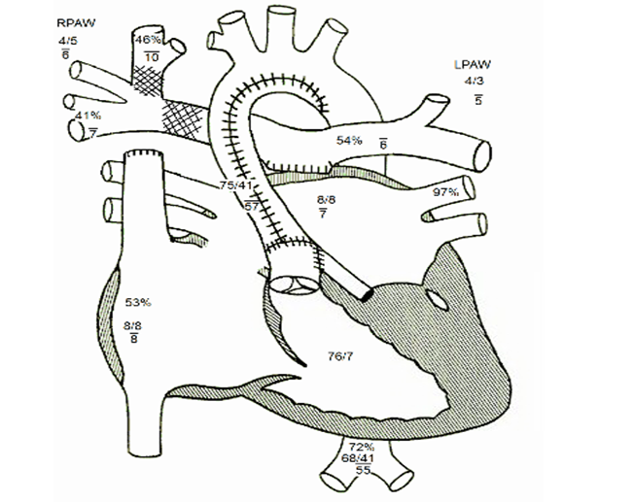
Bidirectional Glenn- procedure 021V0**
Section 0-Medical and Surgical
Body system 2- Heart and Great Vessels
Operation 1- Bypass
Body Part | Approach | Device | Qualifier
V Superior Vena Cava | 0 Open | 8 Zooplastic tissue 9 Autologous venous tissue A Autologous arterial tissue J Synthetic substitute K- Nonautologous tissue substitute Z No Device | P Pulmonary trunk Q Pulmonary artery, right R Pulmonary artery, left S Pulmonary vein, right T Pulmonary vein, left U Pulmonary vein, confluence

Slide 19
Fontan procedure
Goal: direct desaturated systemic venous return from the inferior vena cava into the pulmonary circulation
What must happen?
    Direct blood from the inferior vena cava to the lungs
Intracardiac
Extracardiac
Notes:
redirecting the blood from the IVC to the lungs. At this point, the oxygen-poor blood from upper and lower body flows through the lungs without being pumped (driven only by the pressure that builds up in the veins). This corrects the hypoxia and leaves the single ventricle responsible only for supplying blood to the body.
"indolent and progressive state of heart failure" with predictable long term consequences on several organ systems.^{[7]} Chronic venous hypertension and lowered cardiac output are assumed to be at the root of lymphatic abnormalities such as chylothorax, protein losing enteropathy and plastic bronchitis which may occur in the immediate post-operative period as well as in the medium term. Concerns about damage to the liver have emerged more recently, as Fontan circulation produces congestion in this organ which leads to progressive hepatic fibrosis. Screening protocols and treatment standards are emerging in the light of these discoveries.^{[7]}
The Fontan procedure is palliative — not curative — but in many cases it can result in normal or near-normal growth, development, exercise tolerance, and good quality of life.^{[8]} However, in 20-30% cases, patients will eventually require heart transplantation^{[9]} and given the long-term consequences of chronic venous hypertension and insidious organ damage, freedom from morbidity is unlikely in the long term.

Slide 20
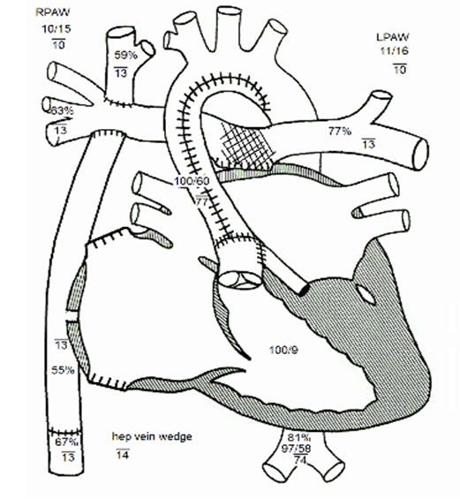
Extra cardiac Fontan procedure 021****
Section 0-Medical and Surgical
Body system 2- Heart and Great Vessels
Operation 1- Bypass
Body Part | Approach | Device | Qualifier
6 Right, atrium 7 Left, atrium | 0 Open | 8 Zooplastic tissue 9 Autologous venous tissue A Autologous arterial tissue J Synthetic substitute K- Nonautologous tissue substitute Z No Device | 7 Atrium, left P Pulmonary trunk Q Pulmonary artery, right R Pulmonary artery, left

Slide 21
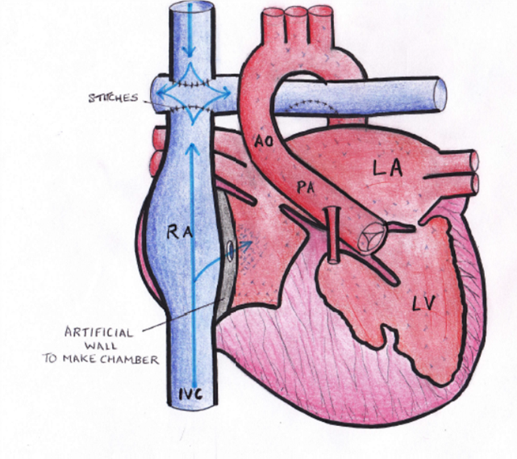
Intracardiac Fontan procedure 021****
Section 0-Medical and Surgical
Body system 2- Heart and Great Vessels
Operation 1- Bypass
Body Part | Approach | Device | Qualifier
6 Right, atrium 7 Left, atrium | 0 Open | 8 Zooplastic tissue 9 Autologous venous tissue A Autologous arterial tissue J Synthetic substitute K- Nonautologous tissue substitute Z No Device | 7 Atrium, left P Pulmonary trunk Q Pulmonary artery, right R Pulmonary artery, left

Slide 22
Fontan completion procedure stage II
ICD-10-CM/PCS Coding Clinic, Third Quarter ICD-10 2014 Page: 29 Effective with discharges: September 15, 2014
Question: A patient diagnosed with hypoplastic left heart syndrome, status post Norwood procedure and bidirectional Glenn procedure, presents for Fontan completion stage II. The intent of the procedure is to connect the inferior vena cava with the right pulmonary artery via a prosthetic conduit. What is the appropriate ICD-10-PCS code for this procedure?
Answer: Although there are various methods to complete the Fontan procedure, ultimately the procedure is performed for blood flow to bypass the right ventricle and the blood to pass from the right atrium to the pulmonary artery. For the Fontan completion stage II procedure, assign ICD-10-PCS code as follows:
02160JQ Bypass right atrium to right pulmonary artery with synthetic substitute, open approach

Slide 23
Hypoplastic Right Heart Syndrome Q226
What is it?
HRHS
Rare, complex congenital heart defect- more rare than HLHS
Right side of the heart is severely underdeveloped and unable to pump blood throughout the body, forcing the right side to do all of the pumping.
Anatomy
Hypoplasia of the right ventricle and pulmonary artery
Enlargement of the left ventricle
Tricuspid valve hypoplastic &/or stenotic
Pulmonary atresia & aortic stenosis

Slide 24
Hypoplastic Right Heart Syndrome Q226
Notes:
Hypoplasia of the right ventricle and pulmonary artery
Enlargement of the left ventricle
Tricuspid valve hypoplastic &/or stenotic
Pulmonary atresia & aortic stenosis

Slide 25
Tetralogy of Fallot q213
What is it?
TOF
Most common congenital heart disease
Cyanotic heart disorder
"tet spell“- turn very blue, have difficulty breathing, become limp, and occasionally lose consciousness
Anatomy
VSD
Pulmonic stenosis
Right ventricular hypertrophy
Overriding aorta
Notes:
Tetralogy of Fallot (TOF) is a congenital heart defect that is present at birth.^{[2]} Symptoms include episodes of bluish color to the skin. When affected babies cry or have a bowel movement, they may develop a "tet spell" where they turn very blue, have difficulty breathing, become limp, and occasionally lose consciousness.

Slide 26
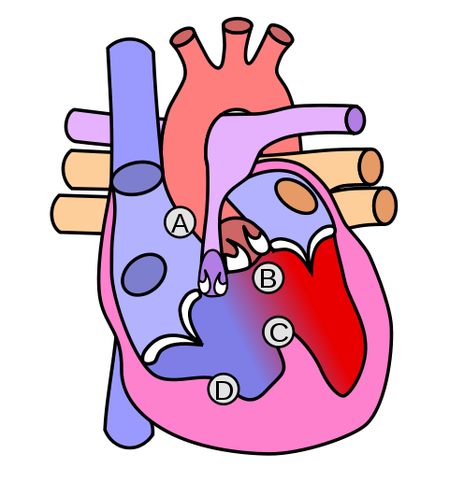
Tetralogy of Fallot q213
A- Pulmonic stenosis
B-Overriding aorta
C- VSD
D- Right ventricular hypertrophy
By Wapcaplet - Modified version by Dake of the original heart diagram by Wapcaplet. See for another version with labels., CC BY-SA 2.5-2.0-1.0, https://commons.wikimedia.org/w/index.php?curid=954537

Slide 27




Tetralogy of Fallot q213
Treatment
Relieve right ventricular outflow tract stenosis
Repair the VSD
Notes:
Patch pulmonary artery
VSD repair

Slide 28
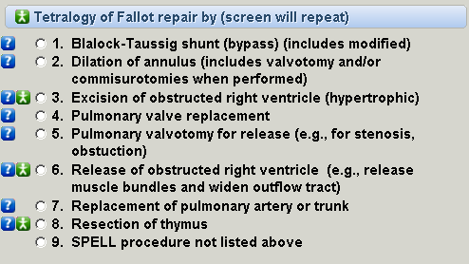
Tetralogy of Fallot procedures
Notes:
Repair depends on what needs corrected

Slide 29
Repair of TOF coding clinic
ICD-10-CM/PCS Coding Clinic, Second Quarter ICD-10 2016 Pages: 23-24 Effective with discharges: May 27, 2016
Question:
A patient with tetralogy of Fallot presents for repair. During the procedure, the anterior portion of the pericardium was resected and treated in glutaraldehyde. Following the repair, the pulmonary arteriotomy site was closed with the autologous pericardial patch to enlarge the main pulmonary artery and left pulmonary artery. The infundibulotomy was closed with an autologous pericardial patch to enlarge the area with running Prolene® suture.
Should the pericardial excision be coded separately? Also, should the closure with pericardial patch be coded separately? If so, what is the appropriate root operation?

Slide 30
Repair of TOF coding clinic
Answer:
When autologous graft is obtained from the site of the procedure, (for example, bone graft obtained from the operative site during a fusion procedure) the tissue harvest is typically not coded separately. Therefore, do not assign a separate code for the pericardial excision. The root operation "Supplement" is assigned for the augmentation of the left pulmonary artery and pulmonary trunk as stated in the operative report. Assign ICD-10-PCS codes as follows:
02UR07Z Supplement left pulmonary artery with autologous tissue substitute, open approach
02UP07Z Supplement pulmonary trunk with autologous tissue substitute, open approach

Slide 31
Repair of TOF coding clinic #2
ICD-10-CM/PCS Coding Clinic, Third Quarter ICD-10 2014 Pages: 16-17 Effective with discharges: September 15, 2014
Question:
A 4-month-old boy with a large conoventricular ventricular septal defect (VSD) with mild aortic override and mild anterior deviation of the conal septum was admitted for surgical repair. The surgeon accomplished a repair of Tetralogy of Fallot. At surgery, cardiopulmonary bypass was established; the ligamentum was ligated; the thymus was resected; the right ventricle outflow tract (RVOT) was divided and widened; and closure of VSD was done with a Gore-tex® patch. What is the correct ICD-10-CM diagnosis code assignment for obstruction of the right ventricular outflow tract (RVOT) muscle bundles? What are the correct ICD-10-PCS procedure code assignments?

Slide 32
Repair of TOF coding clinic #2
Answer:
Assign code Q21.3, Tetralogy of Fallot, as the principal diagnosis. No separate diagnosis code is assigned for the obstruction of the right ventricular outflow tract muscle bundles, since the obstruction is a component of the Tetralogy of Fallot.
The ICD-10-PCS code assignments for the surgery to correct tetralogy of Fallot may be different for each case, since the repair can be performed at various stages. Therefore assign the ICD-10-PCS code(s) describing what was being done during that surgical episode. For this particular case, assign the following ICD-10-PCS codes:
02NK0ZZ Release of right ventricle, open approach (for the widening of the right ventricular outflow tract).
02UM0JZ Supplement ventricular septum, with synthetic substitute, open approach (for the closure of the ventricular septal defect with Goretex® patch)
07TM0ZZ Resection of thymus, open approach
5A1221Z Performance of cardiac output, continuous (for the cardiopulmonary bypass)

Slide 33
Transposition of the great vessels Q203
What is it?
Abnormal arrangement of any of the great vessels:
Superior/ inferior vena cava
pulmonary artery
pulmonary veins
aorta
Anatomy
Aorta comes off the right ventricle
Pulmonary arteries come off the left ventricle
Notes:
Transposition literally means the vessels are transposed.
There are many variations of this disease. For this presentation will talk about transposition of the aorta and the pulmonary arteries
Transposition of the great arteries changes the way blood circulates through the body, leaving a shortage of oxygen in blood flowing from the heart to the rest of the body. Without an adequate supply of oxygen-rich blood
For newborns with transposition, prostaglandins can be given to keep the ductus arteriosus open which allows mixing of the otherwise isolated pulmonary and systemic circuits. Thus oxygenated blood that recirculates back to the lungs can mix with blood that circulates throughout the body.
Typically found prenatally on ultrasound (link between diabetes and this condition), but not always. Will be noticeable within a few hours of birth.
Requires surgery- usually within first week of life

Slide 34
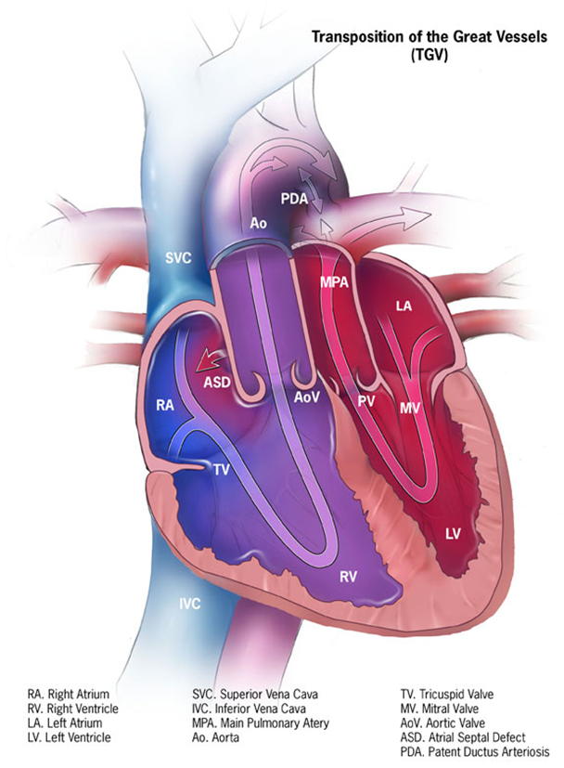
Transposition of the great vessels Q203
https://commons.wikimedia.org/w/index.php?title=Special:Search&profile=default&fulltext=Search&search=transposition+of+the+great+vessels&uselang=en&searchToken=apt9xrbkmoerl2ayo2cwq36px#/media/File:D-tga-575px.jpg
Notes:
For this presentation will talk about transposition of the aorta and the pulmonary arteries

Slide 35
Transposition of the great vessels Q203
Treatment
Arterial switch procedure
  Aorta and pulmonary artery are moved from their native root and attached to the opposite root
    Pulmonary root becomes a neo-aorta
    Aortic root becomes a neo-pulmonary artery
  Coronary arteries transplanted from aorta to neo-aorta
Notes:
General anaesthesia and cardiopulmonary bypass are used.
The aorta and pulmonary artery are detached from their native roots and reattached to the opposite root; thus, the pulmonary root becomes the neo-aorta, and the aortic root becomes the neo-pulmonary artery.
The coronary arteries are transplanted from the aorta/neo-pulmonary artery to the pulmonary artery/neo-aorta.
Length of procedure, from initiation of anaesthesia to post-operative cease thereof, is approximately 6–8 hours.
See slides for coding clinic

Slide 36
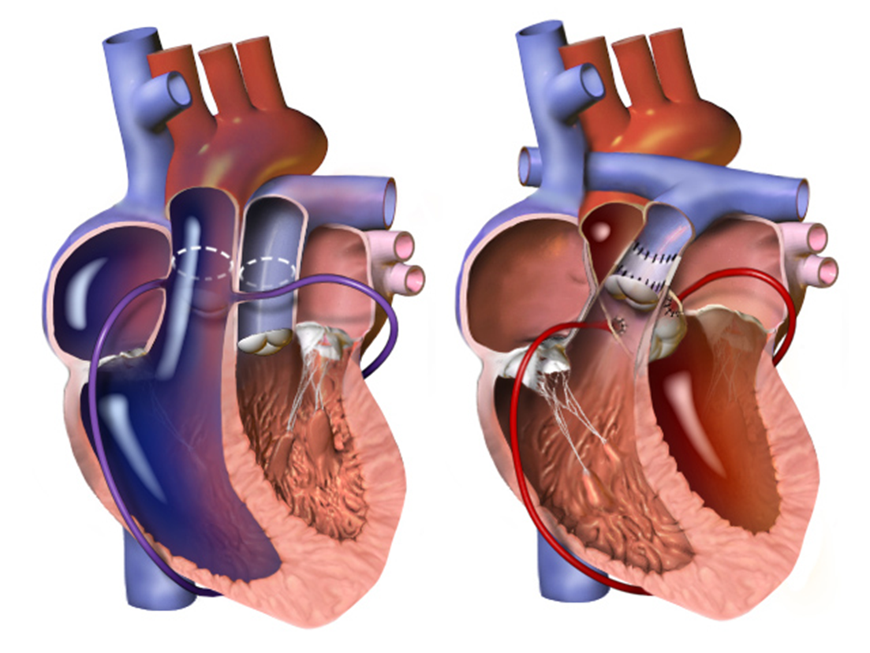
Arterial switch procedure
By BruceBlaus - Own work, CC BY 3.0, https://commons.wikimedia.org/w/index.php?curid=31339211
Notes:
Root operation- reposition

Slide 37
Arterial switch procedure
Section 0- Medical and Surgical
Body System 2- Heart and Great Vessels
Operation- S- Reposition
Body Part | Approach | Device | Qualifier
0 Coronary artery, one artery 1 Coronary artery, two arteries P Pulmonary Trunk Q Pulm Artery, Right R Pulm Artery, Left S Pulm Vein, Right T Pulm Vein, Left V SVC W Thoracic Aorta, Descending X Thoracic Aorta, Ascending/Arch | 0 Open | Z No device | Z No qualifier

Slide 38
Corrective Surgery for Transposition of the Great Arteries, Atrial Septal Defect and Patent Ductus Arteriosus coding clinic
ICD-10-CM/PCS Coding Clinic, Fourth Quarter ICD-10 2015 Pages: 23-24 Effective with discharges: November 13, 2015
Question:
A newborn with transposition of the great arteries, atrial septal defect and patent ductus arteriosus is brought to the operating room for corrective surgery. The patient was placed on cardiopulmonary bypass and the ductus arteriosus was ligated and divided with a clip placed on the aortic end and the atrial septal defect was closed. The pulmonary artery was divided at the bifurcation and brought anterior to the aorta. At this point, left and right coronary ostia were excised and reimplanted in the posterior great vessel and anastomosed to the distal aorta. The defects in the anterior great vessel from which the coronary arteries had been resected were filled with a patch of pulmonary homograft material. What are the correct codes in ICD-10-PCS for the arterial switch procedure with the repositioning of the coronary arteries? Is the repositioning of the coronary arteries assigned a separate code or is that portion of the procedure considered inherent?

Slide 39
Corrective Surgery for Transposition of the Great Arteries, Atrial Septal Defect and Patent Ductus Arteriosus coding clinic
Answer:
The arterial switch surgery is used to treat patients with transposition of the great arteries (TGA). During surgery, the aortic root and pulmonary trunk are switched and connected to the correct ventricles. The coronary arteries (called buttons in this context) are also removed from the original aortic root and reconnected to the switched pulmonary trunk-the new neo-aorta. Assign the following ICD-PCS codes for the corrective surgery to repair transposition of the great arteries, atrial septal defect and patent ductus arteriosus:
02SP0ZZ Reposition pulmonary trunk, open approach
02SW0ZZ Reposition thoracic aorta, open approach
02LR0ZT Occlusion of ductus arteriosus, open approach
02Q50ZZ Repair atrial septum, open approach
02UW07Z Supplement thoracic aorta with autologous tissue substitute, open approach
5A1221Z Performance of cardiac output, continuous

Slide 40
Total anomalous pulmonary venous return Q262
What is it?
TAPVR
Anomalous pulmonary venous connection
4 veins that take blood from the lungs to the heart do not attach to the left atrium- attach to other vessels or other parts of the heart
Can occur with or with out obstruction (Obstruction requires immediate surgery)
Anatomy
Supracardiac- connect above at the superior vena cava
Cardiac- connect behind the heart to the right atrium
Infracardiac- connect below the heart at the inferior vena cava

Slide 41
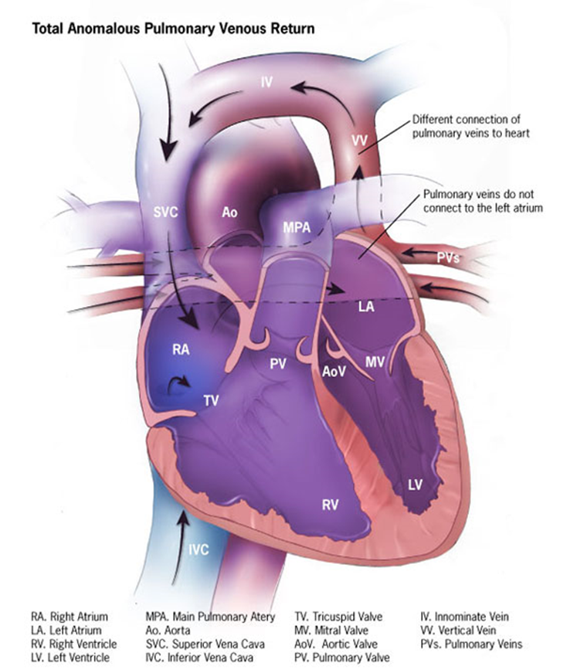
Total anomalous pulmonary venous return Q262
https://commons.wikimedia.org/w/index.php?title=Special:Search&profile=default&fulltext=Search&search=Anomalous+pulmonary+venous+connection&uselang=en&searchToken=cgs3w23buu1nwy4s6wxog24mi#/media/File:Tapv-575px.jpg
Notes:
4 veins that take blood from the lungs to the heart do not attach to the left atrium- attach to other vessels or other parts of the heart

Slide 42
Total anomalous pulmonary venous return Q262
Treatment
Surgery
  4 pulmonary veins are connected to the left atrium
  ASD, VSD, PFO, or PDA closed
Notes:
Re-route the heart to the correct form
Many variations of repair

Slide 43
Total anomalous pulmonary venous return procedure
Section 0- Medical and Surgical
Body System 2- Heart and Great Vessels
Operation 1- Bypass
Body Part | Approach | Device | Qualifier
6 Atrium, Right 7 Atrium, Left | 0 Open | 8 Zooplastic Tissue 9 Autologous Venous Tissue A Autologous Arterial Tissue J Synthetic Substitute K Nonautologous Tissue substitute | P Pulmonary Trunk S Pulmonary Vein, Right T Pulmonary Vein, Left U Pulmonary Vein, Confluence

Slide 44
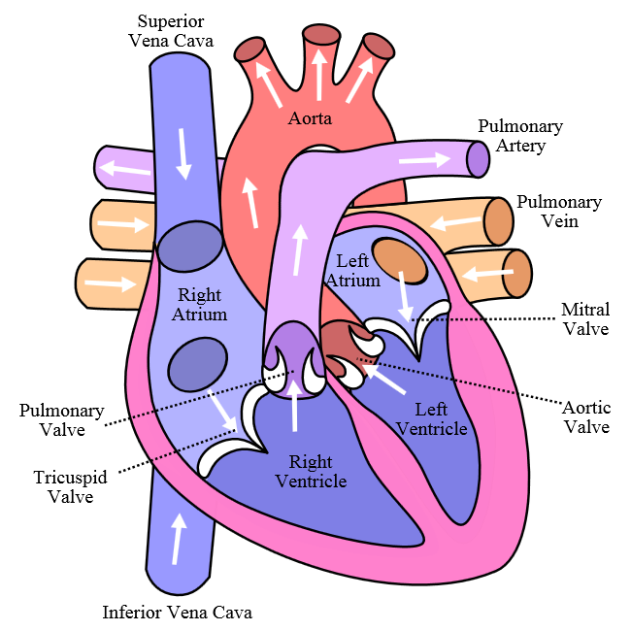
Valvular disorders
Aortic stenosis
Mitral valve stenosis
Pulmonary stenosis
Tricuspid stenosis
By Own work, CC BY-SA 3.0, https://commons.wikimedia.org/w/index.php?curid=830253
Notes:
Aortic stenosis (AS or AoS) is the narrowing of the exit of the left ventricle of the heart (where the aorta begins)
Treatment: repair, replacement, Transcatheter aortic valve replacement, balloon vavuloplasty
Mitral stenosis is a valvular heart disease characterized by the narrowing of the orifice of the mitral valve of the heart
Treatment: medical management, mitral valve replacement by surgery, and percutaneous mitral valvuloplasty by balloon catheter
Pulmonary valve stenosis (PVS) is a heart valve disorder in which outflow of blood from the right ventricle of the heart is obstructed at the level of the pulmonic valve. This type of pulmonic stenosis results in the reduction of flow of blood to the lungs.[1][2] Valvular pulmonic stenosis accounts for 80% of right ventricular outflow tract obstruction
Treatment: valve replacement or surgical repair (depending upon whether the stenosis is in the valve or vessel) may be indicated. If the valve stenosis is of congenital origin, balloon valvuloplasty is another option
Tricuspid valve stenosis is a valvular heart disease which results in the narrowing of the orifice of the tricuspid valve of the heart. It is a relatively rare condition that causes stenosis- increased resistance to blood flow through the valve. (usually found with mitral valve stenosis)
Treatment: typically does not require surgery, tricuspid valve replacement) or percutaneous balloon valvuloplasty

Slide 45
Valvuloplasty
Valvuloplasty is the surgical reconstruction of a deformed cardiac valve, for the relief of stenosis or incompetence.
Dilation
A 18-day-old neonate with congenital pulmonary valve stenosis
S/P percutaneous balloon pulmonary valvuloplasty
Replacement
A 6-year-old with congenital aortic valve stenosis
S/P valvuloplasty with an Edwards SAPIEN heart valve implanted
Supplement
A 18-month-old with history of HLHS post Fontan presents with tricuspid regurgitation
S/P valvuloplasty with annuloplasty ring sutured into place

Slide 46
Common congenital heart devices
Zooplastic
  Admedus cardiocel scaffold collagen
  Edwards SAPIEN valve
  Mosaic bioprosthesis
      aortic or mitral valve
  Contegra conduits
  Baxter PCO404N (bovine)
  Bioprosthesis
Synthetic
  Goretex
  Silicone
  Carpentier-Edwards annuloplasty rings
  CryoLife On-X Valves
Allograft
  Cryolife

Slide 47
Secondary Diagnoses
Acidosis/alkalosis
Acquired coagulation factor deficiency
  Administration of Factor VII
Awaiting transplant status
Cardiomyopathy
Cyanosis
Developmental delays
Down syndrome
Electrolyte imbalances
Exposure to smoke
Failure to thrive
Feeding difficulties
Heart arrhythmias
  Complete heart block
  Junctional ectopic tachycardia (JET)
Heart failure
  Congestive heart failure – systolic / diastolic
  Neonatal heart failure
Hypoxia or hypercapnia
Long-term use of aspirin or anticoagulants
Presence of prosthetic heart valve
Pulmonary artery HTN/secondary pulmonary HTN
Respiratory distress
Respiratory failure
22q11.2 deletion syndrome

Slide 48
Query for Factor VII
Patient is a 10-day-old neonate with d-transposition of great vessels, subpulmonary ventricular septal defect, and patent ductus arteriosus. S/P arterial switch, VSD patch, and division of PDA. OP report notes “Obtaining hemostasis required administration of platelets, cryoprecipitate, and two doses of recombinant factor 7.” Can these clinical findings be further specified? E.g.,
  Acquired coagulation deficiency
  Acquired coagulation disorder
  Other __________________
  Clinically undetermined

Slide 49
Complications of Congenital Heart Surgery
Abnormal shaped heart valve may develop
  Endocarditis
  Regurgitation
Arrhythmias
  Complete heart block
  Junctional ectopic tachycardia (JET)
Cardiomegaly
Chylothorax
Developmental delays
Frequent respiratory infections
Heart failure
  Congestive heart failure – systolic or diastolic
  Neonatal heart failure
Horner’s syndrome
Hypocalcemia (DiGeorge Syndrome)
Learning disability
Plastic bronchitis
Pleural effusions
Post-pericardiotomy syndrome
Protein-losing enteropathy (PLE)
Pulmonary hypertension
Residual defects
Shunt stenosis
Stroke
Shunt thrombosis
Wound infections

Slide 50
Prosthetic valve stenosis due to end of valve life
Many congenital heart repair surgeries require replacement of valves and/or placement of conduits to redirect blood flow.
Most surgically implanted valves or conduits have a life span of 10-20 years before the wear out, become stenotic or calcified, or develop impaired function.
When their function becomes impaired, the valves or conduits need to be replaced.
Both mechanical and bioprosthetic implanted valves and conduits will eventually need to be repaired or replaced.
Principle diagnosis for these patients:
  Z45.09 Encounter for adjustment and management of other cardiac device
Do not code the removal of the device

Slide 51
Prosthetic valve stenosis due to end of valve life coding clinic
Question:
The patient was admitted due to end of life of the heart valve prosthesis. The cardiothoracic surgeon documents "prosthetic valve stenosis due to end of life." In ICD-9- CM, the index directs to code 996.71, Other complications of internal (biological) (synthetic) prosthetic device, implant, and graft, Due to heart valve prosthesis, for prosthetic valve stenosis. However, the surgeon does not agree with this code assignment. He stated that the patient's heart valve prosthesis was placed 19 years ago and has reached its end of life, which is an expected outcome, not a complication. How should end of life of the heart valve prosthesis be coded?

Slide 52
Prosthetic valve stenosis due to end of valve life coding clinic
Answer:
Assign code V53.39, Fitting and adjustment of other device, Other cardiac device, as the principal diagnosis. This situation would not be classified as a complication of the device since the device is eventually expected to wear out and the patient was not experiencing any problems due to the device. When the device is causing problems or complications, such as mechanical breakdown, a code from subcategory 996.6, Mechanical complications of cardiac device, implant and graft, is assigned.
  ICD 10- Z45.09 Encounter for adjustment and management of other cardiac device

Slide 53
Repaired congenital anomaly
ICD-9-CM Coding Clinic, Fourth Quarter 2010 Page: 136 Effective with discharges: October 1, 2010
Question:
If a patient has a history of a congenital condition that has been repaired, is it still a reportable condition?
Answer:
Query the provider as to whether the congenital anomaly has been partially or completely repaired. If the anomaly is still present and has not been completely repaired, it is appropriate to code even in an adult patient. If, however, the anomaly has been completely repaired, assign code V13.65, Personal history of (corrected) congenital malformations of heart and circulatory system. Many congenital anomalies, although present at birth may not manifest until later in life. In addition, some conditions may not be correctible and can persist. The official coding guidelines state in section I.C.14.a "Codes from Chapter 14 may be used throughout the life of the patient." Therefore, it is acceptable to code these conditions, using codes from categories 740-759, Congenital anomalies, in an adult patient.

Slide 54
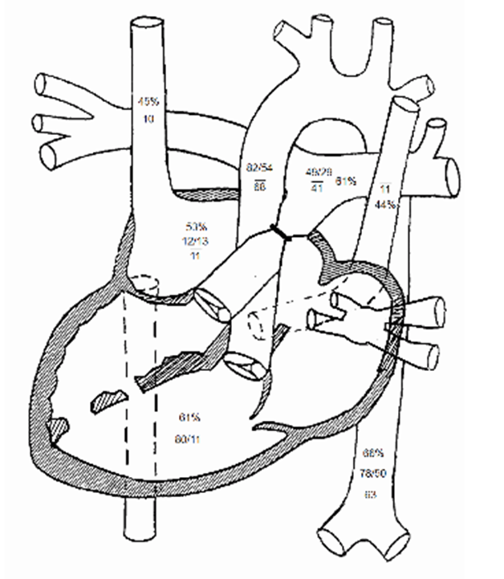
What’s wrong with this heart?
Dextrocardia
Hypoplastic right
ventricle
Tricuspid Atresia
2 VSD’s
ASD
Pulmonary band has been
placed
Notes:
1. Dextrocardia with tricuspid atresia and normally related great
arteries.
2. At least two moderate ventricular septal defects with minimal
restriction.
3. Unrestrictive atrial septal defect with right to left shunt.
4. Left superior vena cava to the coronary sinus…..NO need for Norwood
Surgical repair:
1- atrial connection, shared liver & diaphragm….. right atrium of one baby connected to the left atrium of the other
2- (1 month later) pulm band→ Pulmonary over-circulation
she has elevated pulmonary artery pressures with elevated pulmonary vascular resistance. It is now unlikely that she can tolerate the next stage of a single ventricle palliation because her elevated pulmonary pressures would prevent passive flow needed with a bidirectional Glenn… started Silfinadil

Slide 55

Case study #1
2 day old male- diagnosed in utero as having HLHS
Diagnosis:
1. Hypoplastic left heart syndrome
2. Patent ductus arteriosus
Op note:
1. Median sternotomy with cardiopulmonary bypass and period of cardioplegic arrest.
2. Norwood operation with a 6 millimeter right ventricle to pulmonary artery conduit
3. Ligation and division of patent ductus arteriosus.
4. Open atrial septectomy.
5. Creation of Neoaorta

Slide 56
Procedures- case study #1
Ligation and division of patent ductus arteriosus.
Open atrial septectomy.
Creation of Neoaorta
“We proceeded to place another ligature around the ductus arteriosus and then we divided the ductus arteriosus between ligatures. With the duct fully ligated and divided, we then proceeded to place a vent in the right atrium into the right ventricle”
“we then proceeded to obtain our patch of pulmonary homograft material and we proceeded to sew that patch in place extending from the descending aorta underneath the aortic arch. We made a separate second cutback anteriorly in the descending aorta before beginning placement of that patch. Patch was brought around using the Alfieris technique, both posteriorly and anteriorly trimming as we went and ultimately we were happy with the full arch reconstruction”

Slide 57
Procedures- case study #1
4. Median sternotomy with cardiopulmonary bypass and period of cardioplegic arrest.
5. Norwood operation with a 6 millimeter right ventricle to pulmonary artery conduit.
“we then proceeded to obtain our 6 millimeter ringed Gore-Tex. We needed to enlarge the opening in the pulmonary bifurcation somewhat more and then proceeded to perform a distal anastomosis with running 7-0 Prolene. This was done with a dunk technique using only the rings on the graft into the pulmonary bifurcation. Once that was completed, we then proceeded to remove all of the clamps to allow the arch to fill. We were pleased with how the arch reconstruction appeared. This allowed us to now determine the length of our conduit.
We proceeded to make an incision in the right ventricle at a predetermined site and using a 5 millimeter punch, we were able to get an adequate opening and then we proceeded to dunk the proximal end of the conduit into the right ventricle using 4 separate 6-0 Prolene sutures and then a 5-0 Prolene purse-string around it”

Slide 58
Case study #1 answers
Diagnosis:
Hypoplastic left heart syndrome Q234
Patent ductus arteriosus Q250
Procedures:
Norwood operation with a 6 millimeter right ventricle to pulmonary artery conduit 021K0JP
Ligation and division of patent ductus arteriosus 02LR0ZT
Open atrial septectomy
Creation of Neoaorta 02UW07Z
Cardiopulmonary bypass 02UW07Z
Notes:
021K0JP- Norwood → Bypass right ventricle to pulmonary trunk with Synthetic Substitute, open approach
02LR0ZT- PDA ligation →Occlusion of ductus arteriosus, open approach
No separate code for atrial septectomy- this is integral to the right ventricle to pulmonary artery conduit…. Make sure to look at the intention of the procedure
****If the septectomy is done just to get to the main procedure area then it wouldn’t be coded separately. However sometimes they may have “restrictive atrial septum” so if the procedure was done with this separate objective of correcting the restriction of the atrial septum then it would be coded separately to the root operation of “release”.
02UW07Z- Neoaorta→ Supplement Thoracic aorta, Descending with autologous tissue substitute, open approach
See slide at end with coding clinic for aorta parts
5A1221Z- Cardiopulmonary bypass→ Performance of cardiac output, continuous

Slide 59
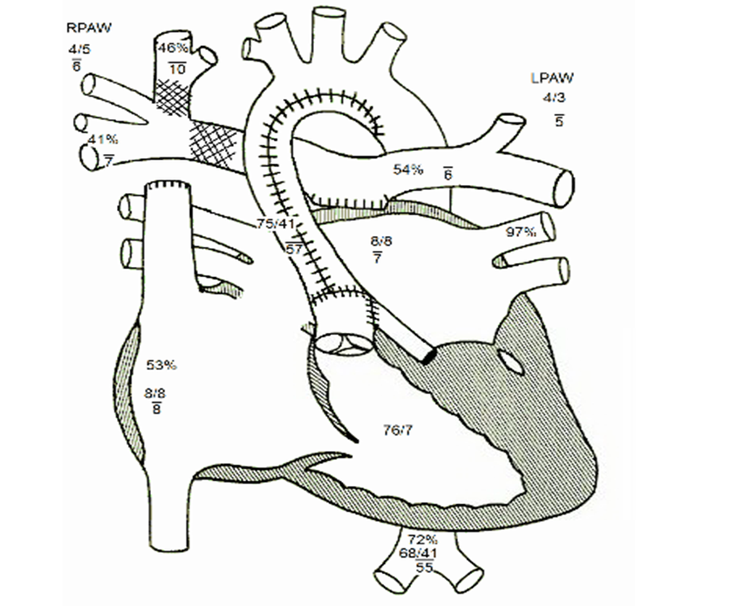
Case Study #2
6 month old with hx of HLHS s/p Sano
Diagnosis:
Hypoplastic left heart syndrome, status post Norwood, with 6 millimeter Sano
Op note:
Redo sternotomy
Takedown OF Sano shunt
Bidirectional Glenn

Slide 60
Procedures- case study #2
Redo sternotomy
Takedown Sano shunt
  “At this point, we began our dissection of the Sano shunt. After we had freed it up off of the heart, we placed medium large clips and divided the Sano shunt. We then continued to mobilize the Sano shunt, dissecting down following it onto its insertion into the PAs. At the Sano insertion site, there was noted to be extensive dense adhesions with a lot of inflammatory reaction, and it took some time to be able to dissect free the LPA, as well as the at this point. We were able to fully mobilize the RPA onto the aorta, as well as the proximal LPA, and after getting control of the LPA, we then removed the Sano from its insertion into the central PAs. At this time, we then pulled the pulmonary bifurcation to the right of the aorta and placed another clamp onto the LPA. The inflammatory tissue at the Sano insertion site onto the PAs was then excised, and the PAs were opened, both leftward and rightward, towards the lower lobe branch of the right pulmonary artery.”

Slide 61
Procedures- case study #2
3. Bidirectional Glenn
“At this time, we then began our posterior wall Glenn anastomosis. 6-0 Prolene sutures were placed into the corners of the SVC, tacking it to the posterior wall of the pulmonary artery. We then sutured the posterior wall of the Glenn anastomosis using 6-0 PDS in a running fashion. After completing the posterior suture line, a homograft patch was brought onto the field to patch the anterior anastomosis. It was then cut to size and brought onto the field. The patch was then sutured to the pulmonary arteries using 6-0 Prolene in a running fashion and then bringing the patch up onto the anterior wall of the SVC to complete our Glenn anastomosis. After completing the suture line, the clamp was removed off of the SVC, and then the clamps were removed off the right and left. The Yasargils were removed from the RPA, and clamp was removed off the LPA. The Glenn filled well without evidence of stenosis or kinking.”

Slide 62
Case Study #2 answers
Diagnosis:
Hypoplastic left heart syndrome Q234
Procedures:
Sano takedown 02PY0JZ, 02PA0JZ
Bidirectional Glenn 021V0ZQ, 02UP0KZ
Cardiopulmonary Bypass 5A1221Z
Notes:
Redo sternonotomy- no code needed- this is the apporach
Sano takedown
02PY0JZ Removal of Synthetic Substitue from great vessel, open approach
02PA0JZ Removal of Synthetic Substitue from heart , open approach
Bidirectional Glenn
021V0ZQ Bypass Superior Vena Cava to Right Pulm Artery, Open approach
02UP0KZ Supplement Pulmonary Trunk with Nonautologous tissue substitute, open approach
Cardiopulmonary Bypass 5A1221Z

Slide 63
Coding clinics
Correction of congenital heart defects
ICD-10-CM/PCS Coding Clinic, Fourth Quarter ICD-10 2016 Pages: 102-109 Effective with discharges: October 1, 2016
Root operation - Creation
ICD-10-CM/PCS Coding Clinic, Fourth Quarter ICD-10 2016 Page: 101 Effective with discharges: October 1, 2016
Notes:
Table changes

Slide 64
Thoracic aorta, ascending/arch and descending
ICD-10-CM/PCS Coding Clinic, Fourth Quarter ICD-10 2016 Pages: 80-81 Effective with discharges: October 1, 2016
The thoracic aorta extends from the aortic valve to the diaphragm (the portion below the diaphragm is the abdominal aorta). The thoracic aorta has three anatomic segments:
ascending aorta, which runs from the aortic valve to the arch
arch, which gives rise to the precerebral arteries supplying the neck and the head, including the brachiocephalic (innominate) artery, left common carotid artery, and left subclavian artery
descending thoracic aorta, which runs from the arch to the diaphragm.

Slide 65

Questions
By Neo luna - Own work, CC0, https://commons.wikimedia.org/w/index.php?curid=7932410

Slide 66
References
Bhimji, S. (2016). Tetralogy of Fallot. Medscape. Retrieved from http://emedicine.medscape.com/article/2035949-overview#a8
Centers for Disease Control and Prevention. Facts about Total Anomalous Pulmonary Venous Return or TAPVR. Retrieved from https://www.cdc.gov/ncbddd/heartdefects/tapvr.html
Cove Point Foundation- Congenital Heart Disease, Helen B. Taussig Children’s Heart Center, Johns Hopkins University
Greenleaf, C.E., Urencio, M., Salazar, J. D., & Dodge- Khatami, A. (2016). Hypoplastic left heart syndrome: current perspectives. Translational Pediatrics, 5 (3): 142-147. DOI:10.21037/tp.2016.05.04
Kuroczynski, W., Senft, D., Elsaesser, A., & Kampmann, C. (2014). Clinical research: Intra- or extracardiac Fontan operation? A simple strategy when to do what. Archives of Medical Science, 10 (4), 706-710. DOI: https://doi.org/10.5114/aoms.2013.33432
Mayo Clinic. Hypoplastic left heart syndrome. Retrieved from http://www.mayoclinic.org/diseasesconditions/hypoplastic-left-heart-syndrome/home/ovc-20164178
Mayo Clinic. Tetralogy of Fallot. Retrieved from
http://www.mayoclinic.org/diseases-conditions/tetralogy-of-fallot/basics/definition/con-20043262
Mayo Clinic. Transposition of the great vessels. Retrieved from http://www.mayoclinic.org/diseases-conditions/transposition-of-the-great arteries/home/ovc-20169432

Slide 67
References
MedlinePlus. Total anomalous pulmonary venous return. Retrieved from https://medlineplus.gov/ency/article/001115.htm
NORD- National Organization of Rare Disorders
Ohye, R.G., Schranz, D., & D’Udekem, Y. (2016). Current therapy for hypoplastic left heart syndrome and related single ventricle lesions. Circulation, 134. 1265-1279. DOI: 10.1161/CIRCULATIONAHA.116.022816
Orphanet- a portal for rare diseases and orphan drugs
Patana, R. (2015). Pediatric hypoplastic left heart syndrome. Pediatrics: Cardiac Disease and Critical Care Medicine. Retrieved from http://emedicine.medscape.com/article/890196-overview
Ramaswamy, P. (2014). Systemic to pulmonary artery shunting for palliation. Pediatrics: Cardiac Disease and Critical Care Medicine. Retrieved from http://emedicine.medscape.com/article/905950-overview#a3
Yabrodi, M & Mastropietro, C. W. (2016). Hypoplastic left heart syndrome: from comfort care to long-term survival. Pediatric RESEARCH. DOI:10.1038/pr.2016.194

