Slide 1
Status Asthmaticus Brain Edema/Compression
Daxa Clarke, MD
Phoenix Children’s Hospital
Pediatric Resource Group

Slide 2
Asthma Facts
5.5 million (7.5%) children in the US have asthma
More than 50% of these children have at least one exacerbation in the prior 12 months
CDC.gov

Slide 3
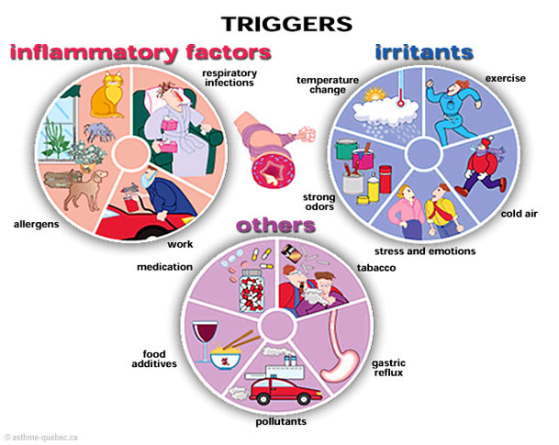
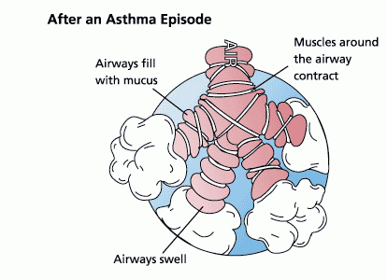
Status Asthmaticus

Slide 4
Baseline Severity of Asthma
Severity | Symptoms
Mild Intermittent | Daytime sxs <= 2 days/week Night awakening <=2 times/month Normal FEV1 Exacerbation <=1/year
Mild Persistent | Daytime sxs >2 and <7 days/week Night awakening 3-4 times/month Minor interference with activity Normal FEV1 Exacerbation >= 2/year
Mod Persistent | Daily sxs Night awakening >1/week Daily use of short-acting beta agonist (SABA) Some activity restriction FEV1 60-80% predicted Exacerbation >=2/year
Severe | Symptoms all day Nightly awakening Use of SABA mult times per day Extreme limitation in activity FEV1 <60% predicted Exacerbation >=2 /year
National Asthma Education and Prevention Program: Expert Panel Report 3 (NAEPP-EPR 3; 2007)

Slide 5
Exacerbation vs. Status Asthmaticus
Exacerbation
Worsening of symptoms followed by improvement with treatment
Status
Worsening of symptoms with minimal improvement with treatment
Requires continuation of treatment
Requires continued escalation of treatment

Slide 6
Consider the diagnosis “Status Asthmaticus” when
Symptoms/History
Respiratory Distress
Associated Diagnoses
Tachypnea
Retractions
Head bobbing
Plan
Continuous Albuterol
Terbutaline
Respiratory Failure
Nasal Flaring
Wheezing
Positive Pressure Ventilation
PE Findings
Asthma: Mild Int, Mild Perst, Mod, Severe
Acute Exacerbation
Tri-podding
Hypoxia
AMS
Failed treatment with albuterol at home
Hx asthma or reactive airway disease
Hx prematurity/BPD
FHx asthma
Reactive Airway Disease
IV Corticosteroid
IV Magnesium Sulfate
PICU Admission
Wheezing Associated Respiratory Illness (WARI)
Recent illness
Hx Allergies/Eczema

Slide 7
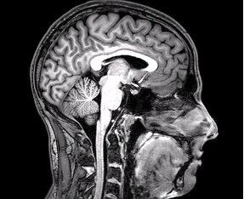
Brain Edema/Brain Compression
Notes:
The skull is a closed system—raises risk of edema/compression.

Slide 8
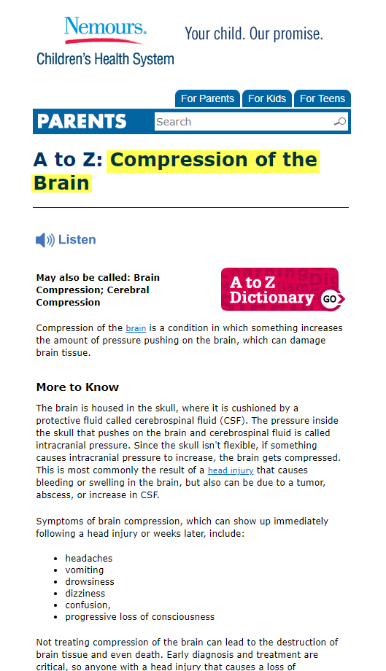

Slide 9
Etiology
Edema
Vasogenic
Compression
Vascular
Related to breakdown of BBB
Cytotoxic
Metabolic
Osmotic
Water
Hemorrhage
Infectious
Abscess
Neoplastic
Trauma
Other
Hydrocephalus
Hydrostatic
Water and electrolytes

Slide 10
Consider the diagnosis “Brain Edema” when
Symptoms
Confused
Disoriented
Associated Diagnoses
Headache
Poor coordination
Lethargic
Vomiting
Brain swelling
Effacement
Herniation
Plan
Mannitol
Decadron
High Altitude
Malignant Hypertension
Anoxia
Brain Tumor with localized edema
Brain Infarct/injury with localized edema
Swollen gyri
Poor differentiation of gray and white matter
Controlled hyperventilation
Controlled hypothermia
Decompressive craniotomy
CT/MRI Findings*
DKA
Meningitis
Hyponatremia/ Hypernatremia
Status Epilepticus
3% Sodium Solution
Head Trauma
*Radiographic imaging not required.

Slide 11
Consider the diagnosis “Brain Compression” when
Symptoms
Confused
Disoriented
CT/MRI Findings*
Mass effect
Diagnosis
Hydrocephalus
Headache
Poor coordination
Lethargic
Vomiting
Mid-line shift
Increase ventricle size
Effacement
Herniation
Brain tumor/neoplasm
Intracranial hemorrhage (ICH)
Plan
Elevated Head of Bed
Decompression
EVD placement
Tumor Resection
Evacuation of ICH
Shunt Revision
VP shunt malfunction
Shunt Placement
*Radiographic imaging not required.

Slide 12
Contrasting BE and BC
Edema
Symptoms: HA, vomiting, confusion, lethargy
Compression
Symptoms: HA, vomiting, confusion, lethargy
Something causing brain to swell: trauma, meningitis, electrolyte shifts, water shifts
Radiology: midline shift, mass effect
Radiology: swollen gyri, effacement
Something causing pressure in areas of the brain: tumor, bleeding, large ventricles, abscess
Medical management
Medical and surgical management

Slide 13
Contact
Daxa Clarke, MD
@daxaclarke
dclarke@phoenixchildrens.com
Phoenixchildrens.com
PediatricRG.com
Pediatric Resource Group

