Slide 1
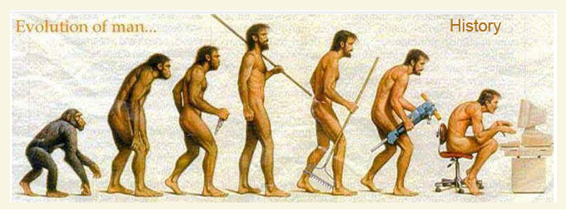
History “of”
Is it really History ??

Slide 4
We have fallen into the
paradigm of saying/documenting
“History of”
even when the disorder
is currently present

Slide 6
Coding will
not be able
to code a
current
condition
if you
document
“History of”

Slide 7
examples:
History of idiopathic scoliosis –
admitted for spinal fusion
2. History of sickle cell disease –
admitted for vaso-occlusive crisis
3. History of asthma –
admitted with status asthmaticus
4. History of Down Syndrome
5. History of Di George Syndrome
6. History of spastic quadriplegia
7. History of diabetes – admitted in DKA
8. History of – I could go on an on………………….

Slide 9
That’s NOT history
Get Credit For
What You Do!

Slide 13
“History of”
Active Problems
Circumcision
Pyloric Stenosis
Recurrent Otitis
Mild persistent
asthma
Insulin dependent
diabetes

Slide 14
It’s a duck
It’s NOT a
“history of”
a duck

Slide 15
It’s still a duck

Slide 16
Guess what –
it’s still a duck

Slide 17
NOW –it’s
“History of” a duck

Slide 18
Duck

Slide 19
“History
of”
duck

Slide 22
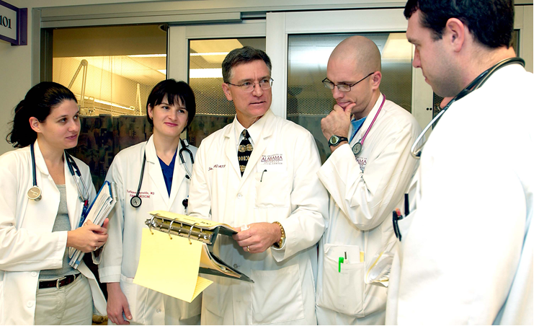

Slide 23
His-to-ry of
& it saves 4 syllables

Slide 27
Pros:
Increased accuracy of documentation
Increased CMI for you and your colleagues
Increased reimbursement for the Children’s Hospital where you work
Providing proper education for the residents you are in charge of
and teaching them the right way to do things
Cons:
??????????????????????????????????????

Slide 29
Evaluation
Education
Before
Attestation

Slide 32
DON’T
The Issue

Slide 33
Use Accurate
-u-mentation

Slide 34
Don’t
Fail to properly
educate your
residents as to what
is history and what is not
It Up
ABS takes a collective sign of relief

