Slide 1

HOT TOPICS
July 18, 2024
Valerie Bica BSN, RN Amy Bush BS, RN, MJ, CCDS, CCS Jeff Morris BSN, RN, CCDS, CCS

Slide 2


Today's speaker for HOT topics:
Kara Lawrence Layman, RN, CCDS
Sr. CDI Specialist
Ensemble Health Partners

Slide 3
Introducing our HOT topics:
Disclaimer: This is a forum for discussion and not meant to replace or challenge any official Guideline or Coding Clinic advice. Please be mindful that our clinical backgrounds, experience, and CDI programs are different and strive to share your knowledge as well as benefit from others’ as well.​
ABO- Which is it?
Q Codes- Do we? or Don't we?

Slide 4
Presentation objectives
Participants will be able to discuss coding clinic perspectives on the topic of ABO incompatibility in the newborn.
Participants will be able to recognize how a Q code can affect the DRG assignment.
Participants will be able to discuss coding guidelines regarding capturing Q codes.

Slide 5
ABO-which is it?
Original Question:
Provider documented ABO incompatibility, so it was captured by coder as ABO isoimmunization.
Denial stated isoimmunization was not present because baby was not treated with phototherapy and DAT (direct antibody test) was negative.
I consulted with our NICU team and they agreed that DAT does not need to be positive, however if true Isoimmunization was present it would be treated with phototherapy.
To reduce confusion, Providers have also started documenting ABO Mismatch or Rh Mismatch rather than incompatability if it is not significant.
Interested in knowing what other organizations are doing as well.

Slide 6
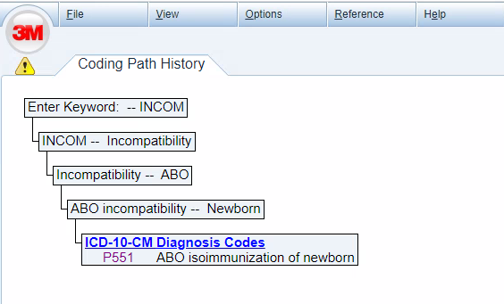
Let's look at how ABO incompatibility is captured:
ABO incompatibility codes to ABO isoimmunization, P551.

Slide 7
Let's look at what ICD-10-CM coding handbook has to say: Chapter 26 perinatal conditions-
  Hemolytic Disease of newborn: Rh+ infants born to Rh negative mothers often develop hemolytic disease owing to fetal-maternal blood group incompatibility. These conditions are classified in category P55, Hemolytic disease of newborn. Note that an indication of incompatibility on a routine cord blood test is not conclusive. Do not assign a code from category P55 on the basis of this finding alone; a diagnosis of isoimmunization or hemolytic disease requires provider confirmation.

Slide 8
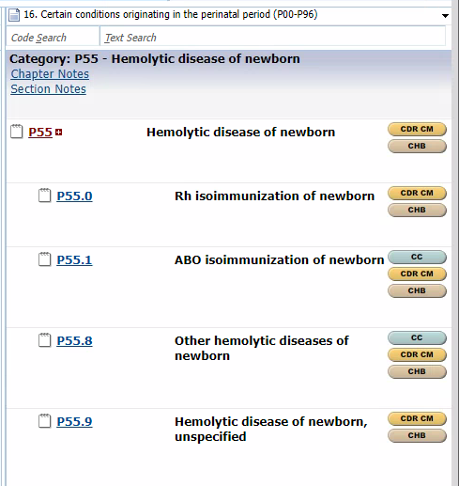

3M integrated Codebook P55

Slide 9
Let's look at some Coding Clinics:

Slide 10
AHA Coding Clinic
Positive Coombs test and ABO isoimmunization ICD-10-CM/PCS Coding Clinic, Third Quarter ICD-10 2015 Page: 20 Effective with discharges: October 7, 2015
Question: Does documentation of a positive Coombs test need to be present in order for the diagnosis code for ABO isoimmunization to be assigned on a newborn record?
Answer: No. If the provider documents ABO incompatibility on a newborn record, assign code P55.1, ABO isoimmunization of newborn.
© Copyright 1984-2023, American Hospital Association ("AHA"), Chicago, Illinois. Reproduced with permission. No portion of this publication may be copied without the express, written consent of AHA.

Slide 11
AHA Coding Clinic
Coombs test positive ICD-9-CM Coding Clinic, Second Quarter 2003 Page: 14 to 15 Effective with discharges: August 1, 2003
Question: Should code 773.1, Hemolytic disease due to ABO isoimmunization, be assigned for a positive Coombs test in a newborn? If not, then what code should be assigned?
Answer: No, code 773.1, Hemolytic disease due to ABO isoimmunization, is inappropriate for only a positive Coombs test in a newborn. Codes should not be assigned based on the laboratory test results alone. Coding of 773.1 should be based on physician documentation of hemolytic disease in the newborn due to ABO incompatibility. As described in Coding Clinic, Third Quarter 1992, page 9, diagnosis should not be based on a single laboratory test. In that case, it was made clear that the physician diagnosis will generally be based on both an ABO incompatibility test and a positive Coombs test. However, please note that additional clinical criteria will usually be important. These would generally include spherocytes on the blood smear (along with potentially other findings), and hyperbilirubinemia. Other clinical findings may also be important as well. A positive Coombs test in a newborn could also be due to Rh incompatibility to some other blood group compatibility or might be a false positive.
If the physician documents the results, the most appropriate code assignment is 790.99, Other nonspecific findings on examination of blood, Other. This supersedes previously published advice in Coding Clinic, Third Quarter 1992, page 9.
© Copyright 1984-2023, American Hospital Association ("AHA"), Chicago, Illinois. Reproduced with permission. No portion of this publication may be copied without the express, written consent of AHA.

Slide 12
AHA Coding Clinic
ABO incompatibility w/negative Coomb's test ICD-9-CM Coding Clinic, Third Quarter 1992 Page: 8 to 9 Effective with discharges: July 1. 1992
Question The index provides code 773.1, Hemolytic disease due to ABO isoimmunization, when you reference ABO incompatibility. Is it appropriate to assign this code when routine cord blood tests show ABO incompatibility but the Coomb's test is negative? There is no documentation that the finding affected the care provided the infant in any way, and there is no other evidence of hemolytic disease of the newborn.
Answer: No, do not assign code 773.1 based solely on routine cord blood tests showing ABO incompatibility. The diagnosis of ABO isoimmunization also depends on whether the Coomb's test (direct antibody test or direct antiglobulin test) results are positive. If routine cord blood tests demonstrate an ABO incompatibility and the Coomb's test result is positive, then hemolytic disease is present and code 773.1 should be assigned.
It should also be noted that there is no correlation between the strength of the reaction to the test and the clinical severity of the disease. For example, an infant with a strongly reacting direct antibody test may have no manifestations, such as jaundice, while an infant with a weak reacting test may require phototherapy or, in rare instances, an exchange transfusion. The infant, in both instances, has hemolytic disease and should be coded as such.
© Copyright 1984-2023, American Hospital Association ("AHA"), Chicago, Illinois. Reproduced with permission. No portion of this publication may be copied without the express, written consent of AHA.
© Copyright 1984-2024, American Hospital Association ("AHA"), Chicago, Illinois. Reproduced with permission. No portion of this publication may be copied without the express, written consent of AHA.

Slide 13

Educational reference: ABO incompatibility
ABO and RhD Incompatibility/Hemolytic Disease : A condition that occurs when the maternal blood type is different than the neonates blood type and has antibodies that destroy the neonates red blood cells. Occurs primarily when the mother has O blood type and the neonate has A, B or AB blood type.
Alloimmune hemolytic disease of the newborn (HDN) primarily involves the major blood groups of Rhesus (Rh), A, B, AB, and O, although minor blood group can also result in significant disease. It occurs when the maternal blood type is different than the neonates blood type and antibodies are created that destroy the neonates red blood cells primarily when the mother has O blood type and the neonate has A, B or AB blood type. HDN can cause anemia, thrombocytopenia, hyperbilirubinemia, jaundice, tachycardia, and lethargy in the neonate.
RhD incompatibility is due to maternal sensitization in an RhD-negative individual caused by a previous exposure to Rh antigen, either through transfusion with Rh-positive red blood cells (RBCs) or pregnancy with a Rh-positive offspring. Thus, in the absence of a transfusion history, RhD HDN generally does not occur in the first pregnancy.
Hydrops fetalis is a severe, life-threatening hemolytic anemia which is manifested by diffuse edema, pleural and/or pericardial effusions, and ascites.
DIAGNOSTIC EVALUATION/CRITERIA
Reticulocyte count: Checked if anemia is present to determine if the neonate is producing extra red blood cells. Reticulocytes are increased with hemolytic diseases such as ABO and RhD incompatibility.
Bilirubin: Routinely checked in all neonates prior to discharge and may be elevated for many reasons including increased blood breakdown such with polycythemia or ABO/RhD hemolytic disease.
Coombs Test/Direct Antiglobulin Test (DAT)/Indirect Antiglobulin Test (IAT): Used to check for hemolysis due to antibodies
Maternal and infant blood type (ABO and RhD) and maternal antibody screen
Peripheral Blood Smear: Used to look for signs of hemolysis such as with ABO or RhD incompatibility
TREATMENT
Hyperbilirubinemia: Phototherapy, exchange transfusion

Slide 14
Considerations: What is your facility doing?
Is the term Incompatibility synonymous with Isoimmunization?
ABO incompatibility the "risk factor" ABO isoimmunization as the "problem"?
What documentation would be an alternative? "set up" "mismatch"
Guidance from Coding Clinic?

Slide 15
References:

Slide 16
Q codes: Do we? or Don't we?
Original Question: "At our institution, we code congenital conditions on newborns (regardless of if they meet criteria for secondary dx) if documented by a provider. For example, if the provider notes birthmark, it is coded."
"This gets even more complicated when echocardiograms are done on newborns for prenatal suspicions. For example: Term infant with prenatal arrhythmia has echo ordered. Echo reveals "PFO." Provider is queried about echo results and responds: "agree with findings, findings are insignificant"
At our facility, we are still coding the PFO in this case as supervisors determined the wording in the Guidelines for Chapter 17 of "whenever the condition is diagnosed by the provider, it is appropriate to assign a code from codes Q00-Q99." Overrides the diagnosis qualifying based on traditional M.E.A.T + implications for future care criteria as well as coding clinic advice such as: "ICD-9-CM coding clinic, first quarter 2013, page 14 effective with discharges: March 27, 2013"
Response to original question: "Is the provider being queried because they aren't pulling the ECHO results into the notes? Because if it's in the notes, regardless of them stating "insignificant", the condition was still worked up and diagnosed so it should be coded without a query"
Response: The provider will document something like "echo for prenatal arrhythmia completed, no evidence of arrhythmia." Our cardiologist will state on the echo report findings such as "PFO normal variant found, no need for follow up" In this case, the echo was not done for murmur, and no arrythmia is noted during admission. It was done for prenatal findings from prior OB visit Echo's. To query for echo results of PFO that is insignificant, but a Q code, when the purpose of the Echo was to rule out arrhythmia only present prenatally?
I am curious to know what other facilities are doing? If documented, is any "Q-code" automatically coded, or are QDS sending queries to validate significance of the congenital condition?

Slide 17
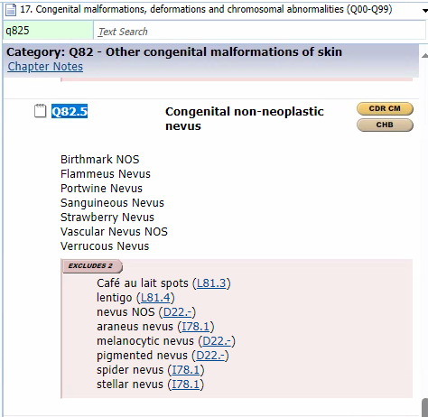

3M Integrated Codebook Q82.5 (affects the DRG)

Slide 18
AHA Coding Clinic
Sacral nevus on a newborn
ICD-9-CM Coding Clinic, First Quarter 2013 Page: 14 Effective with discharges: March 27, 2013
Question:
The provider documented nevus in sacral area on the newborn physical and progress record for the birth admission. There is no documentation in the medical record indicating clinical evaluation, therapeutic treatment, diagnostic procedures, extended length of hospital stay, increased nursing care and/or monitoring, or implications for future health care needs. Is it appropriate to code the sacral nevus as a secondary diagnosis?
Answer:
Yes, it is appropriate to code the sacral nevus. Assign code 757.33, Congenital pigmentary anomalies of skin, for the sacral nevus. A sacral nevus is a congenital anomaly present at birth. It is appropriate to code congenital anomalies when identified by the provider, since they can have implications for further evaluation. For additional information on coding congenital anomalies, see the ICD-9-CM Official Guidelines for Coding and Reporting, Section I.C.14.
© Copyright 1984-2024, American Hospital Association ("AHA"), Chicago, Illinois. Reproduced with permission. No portion of this publication may be copied without the express, written consent of AHA.

Slide 19
Coding guidelines: ICD-10-CM official guidelines for coding and reporting FY 2024
Code all clinically significant conditions. All clinically significant conditions noted on routine newborn examination should be coded. A condition is clinically significant if it requires:
▪ clinical evaluation; or
▪ therapeutic treatment; or
▪ diagnostic procedures; or
▪ extended length of hospital stay; or
increased nursing care and/or monitoring; or
▪ has implications for future health care need
Note: The perinatal guidelines listed above are the same as the general
coding guidelines for “additional diagnoses,” except for the final point
regarding implications for future health care needs. Codes should be
assigned for conditions that have been specified by the provider as
having implications for future health care needs.

Slide 20
3M coding reference ICD -10-CM coding handbook:
Chapter 25 congenital anomalies, Newborn with congenital conditions.
NEWBORN WITH CONGENITAL CONDITIONS
When a diagnosis of a congenital condition is made during the hospital episode in which an infant is born, the appropriate code from chapter 17 of ICD-10-CM should be assigned as an additional code, with the appropriate code from category Z38, Liveborn infants, according to place of birth and type of delivery, used as the principal diagnosis. (See chapter 26 of this handbook.) Examples follow:
Z38.00 + Q36.9 Term birth, single male, vaginal delivery; incomplete cleft lip on right side
Z38.00 + Q54.9 Term birth, single male, vaginal delivery; hypospadias
Note that the following is an exception to the guidelines for reporting other conditions: Congenital conditions that may have future health care implications are reported for newborns even if they are not further evaluated or treated during the current episode of care. Therefore, it is appropriate to assign congenital anomalies codes (Q00-Q99) whenever a congenital condition is diagnosed by the physician.

Slide 21
3M coding reference- ICD-10-CM coding handbook: chapter 26 perinatal conditionOther diagnoses for newborns.
  Additional codes are assigned for all clinically significant conditions noted on the examination of the newborn. A newborn condition is clinically significant when it has implications for the newborn's future health care. This is an exception to the Uniform Hospital Discharge Data Set guidelines.
  Insignificant or transient conditions that resolve without treatment are not coded. Because the conditions usually resolve without treatment and require no additional workup, they are not coded. For example:
    The pediatrician documents in the newborn medical record that the baby's heart murmur is benign and most likely due to a patent ductus arteriosus/patent foramen ovale (PDA/PFO). He orders a cardiac consult and an echocardiogram to evaluate the PDA/PFO. Assign code Q21.12, Patent foramen ovale, for the PFO and code Q25.0, Patent ductus arteriosus, for the PDA. These conditions are being evaluated further; therefore, they can be reported.
    During a routine physical examination of a newborn, the pediatrician notes a possible systolic ejection murmur and recommends further work up post discharge. Assign code P29.89, other cardiovascular disorders originating in the perinatal period. At this point, the underlying cause of the murmur has not been identified.

Slide 22
AHA Coding Clinic
Newborn heart murmur due to PDA/PFO
ICD-9-CM Coding Clinic, Third Quarter 2009 Pages: 17 to 18 Effective with discharges: September 15, 2009
Question:
Documentation in the newborn medical record indicates that the baby's heart murmur was benign and most likely due to a patent ductus arteriosus/ patent foramen ovale (PDA/PFO). The provider ordered a consultation and an echocardiogram to evaluate the PDA/PFO. Does this documentation indicate that the murmur has clinical significance, as defined in the newborn coding guidelines?
Answer:
Assign code 745.5, Ostium secundum type atrial septal defect, for the PFO and code 747.0, Patent ductus arteriosus, for the PDA. It is appropriate to code the PDA/PFO because these conditions were further evaluated (e.g., cardiac consultation and echocardiogram). The murmur is not reported separately since it is captured with the codes for the PDA/PFO.
© Copyright 1984-2024, American Hospital Association ("AHA"), Chicago, Illinois. Reproduced with permission. No portion of this publication may be copied without the express, written consent of AHA.

Slide 23
AHA Coding Clinic
Congenital atrial septal and atrioventricular septal defect and patent foramen ovale
ICD-10-CM/PCS Coding Clinic, Fourth Quarter ICD-10 2022 Pages: 39-40 Effective with discharges: October 1, 2022
Congenital Atrial Septal and Atrioventricular Septal Defect and Patent Foramen Ovale
Two new subcategories with specific codes to identify different types of atrial septal and atrioventricular septal defects, as well as a unique code for patent foramen ovale have been created.
Atrial septal defect (ASD) and atrioventricular septal defect (AVSD) are common congenital heart anomalies. An ASD is a hole in the wall (septum) that divides the upper chambers (atria) of the heart. Conversely, an AVSD involves holes in the wall that divides the right and left chambers (ventricles) of the heart. The AVSD may be partial, involving only the atria or the ventricles, or complete, involving all four chambers. A complete AVSD may also involve incomplete closure of the mitral valve that allows blood to flow back from the left ventricle into the left atrium. An ostium primum atrial septal defect is a partial atrioventricular septal defect.
Previously, ASD and patent foramen ovale (PFO) were classified to the same code. However, classifying two different heart conditions to the same code was problematic. For surveillance purposes, an ASD is considered a major malformation, whereas a PFO is a normal variant in the newborn period, which typically closes during infancy. These new codes will help to differentiate these heart anomalies, improve data quality for surveillance and research purposes, and possibly advance the care of these patients.
© Copyright 1984-2024, American Hospital Association ("AHA"), Chicago, Illinois. Reproduced with permission. No portion of this publication may be copied without the express, written consent of AHA.

Slide 24
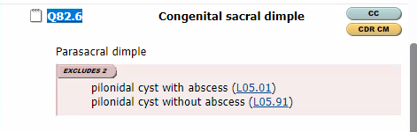
Case example:
Another example is a sacral dimple. Provider will document “shallow sacral dimple, base easily visualized”. No work up is completed, there is no need for future follow up. Should we be coding the sacral dimple base only on the provider stating it is present and it is a Q code? Do we disregard the rest of the provider assessment that the condition does not warrant further eval?
3M integrated Codebook: Q82.6. Does not affect the DRG.

Slide 25
AHA Coding Clinics:
Sacral dimple
ICD-10-CM/PCS Coding Clinic, First Quarter ICD-10 2016 Page: 17 Effective with discharges: March 18, 2016
Question: What is the appropriate code assignment for a newborn diagnosed with a sacral dimple?
Answer: Assign code Q82.8, Other specified congenital malformations of skin, for sacral dimple. A sacral dimple is a congenital condition. Sacral dimples may be associated with a serious underlying abnormality of the spine or spinal cord. It is appropriate to code congenital anomalies when identified by the provider, since they can have implications for further evaluation.
© Copyright 1984-2024, American Hospital Association ("AHA"), Chicago, Illinois. Reproduced with permission. No portion of this publication may be copied without the express, written consent of AHA.
Congenital sacral dimple
ICD-10-CM/PCS Coding Clinic, Fourth Quarter ICD-10 2016 Page: 60 Effective with discharges: October 1, 2016
A new code that describes a congenital sacral dimple (Q82.6) has been created at the request of the American Academy of Pediatrics to uniquely identify this condition. Congenital sacral dimples are indentations in the skin of the lower back. They are a relatively common condition in neonates which may be benign in nature. However, sacral dimples with accompanying nearby tuft of hair or certain types of skin discoloration may indicate a serious underlying abnormality of the spine or spinal cord such as spina bifida or tethered cord syndrome. It is appropriate to code congenital anomalies when identified by the provider, since they can have implications for further evaluation.
© Copyright 1984-2024, American Hospital Association ("AHA"), Chicago, Illinois. Reproduced with permission. No portion of this publication may be copied without the express, written consent of AHA.

Slide 26
What are you doing at your facility?
"curious to know what other facilities are doing. If documented, is any “Q-code” automatically coded? Or are QDS sending queries to validate significance of the congenital condition?"

Slide 28


  OUR NEXT MEETINGS
  June 1st, 2023
  September 7th, 2023
  December 7th, 2023
Sharing Knowledge is ESSENTIAL! Let Us Know If You Or Someone You Know Can Present!

