Slide 1
Coding Clinic Update
Kyra Brown, RHIA, CCDS
CDI Manager Educator
Erlanger
July 15, 2016

Slide 2
Learning Objectives
At the completion of this educational activity, the learner will be able to:
  Provide an overview on structure of ICD-10-CM/PCS coding conventions, guidelines, and official advice essential to understanding Coding Clinic advice
  Outline the history, authority, and utility of the Coding Clinic for ICD-10-CM/PCS in promoting documentation and coding compliance
  Explore recent Coding Clinic advice and concepts affecting CDI practice
  Develop strategies that engages Coding Clinic to help us solve challenges with ICD-10

Slide 3
Foundations
Coding Clinic for ICD-10-CM/PCS

Slide 4
The AHA Central Office
Origins and Goals
Created through a written Memorandum of Understanding between the American Hospital Association (AHA) and the National Center for Health Statistics (NCHS) in 1963 to:
  Serve as the U.S. clearinghouse for issues related to the use of ICD-9-CM and ICD-10
  Work with NCHS, the Centers for Medicare & Medicaid Services (CMS), and AHIMA (American Health Information Management Association)—known as the Cooperating Parties—to maintain the integrity of the classification system
  Recommend revisions and modifications to the current and future revisions of the International Classification of Disease
  Develop educational material and programs on ICD-10-CM/PCS
Whereas the ICD-10-CM/PCS transaction sets (supplemented by the Guidelines) are the Constitution, Coding Clinic serves as the Supreme Court in interpreting ICD-9-CM or ICD-10-CM/PCS and their guidelines. Its advice is official.

Slide 5

The AHA Central Office
  Nelly Leon-Chisen, RHIA
Director, Coding and Classification & Executive Editor for AHA Coding Clinic for ICD-10-CM/PCS and AHA Coding Clinic for HCPCS
The Editorial Advisory Board (EAB) for Coding Clinic for ICD-10-CM/PCS was developed to ensure that the needs of users of these classification systems are addressed
  Assists hospitals/networks in collecting and reporting standardized quality data by:
    Advocating to ensure data used by integrated information systems and federal programs is based upon clearly defined and uniform standards
    Serving as the authoritative source of coding/classification information
Meets quarterly for 2–3 days (or as needed) to address issues brought to them by Central Office staff
  Reactive to Central Office issues, not proactive
  Meetings are NOT open to the public
  EAB members are sworn to secrecy on their deliberations

Slide 6
The AHA Central Office
Coding Clinic for ICD-10-CM/PCS
Publishes Coding Clinic for ICD-10-CM and ICD-10-PCS
Deemed as official advice by the ICD-10-CM/PCS Cooperating Parties
  Other publications, written by the Central Office or other members of the Cooperating Parties, are not official
Changes in the ICD-9-CM (now ICD-10-CM/PCS) classification supersede previously published Coding Clinic advice
  Coding Clinic (CC), 1st Q, 2011, p. 19

Slide 7
Use of Coding Clinic for ICD-9-CM with ICD-10-CM/PCS
In general, clinical information and information on documentation best practices published in Coding Clinic were not unique to ICD-9-CM, and remain applicable for ICD-10-CM with some caveats.
  For example, Coding Clinic may still be useful to understand clinical clues when applying the guideline regarding not coding separately signs or symptoms that are integral to a condition. Users may continue to use that information, as clues—not clinical criteria.
As far as previously published advice on documentation is concerned, documentation issues would generally not be unique to ICD-9-CM, and so long as there is nothing new published in Coding Clinic for ICD-10-CM and ICD-10-PCS to replace it, the advice would stand.
Coding Clinic, Fourth Quarter ICD-10 2015 Pages: 20-21

Slide 8
Use of Coding Clinic for ICD-9-CM with ICD-10-CM/PCS
Previously published ICD-9-CM advice that is still relevant and applicable to ICD-10 will continue to be re-published in Coding Clinic for ICD-10- CM/PCS.
  As with the application of any of the coding advice published in Coding Clinic, the information needs to be reviewed carefully for similarities and differences on a case by case basis.
In order to simplify the learning process, when the Cooperating Parties developed the ICD-10-CM guidelines, every attempt was made to remain as consistent with the ICD-9-CM guidelines as possible, unless there was a change inherent to the ICD-10-CM classification.
  If a particular guideline has remained exactly the same in both coding systems, and Coding Clinic for ICD-9-CM has published an example of the application of that guideline, it’s more than likely that the interpretation would be similar.

Slide 9
Use of Coding Clinic for ICD-9-CM with ICD-10-CM/PCS
Care must be exercised as the codes may have changed. Such change could be related to new codes, new combination codes, code revisions, a change in nonessential modifiers, or any other instructional note. This is particularly true as ICD-10-CM has many new combination codes that were not available in ICD-9-CM.
  For example, previous Coding Clinic for ICD-9-CM advice has indicated that hypoxia is not inherent in chronic obstructive pulmonary disease (COPD) and it could be separately coded. Coders should not assume this advice inevitably applies to ICD-10-CM. (????)
  The correct approach when coding with ICD-10-CM is to review the Index entries for COPD, and determine whether or not there is a combination code for COPD with hypoxia, verify the code in the Tabular List, and review any instructional notes. The coder should then determine whether to code the hypoxia separately—and not automatically assume that a separate code should be assigned.
Notes:
Use with caution,

Slide 10
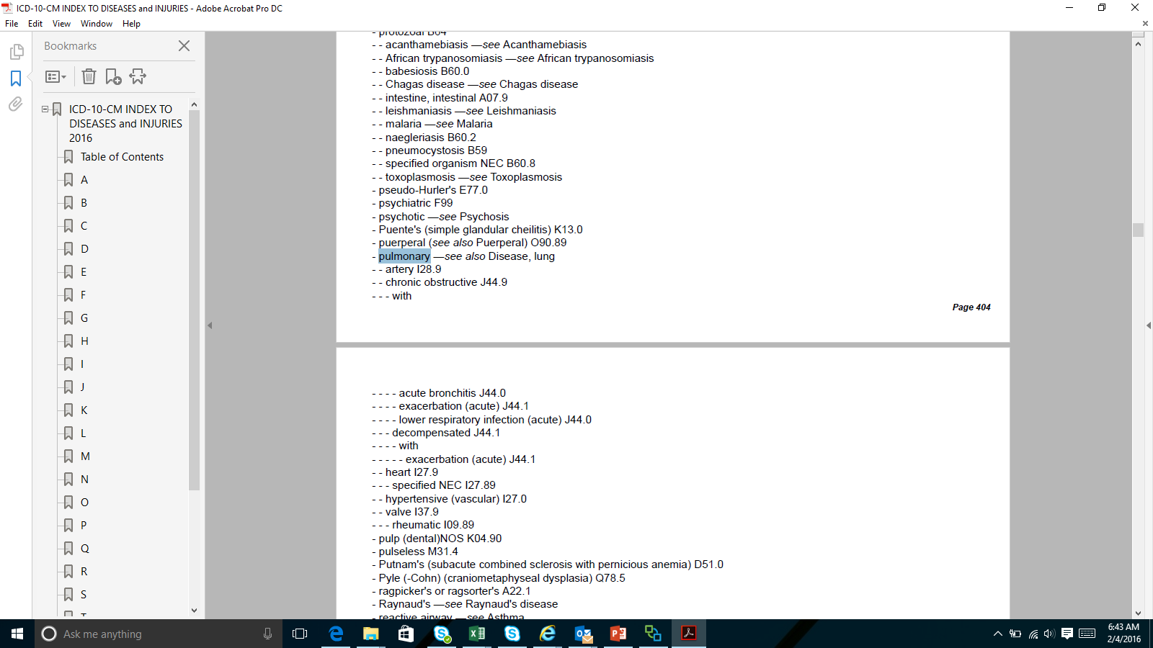
Hypoxia with COPD
Disease
It appears OK to add hypoxemia if documented

Slide 11
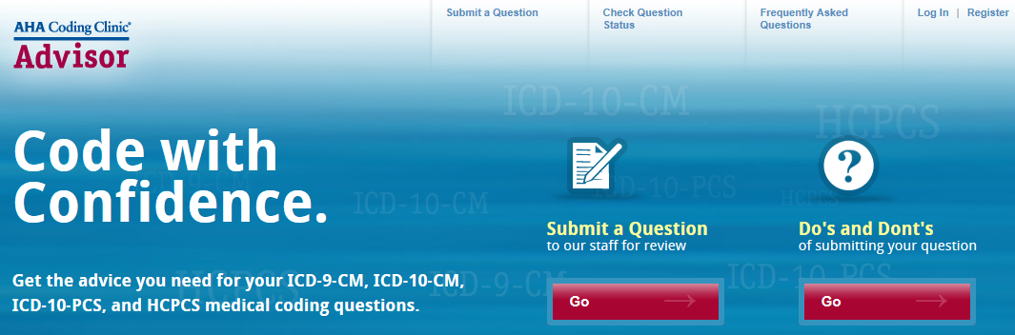
Send Your Own Questions to
Coding Clinic Advisor
Anyone can send in questions and do it online
http://www.codingclinicadvisor.com
Always best to submit a de-identified medical record
Responses sent by US Mail (may take a while)
It’s FREE!

Slide 12
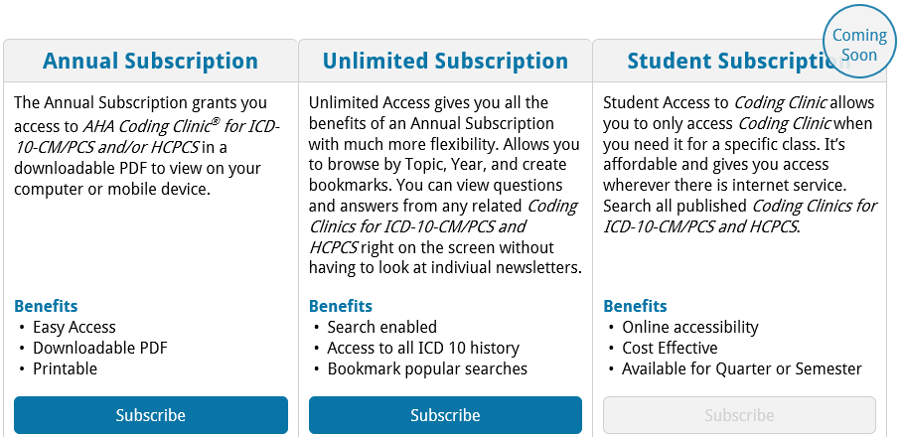
Obtaining Coding Clinic Advice
Subscribing
$375 – General public $1,300 – initial year No pricing yet
$294 – AHIMA member
$245 – AHA member
Note: AHIMA and AHA rates not available on website
Call them to get discounts – 800-621-6902

Slide 13
Foundations
Coding 101

Slide 14
Diagnoses
ICD-10-CM Hierarchy
ICD-10-CM Index to Diseases
  The term must be looked up here first
ICD-10-CM Table of Diseases
  Offers additional instructions, such as “code first”, “code in addition”, “in diseases classified elsewhere”, “Excludes1”, “Excludes2”, and others
ICD-10-CM Official Guidelines for Coding and Reporting
  May add or subtract codes or influence sequencing
Advice from the Coding Clinic for ICD-10-CM/PCS
Notes:
What is the pecking order? Or authority

Slide 15
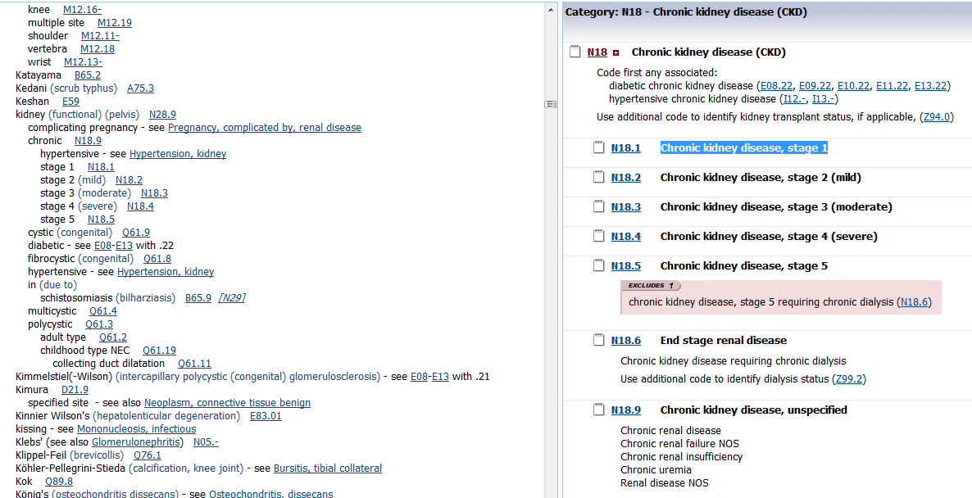
How to Look Up a Diagnosis Code
Chronic Kidney Disease
Disease
Index
Table
Essential to use both the Index (first) and then the Table when looking up a code!
Notes:
Use of codebook only.

Slide 16
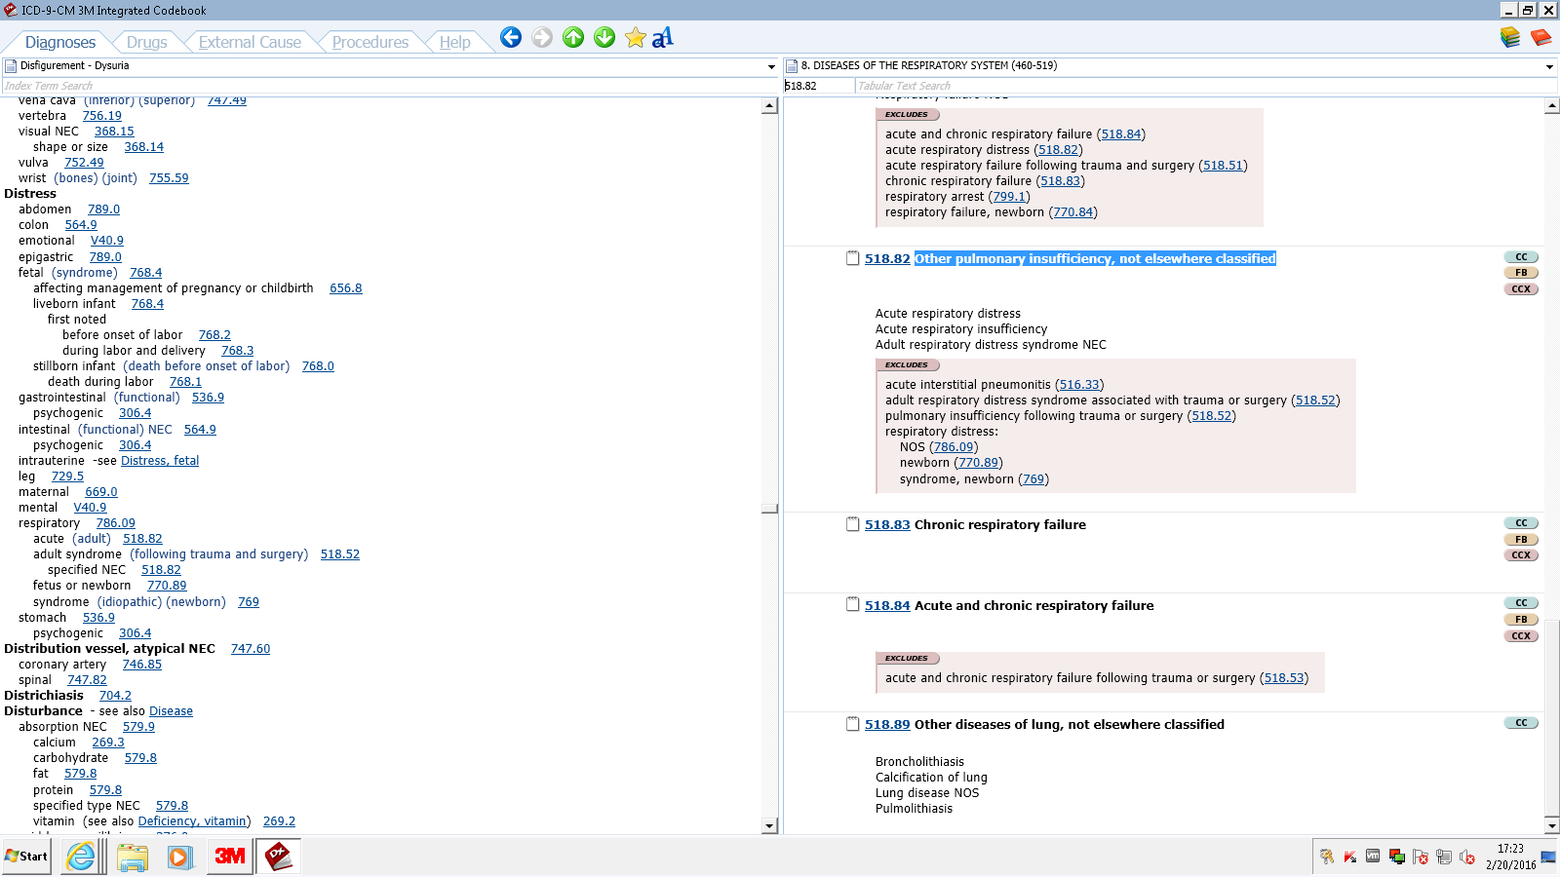
Acute Respiratory Distress
ICD-9-CM
Acute respiratory distress or insufficiency and “adult” respiratory distress syndrome shared the same code in ICD-9-CM
A MS-DRG “CC” for patients admitted with asthma or decompensated heart failure without acute respiratory failure
Notes:
786.09 Other Respiratory Symptom

Slide 17
Hypoxemia & Hypercapnia
Respiratory Insufficiency/Failure in ICD-9-CM
Entity | MS-DRG | APR – SOI | APR-ROM
Hypoxemia | No CC | 1 | 1
Hypercapnia | No CC | 1 | 1
Respiratory insufficiency or distress | No CC | 1 | 1
Acute respiratory insufficiency | A CC | 2 | 3
Acute respiratory distress | A CC | 2 | 3
Acute resp. failure | MCC | 4 | 4
Chronic resp. failure | CC | 3 | 2
Acute respiratory insufficiency and distress
were CCs in ICD-9-CM

Slide 18
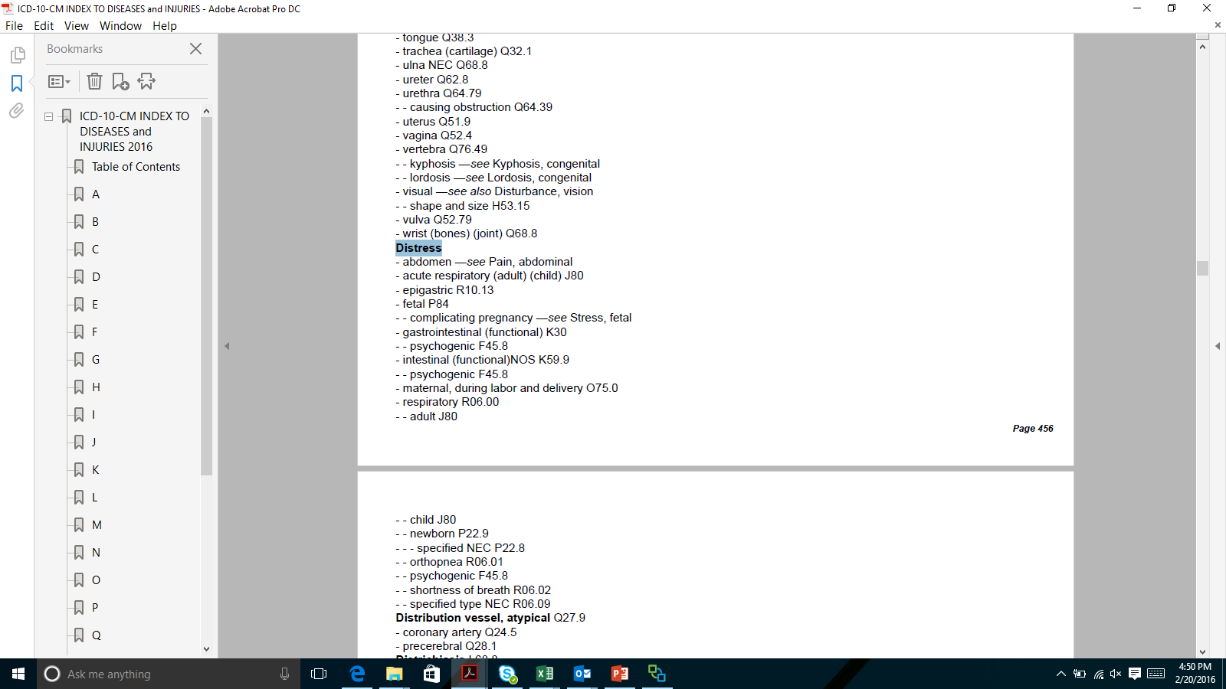
Acute Respiratory Distress in ICD-10
Classified as ARDS
Acute respiratory insufficiency codes to dyspnea
Acute respiratory distress syndrome (ARDS), previously known as respiratory distress syndrome (RDS), acute lung injury, adult respiratory distress syndrome, or shock lung
is a severe, life-threatening medical condition characterized by widespread inflammation in the lungs.
is a disease of the microscopic air sacs of the lungs (alveoli) that leads to decreased exchange of oxygen and carbon dioxide (gas exchange).
is associated with several pathologic changes: the release of inflammatory chemicals, breakdown of the cells lining the lung's blood vessels, surfactant loss leading to increased surface tension in the lung, fluid accumulation in the lung, and excessive scarring.

Slide 19
Title of Code Suggested by Index
Does Not Clearly Identify the Condition Correctly
(If the index is confusing), “A basic rule of coding is that further research is done if the title of the code suggested by the index clearly does not identify the condition correctly.”
  Coding Clinic, Second Quarter 1991 Page: 20
  Coding Clinic, Third Quarter 2004 Page: 5 to 6
  Coding Clinic, First Quarter 2013 Pages: 13-14
If the patient has acute respiratory distress but does not have ARDS, should J80, Acute Respiratory Distress Syndrome be assigned?

Slide 20
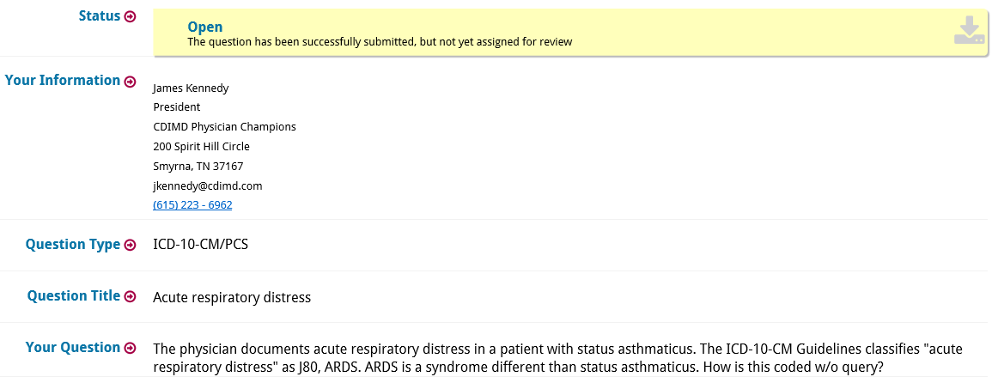
Answer Pending From
Coding Clinic Advisor

Slide 21
Hypoxemia & Hypercapnia
Respiratory Insufficiency/Failure in ICD-10-CM
Entity | MS-DRG | APR – SOI | APR-ROM
Hypoxemia | No CC | 1 | 1
Hypercapnia | No CC | 1 | 1
Respiratory insufficiency or distress | No CC | 1 | 1
Acute respiratory insufficiency | No longer a CC in MS-DRGs | 1 | 1
Acute respiratory distress syndrome | A CC only if considered to be ARDS | SOI 2 only if considered to be ARDS | ROM 3 only if considered to be ARDS
Acute resp. failure | MCC | 4 | 4
Chronic resp. failure | CC | 3 | 2
Acute respiratory insufficiency and distress
were CCs in ICD-9-CM

Slide 22
Diabetes “with” and “due to”

Slide 23
ICD-10-CM Index
With vs. “Due To” vs. “In”
ICD-10-CM Guidelines
  The word “with” should be interpreted to mean “associated with” or “due to” when it appears in a code title, the Alphabetic Index, or an instructional note in the Tabular List.
  “Due to” means “due to” – must be explicitly linked as a cause and effect
  “In” also means “Due to”

Slide 24
ICD-10-CM Index
With vs. “Due To” vs. “In”
ICD-10-CM Guidelines
  The word “with” should be interpreted to mean “associated with” or “due to” when it appears in a code title, the Alphabetic Index, or an instructional note in the Tabular List.
  “Due to” means “due to” – must be explicitly linked as a cause and effect
  “In” also means “Due to”
Notes:
SKIP

Slide 25
Diabetes and Associated Conditions
Coding Clinic 2nd Quarter, 2016 page 36
Published advice is based on Guideline Section I.A which says: The word “with” should be interpreted to mean “associated with” or “due to” when it appears in a code title, the Alphabetic index, or an instructional in the Tabular List.
The classification presumes a causal relationship between the two conditions linked by these terms in the Alphabetic Index or Tabular.
The subterm “with” in the Index should be interpreted as a link between diabetes and any of those conditions indented under the word “with”.

Slide 26
Diabetes “With” Conditions
According to the ICD-10-CM Official Guidelines for Coding and Reporting, the term “with” means “associated with” or “due to,” when it appears in a code title, the Alphabetic Index, or an instructional note in the Tabular List, and this is how it’s meant to be interpreted when assigning codes for diabetes with associated manifestations and/or conditions.
  The classification assumes a cause-and-effect relationship between diabetes and certain diseases of the kidneys, nerves, and circulatory system.
  Assumed cause-and-effect relationships in the classification are not necessarily the same in ICD-9- CM and ICD-10-CM.
Coding Clinic, ICD-10, 1st Q, 2016, page 11
Notes:
Skip

Slide 27
Diabetes and Associated Conditions
Coding Clinic 2nd Quarter, 2016 page 36
The physician documentation does not need to provide a link between the diagnoses of diabetes and chronic kidney disease to accurately assign code E11.22, Type 2 diabetes mellitus with diabetic chronic kidney disease,
The link can be assumed since the CKD is listed under the subterm “with”.
Notes:
Punchline

Slide 28
Diabetes and Associated Conditions
Coding Clinic 2nd Quarter, 2016 page 36
These conditions should be coded as related even in the absence of provider documentation explicitly linking them, unless the documentation clearly states the conditions are unrelated and due to some other underlying cause besides diabetes.
For conditions not specifically linked by these relational terms in the classification, provider documentation must link the conditions in order to code them as related.
Notes:
Punch line continued

Slide 29
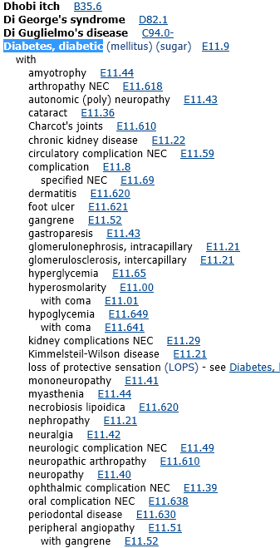
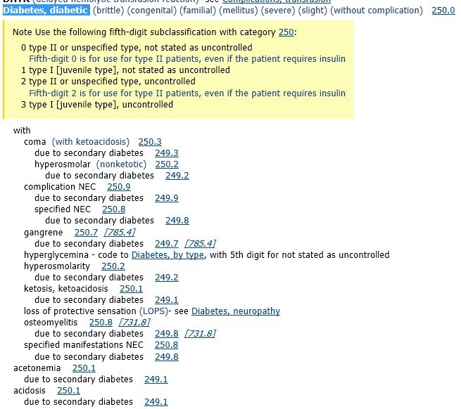

ICD-9-CM vs. ICD-10-CM
Diabetes
Note that the list of conditions “with” diabetes in ICD-9-CM is longer than in ICD-10-CM
Note osteomyelitis is not on the list in ICD-10-CM
Note foot ulcer, nephropathy, CKD, and neuropathy is on the list in ICD-10-CM

Slide 30
Diabetes “with” Osteomyelitis
Coding Clinic, 1st Quarter, 2016, p. 13
Question: A woman, who has had type 1 diabetes for over 40 years, developed chronic osteomyelitis of the right heel and presents to the infectious disease clinic for follow-up.
  The provider also noted, “Chronic renal impairment (creatinine 2.9) due to diabetes.”
  Does ICD-10-CM assume a relationship between diabetes and osteomyelitis when both conditions are present?
Answer: No, ICD-10-CM does not presume a linkage between diabetes and osteomyelitis.
  The provider will need to document a linkage or relationship between the two conditions before it can be coded as such.
  This information is consistent with that previously published in Coding Clinic, Fourth Quarter 2013, page 114.
Notes:
What about cellulitis?

Slide 31
Diabetes “with” ESRD, Neuropathy, Foot Ulcer
Coding Clinic, 1st Quarter, 2016, p. 12-13
Question: The provider documented, “Diabetic foot ulcer with skin breakdown, positive for Methicillin resistant Staphylococcus aureus (MRSA) infection.”
  She also had been diagnosed with polyneuropathy, end-stage renal disease (ESRD), on hemodialysis maintenance.
  Does the ICD-10-CM assume a cause-and-effect relationship between the diabetes mellitus, the foot ulcer, polyneuropathy and ESRD? How should this case be coded?
Answer: ICD-10-CM assumes a causal relationship between the diabetes mellitus and the foot ulcer, the polyneuropathy, as well as the chronic kidney disease.
  Note: Though ESRD is documented, it falls under the category of chronic kidney disease in the ICD-10-CM Table

Slide 32
Diabetes “With” Conditions
However, if the physician documentation specifies diabetes mellitus is not the underlying cause of the other condition, the condition should not be coded as a diabetic complication.
  When the coder is unable to determine whether a condition is related to diabetes mellitus, or the ICD-10-CM classification does not provide coding instruction, it is appropriate to query the physician for clarification so that the appropriate codes may be reported.
Coding Clinic, ICD-10, 1st Q, 2016, page 11-12

Slide 33
Diabetes “With” Conditions
"It is not required that two conditions be listed together in the health record.
  However, the provider needs to document the linkage, except for situations where the classification assumes an association (e.g., hypertension with chronic kidney involvement).
When the provider establishes a linkage or relationship between the two conditions, they should be coded as such.
  However, the entire record should be reviewed to determine whether a relationship between the two conditions exists.
    The fact that a patient has two conditions that commonly occur together does not necessarily mean they are related.
    A different cause may be documented by the provider.
If it is not clear whether or not two conditions are related, query the provider."
Coding Clinic, Third Quarter 2012, page 3
Notes:
DELINKING CONCEPT: Could the ulcer be a pressure ulcer? Look up cataract

Slide 34
Ulcers “with” Diabetes
“Clinical Clue”
It is important to recognize that not all ulcers in diabetic patients are diabetic ulcers
Diabetic ulcers of the foot generally start on the toes and move upward
Diabetic ulcers do not usually start on the heel. Ulcers of the heel are almost always decubiti
Coding Clinic, 1st Q, 2004, pp. 14-15
Note that in ICD-10-CM, any skin ulcer occurring in diabetes is linked to diabetes unless the physician explicitly states that the ulcer is due to another cause (e.g. pressure ulcer, venous insufficiency)
Notes:
Delinking Concept

Slide 35
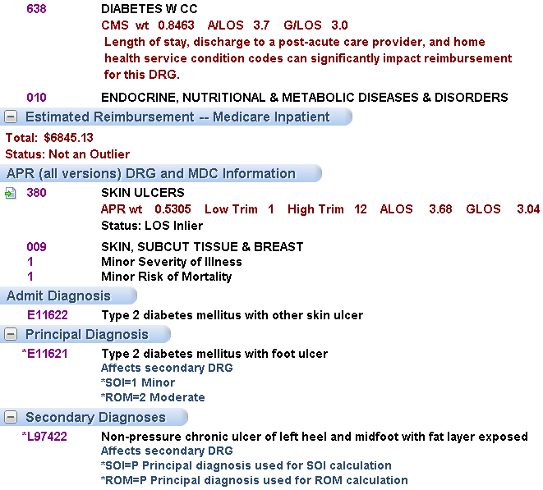
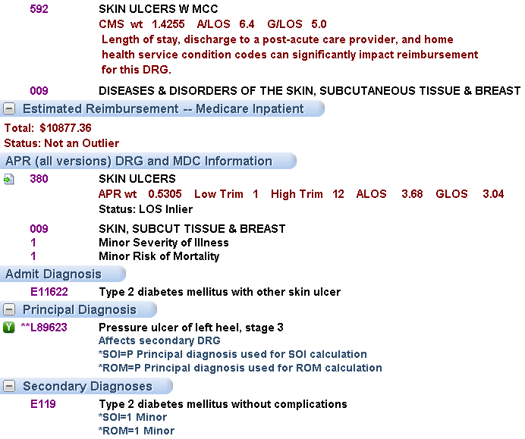
Ulcers “with” Diabetes
Non-pressure vs. Pressure DRGs
PDx – Heel ulcer with exposed fat in a diabetic
PDx - Pressure ulcer with necrosis of subQ tissue
MS-DRG affected
APR-DRG
not affected
Note: Stage 3 pressure ulcers defined by ICD-10-CM table as “full thickness skin loss involving damage or necrosis of subcutaneous tissue”

Slide 36
Is it Linked to Diabetes or Not?
3rd Quarter, 1991 page: 9
Mononeuropathy
Cataracts
  True Diabetic cataract or Snowflake cataract
    Is Rare
    Occurs in Type 1
Senile Cataracts in persons with Diabetes are not coded as Diabetic
Can Be Due to Entrapment, Injury
Diabetes

Slide 37
Excludes1 and Excludes2 Notes
ICD-10-CM Official Guidelines
Excludes1
  A type 1 Excludes note is a pure excludes note. It means “NOT CODED HERE!”
    An Excludes1 note indicates that the code excluded should never be used at the same time as the code above the Excludes1 note.
  An Excludes1 is used when two conditions cannot occur together, such as a congenital form versus an acquired form of the same condition.
Excludes2
  A type 2 Excludes note represents “Not included here”.
  An excludes2 note indicates that the condition excluded is not part of the condition represented by the code, but a patient may have both conditions at the same time.
  When an Excludes2 note appears under a code, it is acceptable to use both the code and the excluded code together, when appropriate.

Slide 38
Respiratory Distress Syndrome and
Respiratory Failure of Newborn

Slide 39
Excludes1 Note Caveat
Coding Clinic, 4th Quarter, 2015
There are circumstances that have been identified where some conditions included in Excludes1 notes should be allowed to both be coded, and thus might be more appropriate for an Excludes2 note
  However, due to the partial code freeze, no changes to Excludes notes or revisions to the official coding guidelines can be made until October 1, 2016
  This new guidance concerning Excludes1 notes is intended to allow conditions to be reported together when appropriate even though they may currently be subject to an Excludes1 note
http://www.cdc.gov/nchs/data/icd/Interim_advice_updated_final.pdf

Slide 40
Excludes1 Note Caveat
Coding Clinic, 4th Quarter, 2015
Question: We have received several questions regarding the interpretation of Excludes1 notes in ICD-10-CM when the conditions are unrelated to one another. How should this be handled?
Answer: If the two conditions are not related to one another, it is permissible to report both codes despite the presence of an Excludes1 note.
  For example, the Excludes1 note at code range R40-R46, states that symptoms and signs constituting part of a pattern of mental disorder (F01-F99) cannot be assigned with the R40-R46 codes.
    However, if dizziness (R42) is not a component of the mental health condition (e.g., dizziness is unrelated to bipolar disorder), then separate codes may be assigned for both dizziness and the mental health condition.
  In another example, code range I60-I69 (Cerebrovascular Diseases) has an Excludes1 note for traumatic intracranial hemorrhage (S06.-). Codes in I60-I69 should not be used for a diagnosis of traumatic intracranial hemorrhage.
    However, if the patient has both a current traumatic intracranial hemorrhage and sequela from a previous stroke, then it would be appropriate to assign both a code from S06- and I69-.
http://www.cdc.gov/nchs/data/icd/Interim_advice_updated_final.pdf

Slide 41
Neutropenia with Pancytopenia
Coding Clinic, 4th Quarter, 2014, pp 22-23
Question: A patient with anemia and thrombocytopenia is admitted with fever and neutropenia. The provider documented that the neutropenia and anemia are secondary to chemotherapy for medulloblastoma with spinal metastasis. Since pancytopenia includes anemia, neutropenia and thrombocytopenia, is it appropriate to assign a code for pancytopenia when the neutropenia is secondary to chemotherapy?
Answer: Assign code D70.1, Agranulocytosis secondary to cancer chemotherapy, as the principal diagnosis. Codes R50.81, Fever with conditions classified elsewhere, T45.1X5A, Adverse effect of antineoplastic and immunosuppressive drug, Initial encounter, D64.81, Anemia due to antineoplastic chemotherapy, D69.59, Other secondary thrombocytopenia, should be assigned as additional diagnoses.
Patients may present with both pancytopenia and neutropenia with fever. They are clinically different processes. The pancytopenia code alone does not convey the complete clinical picture. However, the excludes1 note at category D61, Other aplastic anemias and other bone marrow failure syndromes, prohibits assigning code D70.1 along with a pancytopenia code in this category. The National Center for Health Statistics (NCHS) has agreed to address the issue of the excludes1 at category D61 at a future ICD-10-CM Coordination and Maintenance Committee (C&M) meeting.
Note: DRG impact of changing to an Excludes2 note minimal

Slide 42
Excludes1 Note
Neutropenia and Pancytopenia

Slide 43
Take Home Lesson
Excludes1 Waiver (Not expected to be resolved 10/1/2016)
Consider developing written policies of what common “Excludes1 conditions” are not “related to each other”
  Clear cut examples are those published by the Coding Clinic and the CDC (e.g. neutropenia and pancytopenia; mental disorders with R40-R46 codes)
  A controversial example may be acute respiratory failure with respiratory distress syndrome
    Many maintain respiratory failure is related; some do not
      Worth getting an opinion from your neonatologists
      Perhaps the Coding Clinic Advisor would be of help
Essential to have in place for audit defense

Slide 44
Sepsis 2 vs Sepsis-3
Coding Clinic’s Advice
How will Auditors React to Sepsis?

Slide 45
Sepsis-2 (2001 to February 22, 2016)
Infection, Documented or Suspected and “Some” of the Following:
General variables
  Fever (> 38.3°C or 101.0°F)
  Hypothermia (core temperature < 36°C)
  Heart rate > 90/min or more than two SD above the normal value for age
  Tachypnea
  Altered mental status
  Significant edema or positive fluid balance (> 20 mL/kg over 24 hr)
  Hyperglycemia (plasma glucose > 140 mg/dL or 7.7 mmol/L) in the absence of diabetes
Inflammatory variables
  Leukocytosis (WBC count > 12,000/μL)
  Leukopenia (WBC count < 4000/μL)
  Normal WBC count with greater than 10% immature forms
  Plasma C-reactive protein more than two SD above the normal value
  Plasma procalcitonin more than two SD above the normal value
Hemodynamic variables
  Arterial hypotension (SBP <90 mm Hg, MAP <70 mm Hg or an SBP decrease >40 mm Hg in adults or less than two SD below normal for age)
Organ dysfunction variables
  Arterial hypoxemia (Pao2/Fio2 <300)
  Acute oliguria (urine output < 0.5 mL/kg/hr for at least 2 hrs despite adequate fluid resuscitation)
  Creatinine increase > 0.5 mg/dL or 44.2 μmol/L
  Coagulation abnormalities (INR>1.5 or aPTT> 60 s)
  Ileus (absent bowel sounds)
  Thrombocytopenia (platelet ct < 100,000/μL)
  Hyperbilirubinemia (plasma total bilirubin > 2 mg/dL or 70 μmol/L)
Tissue perfusion variables
  Hyperlactatemia (> 2 mmol/L)
  Decreased capillary refill or mottling
Source: http://www.sccm.org/Documents/SSC-Guidelines.pdf
Notes:
CDIMD
45

Slide 46
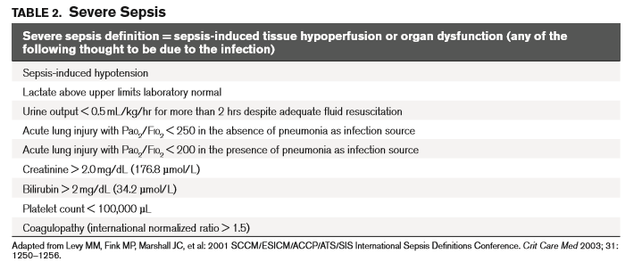
Sepsis-2 - Severe Sepsis
Induced Organ Dysfunction/Hypoperfusion
The physician must state that the organ dysfunction is due to sepsis to qualify as severe sepsis in ICD-10-CM
Source: http://www.sccm.org/Documents/SSC-Guidelines.pdf

Slide 47
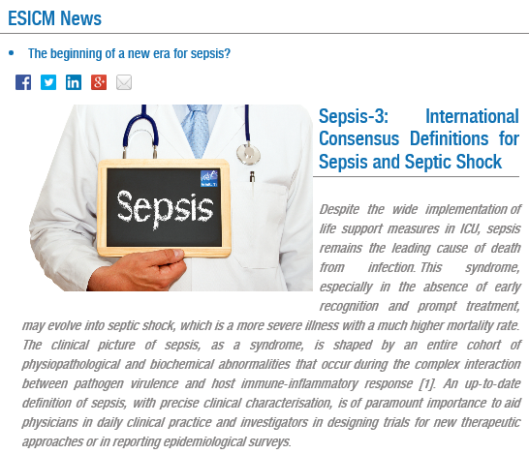
Sepsis Adult Redefinition (Sepsis-3)
February 22, 2016
Announced at the SCCM meeting in Orlando on February 22, 2016
Published in JAMA on February 23, 2016
http://www.tinyurl.com/2016sepsis
http://www.esicm.org/news-article/Sepsis-3-International-Consensus-definitions-Sepsis-Septic-Shock-Feb-2016

Slide 48
Sepsis-3 Adult Redefinition
Requirement for Organ Dysfunction
Sepsis is now defined as a ‘life-threatening organ dysfunction due to a dysregulated host response to infection’ (Formerly called Severe Sepsis)
  In this new definition the concept of the non-homeostatic host response to infection is strongly stressed while the SIRS criteria have been removed
  The inflammatory response accompanying infection (pyrexia, neutrophilia, etc) often represent an appropriate host response to any infection, and this may not necessarily be life-threatening.

Slide 49
Sepsis-3 Adult Redefinition
Organ Dysfunction – SOFA Scores
The key element of sepsis-induced organ dysfunction is defined by ‘an acute change in total SOFA score ≥ 2 points consequent to infection, reflecting an overall mortality rate of approximately 10%
  The baseline Sepsis-related Organ Failure Assessment (SOFA) score may be taken as zero unless the patient is known to have previous comorbidity (e.g. head injury, chronic kidney disease, etc).
  In light of this, the current definition of 'severe sepsis' becomes obsolete, as does the term.

Slide 50
Sepsis-3 Adult Redefinition
SOFA Scores
Still need diagnoses to support these clinical indicators

Slide 51
Surviving Sepsis Response to Sepsis-3
Screening for Organ Dysfunction and Management of Sepsis (formerly called Severe Sepsis)
  Patients with sepsis (formerly called severe sepsis) should still be identified by the same organ dysfunction criteria (including lactate level greater than 2 mmol/L) “as has been previously recommended by SSC”.
  Organ dysfunction may also be identified in the future using the quick Sepsis-Related Organ Failure Assessment (qSOFA)
    Evidence of 2 out of 3 qSOFA elements (altered mental status, respiratory rate greater than or equal to 22 breaths/min and systolic blood pressure less than or equal to 100 mm Hg) in patients who have screened positive for infection may be used as a secondary screen to identify patients at risk for clinical deterioration.
http://www.survivingsepsis.org/SiteCollectionDocuments/SSC-Statements-Sepsis-Definitions-3-2016.pdf

Slide 52
Sepsis-2 versus Sepsis-3
Sepsis Validity
While Sepsis-3 requires acute organ dysfunction to define sepsis, a provider must document “severe sepsis” or link the organ dysfunction to sepsis to obtain a code for severe sepsis

Slide 53
Official Coding Clinic Response
June 23, 2016
Dear Dr. Kennedy,
This message is in reference to your recommendations for the coding of sepsis as defined by the new sepsis clinical definitions. The issue has been referred to the Editorial Advisory Board (EAB) of Coding Clinic.
In the interim, continue to code sepsis, severe sepsis and septic shock using the most current version of the ICD-10-CM classification and the ICD-10-CM Official Guidelines for Coding and Reporting.
Until coding modifications are made, code assignment is based on physician documentation (regardless of the clinical criteria the physician used to arrive at that diagnosis).
I trust this information will be of assistance to you.
Nelly Leon-Chisen, RHIA
AHIMA Approved ICD-10-CM/PCS Trainer
Director, Coding and Classification
Executive Editor AHA Coding Clinic publications
American Hospital Association

Slide 54
Payer Preference
Coding Clinic, First Quarter ICD-10 2014 Pages: 16-17
Question: Can you help with coding disputes with payers when they don’t follow Coding Clinic (CC) advice or the Official Guidelines for Coding and Reporting?
Answer: Traditionally CC does not address coding for reimbursement. CC’s goal is to provide advice according to the most accurate and correct coding consistent with ICD-10-CM and ICD-10-PCS principles. The official guidelines are part of the HIPAA code set standards. There are a variety of payment policies that may impact coding. Some payment policies may contradict each other or may be inconsistent with coding rules/conventions. Therefore, it is not possible to write coding guidelines that are consistent with all existing payer guidelines.

Slide 55
Payer Preference
Coding Clinic, First Quarter ICD-10 2014 Pages: 16-17
The following advice is provided to help providers resolve coding disputes with payers:
  First, determine whether it is really a coding dispute and not a coverage or payment issue. Therefore, always contact the payer for clarification if the reason for the denial is unclear.
  If a payer really does have a policy that clearly conflicts with official coding rules or guidelines, every effort should be made to resolve the issue with the payer. Provide applicable coding rule/guideline to payer.
  If the payer refuses to change its policy, obtain the payer requirements in writing. If the payer refuses to provide their policy in writing, document all discussions with the payer, including dates and the names of individuals involved in the discussion. Confirm the existence of the policy with the payer’s supervisory personnel.
  Keep a permanent file of the documentation obtained regarding payer coding policies. It may be come in handy in the event of an audit.

Slide 56
Heart Failure

Slide 57
Heart Failure w/Preserved EF (HFpEF)
Heart Failure w/Reduced EF (HFrEF)
Question: If a physician documents heart failure with preserved ejection fraction (HFpEF), or heart failure with preserved systolic function, or alternatively heart failure with reduced ejection fraction (HFrEF), heart failure with low ejection fraction, heart failure with reduced systolic function, or other similar terms, can the coder assume the physician means “diastolic heart failure” or “systolic heart failure,” respectively, and apply the proper ICD-9-CM code based on the documented clinical circumstances?
Answer: No, the coder cannot assume either diastolic or systolic failure or a combination of both, based on these newer terms. Therefore, query the provider to clarify whether the patient has diastolic or systolic heart failure
Coding Clinic, ICD-10, 1st Q, 2014, page 25

Slide 58
Heart Failure w/Preserved EF (HFpEF)
Heart Failure w/Reduced EF (HFrEF)
Based on additional information received from the American College of Cardiology (ACC), the Editorial Advisory Board for Coding Clinic for ICD- 10-CM/PCS has reconsidered previously published advice about coding heart failure with preserved ejection fraction (HFpEF), and heart failure with reduced ejection fraction (HFrEF).
  HFpEF may also be referred to as heart failure with preserved systolic function, and this condition may also be referred to as diastolic heart failure.
  HFrEF may also be called heart failure with low ejection fraction, or heart failure with reduced systolic function, or other similar terms meaning systolic heart failure.
Coding Clinic, ICD-10, 1st Q, 2016, page 25

Slide 59
Heart Failure w/Preserved EF (HFpEF)
Heart Failure w/Reduced EF (HFrEF)
These terms HFpEF and HFrEF are more contemporary terms that are being more frequently used, and can be further described as acute or chronic.
Therefore, when the provider has documented HFpEF, HFrEF, or other similar terms noted above, the coder may interpret these as “diastolic heart failure” or “systolic heart failure,” respectively, or a combination of both if indicated, and assign the appropriate ICD-10-CM codes.
Coding Clinic, ICD-10, 1st Q, 2016, page 25
Kennedy note: The provider must still state “acute”, “decompensated”, or “acute on chronic” for a coder to use the higher weighted codes

Slide 60
Adverse Effects of Coumadin

Slide 61
Coumadin Coagulopathy – ICD-9-CM
Not Allowed
Question: A patient is admitted with hemoptysis and blood in stool. The physician states that the hemoptysis and blood in stool were due to coagulopathy related to the patient's recent usage of Coumadin. What is the appropriate diagnosis code assignment(s) for this case?
Answer: Assign code 786.3, Hemoptysis, or code 578.1, Blood in stool, as the principal diagnosis. Assign code E934.2, Drugs, medicinals, and biological substances causing adverse effects in therapeutic use, Anticoagulants, to describe the external cause.
A code from category 286, Coagulation defects, is not appropriate for patients on anticoagulant therapy.
Coding Clinic, Second Quarter 2006 Page: 17

Slide 62
Coumadin Coagulopathy – ICD-9-CM
Not Allowed
Question: An 89 yo male with a history of CHF and atrial fibrillation on Coumadin therapy was admitted for treatment of severe epistaxis. The physician documented, "Epistaxis secondary to Coumadin therapy." Would a code from category 286, Coagulation defects, be appropriate? If not, how should this be coded?
Answer: Assign code 784.7, Epistaxis, as the principal diagnosis with code E934.2, Drugs, medicinal and biological substances causing adverse effects in therapeutic use, Agents primarily affecting blood constituents, Anticoagulants, to identify the external cause of the nasal bleeding. Code V58.61, Long-term (current) use of anticoagulants, should be assigned as additional diagnoses.
An increased risk for bleeding is a side effect associated with anticoagulant therapy. Coagulation deficiency (prolonged prothrombin time) is also an expected outcome of anticoagulant therapy.
  It should be noted that a code from the 286 series would not be used to identify patients on anticoagulant therapy.
  Therefore, code 286.5, Hemorrhagic disorder due to circulating anticoagulants, is an inappropriate code assignment for patients on Coumadin therapy.
Coding Clinic, Third Quarter 2004 Page: 7

Slide 63
Bleeding due to Coumadin Therapy
“Drug-induced Hemorrhage Disorder”
Question: What is the code assignment for duodenal ulcer with hemorrhage due to Coumadin therapy, initial encounter?
  Is D68.32, Hemorrhagic disorder due to extrinsic circulating anticoagulant, assigned for bleeding that is due to anticoagulation therapy?
Answer: Assign codes K26.4, Chronic or unspecified duodenal ulcer with hemorrhage, D68.32, Hemorrhagic disorder due to extrinsic circulating anticoagulant, and T45.515-, Adverse effect of anticoagulants.
  Depending on the circumstances of the admission, it may be appropriate to sequence either K26.4 or D68.32 as the principal or first listed diagnosis.
Coding Clinic, First Quarter 2016 Page: 14

Slide 64
Support For This Advice
ICD-10-CM Table of Diseases
Notice that drug-induced hemorrhagic disorder is part of D68.32
As such, warfarin-induced hemorrhagic disorder is part of ICD-10-CM whereas it was not in ICD-9-CM

Slide 65
Bleeding due to Coumadin Therapy
“Drug-induced Hemorrhage Disorder”
Question: Should bleeding due to therapeutic anticoagulant be coded as a hemorrhagic disorder (category D68)?
Answer: For the most part, “hemorrhagic disorder” or “coagulation defects” must be specifically diagnosed and documented by the provider, in order to assign codes at category D68, Other coagulation defects.
  However, for bleeding such as hemoptysis, hematuria, hematemesis, hematochezia, etc., that is associated with a drug, as part of anticoagulation therapy, assign code D68.32, Hemorrhagic disorder due to extrinsic circulating anticoagulants.
Coding Clinic, First Quarter 2016 Page: 14

Slide 66
Bleeding due to a Platelet Inhibitor
“Drug-induced Hemorrhage Disorder”
Question: This patient underwent an emergency ileocecectomy. The patient's stay was complicated by postoperative coagulopathy and intra-abdominal hemorrhage due to Prasugrel and aspirin taken as prescribed prior to admission. What is the appropriate code for the acquired coagulopathy secondary to Prasugrel and aspirin?
Answer:
Assign code D68.32, Hemorrhagic disorder due to extrinsic circulating anticoagulants, along with codes T45.525A, Adverse effect of antithrombotic, Initial encounter, T39.015A, Adverse effect of aspirin, Initial encounter, and K91.840, Postprocedural hemorrhage and hematoma of a digestive system organ or structure following a digestive system procedure.
Prasugrel (Effient®) is a platelet inhibitor and works by keeping the platelets in the blood from coagulating to prevent unwanted blood clots that can occur with certain heart or blood vessel conditions.

Slide 67
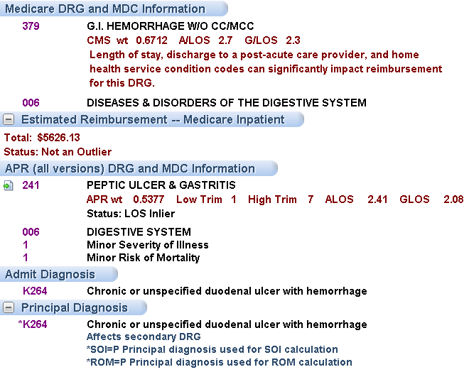
DRGs wo a code for an extrinsic circulating anticoagulant

Slide 68
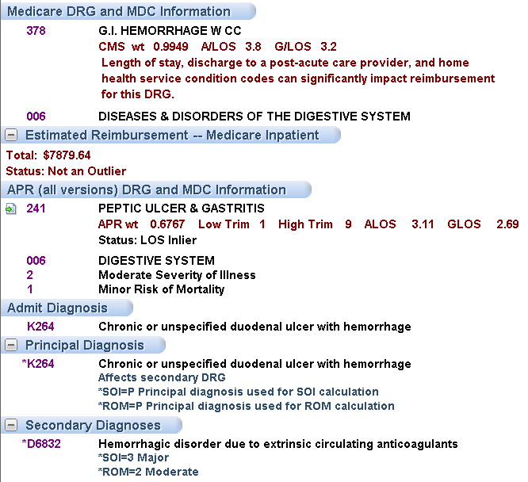

Slide 69
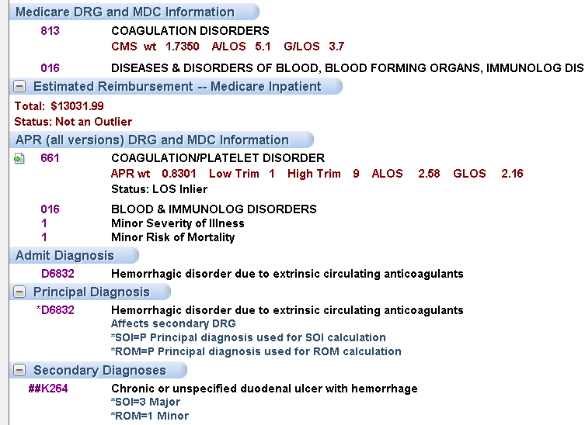
D68.32 as the PDx changes the MS-DRG and APR-DRG
Post-acute transfer policy doesn’t apply to MS-DRG 813

Slide 70
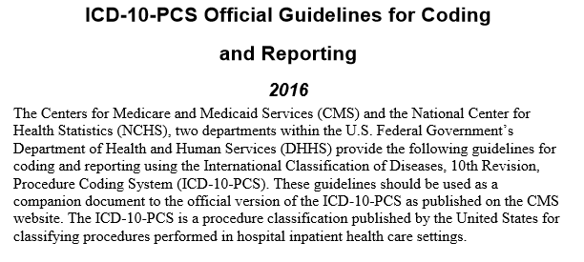
ICD-10-PCS
Official Guidelines
http://www.tinyurl.com/2016ICD10PCSguidelines

Slide 71
Questions?
Thank you!

Slide 72
ICD-10-PCS Official Guidelines
Independence of the Table
A6 The purpose of the alphabetic index is to locate the appropriate table that contains all information necessary to construct a procedure code. The PCS Tables should always be consulted to find the most appropriate valid code.
A7 It is not required to consult the index first before proceeding to the tables to complete the code. A valid code may be chosen directly from the tables.

Slide 73
Obstetrical Lacerations

Slide 74
Obstetrical Lacerations
Definitions
First degree lacerations involve injury to the skin and subcutaneous tissue of the perineum and vaginal epithelium only. The perineal muscles remain intact.
Second degree lacerations extend into the fascia and musculature of the perineal body, which includes the deep and superficial transverse perineal muscles and fibers of the pubococcygeus and bulbocavernosus muscles. The anal sphincter muscles remain intact.
Third degree lacerations extend through the fascia and musculature of the perineal body and involve some or all of the fibers of the EAS and/or the IAS.
Fourth degree lacerations involve the perineal structures, EAS, IAS, and the rectal mucosa.
ICD-10-PCS Guideline B3.5
“If the root operation Excision, Repair or Inspection is performed on overlapping layers of the musculoskeletal system, the body part specifying the deepest layer is coded.”
In the context of a third degree obstetric laceration, the anal sphincter muscle is beneath the perineal muscle and is therefore the deepest layer in this scenario.

Slide 75
Obstetrical Lacerations Approaches
Coding Clinic, 1st Quarter, 2016, pp
First-degree perineal laceration
  Assign code 0HQ9XZZ, Repair perineum skin, external approach, for repair of a first degree perineal laceration
    No mention of repair of the vaginal mucosa
Second-degree perineal laceration
  Assign code 0KQM0ZZ, Repair perineum muscle, open approach, for repair of a second degree perineal laceration
    Doctor doesn’t have to document the repair of the muscle
Third-degree perineal laceration
  Assign code 0DQR0ZZ, Repair anal sphincter, open approach, for repair of a third degree perineal laceration
    Doctor doesn’t have to document the repair of the anal sphincter
Fourth-degree perineal laceration
  Assign code 0DQP0ZZ, Repair rectum, open approach, for the repair of the fourth-degree tear
    Doctor doesn’t have to document the repair of the rectum

Slide 76
Debridement

Slide 77
Debridement Definition
Clinical or CPT
  Merriam-Webster: The usually surgical removal of lacerated, devitalized, or contaminated tissue
  Stedman’s, 23rd Edition: Excision of contused and devitalized tissue from a wound surface
  CPT Assistant, May 2011: Includes removal of foreign material at the site of an open fracture and/or an open dislocation
ICD-10-PCS Root Operations
  Excision - Cutting out or off, without replacement, a portion of a body part
  Extraction - pulling or stripping out or off all or a portion of a body part by the use of force
  Extirpation – Taking or cutting out solid matter from a body part
  Destruction – The physical eradication of all or a portion of a body part by the direct use of energy, force, or a destructive

Slide 78
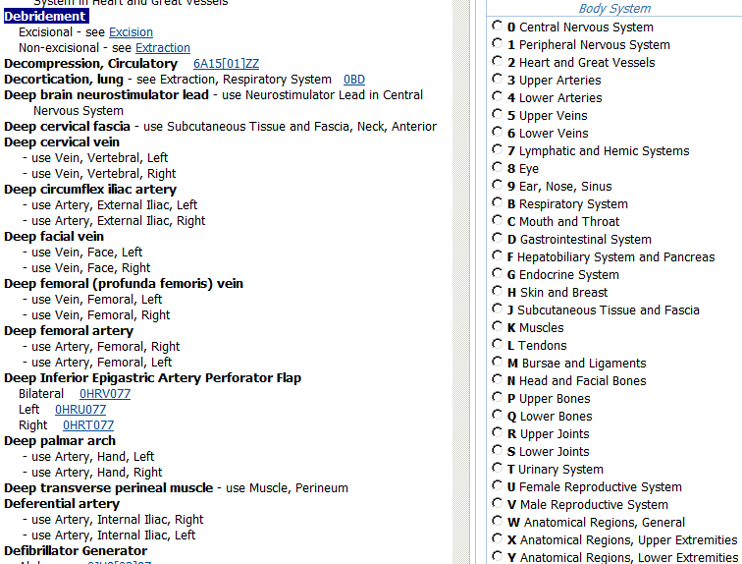
ICD-10-PCS Index To Procedures
Debridement

Slide 79
ICD-10-PCS
Guidelines
B3.5 If the root operations Excision, Repair or Inspection are performed on overlapping layers of the musculoskeletal system, the body part specifying the deepest layer is coded.
  Example: Excisional debridement that includes skin and subcutaneous tissue and muscle is coded to the muscle body part.
A11 Many of the terms used to construct PCS codes are defined within the system. It is the coder’s responsibility to determine what the documentation in the medical record equates to in the PCS definitions. The physician is not expected to use the terms used in PCS code descriptions, nor is the coder required to query the physician when the correlation between the documentation and the defined PCS terms is clear.
  Example: When the physician documents “partial resection” the coder can independently correlate “partial resection” to the root operation Excision without querying the physician for clarification.

Slide 80
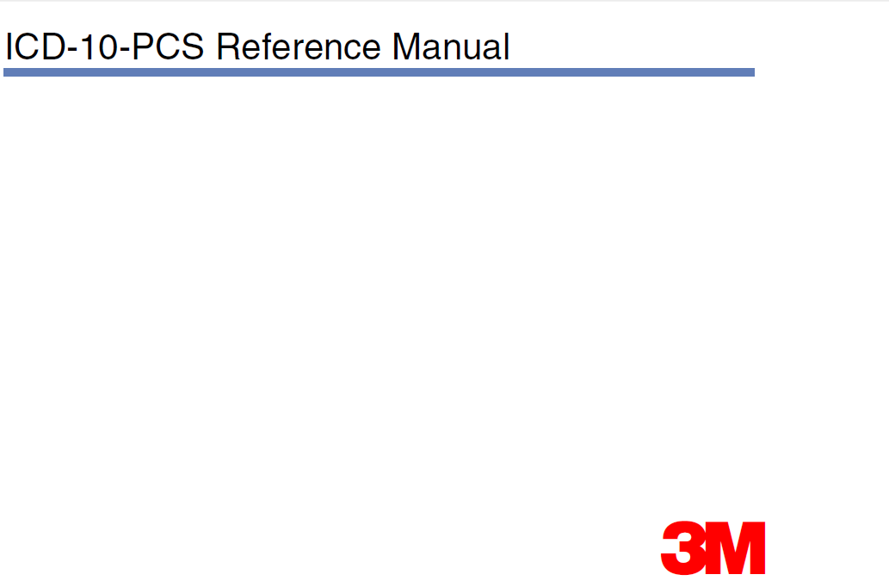
ICD-10-PCS
Reference Manual
http://tinyurl.com/2016ICD10pcsReference

Slide 81
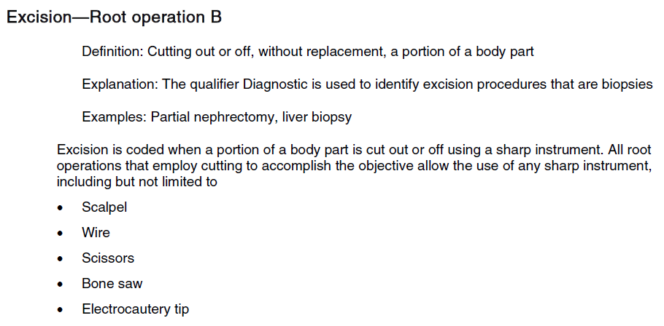
Root Operation – Excision
Definition
While the ICD-10-PCS Reference Manual states that excisions can be done with scissors, does Coding Clinic trump it?

Slide 82
Coding Clinic Advice
3rd Quarter 2015
Excisional debridement of the skin or subcutaneous tissue is the surgical removal or cutting away of such tissue, necrosis, or slough and is classified to the root operation "Excision."
Use of a sharp instrument does not always indicate that an excisional debridement was performed. Minor removal of loose fragments with scissors or using a sharp instrument to scrape away tissue is not an excisional debridement.
Excisional debridement involves the use of a scalpel to remove devitalized tissue.
Documentation of excisional debridement should be specific regarding the type of debridement.
If the documentation is not clear or if there is any question about the procedure, the provider should be queried for clarification.

Slide 83
Coding Clinic Advice
3rd Quarter 2015
Question: In terms of coding excisional debridement, does dissection mean the same as excisional? For example, the provider's documentation states: "The debridement was sharp using knife dissection."
Answer: No, knife dissection is not sufficient language to be able to code the root operation "Excision."
Knife dissection may only be referring to the means used to reach the procedure site, and doesn't necessarily say what was done at the site.
Query the physician for more information when the documentation only states knife dissection.
Use of a sharp instrument does not always indicate that an excisional debridement was performed.
Notes:
PUNCHLINE

Slide 84
Coding Clinic Advice
3rd Quarter 2015
Question: Can you clarify what determines that a debridement in ICD-10-PCS is excisional? The progress note states: "I have debrided the abscess cavity, removing necrotic tissue and bone by sharp debridement."
  Does the word "excision" need to be present as with ICD-9-CM?
Answer: Yes, the documentation standard for coding excisional debridement in ICD-10-PCS is the same as it is for ICD-9-CM.
  As with ICD-9-CM, the words "sharp debridement" are not enough to code the root operation Excision.
  A code is assigned for excisional debridement when the provider documents "excisional debridement," and/or the documentation meets the root operation definition or "excision" (cutting out or off, without replacement. a portion of a body part).
Notes:
PUNCHLINE

Slide 85
Coding Clinic Advice
3rd Quarter, 2015
Question: If a physician documents "debridement of bone, fascia or muscle," without specifying "excisional debridement," can that be reported as excisional debridement?
In order for the surgeon to get down into these areas, wouldn't he or she need to excise/cut? What code should we report for debridement performed on bone, muscle or fascia, if not specified as excisional?
Answer: Coders cannot assume that the debridement of bone, fascia, or muscle is always excisional.
For example, if a patient suffers a traumatic open wound and fascia, muscle, or bone is exposed, an excisional debridement may not be performed.
lCD-10-PCS does not provide a default if the debridement is not specified as "excisional" or "nonexcisional."
Notes:
PUNCHLINE

Slide 86
Anatomy Specificity

Slide 87
Lysis of Cardiac Adhesions
Anatomy Requirements in the Table
ICD-10-PCS requires documentation of what is being freed – note there’s no listing for “heart NOS”

Slide 88
Excision of Saphenous Vein
Requirement for Laterality/Type of Vein

Slide 89
Coding Clinic, 3rd Q, ICD-10 2014 Page: 8
Facility Specific Guidelines
Question: Please provide clarification for coding the harvest of the saphenous vein for coronary artery bypass grafting (CABG).
  In the operative note, the physician documents harvest of left saphenous vein from the leg with no further specificity.
  Is there any guidance when the documentation does not state upper/greater, or lower/ lesser saphenous vein?
Answer: ICD-10-PCS does not have an “unspecified” or “not otherwise specified” designation for procedures performed on the saphenous vein.
  If the documentation does not specify which saphenous vein was harvested, query the physician for clarification so that the appropriate body part may be reported.
  Facilities may also work with providers to develop facility- specific coding guidelines, which will establish a default code based on common practice.

Slide 90
Areas Where Guidelines May Help
Greater vs. lesser omentum
Release of adhesions for heart
High vs. low osmolar contrast
  If facility only uses low osmolar contrast, then the policy can stipulate that only low osmolar contract is used
Others where there’s frequent queries for anatomy

Slide 91

Coding Rules
CDI Lessons
Learn how to use the Index, Table, Guidelines, and Coding Clinic advice
  Great bridge builders between CDI teams and coders
Coding Clinic is available to all invested in documentation integrity
  Must be advocated in light of the patient’s clinical indicators, the provider’s documentation, and official coding rules
Photo credit: Wikipedia
http://en.wikipedia.org/wiki/Bridge

Slide 92
Summary
Coding Clinic is worth reading
Coding Clinic is the Supreme Court
You can ask Coding Clinic questions and get answers
Coding Clinic is worth discussing with your coding staff

Slide 93
Thank you. Questions?
Email questions to: jkennedy@cdimd.com

