Slide 1
Oh Baby, Oh Baby (DRGs 789-795)
Created by Mary Sunde, RN and Sarah James, RN

Slide 2
Objectives
Barriers to initializing CDI neonate reviews
Common diagnoses found in newborn charts that can shift a DRG
Normal LOS of neonates, how to set up a work queue
Differential of Respiratory Distress Syndrome Type I versus Type II of a Newborn
Neonatal Sepsis

Slide 3
Oregon Health and Science University Hospital
576 Licensed beds
151 pediatric beds
46 NICU
20 PICU
85 Acute Care beds

Slide 4
U.S. News & World Report health care rankings, 2020-21:
Best hospital in Oregon
Children’s specialties:
Neonatology, No. 32
Pediatric cancer, No. 40
Pediatric diabetes and endocrinology, No. 30
Pediatric nephrology, No. 32
Pediatric neurology and neurosurgery, No. 36
Pediatric orthopedics, No. 44

Slide 5
CDI Department
Jennifer Grubb – Assistant Director
Eleven CDI nurses
Rotate assignments every four months
Mortality reviews
PSI reviews
Software – 3M 360, 3M 360 MD for queries
Neonates reviewed retrospectively

Slide 6
Why neonatal reviews?
OHSU uses a third party service called Cloud Med also known as medical detective for DRG validation.
Focus on neonates for coding integrity and revenue assurance
Opportunity to increase our case mix index for pediatrics

Slide 7
Barriers to Trial CDI Neonate Reviews
If this is the first time organization has reviewed neonates engage OBGYN’s and neonatologists
Why are you sending me a query? I’ve never seen this before
Palliative live births – Who should document?
Recruitment of Pediatric physician liaison
Engagement with neonatologist

Slide 8
Neonatal reviews
Born in your facility, Z code for the pdx with specification of single, double and delivery ie c-section, vag delivery
Live birth – breath, heartbeat, umbilical cord pulsation, definitive movement of voluntary muscle.
Transferred from another hospital – pdx diagnosis necessitating the transfer
Clinically significant secondary diagnoses requiring evaluation, monitoring, and treatment.

Slide 9
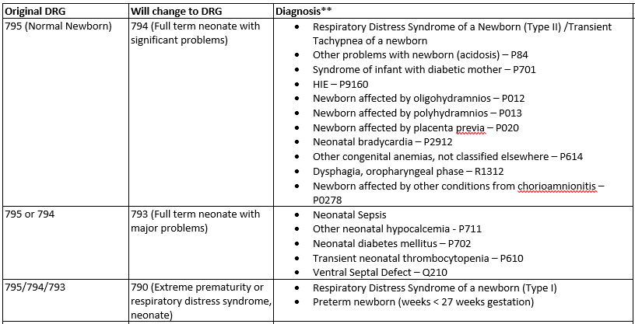
Normal Newborns DRGs 793-795

Slide 10
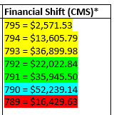
Premature Newborn DRGs 790-792

Slide 11
Respiratory Distress Syndrome of a Newborn
Respiratory Distress Syndrome – Type I – Idiopathic – DRG 790
Respiratory Distress Syndrome – Type II – Transient Tachypnea of a Newborn (TTN) – DRG 794
More prevalent in preemies due to lungs not fully developed and lack of surfactant.
Signs and symptoms: respiratory distress, nasal flaring, cyanosis, grunting, and intercostal retractions, Review CXR for ground glass appearance or atelectasis
Review medical record for Respiratory or metabolic acidosis
Treatment: Resuscitation suite, administration of surfactant, oxygen, CPAP or mechanical ventilation
Complications: Cerebral or pulmonary hemorrhage, sepsis
More common with c-section deliveries due to the delay in clearance of alveolar fluid.
Signs and symptoms: Nasal flaring, mild retractions, grunting and possible apnea
Review CXR for perihilar infiltrates, patchy infiltrates and pleural effusions
Treatment: Oxygen, nebulizers, decreased stimulation and sometimes CPAP. Typically resolves in 24-48 hours.

Slide 12
Respiratory Distress Syndrome of a Newborn
Coding Guidelines
ICD-9-CM Coding Clinic, Third Quarter 2009 Pages: 20 to 21 Effective with discharges: September 15, 2009
Question:
If provider documentation only indicates "respiratory distress" may the coder assign a code for either Type I or Type II respiratory distress syndrome of a newborn based on the length of time it takes for the condition to resolve? For example, Coding Clinic November-December 1986, page 6, and First Quarter 1989, page 10, provided timeframes for newborn respiratory distress.
Answer:
Do not assign a code for Type I or Type II respiratory distress syndrome of a newborn based on the length of time it takes for respiratory distress to resolve. If the provider indicates "respiratory distress of newborn," code 770.89 is assigned. Codes are not assigned for respiratory distress syndrome/type I (769) or transitory tachypnea of newborn/type II (770.6) unless the provider specifically documents these conditions.
Code assignment is on the basis of provider documentation. The information published in Coding Clinic should not be used as clinical criteria for code assignment. Any clinical information published in Coding Clinic is provided as background material to aid the coder. It is not intended to replace the need for specific provider documentation to substantiate code assignment.

Slide 13
Hypoglycemia in Newborns
Hypoglycemia in infant of gestational diabetic mother (DRG 794)
Hypoglycemia in infant of diabetic mother (DRG 794)
Hypoglycemia transient (DRG 793)
Iatrogenic Hypoglycemia (DRG 793)
Hypoglycemia parameters – less than 30 first 24 hours of life and below 45 thereafter

Slide 14
Case Study – Transient Hypoglycemia
Baby 39 weeks, large for gestational age, monitored on the hypoglycemia protocol, blood sugars:
2/16/2021 12:57, BLOOD GLUCOSE, POC: 39 (<)
2/16/2021 14:04, BLOOD GLUCOSE, POC: 48
2/16/2021 15:47, BLOOD GLUCOSE, POC: 56
The patient received Glutose 40% gel 2 mL at 1305 on 2/16/21.
DRG | Relative Weight | CMS Reimbursement | SOI/ROM
795 | 0.1905 | $2,648.41 | 1 / 1
793 | 3.9757 | $38,497.26 | 2 / 1

Slide 15
Hypoglycemia review opportunities
Review blood sugars
Review medications for administration of Glutose gel and or D10.
Large for gestation age
Mom with diabetes, gestational diabetes

Slide 16
Neonatal Sepsis
Clinical Indicators
Low temperature (hypothermia of newborn) or elevated temperature
Feeding difficulties
Pre existing infection by mother
+GBS without antibiotics
Chorioamnionitis
HPV infection
Treatment/Sepsis Protocol
Lumbar Puncture
Prophylactic antibiotics
Sepsis protocol may be started but this does not mean neonate was treated for sepsis
Query
Was Neonatal Sepsis ruled in or ruled out?
Asking if neonatal sepsis is being treated may not be sufficient

Slide 17
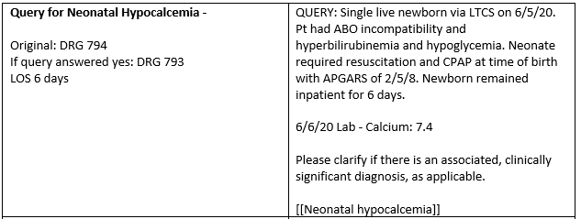
Case Study
DRG | Relative Weight | CMS Reimbursement | SOI/ROM
794 | 1.4072 | $14,171.52 | 2 / 1
793 | 3.9757 | $38,497.26 | 1 / 1
Additional queries: hypoglycemia and neonate required resuscitation and CPAP at time of birth (TTN).

Slide 18
Case Study - Meconium
Infant born to a 29 yo G3P0020 mother, admitted to the DNICU for respiratory distress after birth requiring CPAP. Complications of labor included: category II FHT & meconium stained fluid.
Brought to warmer and NRP initiated with suction, drying, and stimulation. Pt was then brought to the resuscitation bay for further respiratory support. She required PPV at bedside and was relatively unresponsive and needed further intervention with CPAP, which was successful and pt was able to maintain saturation on own after twenty minutes.
Patient was brought to NICU for observation. After ~3 hours of observation, developed respiratory distress (grunting, nasal flaring, mild retractions) without desaturations and was placed back on CPAP 5 21%.
General: This is day 0 days of life for this PMMA 40w1d week infant with respiratory distress without respiratory failure requiring CPAP after birth in the setting of meconium stained amniotic fluid. Presentation is most consistent with TTN vs meconium aspiration syndrome.
Baby born by forceps assisted vaginal delivery. Meconium was present. Brought to warmer and NRP initiated with suction, drying, and stimulation. Pt was then brought to the resuscitation bay for further respiratory support. She required PPV at bedside and was relatively unresponsive and needed further intervention with CPAP, which was successful and pt was able to maintain saturation on own after twenty minutes.
Skin: Acrocyanotic
Please clarify if there is an associated, clinically significant diagnosis, as applicable.
Neonatal aspiration of meconium with respiratory symptoms
Neonatal aspiration of meconium without respiratory symptoms
Transient tachypnea of a newborn

Slide 19
Maternal Drug use while fetus in-utero
CDI / Coder Collaboration results in “Newborn affected by maternal use of other drugs of addiction” diagnosis – P0449 (DRG 794)
Documented in Chart: (baby must be affected)
Substance exposed infant (SEI)
Maternal drug use throughout pregnancy; exposure in first trimester to substances other than THC
Mother positive for THC on L&D
Monitor for signs of withdrawal - NOWS protocol baby is jittery, easily startled, with poor feeding and difficulty consoling with pacifier; consoles well with skin to skin with mother
DHS aware and planning to see mom

Slide 20
Newborn affected by noxious substances transmitted via placenta or breast milk
ICD-10-CM/PCS Coding Clinic, Fourth Quarter ICD-10 2018 Pages: 24-25 Effective with discharges: October 1, 2018
Several modifications have been made to codes in category P04, Newborn affected by noxious substances transmitted via placenta or breast milk. The inclusion term under code P04.0, Newborn affected by maternal anesthesia and analgesia in pregnancy, labor and delivery, has been revised to state: "Newborn affected by reactions and intoxications from maternal opiates and tranquilizers administered for procedures during pregnancy or labor and delivery.“
Subcategory P04.1, Newborn affected by other maternal medication, has been expanded and new codes were created to identify specific substances known to have teratogenic effects. A teratogenic drug can be a prescribed medication, a street drug, or alcohol use that can increase the risk of congenital anomalies. According to research, approximately 4% to 5% of birth defects are caused by exposure to a teratogen. Several substances have recognized teratogenic effects when the mother is exposed to the substance during pregnancy.
An instructional note "Code first withdrawal symptoms from maternal use of drugs of addiction, if applicable (P96.1)" has also been added under subcategory P04.1. For example, if the infant experiences signs of drug withdrawal, because of the mother's use of opiates, assign code P96.1, Neonatal withdrawal symptoms from maternal use of drugs of addiction, and code P04.14, Newborn affected by maternal use of opiates. Both codes are required to capture the infant's withdrawal symptoms and the specific drug causing the withdrawal. Code P96.1 is sequenced first.

Slide 21
The new codes identifying specific substances the mother used are as follows:
P04.11 Newborn affected by maternal antineoplastic chemotherapy
P04.12 Newborn affected by maternal cytotoxic drugs
P04.13 Newborn affected by maternal use of anticonvulsants
P04.14 Newborn affected by maternal use of opiates
P04.15 Newborn affected by maternal use of antidepressants
P04.16 Newborn affected by maternal use of amphetamines
P04.17 Newborn affected by maternal use of sedative-hypnotics
P04.1A Newborn affected by maternal use of anxiolytics
P04.18 Newborn affected by other maternal medication
P04.19 Newborn affected by maternal use of unspecified medication

Slide 22
Work Queue Build
Neonates ≥ 3 LOS
Non Caesarean section babies LOS ≤ 2 days
DRG ≠ 789 or 790
Hit the queue after coders have completed coding
Stop bill applied until CDIS has reviewed
All Payers

Slide 23
Questions?
Jennifer Grubb – grubbj@ohsu.edu
Mary Sunde – sundem@ohsu.edu
Robin Gulzow – gulzowr@ohsu.edu
cdis@ohsu.edu

