Slide 1

Playing to Win: How to Engage Physicians in CDI
Nicole Fox MD, MPH, FACS, CPE
Associate Chief Medical Officer
Medical Director Clinical Documentation Integrity
Cooper University Hospital
Camden, NJ
This is the Full Title of a Session

Slide 2
No disclosures

Slide 3
Learning Objectives
At the completion of this educational activity, the learner will be able to:
  Understand the “physician personality”
  Discuss strategies to engage physicians in CDI
  Discuss strategies to incorporate the CDS into the medical team
  Manage the “difficult” physician
  List the “keys to success”

Slide 4
Disclaimer
The opinions expressed here are our own
The model we built is very successful
Some of this may be feasible at your institution…
…some of it may not
Trial & error
Informal, interactive
Interrupt with questions any time: can put in “chat box”

Slide 5
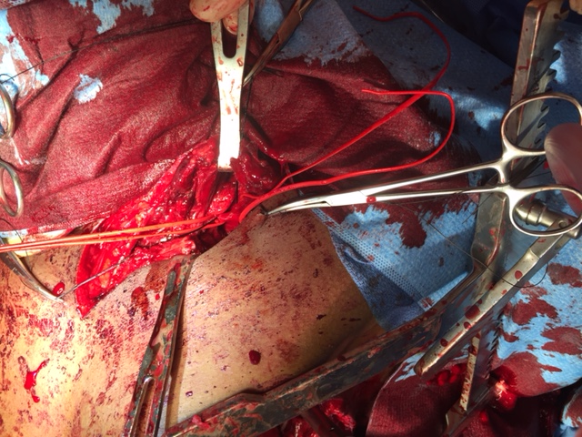

Sometimes we end up in places we didn’t plan to go…..

Slide 6
…places we REALLY didn’t plan to go
Medical Director of CDI
PSI’s
CMI
HCC’s
ICD-10
DRG

Slide 7
CDI at Cooper
Launched in 2014
Hybrid team (remote & on-site)
Inpatient and ambulatory
Patient safety indicators/Hospital acquired conditions and infections
National presentations
Peer reviewed publications
100% physician response rate to queries

Slide 8
Understanding Physicians

Slide 9
The Issues
The healthcare environment is constantly changing
We have many competing priorities
We want our patients to have good care and do well
The stakes can be VERY, VERY high
Unpredictability and change is STRESSFUL
We struggle with a lack of needed skills
Notes:
I have sacrificed much of my own life in order to make a difference in other people’s lives

Slide 10
The Reality
What we are taught…
…& what we are not
Basic sciences
Clinical medicine
Procedural skills
Communication
DOCUMENTATION
Compliance
Appropriate/Efficient use of the EHR
Value based purchasing
Coding/Billing
Revenue cycle

Slide 11
ACS Surgery News…
…..LAS VEGAS – Doctors are dreading what some have started to call EHR ‘pajama time.’ “That’s the hour or two that physicians are spending – every night after their kids go to bed – finishing up their documentation, clearing out their in-box,” according to Dr. Christine Sinsky, vice president of professional satisfaction at the American Medical Association.

Slide 12
Physician Burnout
46% of physicians are experiencing at least one symptom of burnout
Common drivers include: paperwork, feeling undervalued, difficult patients, medico-legal issues
300-400 physicians die by suicide each year in the U.S.

Slide 13
Do We “Sell” it Wrong?
Quality Metrics
Hospital Profiling
Revenue
CMI shift
Good patient care
the hassle factor
Health of the health system

Slide 14
“Physicians are highly intelligent. It doesn’t take them long to figure out that if the healthcare system is struggling financially and operationally it will impact their potential and compensation.
In other words, their own performance will impact the health of the organization…”

Slide 15
CDI Foundation
Engage physicians early, understanding that:
  We want the healthcare system to do well
  We want our patients to receive great care
  We need HELP achieving these goals (but most of us don’t know how or don’t want to ask for it!)
Be mindful of physician workflow
Be sensitive to deficiencies in skills
“We are here to ease the burden, NOT add to it”

Slide 16
Building the Team

Slide 17
Team Members
Medical Director
&
CDS(s)
HIM
Compliance
Physician champions
Informatics/IT
Revenue Cycle
Population Health

Slide 18
Answer These Questions
Who “owns” CDIP at your organization?
Is there a plan to promote CDIP?
Who do the physicians ultimately answer to?
Are you able to obtain necessary resources?
Are you considered a “value-added” service?

Slide 19
Medical Director
This person has to OWN the role
Should be hired by senior administration
Should be
  A practicing clinician
  Well known by the medical staff
  LIKED by the medical staff
  A leader and communicator
Disclaimer: May need EDUCATION

Slide 20
Medical Director
Should make the team visible in the organization
Establish relationships with all stakeholders
Provide/be present at physician education activities
Serve as an intermediary between physicians and the team
Be deployed to handle the difficult physician
Share results with administration, physician leaders

Slide 21
The CDS/Physician Relationship
It’s all in the EXECUTION
CDS with clinical background
  Consider hiring from within
  ICU experience is a +
Assign by specialty/area
Medical director facilitates initial meeting
Incorporate CDS into rounds when appropriate
Department/division meetings
Be prepared with FEEDBACK

Slide 22
P.S. and the Trauma Service
Former ICU RN
Outgoing but succinct
Rounds once/week
Personal calls/emails
Peer reviewed publication: Fox N, Swierczynski P, Willcutt R, Elberfeld A, Mazzarelli AJ. Lost in translation: Focused documentation improvement benefits trauma surgeons. Injury. 2016 Sep;47(9):1919-23.

Slide 23
Physician Focused CDI

Slide 24
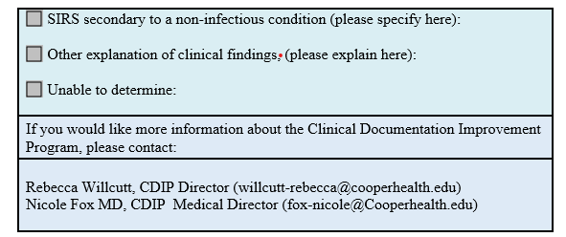
Physician Friendly Query
Within the EHR
Answer and sign
Part of the permanent medical record
Room for comments
Dx added to the problem list by CDS

Slide 25
Establish an Escalation Process
1st notice:
Email to physician
2nd notice:
Email to physician & medical director
3rd notice:
Email to physician, chairman/division head & medical director
CMO notified
of non-compliance

Slide 26
Feedback
Get your team on the agenda for:
  Division/department meetings
  Grand rounds
  Medical executive committee
  Any forum where physicians are present
Use this time to identify physician champions
Use this time to promote your CDS’s
Solicit feedback on your program

Slide 27
Feedback
Prepare clean, concise reports:
  CMI shift
  Most common queries
  Response rate
  Agreement rate
  Quality & safety metrics
Try to use clinical examples and actual notes
Make it a dialogue
Be prepared to answer: “why should I care??”

Slide 28
Table 1. Summary of FDI Results by Surgeon (n=9)
Variable | S1 | S2 | S3 | S4 | S5 | S6 | S7 | S8 | S9 | Avg
No. of Queries | 34 | 25 | 66 | 20 | 17 | 24 | 38 | 21 | 31 | 30.6
CMI Shift | 0.40 | 0.45 | 0.58 | 0.07 | 0.24 | 0.16 | 0.33 | 0.14 | 0.39 | 0.31
Clinical FTE (%) | 0.95 | 0.90 | 0.95 | 0.50 | 0.50 | 1 | 0.95 | 1 | 0.60 | 0.82
Financial Impact (USD) | 50,483 | 91,888 | 213,627 | 91,612 | 24,536 | 170,955 | 221,248 | 169,532 | 98,700 | 154,092*
Response Rate (%) | 100% | 100% | 100% | 100% | 100% | 100% | 100% | 100% | 100% | 100%
Agreement Rate (%) | 97% | 68% | 97% | 95% | 76% | 88% | 100% | 95% | 91% | 90%
MCC | 4 | 5 | 11 | 8 | 3 | 9 | 8 | 5 | 5 | 6.4
CC | 0 | 0 | 4 | 2 | 1 | 2 | 2 | 1 | 2 | 1.5
Severity | 24 | 18 | 42 | 10 | 10 | 9 | 21 | 12 | 18 | 18.2
Principal Diagnosis | 4 | 0 | 6 | 0 | 2 | 2 | 2 | 3 | 1 | 2.2
*average per clinical full-time equivalent (FTE)

Slide 30
Re-Think Your Organizational Structure

Slide 31
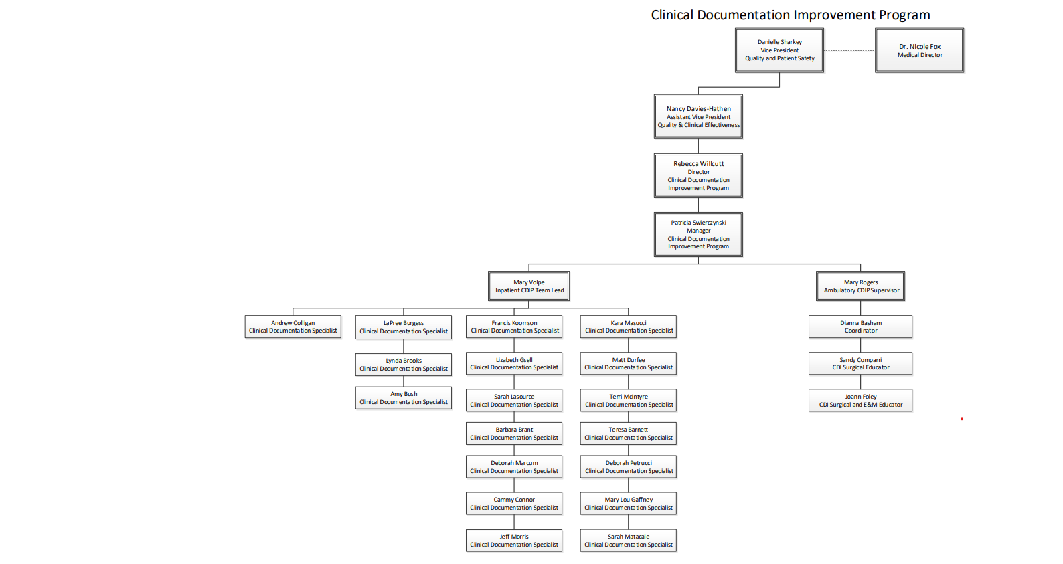

Slide 32
Expanding the Scope
Find ways to stay relevant
Promote and support education for your team
Get outside the walls
Areas for expansion:
  Quality & safety
  Revenue integrity
  Ambulatory
  Professional services

Slide 33
Challenges & Opportunities

Slide 34
The Disruptive Physician
80% of physicians NEVER have a disruptive incident
16-18% will have a singular event (provoked by circumstances or personal issues)
2-4% will display REPEATED disruptive behavior

Slide 35
What DOES NOT Work
Becoming confrontational
Using terminology that is unfamiliar or confusing
Delivering mixed messages
Lack of rationale behind requests (no behavior changes without reason and logic)
Notes:
Give examples

Slide 36
What works
Non-confrontational approach
Peer to peer
Acknowledge concerns, LISTEN
Do not be intimidated
“Choose carefully the hills you are willing to die on….”
Notes:
Give examples

Slide 37
Keys to Success
Administrative support
Engaged medical director & physician champions
Clinically oriented CDS’s
Friendly, unobtrusive query process
Tangible, regular feedback
Escalation process
Expand scope over time
On-going education
SHARE KNOWLEDGE

Slide 38
Thank you. Questions? fox-nicole@cooperhealth.edu

