Slide 1
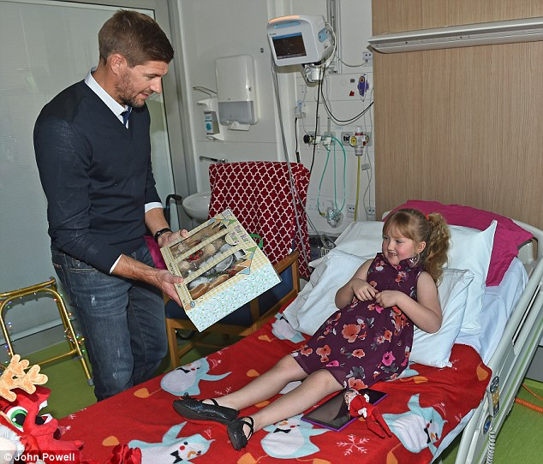
Presents
On
Admission
Doug Campbell MD, FAAP
Physician Advisor
Clinical Documentation Improvement
Utilization Management

Slide 3
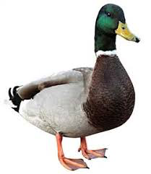
Acute vaso-occlusive
crisis secondary to SCD
Your sure it’s
a duck?
Acute Appendicitis
It’s a duck
…...........
Yup, it’s
absolutely a duck
Pneumonia
Comminuted fracture
Left distal femur

Slide 4
Really ….. a
duck or a horse...
Ok, just send it up

Slide 5
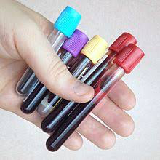
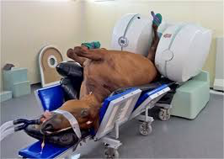
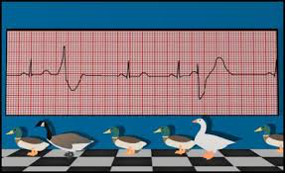

Slide 6
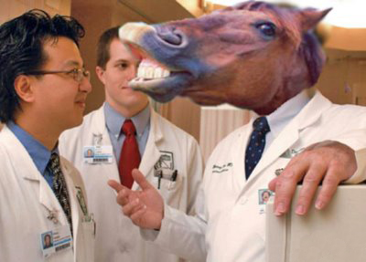

Slide 7
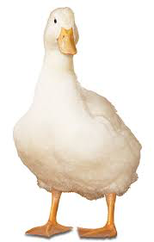
So – the principle diagnosis should be…....
Duck -
“present on admission”

Slide 8
History & Physical
Assumes
POA
Document in H&P -
Presumptive PDX
Active diagnoses
Catheters
Decubitus

Slide 9
Weak
Words
Suspicious
Consistent
with
Consider
Possible
STRONG
WORDS
Presumed
Probable
Likely
Suspected
Words matter
We can code from the strong words – not from weak ones.

Slide 10
Presumed
Suspected
1
Likely
Probable
Assumed
Strong Word

Slide 11
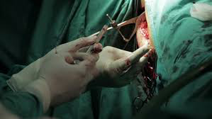
Use Strong Words
Anyone who cuts into another live human being
as a profession – should not use weak words.

Slide 12
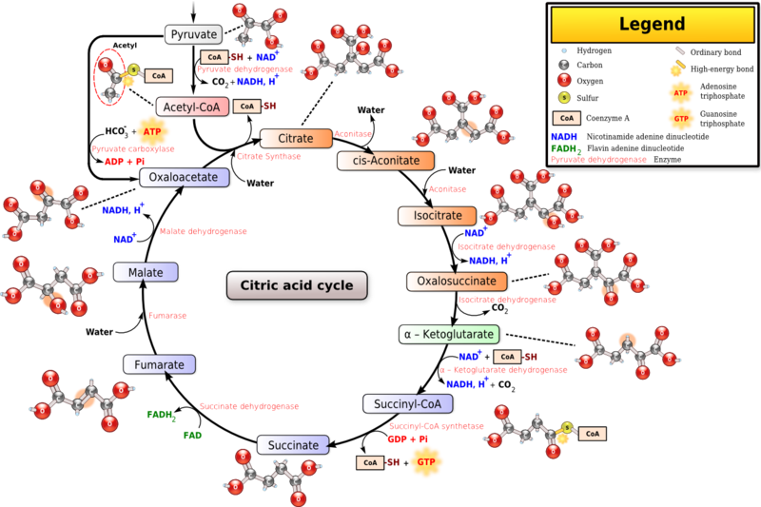
Use Strong Words
Anyone who has been forced to learn the Kreb’s cycle
at least twice – should feel free to use strong words

Slide 13
If it’s not
clear initially
When it is…......
Document that condition
in the EMR as ..
“Present on admission”

Slide 14
Conditions not specifically addressed in the History
and Physical, or specifically documented as having
been present on admission, may be considered to
as having occurred during the hospitalization.
A hospital acquired condition. (HAC)
The Joint Commission tracks HAC’s in regards to
hospital accreditation.
CMS tracks HAC’s in regards to payment.

Slide 15
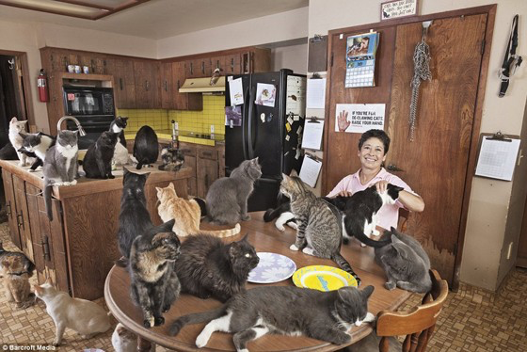
Sometime less is better
like HAC’s

Slide 16
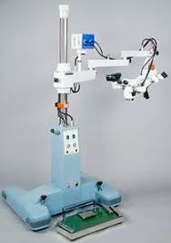
Why should you care ???????

Slide 17
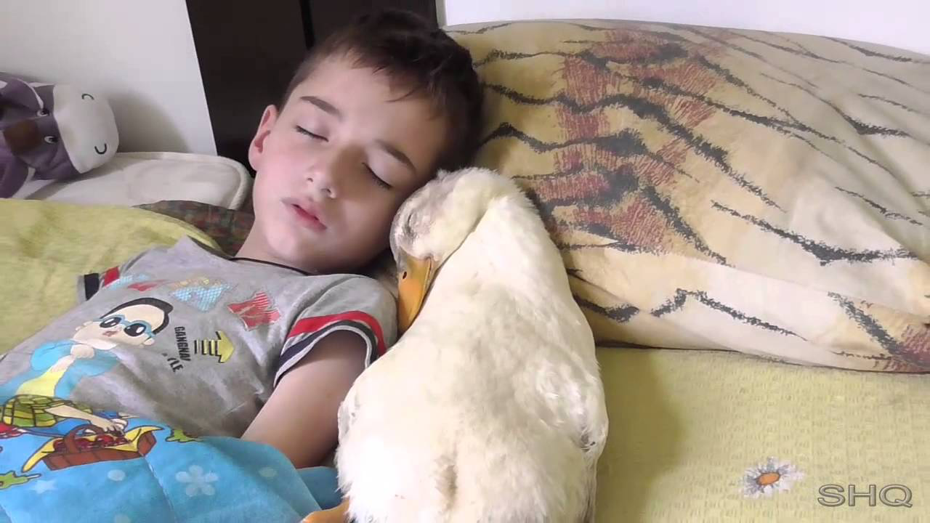
It’s not all ducks….......
Let’s
do
some
cases

Slide 18
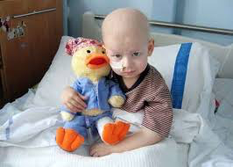
Three year old child with ALL, never in remission, with a PORT
is admitted to the hospital from the ED after presenting with
fever and neutropenia with labs significant for an ANC of 150
and a UA with many bacteria and 17 WBC’s
The patient is cultured and admitted to the hospital and is placed
on intravenous antibiotics.
Initial Principle
Diagnosis:
Neutropenic Fever
presumed
secondary to
pyleonephritis

Slide 19
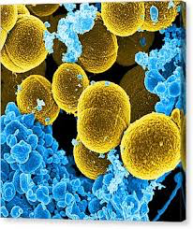
Two days later the UC is negative and the BC is positive for ORSA.
The primary diagnosis should be amended to.
Bloodstream infection secondary to ORSA – present on admission.
Not a Hospital
Acquired Condition (HAC)

Slide 20
One
more
example

Slide 21
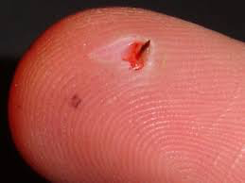
18 month old infant is admitted from ED after presenting with acute
cellulitis of the R foot
Was running on granddad's dock and got a splinter.
After a day the foot was red and the splinter was
removed by pediatrician who put the child on Keflex
and topical ointment.
Over two days it got better before it got worse.
The foot became red and she would not bear weight.
Patient admitted from ED with WBC of 15.7 and ESR of 23. The X-ray
was remarkable only for soft tissue swelling. No fb noted on PE or Xray
Admission Dx – Acute cellulitis, presumed secondary to Staphylococcus
plantar surface, R foot, foreign body previously removed
Failure of outpatient antibiotics

Slide 22
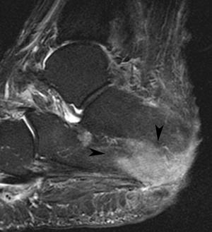
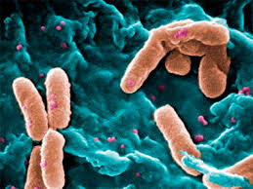
Patient placed on IV clindamycin, warm soaks, elevation –
and it got better before it got worse.
MRI showed osteomyelitis and patient taken to the OR where cultures grow Pseudomonas.
So what about
the osteomyelitis?

Slide 23
Acute osteomyelitis of the right calcaneus
due to pseudomonas
1.
2.
3.
Present on admission
Hospital Acquired Condition
Spontaneous generation

Slide 24
Whatever
you think…
Document
in EMR

Slide 25
With
EMR’s,
now,
more
than
ever,
it’s all
about
the
documentation

Slide 26
The EMR needs to accurately and specifically reflect
the patient’s condition
Whether their condition was present on admission
or it developed in the hospital
Notes:
What we do want

Slide 27
What we don’t want,
is to negatively impact
the Children's Hospital
secondary to the
lack of attention to
complete and specific
documentation in the
EMR including
“Present on Admission”
Notes:
What we don’t want

Slide 29
Working together for
Wolfson’s

