Slide 1
THE CLINICAL TRUTH
TM
CESAR M LIMJOCO, MD
CHIEF MEDICAL OFFICER
T-MEDICUS LLC

Slide 2
When you know WHY, you’ll know your way - Simon Sinek
Cesar M Limjoco, MD

Slide 3
START WITH WHY
REIMBURSEMENT
QUALITY MEASURES
MIPS/MACRA
DATA ANALYTICS
FRAUD & ABUSE
PEER BENCHMARKING
MEDICAL NECESSITY
COMPLIANCE
RISK MANAGEMENT
Cesar M Limjoco, MD

Slide 4
Albeit this can be due to many factors:
Medical Necessity
Claims Billing
Claims Processing
Underdocumentation
Conflicting Documentation
Copying/Pasting
Traditional CDI work pursued revenue as its main mission
Pendulum has swung from underdocumentation to overdocumentation in many instances
Shift CDI focus to the full narrative
Need to redirect the goal to achieving the clinical truthTM
https://www.healthleadersmedia.com/finance/claims-appeals-cost-hospitals-86b-annually
Cesar M Limjoco, MD

Slide 5
TM
Clinical Truth
Cesar M Limjoco, MD

Slide 6
Clinical Documentation Improvement Program
Integrity
What is this all for?
Physicians accurately describe the etiology/specificity of diseases
Coders follow rules & guidelines translating explicitly documented diagnoses and procedures
Mitigate fraud and abuse
Enhance YOUR PROFILES Improve severity adjusted mortality rates
Get the credit for the work
Improve patient care
Cesar M Limjoco, MD
Notes:
UM will check on the resource utilization

Slide 7
Utilization review – medical necessity for inpatient care
CDI – need to ask the 3-fold question:
what is the most worrisome condition that the patient presents
that necessitates acute care
that cannot be mitigated in an outpatient setting?
Cesar M Limjoco, MD

Slide 8
Cesar M Limjoco, MD

Slide 9
Abnormal findings (Physical manifestations, Laboratory, Radiology, Pathology, EKG)
Confirm the diagnosis
Due to other etiologies
False positive
Cesar M Limjoco, MD

Slide 10
SCREENING PROTOCOLS
PRACTICE GUIDELINES
EVIDENCE-BASED MEDICINE
CONSENSUS STATEMENTS
AMI
SEPSIS-3
NSQIP
AHRQ
Cesar M Limjoco, MD

Slide 11
And so it goes with Diseases…
It’s requisite to discount all other factors before acknowledging the definitive diagnosis.
Meeting disease definition, criteria or protocol is only part of the equation.
Need to also equally consider response to therapy and the disease course to get to the definitive diagnosis.
Cesar M Limjoco, MD

Slide 12
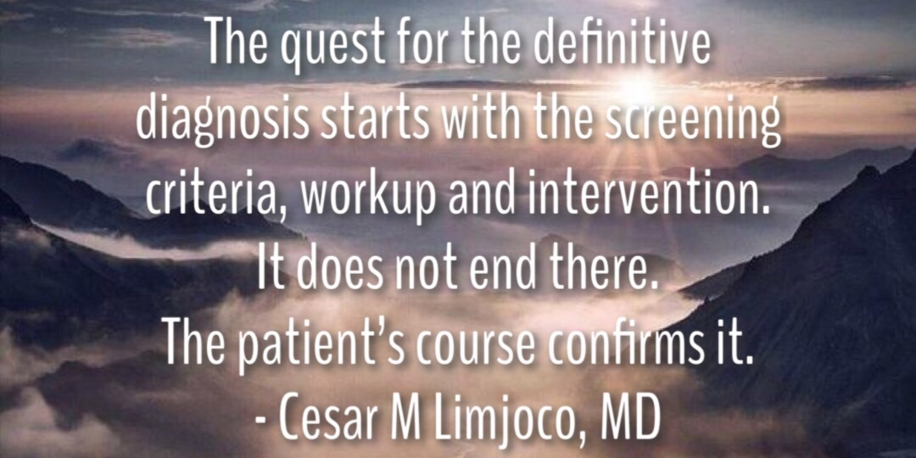

Slide 13
Follow
the narrative!

Slide 15
The Sepsis Alliance
Estimates that 258,000 patients die from the condition each year in the U.S.
To save lives and improve the bottom line, hospitals across the nation are trying different approaches to reduce sepsis morbidity and mortatlity.
At the same time, innovators strive to create ways to identify the condition earlier.
Cesar M Limjoco, MD
Notes:
Early ID also leads to increased false positives

Slide 16
Positive blood cultures – Sepsis?
False positive
Contamination
Colonization
Transient bacteremia
No clinical sequelae
Tooth drilling, urethral catheterization, invasive instrumentation, rectal probing
Expected occurrence in certain infections
Pneumonia
UTI/Pyelonephritis
Bacterial endocarditis
Sepsis
+/- blood culture
Organ dysfunction caused by dysregulated host response to infection
Severe Sepsis
+/- blood culture
Organ dysfunction goes into Organ Failure
Acute Kidney Injury
Acute Respiratory Failure
Metabolic Encephalopathy
Septic Shock
Cesar M Limjoco, MD
Notes:
Sepsis is about our own body's immune system going awry
Body’s all or nothing response to insults (SIRS/CARS)
Narrative: submarine down

Slide 17
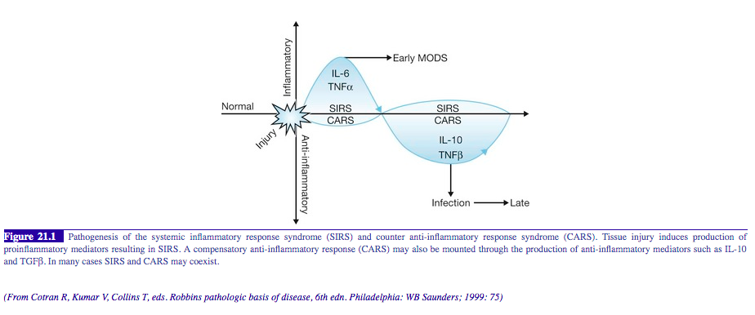
SIRS, CARS, MARS
Tissue injury = Infection, Inflammation, Trauma, Concussion, Burns, Anaphylaxis, Severe Pancreatitis, Surgery, Organ Replacements, etc.
Cesar M Limjoco, MD

Slide 18
Acute respiratory failure
pO₂ <60 mm Hg or SpO₂ (pulse oximetry) <91% @ room air
1
pCO₂ >50 and pH <7.35
2
P/F ratio (pO₂/FIO₂) <300
3
pO2 decrease or pCO2 increase by 10 mm Hg from baseline (if Known)
4
Cesar M Limjoco, MD
Notes:
Narrative: ICU 13 Sepsis admission with O2 sats falling to 83

Slide 19
The hallmark of Encephalopathy is Altered Mental Status, but not all Altered Mental Status Is Encephalopathy.
Cesar M Limjoco, MD

Slide 20
Encephalopathy
Encephalopathy
Expected Medication Effect
Sedatives
Anesthetics
Acute intoxication
Hypovolemia
Dehydration
Acute Toxic Encephalopathy
Poisoning
Overdose
Chronic Encephalopathy
Prolonged exposure to harmful agents
Drugs, Alcohol
Chemical agents
Acute Metabolic Encephalopathy – internal metabolic processes
Sepsis
Hypo/hypernatremia
Hepatic Failure
Kidney Failure
Toxic-metabolic Encephalopathy (combination)
Cesar M Limjoco, MD

Slide 21
Physician engagement
Clinical Approach
Focus on the narrative
Evidence-based clarification
Will it stand claims denial?
Cesar M Limjoco, MD

Slide 22
Summary
Paint the picture of the patient’s true severity of illness.
What necessitated the patient’s admission/surgery
What co-morbid conditions does the patient bring to the hospital
Why a condition developed during the hospital course
Drill down to the etiology of patient’s condition
Use phrases “due to” or “related to”
Use descriptive words
Acute, Chronic, Acute on Chronic (or Exacerbation)
Condition Ruled in, Ruled out, Improved, Resolved
Events after surgery are due to the nature of:
Disease
Procedure
Complication – explain why it happened
Cesar M Limjoco, MD

