Slide 1
Untangling the Web of Sepsis: Sepsis 2 or Sepsis 3 Sep 1 Bundle and CMS
Rhoda Chism, RN, CCDS, CCS
Manager of CDI Audit & Education

Slide 2
Program Objectives: Attendees will be able to:
Describe
Describe Sepsis 1, 2, and 3 definitions
Understand
Understand Sep 1 Bundle requirements
Craft
Craft a compliant sepsis query
Craft
Craft a compliant clinical validation query

Slide 3
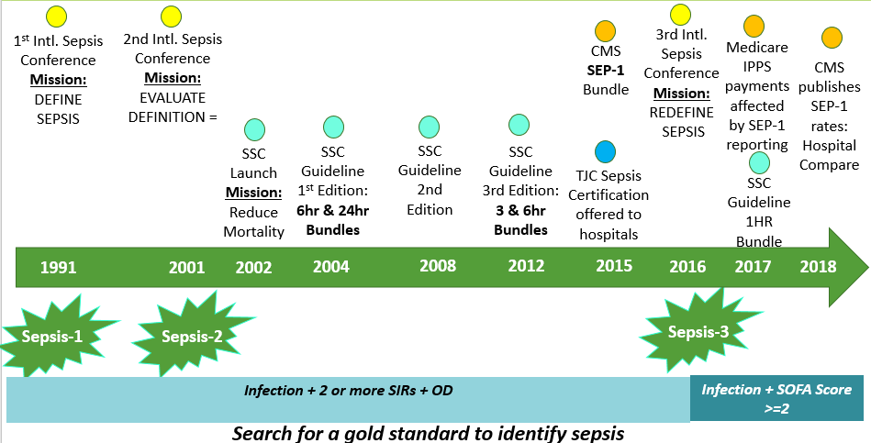
Sepsis: How Did We Get Here?
Sep 1 Bundle
3-Hour Resuscitation Bundle
Measure lactate
Collect Blood Culture(s)
Broad Spectrum Abx
IV Crystalloid Fluids ≥ 30 ml/kg **
6-Hour Resuscitation Bundle
Repeat Lactate Measure if initial resulted > 2.0
Vasopressor(s) to maintain MAP >65
Focused Exam by provider
Initiated with ¾ SIRS criteria and possibility of infection
SEP 1 BUNDLE IS SEPARATE FROM SEP 3 “CRITERIA”

Slide 4
Actual Denial Letters From Auditors
“To validate sepsis, the medical record is examined for consistent documentation of the condition; evidence that the patient's presentation cannot be explained by the local infection alone or by a non-infectious condition; and evidence of organ dysfunction caused by a dysregulated response to infection. While the patient’s presentation warranted consideration of sepsis as a possible diagnosis, and localized infection of pneumonia was identified, upon investigation, the diagnosis of sepsis was not supported by the clinical evidence.”
“It is acknowledged a positive blood culture was obtained; however, “bacteremia” is not evidence of sepsis. There was no evidence in the medical record provided of a systemic response to infection beyond that expected with pneumonia.”
“Though the patient was noted to have tachycardia, tachypnea, and leukocytosis; these are expected findings with an infectious process such as pneumonia. It is acknowledged the patient was hypotensive, yielding a SOFA score of 1. This resolved quickly with fluids.”

Slide 5
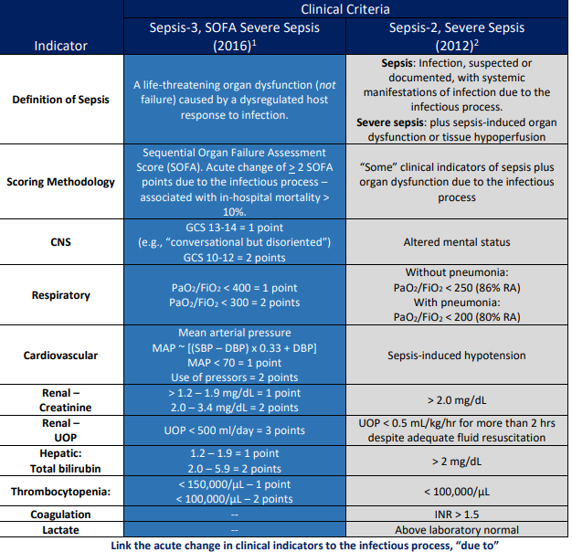
The Society of Critical Care Medicine supports the Sepsis-3 (SOFA) scoring system to diagnose severe sepsis.
The 2016 JAMA paper suggests that all sepsis is severe sepsis when using the SOFA criteria. The patient must have an acute change in physical exam and/or laboratory findings consequent to infection to meet the criteria
The Sepsis-3 publication states that sepsis diagnosed using SOFA criteria is always Severe Sepsis.
Linking sepsis with organ dysfunction allows the coder to pick up the secondary code R65.20 for severe sepsis (even if the physician does not write severe sepsis) which leads to fewer charts pulled for audit.
Sepsis causing acute hypoxic respiratory failure
Sepsis with AKI
Metabolic encephalopathy due to sepsis
A419 sepsis only will trigger audit

Slide 7
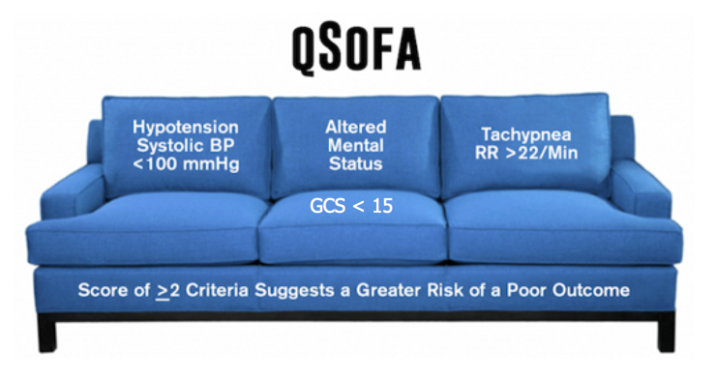
The qSOFA score (also known as quickSOFA) is a bedside prompt that may identify patients with suspected infection who are at greater risk for a poor outcome outside the intensive care unit (ICU). It uses three criteria, assigning one point for low blood pressure (SBP≤100 mmHg), high respiratory rate (≥22 breaths per min), or altered mentation (Glasgow coma scale<15). qSOFA is NOT USED TO DIAGNOSE SEPSIS

Slide 8
Clinical Example 1
51-year-old female presents to ED c/o lethargy and R flank pain. No significant past medical history but states she was treated recently for a UTI and completed 10 days of Bactrim 2 days prior to arrival. Denies fever, chills but does have occasional nausea and R flank pain.
ABD / Pelvis CT: R ureteral calculi with stranding renal pole.
V/S : B/P 104/60, Pulse 90, Resp 20, Temp 99.0 O2 sat 95% RA
Labs: WBC 9.9 Platelets 128 Glucose 151 T. Bili 1.2 BUN 24 Creatinine 2.3
Lactic acid 2.0 U/A: large blood, nitrates and leukocytes.
Blood cultures drawn and pending
Orders:
Admit to floor
IV NS @100cc/ hr
IV Ampicillin q 6 hours
Gent IV q 24 hours
H&P Impression:
51 year old female with pyelonephritis and AKI.

Slide 9
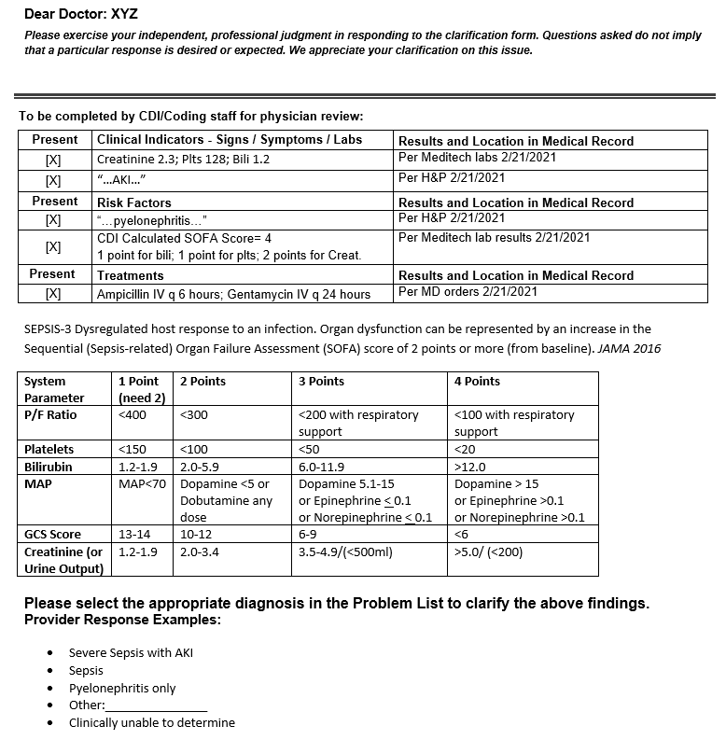
Query Example 1
TRIC
Treatment: IV antibx
Risk: pyelonephritis
Indicators: labs (SOFA)
Compliant Question: brief, concise
Query to link organ dysfunction to capture severe sepsis when sepsis alone is documented.
(secondary code: severe sepsis R65.20)

Slide 10
Clinical Example 2
50 year old female presented to the ED with c/o ABD pain and bloody stool. PMHx of hypothyroidism, fibromyalgia, DM, and HTN
VS: 149/85 114 20 98.7 O² sat 97% on room air
CT Abdomen- probable colitis extending from the distal transverse colon to the lower descending colon
Labs: WBC 28.8, plts. 429, NA ⁺⁺ 129, Glucose 341, Creat. 0.5, Bili. 0.8
Lactic Acid 2.2
H&P: Feels feverish and tired, c/o nausea and bloody diarrhea. Reports appetite is decreased but UOP is good. Denies recent antibx.
Impression & Plan:
Sepsis on admission- patient has colitis, and met 3/4 SIRS criteria, tachycardia, tachypnea, leukocytosis
Admit to floor, Start Rocephin and Flagyl IV, consult GI and surgery
Colonoscopy on hospital day 3
Colonoscopy: An area of severely inflamed and ulcerated mucosa was found at 35-50 cm proximal to the anus. Inflammation was noted throughout visualized colon.
Pathology: Fragments of colon with changes c/w ischemic colitis

Slide 11
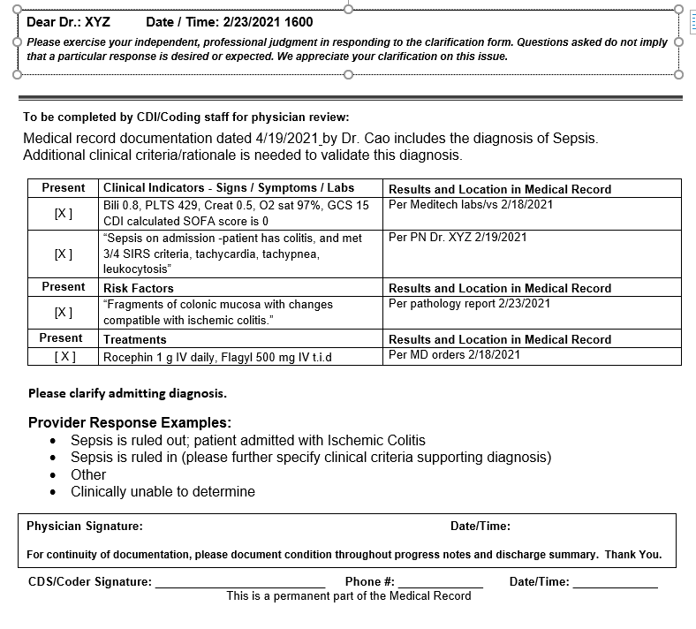
Query Example 2
TRIC
Treatment: IV antibx,
Risk: Colitis
Indicators: labs,SOFA 0
Compliant Question: brief, concise

Slide 12
Sepsis Validation
Clearly link any organ dysfunction to the diagnosis of sepsis
Watch for encephalopathy, AKI/ATN, acute respiratory failure, shock liver, acute heart failure, NSTEMI, seizures, ischemic gut, etc.
List infection site causing sepsis
Important when coding principal dx
Multi-system Organ Failure
No code for this, must specify type of failure and body system involved
Infection due to device
Must be linked
Ex. UTI due to catheter (not with) “complicated UTI” will not link
Link positive cultures to the infection
Ex. Pseudomonas pneumonia vs pneumonia and sputum grew Pseudomonas
Providers hold the ultimate responsibility for both establishing a diagnosis and documenting the criteria that led to the establishment of said diagnosis. When the medical record appears to lack evidence-based clinical criteria for a diagnosis, CDI specialists must query the provider. Doing so provides the physician an opportunity to either add more clinical criteria to support the diagnosis, confirm the diagnosis as it stands, or confirm that the diagnosis was ruled out or is without clinical significance.
Common severity drivers
Acidosis
Obesity
Chronic hypoxic, hypercapnic respiratory failure
Thrush
Stage II decubs
Chronic systolic/diastolic chf (HFpEF, HFrEF)
Malnutrition
Hemiplegia
Paralysis
DM with manifestations
Specific pneumonias (aspiration pneumonia, staph pneumonia, etc.)
CKD III, IV
Specific types of seizures (complex partial seizures)
Create the link for appropriate capture of SOI/ROM
PDx A41.9 (unspecified sepsis)
SDx R65.20 (severe sepsis)

Slide 13
Sepsis Coding

Slide 14
Clinical Criteria and Code assignment

Slide 15
Coding Guideline for Sepsis

