Slide 1
Who owns it?
J. Douglas Campbell MD, FAAP, MHA
Physician Advisor – CDI / UM

Slide 2
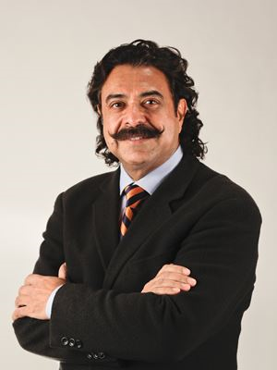
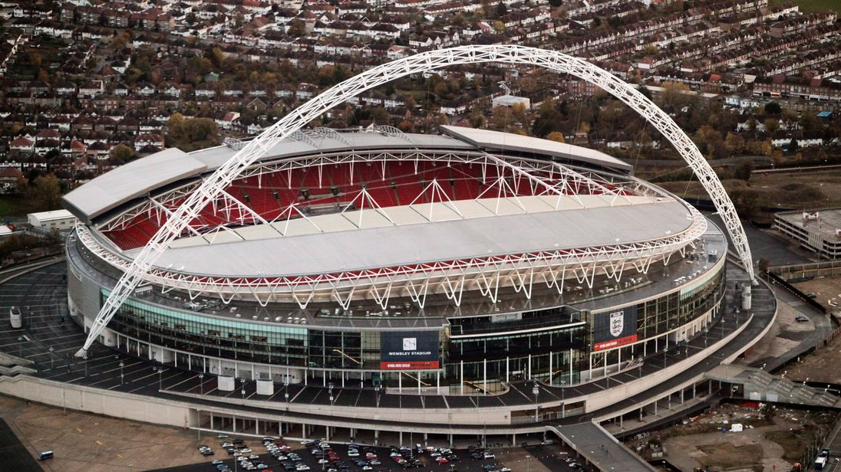

Slide 5
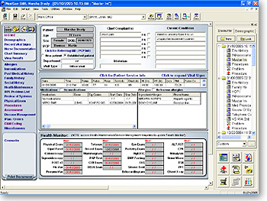
You, the
Attending
Physician
own
the
EMR

Slide 7
……… health care organizations should focus on ensuring
accuracy and completeness in clinical documentation.....
…..any new diagnoses or any diagnoses that have been
Previously established should be documented……………
……. It is the responsibility of the attending physician
to determine the relative importance of all documentation
in the patient’s record………………

Slide 8
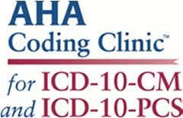
Third quarter 2016
It is the responsibility the attending physician to gather
and collate all findings from the consultants and other
providers involved in the care of the patient.

Slide 9
All findings/ diagnoses:
Not some
Not just what happened today or even this week
All……everything…………… the whole enchilada

Slide 10
The absence of complete documentation and
The patient medical record a negative effect on:
Statistical databases
Financial planning
Clinical preparedness
Gross revenue

Slide 11
CDI codes and queries
in real time

Slide 12
CDI nurses make every attempt to query to the physician who was
the attending at the time of the diagnosis / specificity in question

Slide 13
However –
The patient may have been transferred to the ICU
The patient may have been transferred to the floor
The night attending is not the day attending
The attending yesterday is not the attending today
The attending yesterday is off for 2 weeks
In Both the Medical and Coding World:
The attending physician has the final say.
We query the attending as soon as the
clinical question arises

Slide 15
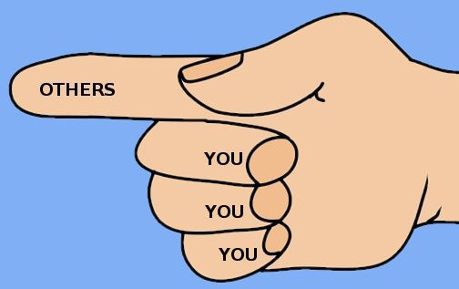
I wasn’t on service that day
That happened in the ICU
That happened on the floor
That was one of my partners
I just took over the care of the patient
It’s my first day on service
That happened 2 days ago – I wasn’t here

Slide 16
The attending physician queried may not have
been present throughout the patient’s stay
But - is certainly qualified to review the patient’s
record, diagnostic findings and treatment to be
able to agree or disagree with an earlier physicians
diagnosis or a resolved condition.
…..and answer the query in the EMR

Slide 17
> 94% query agree rate at Wolfson

Slide 18
Job
#1
JOB
#2

Slide 19
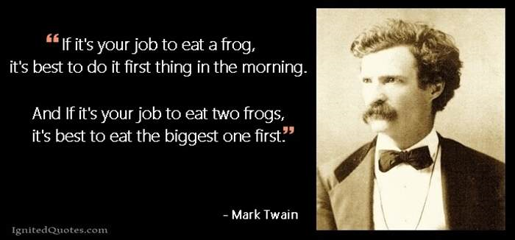

Slide 20
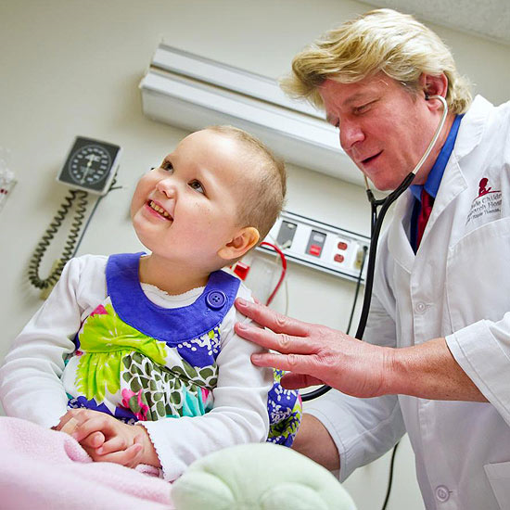

Slide 24
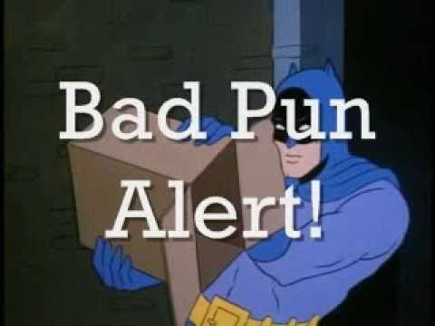

Slide 25
Who owns the chart?
Do
The Attending Physician

Slide 26
Not Me

Slide 28
C
D
I
If the chart is complete and specific –
we will not query you
2. If it’s not – we probably will

