Slide 1
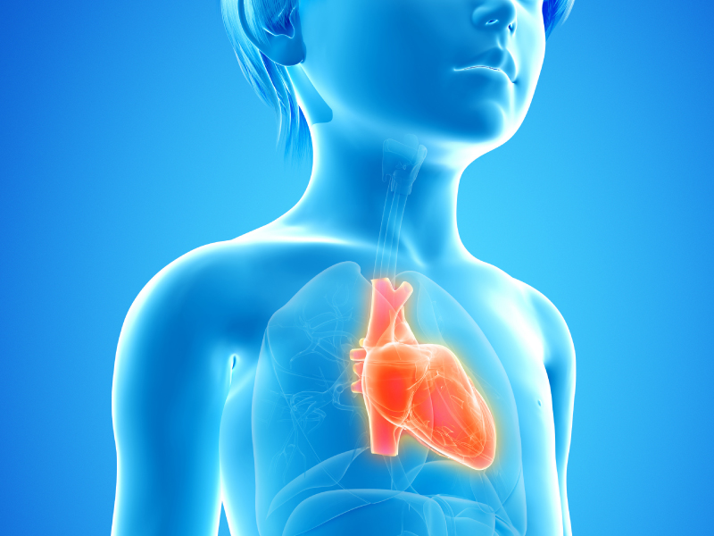
Pediatric
Heart Failure
J. Douglas Campbell M.D., FAAP, MHA, BAMF
Physician Advisor – CDI/UM Wolfson Children’s Hospital

Slide 2
Pediatric Heart Failure
The path forward to
an imperfect solution
H
Hey my heart doesn’t work right

Slide 3
Today's talk -
Basic’s of Pediatric Heart Failure
Getting Heart Failure documented in the EMR

Slide 4
Heart Failure Basics
Heart failure has a broad definition but the basis of the disease process is that the cardiac output is insufficient to meet the metabolic demands of the body.
It results from the impairment of the ventricle to fill with or eject blood.
Heart failure is caused by ventricular pump dysfunction, overload of volume (preload), or by overload of pressure (afterload).
The majority of pediatric heart failure can be categorized as:
Excessive preload
Increased afterload
Abnormal rhythm leading to decreased contractility

Slide 5
Epidemiology :
Pediatric heart failure is estimated to affect 22,000 to 37,000 individuals under the age of 19 years in the United States.
In the United States, heart failure-related hospitalization are increasing, and accounts for approximately 15,500 hospitalizations in children.
Heart failure is the most common reason that infants and children who have heart disease receive medial therapy and accounts for at least 50% of referrals for pediatric heart transplantation.
The largest pediatric heart failure population comes from children born with congenital malformations.
However, the etiology of heart failure is diverse due to the numerous underlying cardiac manifestations and presentations that can lead to a diagnosis of heart failure.

Slide 6
Pathophysiology
The etiology of pediatric heart failure can primarily be divided into three large categories with a variety of disease process fitting in either category with some overlay.
The three categories are:
1. Ventricular pump dysfunction
2. Volume overload (increased preload)
3. Pressure overload (increased afterload)

Slide 7
Cardiac Malformations
Shunt lesions:
VSD PDA Aortopulmonary Window
Atrioventricular septal defects
Single ventricle
ASD
Valvular Regurgitation:
MR
AR
Inflow Obstruction:
Cor triatriatrium
Pulmonary vein stenosis
Mitral stenosis
Outflow Obstruction:
Aortic valve stenosis
Coarctation of aorta

Slide 8
With Structurally Normal Heart
Primarily Cardiac:
Cardiomyopathy
Myocarditis
MI
Acquired valve disorders
Hypertension
Kawasaki syndrome
Arrhythmias
Non-Cardiac :
Anemia
Sepsis
Hypoglycemia
DKA
Hypothyroidism
AVM / AV fistula
Renal failure
Muscular dystrophies

Slide 9
Clinical Manifestations
Due to pediatric heart failure having several etiologies,
it has a variety of age- dependent clinical presentations.
Infants
Feeding difficulties occur due to dyspnea and increased
fatigability, tachypnea, irritability, and poor weight gain.
They ultimately are lead to failure to thrive diagnosis.
Upon physical exam you may find:
Mild-severe retractions
Tachypnea
Grunting
Tachycardia
S3 or S4 heart sound (gallop rhythm)
Hepatomegaly
Crackles

Slide 10
Clinical Manifestations
Young Children:
Symptoms may be mistaken for common childhood illness
such as gastroenteritis or asthma.
This is due to presentation of abdominal pain, poor appetite,
easy fatigability, chronic cough, or wheezing.
Older Children:
Present with more “adult like” symptoms such as:
Exercise intolerance
Somnolence
Cough with crackles and
Gallop rhythm (S3, S4).

Slide 11
Therapy
The management of pediatric heart failure is dependent
on its etiology and severity. The primary therapeutic goal
is to treat the underlying cause.
Therapeutic goals are to decrease symptoms, morbidity,
and hospitalizations and to slow progression of heart failure.
Treatment of non-cardiac causes of heart failure such as
anemia or endocrine disorders as well as timely referral for
surgical corrections can prevent or limit the staging of heart failure.
Surgical or catheter-based interventions
Used to correct structural defects such as shunts or
valvular defects causing either volume or pressure overload,
and preserved ventricular function.

Slide 12
Principles of Managing Heart Failure:
Recognition & treatment of underlying systemic disease
Timely surgical repair of structural lesions
Afterload reduction: ACE inhibitors; angiotensin receptor blockers, milrinone, nitrates
Preload reduction; diuretics
Sympathetic Inhibition; beta blockers, digoxin
Cardiac remodeling prevention; mineralocorticoid inhibitors
Intropy - digoxin

Slide 13
So –
Kids get heart failure
Heart failure can be acquired or congenital
Kids with heart failure often show symptoms
Kids with heart failure often need medications
So if –
Kids have symptoms of heart failure and ………………..
There exist modalities to evaluate cardiac function……….
And kids who have normal hearts don’t usually need
to be on medications to improve cardiac function……..
4. And kids with normal hearts don’t normally need cardiac surgery..

Slide 14
Why is it so damn hard to get pediatric heart failure documented in the EHR?

Slide 15
ICD - IV

Slide 16
Problem
#1

Slide 17
Heart
Failure

Slide 18
Huh?
Adults – common, easily treated, surgery uncommon, cure uncommon
Kids – uncommon, multiple presentations and etiologies, surgery to
correct failure common, wide spectrum of disease

Slide 19
Has hypoplastic L heart
Has had Norwood
and Glenn
Is on lasix and
digoxin
Has Class II CHF is
on Lasix and digoxin
Failure

Slide 21
Failure

Slide 22
It is easier to
pass a camel
through the eye
of a needle, than
to get a pediatric
cardiologist to document
“heart failure” in the EMR.
Campbell 4:20

Slide 23
“Don’t ever diminish the
power of words. Words
move hearts
and hearts move limbs”.
Hamsa Yusuf
“If you don’t write it down
your not getting paid”.
Some smart CDIS

Slide 24
One major problem is the word
FAILURE
Dysfunction is dysfunctional
Insufficiency is insufficient
We need the word “FAILURE”

Slide 25
Mrs. Jones, your heart failure is very stable with the 2 meds you
are on, lets see you in 6 months.
Thank you Doctor Smith – I appreciate your help with my heart.

Slide 26
Mrs. Jones, little Cloe's heart failure is doing well on the lasix. She is gaining
weight and will be ready for surgery next year.
What do you mean Dr. Smith?!?!? Cloe’s heart isn’t failing, she’s not a failure.
You said you could fix her. Old people have heart failure she’s just a child.
Failure, no one else has said failure. You can’t say she has heart failure that
is an old people’s disease.
Well Mrs. Jones, her heart is not working like it is supposed to. She needs
daily medication and will need surgery. But she will get better after surgery
so lets just call it pulmonary over-circulation with a little pumping dysfunction
and we will get all that fixed.
That’s much better Dr. Smith. That makes more sense to me.
Just as long as she doesn't have heart failure. See you in 6 months.

Slide 27
Problem
#2

Slide 28
Where you are from may
determine what you call these

Slide 29
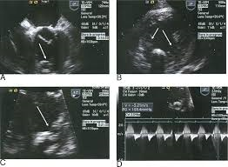
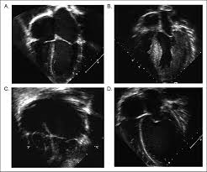
Where you were trained may
determine what you call this

Slide 30
Isn’t that the same thing?
I’m calling it pulmonary over circulation with decreased ventricular function
I’m calling it decreased ventricular shortening due to increased afterload

Slide 31
The problem is
they are
NOT
calling it failure.
And not documenting failure
in the EMR.

Slide 32
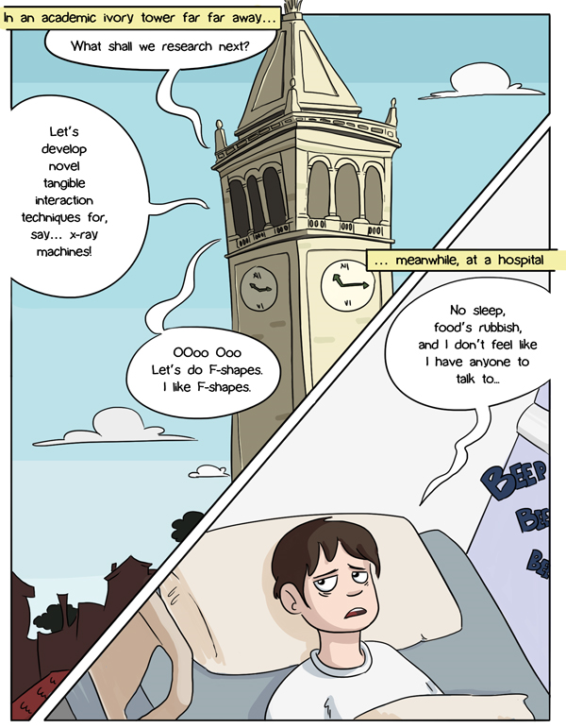
The majority of
Pediatric cardiologists
Pediatric cardiac surgeons
Pediatric heart surgeries

Slide 33
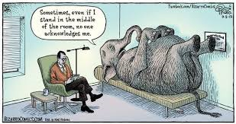
There is no incentive
for providers couched
in an academic setting
to routinely use the word
failure when it comes to
kids with cardiac disease.
Even kids who are
symptomatic or are
requiring medication or
surgery to treat there
adverse cardiac
symptomology.

Slide 34
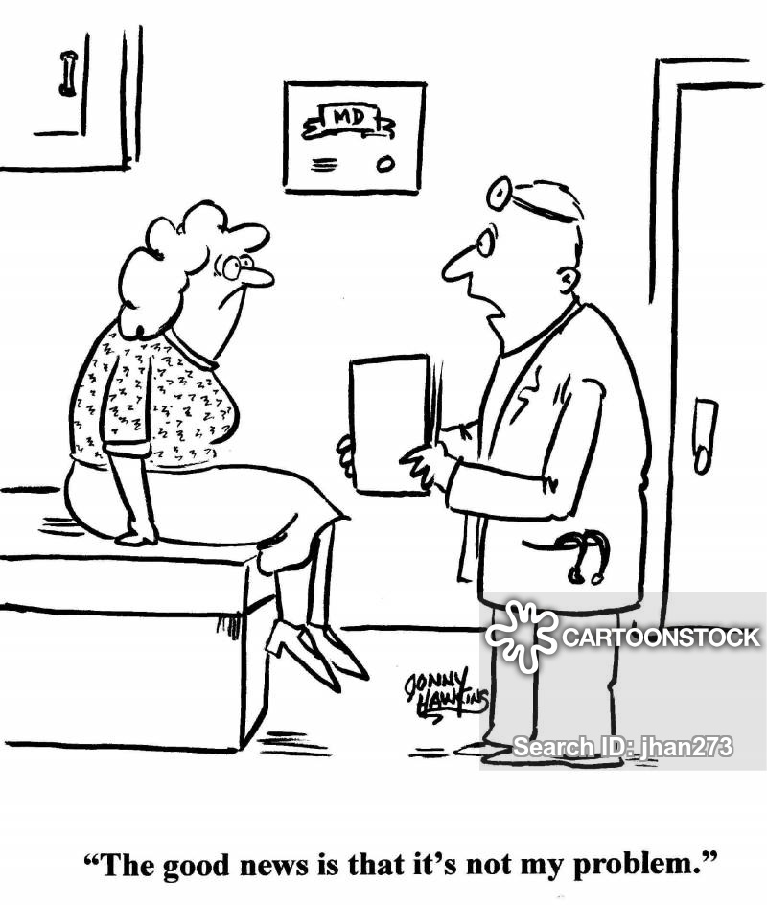
Problem
#3

Slide 35
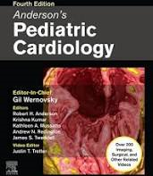
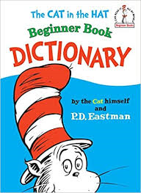
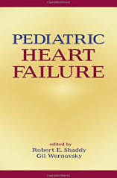
No universally
accepted definition
of heart failure
in pediatrics

Slide 36
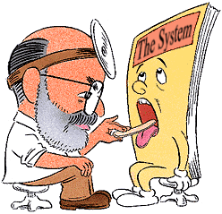
Our system
is sick

Slide 37
We can’t just give up

Slide 39
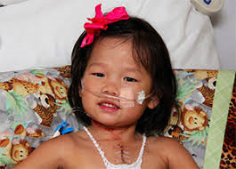
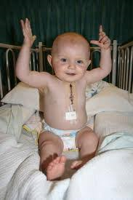
If we don’t get paid for
taking care of them…..

Slide 40
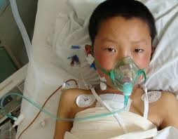
Where do we get the
money to take care of these kids?

Slide 41
What can
we do?

Slide 42
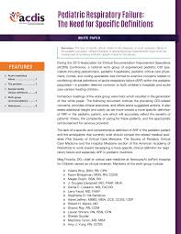

Slide 43
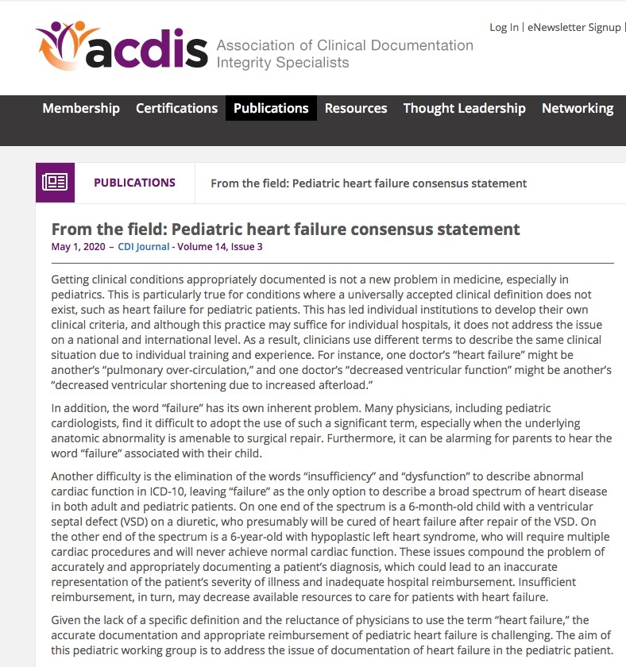

Slide 44
We didn’t define heart failure
When to query the provider

Slide 45
Clinical symptomology

Slide 46
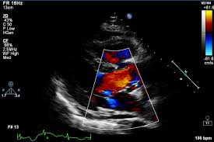
Radiographic Evidence
Left ventricular systolic dysfunction in children is characterized by a
shortening fraction < 25% and/or an ejection fraction < 55%.
Notes:
Not CXR

Slide 47
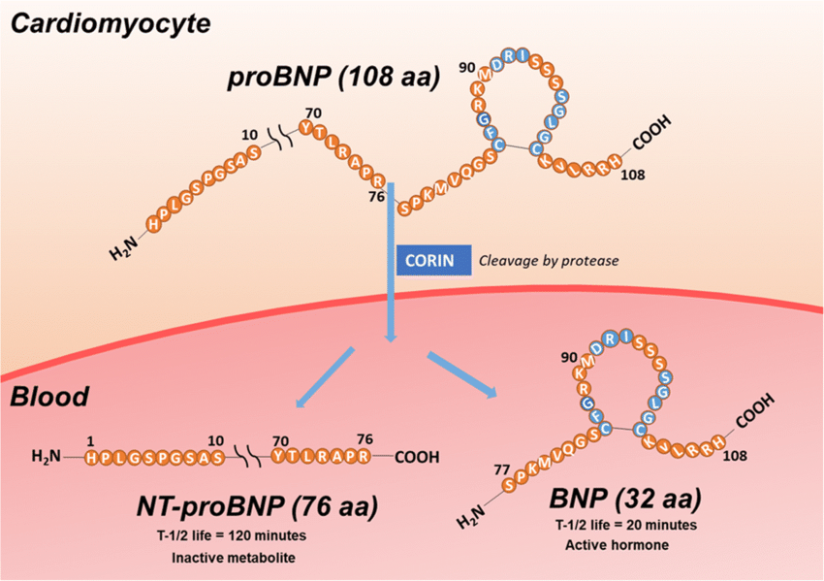
Laboratory Evidence
Proteins BNP and NT-proBNP increase when heart muscle is stretched and/or has to work harder. BNP and NT-proBNP can be helpful in differentiating cardiac from pulmonary disease, monitoring the effects of heart failure treatment and predicting unfavorable outcomes but should not be used as the sole basis for the diagnosis of heart failure in pediatric patients.
Notes:
CK, CPK, CPK-MB – specific for adults with ischemia – not useful for failure without ischemia H/H may increase, lactate may increase – none specific

Slide 48
Pharmacologic Evidence
Afterload reduction: ACE inhibitors; angiotensin receptor blockers, milrinone, nitrates
Preload reduction; diuretics
Sympathetic Inhibition; beta blockers, digoxin
Cardiac remodeling prevention; mineralocorticoid inhibitors
Intropy - digoxin

Slide 49
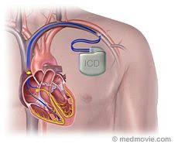
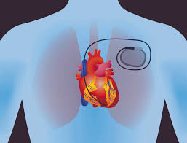
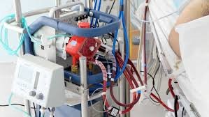
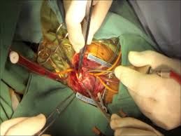
Other Evidence

Slide 50
If the provider
doesn’t document it,
you have to query for it

Slide 51
50 Heart failure NON-BILLABLE
I50.1 Left ventricular failure BILLABLE
I50.2 Systolic (congestive) heart failure NON-BILLABLE
I50.20 Unspecified systolic failure BILLABLE
I50.21 Acute systolic (congestive) heart failure BILLABLE
I50.22 Chronic systolic (congestive) heart failure BILLABLE
I50.23 Acute on chronic systolic (congestive) heart failure BILLABLE
I50.3 Diastolic (congestive) heart failure NON-BILLABLE
I50.30 Unspecified diastolic (congestive) heart failure BILLABLE
I50.31 Acute diastolic (congestive) heart failure BILLABLE
I50.32 Chronic diastolic (congestive) heart failure BILLABLE
I50.33 Acute on chronic diastolic heart failure BILLABLE
I50.4 Combined systolic and diastolic heart failure NON-BILLABLE
I50.40 Unspecified combined systolic and diastolic heart failure BILLABLE
I50.41 Acute combined systolic and diastolic heart failure BILLABLE
I50.42 Chronic combined systolic and diastolic heart failure BILLABLE
I50.43 Acute on chronic combined systolic and diastolic heart failure BILLABLE
I50.9 Heart failure, unspecified BILLABLE

Slide 52
Acuity
Acute
Chronic
Acute on Chronic
S
P
E
F
I
C
I
T
Y
Phase
Systolic
Diastolic
Combined

Slide 53
If they
are not
going to
say “Failure”
They are
certainly not
going to
determine
acuity or
phase.

Slide 54
Cardiologists
Well, CDIS Smith, indeed
little Johnny certainly has
issues with his heart but
with this surgery he should
certainly should be better.
Let’s not call it failure.
So Dr. Jones, little Johnny has hypoplastic L heart, has FTT was on digoxin and lasix, and had an ejection fraction of 37% preop and he just had surgery and is on milrinone right now. Did he have heart failure before surgery
akingmmm
Maybe I should
try Real Estate

Slide 55
What can we do?
Education Education Education.
Education of cardiologists by CDIS.
Education of parents by cardiologists.
Show the administration, cardiologists and cardiac surgeons
what a difference diagnosing “Heart failure” with specificity
makes.
Persistence should pay off in the long term.
Lobby AHIMA for specific codes for pediatric heart failure.

Slide 57
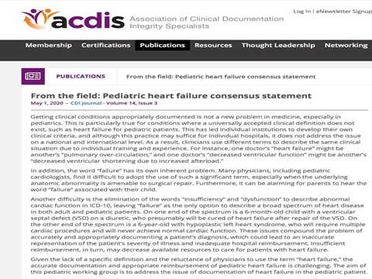
Download the statement

Slide 58
Read it with your Doctors

Slide 59
Develop Institutional Criteria
Criteria for Heart Failure (only require one):
Clinical Criteria – Stage II or greater of the modified Ross Criteria.
a. Infants – diaphoresis or dyspnea with feedings secondary to cardiac disease
b. Older children – dyspnea on exertion secondary to cardiac disease
2. Pharmacologic Criteria – The need for medications in attempt to improve cardiac function.
a. Medications that decrease preload – such as Lasix
b. Medications that increase cardiac contractility –
such as digoxin, dobutamie, epinephrine, milrinone
c. Medications that decrease afterload – such as ace inhibitors and beta blockers
d. Antiarrhythmic medication – such as Sotolol, beta blockers, amiodarone
e. Inhibitors of maladaptive remodeling – such as carvedilol, aldactone
3. Echocardiographic Criteria – Left ventricular ejection fraction < 55% secondary to a
cardiac etiology with signs of decreased cardiac output
4. Laboratory Criteria
BNP – brain natriuretic peptide (> 300pg/ml in new onset) or
> 20% increase over baseline ifknown
b. Elevated serum lactate > 2.0 mmol/L felt secondary to cardiac dysfunction

Slide 60
Query based on common ground

Slide 61
You may not get it every time
Don’t fail to query
for Heart Failure

